Slide 1
Introduction to Quantum Computing
Prof. dr. Egon Pavlica
University of Nova Gorica

Slide 2
Outline
Michelson-Morley experiment
Two-slits experiement
Classical computer
Introduction to qubit
Two beam—splitters‘ experiment
Mathematical description of two beam-splitters‘ experiment
Tutorial on quantum computer (Qiskit)

Slide 3
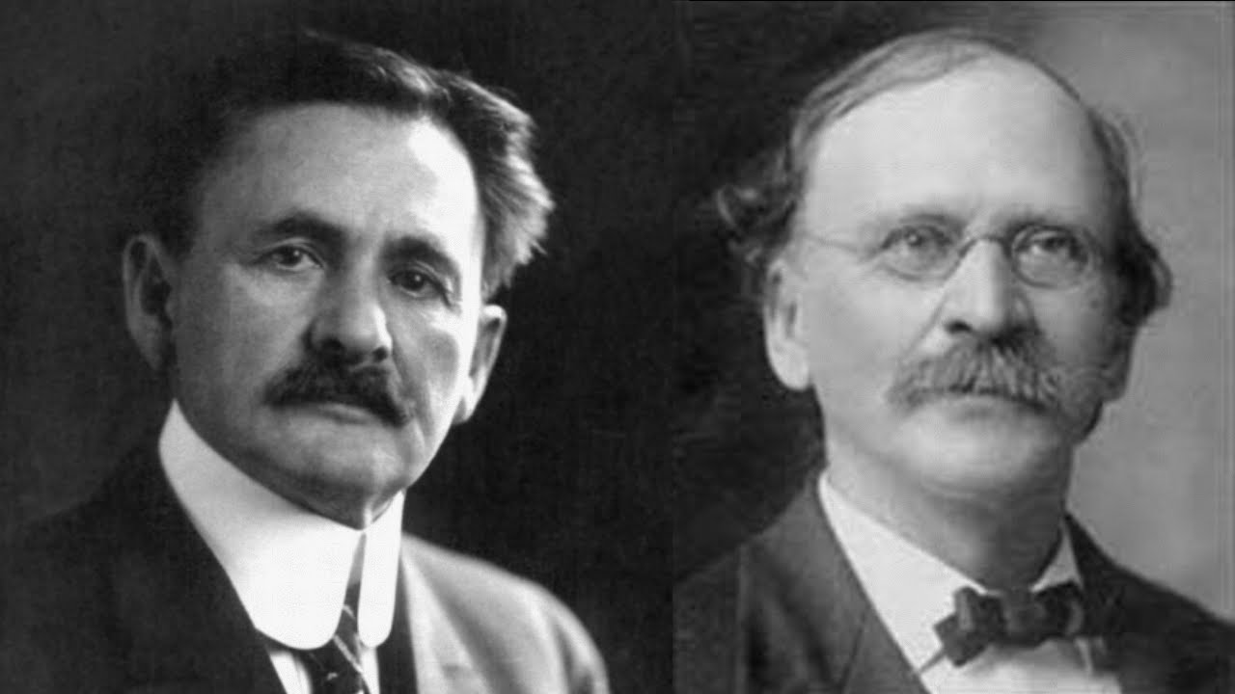
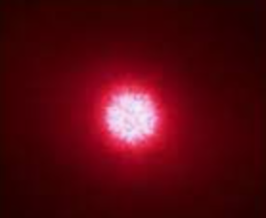
Michelson – Morley experiment
between April and July 1887
Red Laser
Semitransparent glass
Mirror
Screen

Slide 4
Michelson – Morley experiment
Mirror
Red Laser
Semitransparent glass
Screen

Slide 5
Michelson – Morley experiment
Mirror
Red Laser
Semitransparent glass
Mirror
Screen

Slide 6
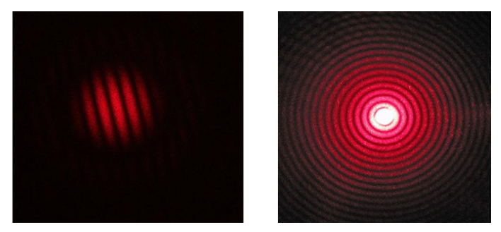
Michelson – Morley experiment
Mirror
between April and July 1887
Red Laser
Semitransparent glass
Mirror
Screen

Slide 7
Michelson – Morley experiment
Mirror
Red Laser
Semitransparent glass
Mirror
Screen

Slide 8
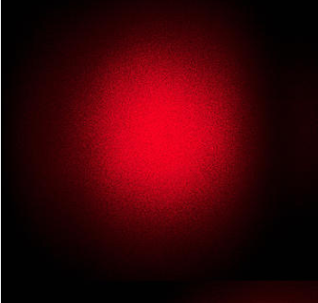
Michelson – Morley experiment
Mirror
Piece of paper
Red Laser
Semitransparent glass
Mirror
Screen

Slide 9
Michelson – Morley experiment
Mirror
Red Laser
Semitransparent glass
Mirror
Screen

Slide 10
Michelson – Morley experiment
Mirror
Red Laser
Semitransparent glass
Mirror
Piece of paper
Screen

Slide 11
Michelson – Morley experiment
Mirror
Piece of paper
Red Laser
Semitransparent glass
Mirror
Piece of paper
Screen

Slide 12
Two-slits experiment setup

Slide 13
Two-slits experiment computer simulation
computer simulation

Slide 14
Two-slits experiment

Slide 15
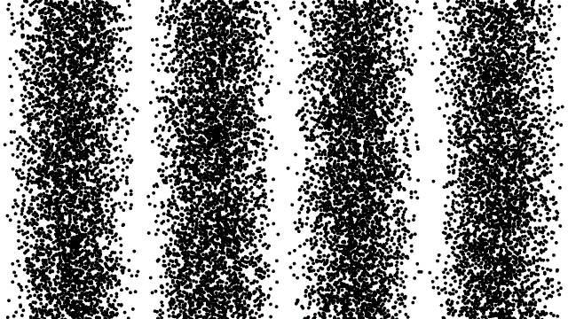
Two-slits experiment with low light intensity
number of photons
computer simulation

Slide 16
We don’t know where a single photon will travel!!!

Slide 17
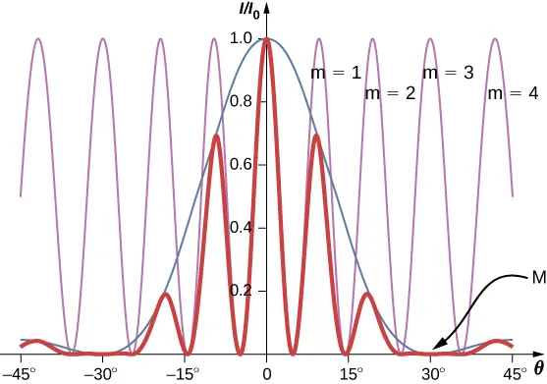
Mathematics
Photons
We don‘t know where a single photon will travel -> we know the probability
We know where bunch of photons will travel – interference pattern
Single photon knows where to go
Photons interfere with each-other
Photon obeys quantum mechanics

Slide 18
Michelson – Morley experiment
Mirror
Piece of paper
Red Laser
Semitransparent glass
Mirror
Piece of paper
Screen

Slide 19
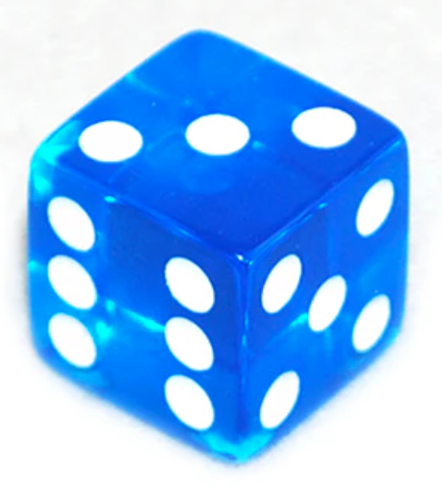
A Simple quantum computer
Task: generator of random numbers
“Quantum dice”
Slits
Single photon detector
Number “1”
Single photon detector
Number “2”
Single photon source
Single photon detector
Number “3”
Single photon detector
Number “6”

Slide 20
Basic blocks of quantum computer
Slits
Single photon detector
Number “1”
Single photon detector
Number “2”
Single photon source
Single photon detector
Number “3”
Single photon detector
Number “6”
SOURCE
GATE
MEASUREMENT

Slide 21
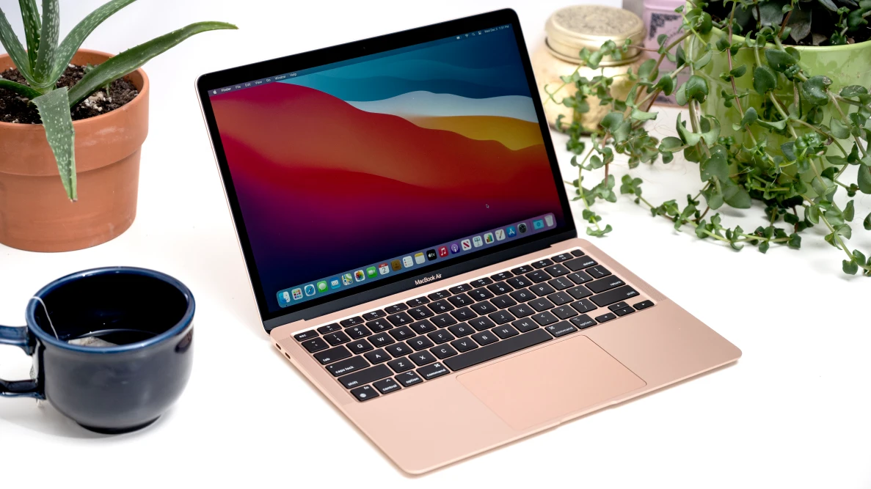
Classical computers

Slide 23
Classical computation is about 0 and 1

Slide 24
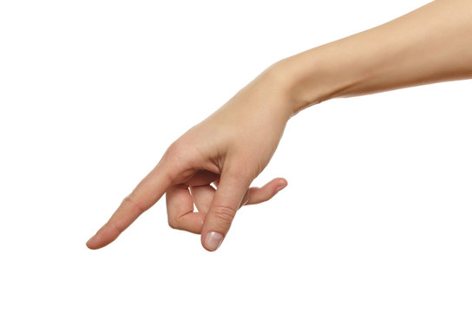
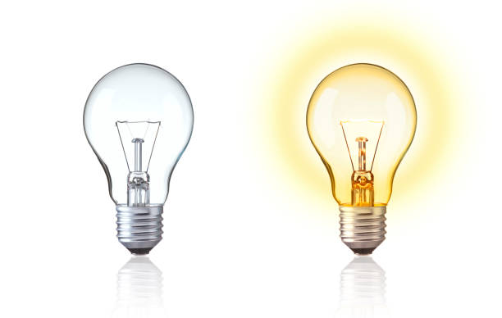
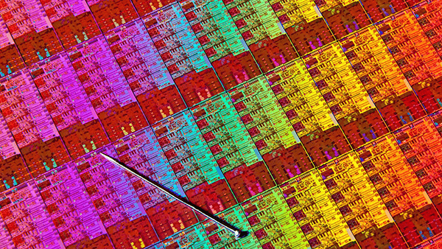
Classical computer – a box of switches
Switch in computer is realized by a transistor
A modern CPU has billions of transistors: e.g. Apple M2 Max - 67 billion transistors
“zero state”
“one state”

Slide 25
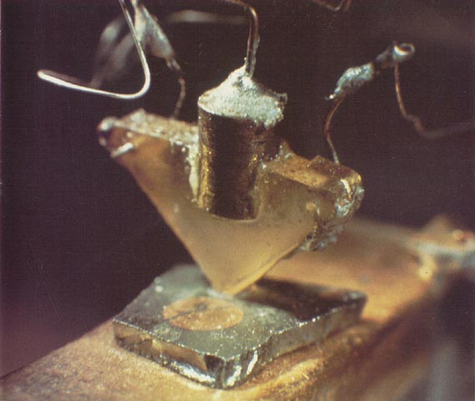
Transistor – electronic switch
metal
insulator
semiconductor
Semiconducting material enabled minituarzation of electric switches
J. Bardeen, W. Brattain 1947

Slide 27
Minituarization reduced insulator thickness to 2 -5 nm in 2024.
Still number of electrons is large
as a result the quantum phenomena averages out

Slide 28
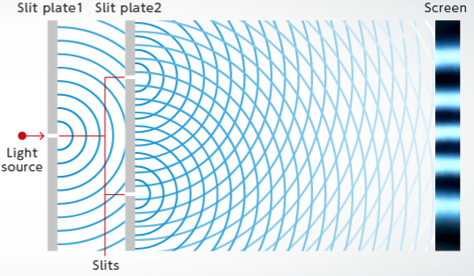
Quantum state
Classical state
Single photon can hold the information
Single photon hold more than just „0“ or „1“
Semiconductor can be conducting or non-conducting
semiconductor can hold the information of „0“ or “1“.
“zero state”
“one state”

Slide 29
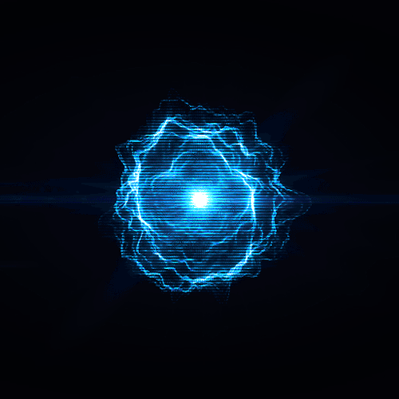
Introduction of quantum bit - qubit
Classical bit is “0” or “1”
$$BIT= \left|\left.0\right\rangle or BIT=\left|\left.1\right\rangle \right.\right.$$
Quantum bit – superposition of both states – “0” and “1”
$$QuBIT= α∙\left|\left.0\right\rangle +β∙\left|\left.1\right\rangle \right.\right.$$

Slide 30
Probability
to be in “0” and “1” must be 1
$$QuBIT= α∙\left|\left.0\right\rangle +β∙\left|\left.1\right\rangle \right.\right.$$
$$P\left(QuBIT\right)= α^{2}+β^{2}=1$$
Bloch sphere representation of qubit
$$\left|\left.Ψ\right\rangle \right.= α∙\left|\left.0\right\rangle +β∙\left|\left.1\right\rangle \right.\right.$$
$$\begin{matrix}α=\cos{\frac{θ}{2}} & β=e^{iφ}\sin{\frac{θ}{2}}\end{matrix}$$

Slide 31
Classical vs Quantum bit

Slide 32
QuBIT systems

Slide 33
Michelson – Morley experiment
Mirror
Piece of paper
Red Laser
Semitransparent glass
Mirror
Piece of paper
Screen

Slide 34
Mach-Zehnder interferometer
Detector
Mirror
Semitransparent glass
Detector
Red Laser
Semitransparent glass
Mirror
SOURCE
GATE
MEASUREMENT

Slide 35
$\left|\left.0\right\rangle \right.$path
Detector
Qubit state of $\left(\begin{matrix}1 \\ 0\end{matrix}\right)$
Mirror
Semitransparent glass
Detector
Red Laser
Semitransparent glass
Mirror

Slide 36
$\left|\left.1\right\rangle \right.$path
Detector
Qubit state of $\left(\begin{matrix}0 \\ 1\end{matrix}\right)$
Mirror
Semitransparent glass
Detector
Red Laser
Semitransparent glass
Mirror

Slide 37
Red Laser
Experiment shows that photons travel only to path $\left|\left.1\right\rangle \right.$

Slide 38
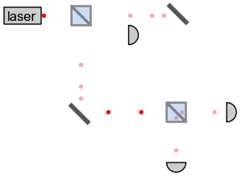
Mathematical description
Qubit at the exit of the laser: $\left(\begin{matrix}1 \\ 0\end{matrix}\right)$
After BS: $α\left(\begin{matrix}1 \\ 0\end{matrix}\right)+β\left(\begin{matrix}0 \\ 1\end{matrix}\right)=\left(\begin{matrix}α \\ β\end{matrix}\right)$
Beam-splitter operation: $A=\frac{1}{\sqrt{2}}\left[\begin{matrix}1 & i \\ i & 1\end{matrix}\right]$
After first beam-splitter:
$$\frac{1}{\sqrt{2}}\left[\begin{matrix}1 & i \\ i & 1\end{matrix}\right]∙\left(\begin{matrix}1 \\ 0\end{matrix}\right)=\frac{1}{\sqrt{2}}\left(\begin{matrix}1 \\ i\end{matrix}\right)$$
After second beam-splitter:
$$\frac{1}{\sqrt{2}}\left[\begin{matrix}1 & i \\ i & 1\end{matrix}\right]∙\frac{1}{\sqrt{2}}\left(\begin{matrix}1 \\ i\end{matrix}\right)=i\left(\begin{matrix}0 \\ 1\end{matrix}\right)$$
$$\left(\begin{matrix}1 \\ 0\end{matrix}\right)$$
$$\left(\begin{matrix}0 \\ 1\end{matrix}\right)$$
Red Laser

Slide 39
Mach-Zehnder interferometer
Detector
Mirror
Semitransparent glass
Detector
Red Laser
Semitransparent glass
Mirror

Slide 40
1. Create an account:
https://quantum-computing.ibm.com

Slide 41
1. Create an account:
https://quantum-computing.ibm.com
2. Launch IBM Quantum Composer

Slide 42
1. Create an account:
https://quantum-computing.ibm.com
2. Launch IBM Quantum Composer
3. Modify to have one, two or three qubits -> study the changes

Slide 43
1. Create an account:
https://quantum-computing.ibm.com
2. Launch IBM Quantum Composer
3. Modify to have one, two or three qubits -> study the changes
4. Leave only one qubit, and study H and S operations
Hadamard operation: $H=\frac{1}{\sqrt{2}}\left[\begin{matrix}1 & 1 \\ 1 & −1\end{matrix}\right]$
Phase change: $S=\left[\begin{matrix}1 & 0 \\ 0 & i\end{matrix}\right]$

Slide 44
Setup Beam-splitter gate
1st Beam-splitter: $A\left[\begin{matrix}1 \\ 0\end{matrix}\right]=\frac{1}{\sqrt{2}}\left[\begin{matrix}1 & i \\ i & 1\end{matrix}\right]\left[\begin{matrix}1 \\ 0\end{matrix}\right]=\frac{1}{\sqrt{2}}\left[\begin{matrix}1 \\ i\end{matrix}\right]$
$$S∙H∙S\left[\begin{matrix}1 \\ 0\end{matrix}\right]=\frac{1}{\sqrt{2}}\left[\begin{matrix}1 & 0 \\ 0 & i\end{matrix}\right]∙\left[\begin{matrix}1 & 1 \\ 1 & −1\end{matrix}\right]∙\left[\begin{matrix}1 & 0 \\ 0 & i\end{matrix}\right]\left[\begin{matrix}1 \\ 0\end{matrix}\right]=$$
$$=\frac{1}{\sqrt{2}}\left[\begin{matrix}1 & 0 \\ 0 & i\end{matrix}\right]∙\left[\begin{matrix}1 & i \\ 1 & −i\end{matrix}\right]\left[\begin{matrix}1 \\ 0\end{matrix}\right]=$$
$$=\frac{1}{\sqrt{2}}\left[\begin{matrix}1 & i \\ i & 1\end{matrix}\right]\left[\begin{matrix}1 \\ 0\end{matrix}\right]=\frac{1}{\sqrt{2}}\left[\begin{matrix}1 \\ i\end{matrix}\right]$$
1st+2nd Beam-splitter: $A∙A\left[\begin{matrix}1 \\ 0\end{matrix}\right]=\left[\begin{matrix}0 \\ i\end{matrix}\right]$
$$\left(S∙H∙S\right)∙\left(S∙H∙S\right)\left[\begin{matrix}1 \\ 0\end{matrix}\right]=\left[\begin{matrix}0 \\ i\end{matrix}\right]$$

Slide 45
1st Beam spliter
$$S∙H∙S\left[\begin{matrix}1 \\ 0\end{matrix}\right]=$$
$$=\frac{1}{\sqrt{2}}\left[\begin{matrix}1 \\ i\end{matrix}\right]$$

Slide 46
2nd Beam spliter
$$\left(S∙H∙S\right)∙\left(S∙H∙S\right)\left[\begin{matrix}1 \\ 0\end{matrix}\right]=$$
$$=\left[\begin{matrix}0 \\ i\end{matrix}\right]$$

Slide 47
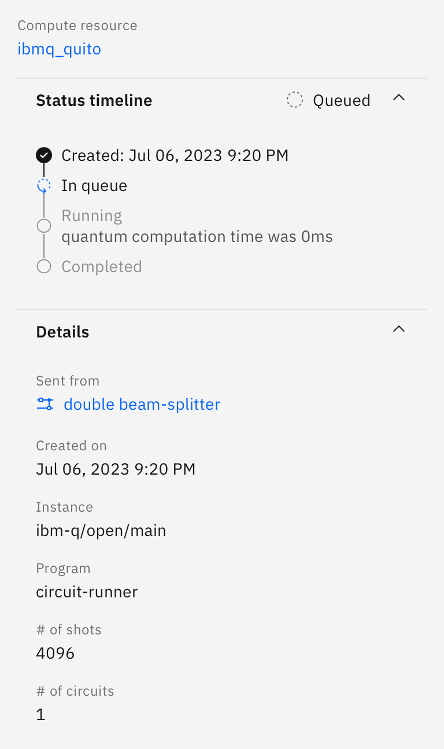
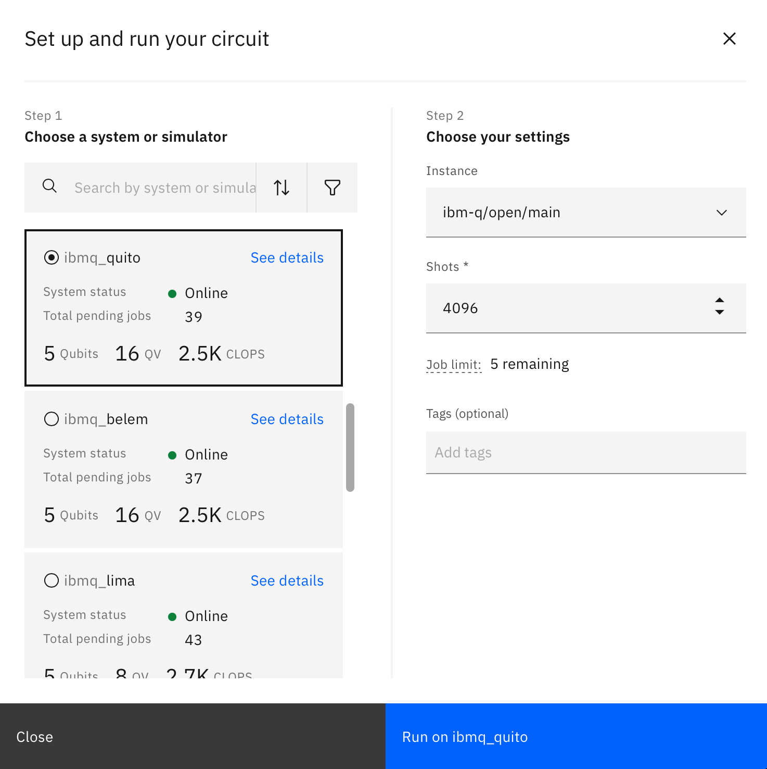
Add a measure and run the quantum program!

Slide 48
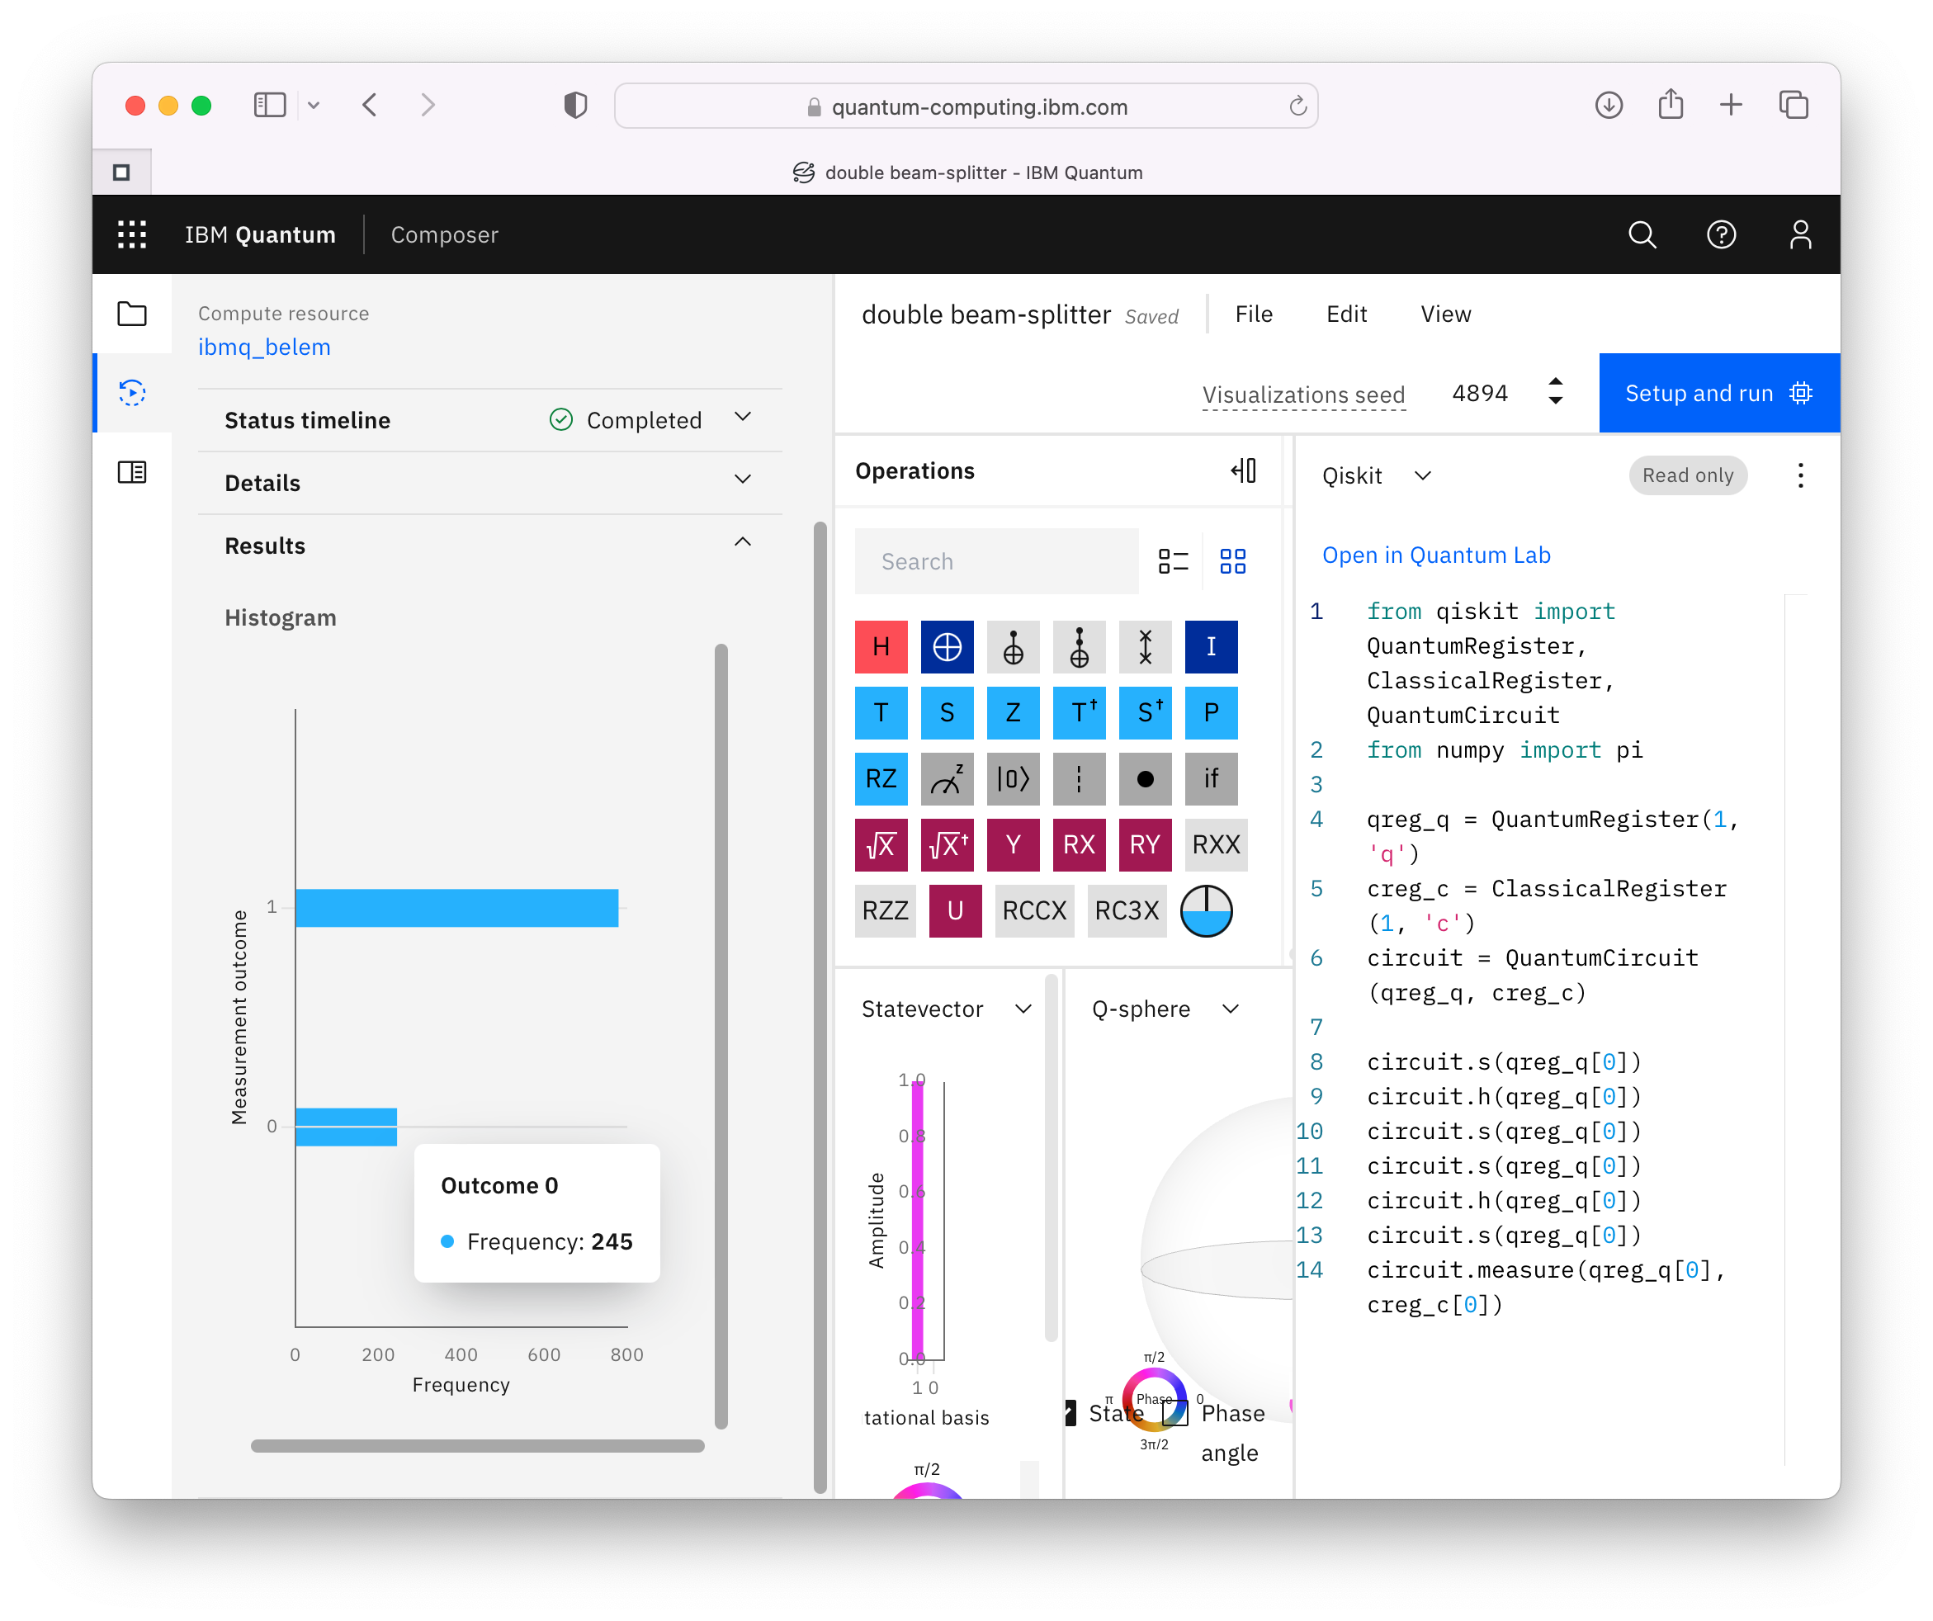
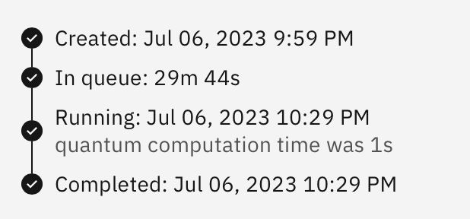
Check the number of |0> and |1>
Note: Real quantum computers have also errors!

Slide 49
Want more? Take the red pill ;)
Egon Pavlica (mailto:egon.pavlica@ung.si)

