Slide 1

Graphene - Magic of Carbon
Professor Volodymyra BOICHUK
Notes:
My name is .. I represent Precarpathian (Прікапесіан) National University, Ukraine
The topic of my lecture is Graphene - Magic of Carbon. You had the lecture about the reasons for the special properties of nanomaterials, because the explanation of the properties of carbon nano-systems will be carried out using its conclusion. What should we remember? First of all, the basics of general physics and quantum mechanics as well as the basics of chemistry.

Slide 2
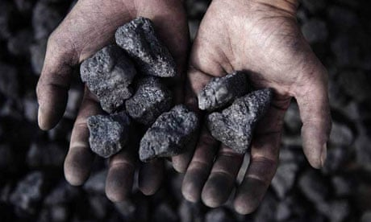
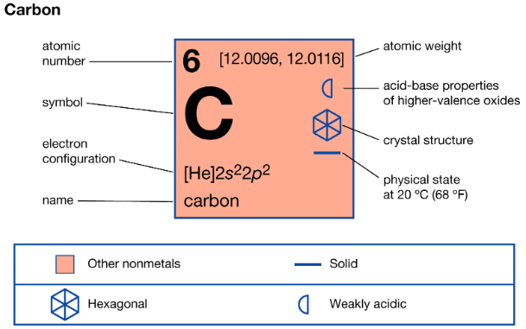
Carbon. Starting point
In the second part of the eighteenth-century carbon was first identified as an element.
The name "carbon" comes from the Latin word carbon, meaning "charcoal".
Carbon (C) is the sixth element on the periodic table and the sixth most abundant element in the universe.
Carbon is unique because of its four valence electrons, which make it very versatile and allow it to bond with many other elements.
https://www.britannica.com/science/carbon-chemical-element
Notes:
Carbon as an element was discovered in 18th (eighteenth) century from charcoal and got its name because “carbo” means “coal” in Latin.
Carbon is 4th (fourth) most abundant (абендент) element in our solar system, and it is 17th (seventeenth) - in earth (ерс) crust.
After oxygen, carbon is 2nd (second) abundant element in the human body.
It is very interesting that carbon is 6th (sixth) element in periodic table and 6th (sixth) most abundant element in the Universe.
Carbon is unique because of its 4 valence electrons, which makes it very versatile (версетл) and allows it to bond with many other elements.
There are over 10 million known carbon-containing compounds (organic and inorganic).
As you know, the main reason for electrical, optical, magnetic and other properties of material is features (фічез) of its electronic structure.

Slide 3
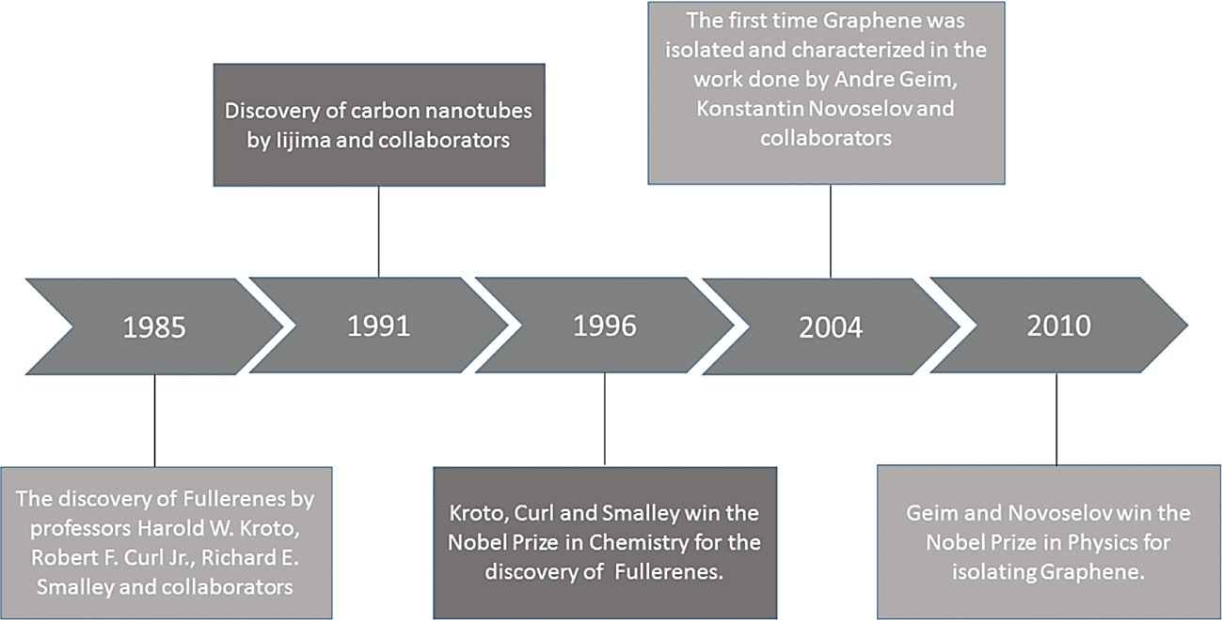
Carbon. Allotropes
Notes:
Here is a short timeline containing information about the year of discovery and the main awards (еводс) of work related to carbon nanostructures.
Among the new materials developed with the advancement of nanotechnology, carbon nanomaterials should be highlighted because they are considered highly versatile. Carbon nanomaterials presented thermal, electrical, chemical, and mechanical characteristics, besides the richness and diversity of carbon, which is the chemical element that considered the symbol of life.
The discovery of fullerenes, followed by CNTs and the recent isolation (айсолейшн) and characterization of graphene in 2004 (two thousands and four) provided new possibilities in chemistry and physics of carbon and increased interest in carbon nanomaterials.

Slide 4
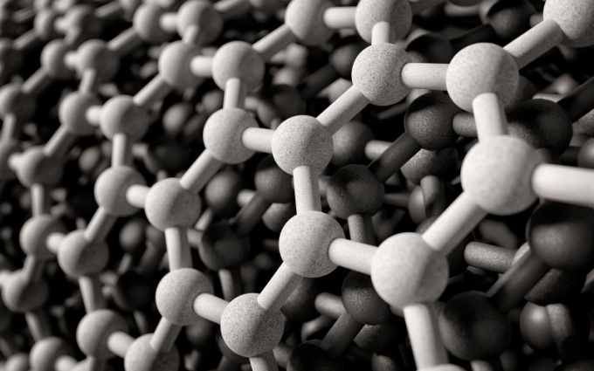
Carbon. Allotropes
Allotropy is the property of certain chemical elements to exist in two or more distinct forms (phases), known as elemental allotropes.
Allotropes have different structure: the atoms of the same element are bonded together in different ways.
The allotropes of carbon include:
diamond
graphite
graphene
fullerenes
carbon nanotubes
Q-carbon
Carbyne
amorphous carbon
schwarzites
cyclocarbon
glassy carbon
What is the reason for structural variations and cardinal changes in properties?
Notes:
Due to its electronic structure, carbon forms a number of allotropic modifications. Allotropy is the property of some chemical elements to exist in two or more different forms (phases), known as allotropes. Allotropes have different structure: the atoms of the same element are bonded together in different manners.
As a result, the different allotropes have different types of symmetry of crystal lattice. The allotropes of carbon include:
diamond (the carbon atoms are bonded together to form a cubic lattice of tetrahedra), graphite (the carbon atoms are bonded together in sheets of a hexagonal lattice), graphene (single sheets of graphite), fullerenes (the carbon atoms are bonded together in spherical, tubular, or ellipsoidal formations). carbon nanotubes, Q-carbon, Carbyne, amorphous carbon, cyclocarbon, glassy carbon
Each allotrope has the special properties but what is the reason of structural variation and crucial (крушел) changes in properties of different allotropes?

Slide 5
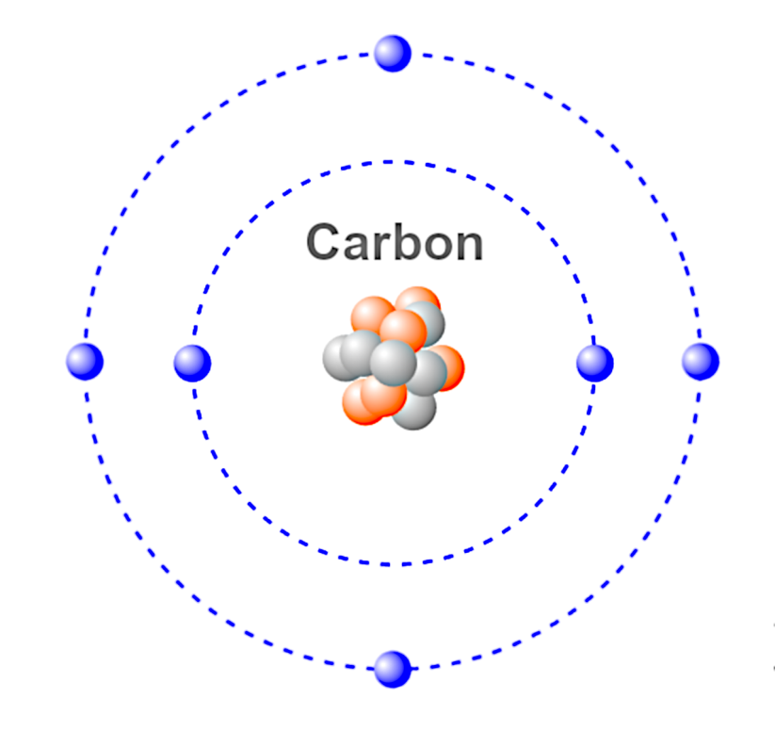
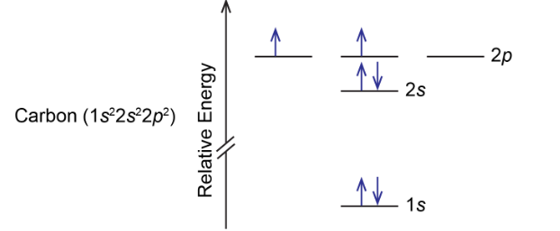
Carbon. Atom
Carbon atoms are made up of a nucleus of six protons and six neutrons (¹²C isotope) and surrounded by six electrons.
The electron configuration of carbon is 1s² 2s² 2p².
The 1s orbital is the lowest energy level. Since 1s can only hold two electrons the next 2 electrons for C goes in the 2s orbital, and it can also hold a maximum of two electrons.
The 2p orbital is the third energy level, and it consists of three sub-levels: 2pₓ, 2pᵧ, and 2p_{z}.
Each of these sub-levels can hold a maximum of two electrons. In carbon atom two of the 2p orbitals (2pₓ and 2p_{y}) hold one electron each, while the third 2p orbital (2p_{z}) is empty.
The first wonder of carbon is the electronic structure
Notes:
As you know, carbon atom consists of 6 protons, 6 neutrons (ньютронс) (C12 isotope), surrounded by 6 electrons. We remember that the Rutherford model of an atom (where the electrons are alike the planets of solar system) is only the basic one, but at the next level we should use terms of quantum mechanics about the electron as a wave packet distributed over certain orbitals.
The electronic configuration of carbon is 1s² 2s² 2p².
The 1s orbital is the lowest energy level. Since 1s can only hold two electrons the next 2 electrons for C goes in the 2s orbital, and it can also hold a maximum of two electrons.
The 2p orbital is the third energy level, and it consists of three sub-levels: 2pₓ, 2pᵧ, and 2p_{z}.
Each of these sub-levels can hold a maximum of two electrons. In carbon atom two of the 2p orbitals (2pₓ and 2p_{y}) hold one electron each, while the third 2p orbital (2p_{z}) is empty.
The electronic structure of carbon (1s² 2s² 2p²) accounts for the ability of carbon to form four covalent bonds, as it can share its four valence electrons with other atoms to achieve a stable electronic configuration.

Slide 6
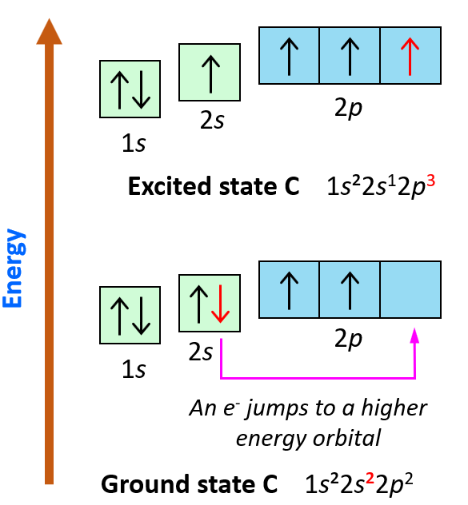
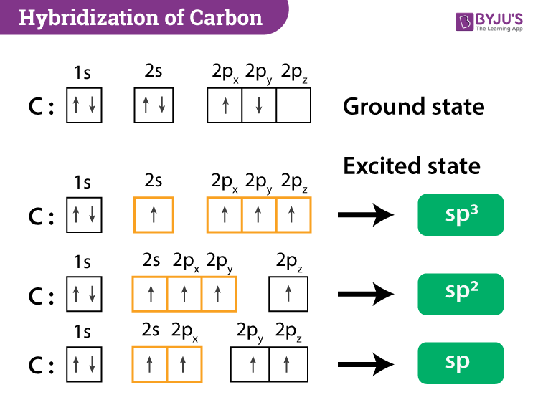
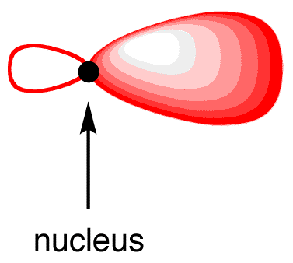
Carbon. Electronic structure
Hybridization is a concept describing the mixing of atomic orbitals to form hybrid orbitals with different geometries and energies.
This hybridization occurs when atoms join together to form a more energetically favorable configuration.
The shape of the single sp- , sp² or sp³-hybridized orbital
The most common types of hybridization for carbon are:
sp³ , sp² , sp
Notes:
What is the exited (іксайтед) state of atom? It is a state in which the total energy of the electrons can be lowered by transferring one or more electrons to different orbitals which are higher in energy.
The next step of energy optimization of carbon atom as a quantum system is an orbital hybridization. Hybridization is a concept that describes the mixing of atomic orbitals to form hybrid orbitals with different geometries and energies. This hybridization occurs when atoms bond together to form more energetically favorable configuration. So, the hybridization predicts the certain symmetry of atomic spatial distribution.
There are 3 options of hybridization of 2s and 2p orbitals, which are known as sp, sp2, and sp3 and correspond to formation of 2, 3 or 4 hybridized orbitals.
Each hybridized orbital has spatial geometry like asymmetrical dumbbell (дамбел)

Slide 7
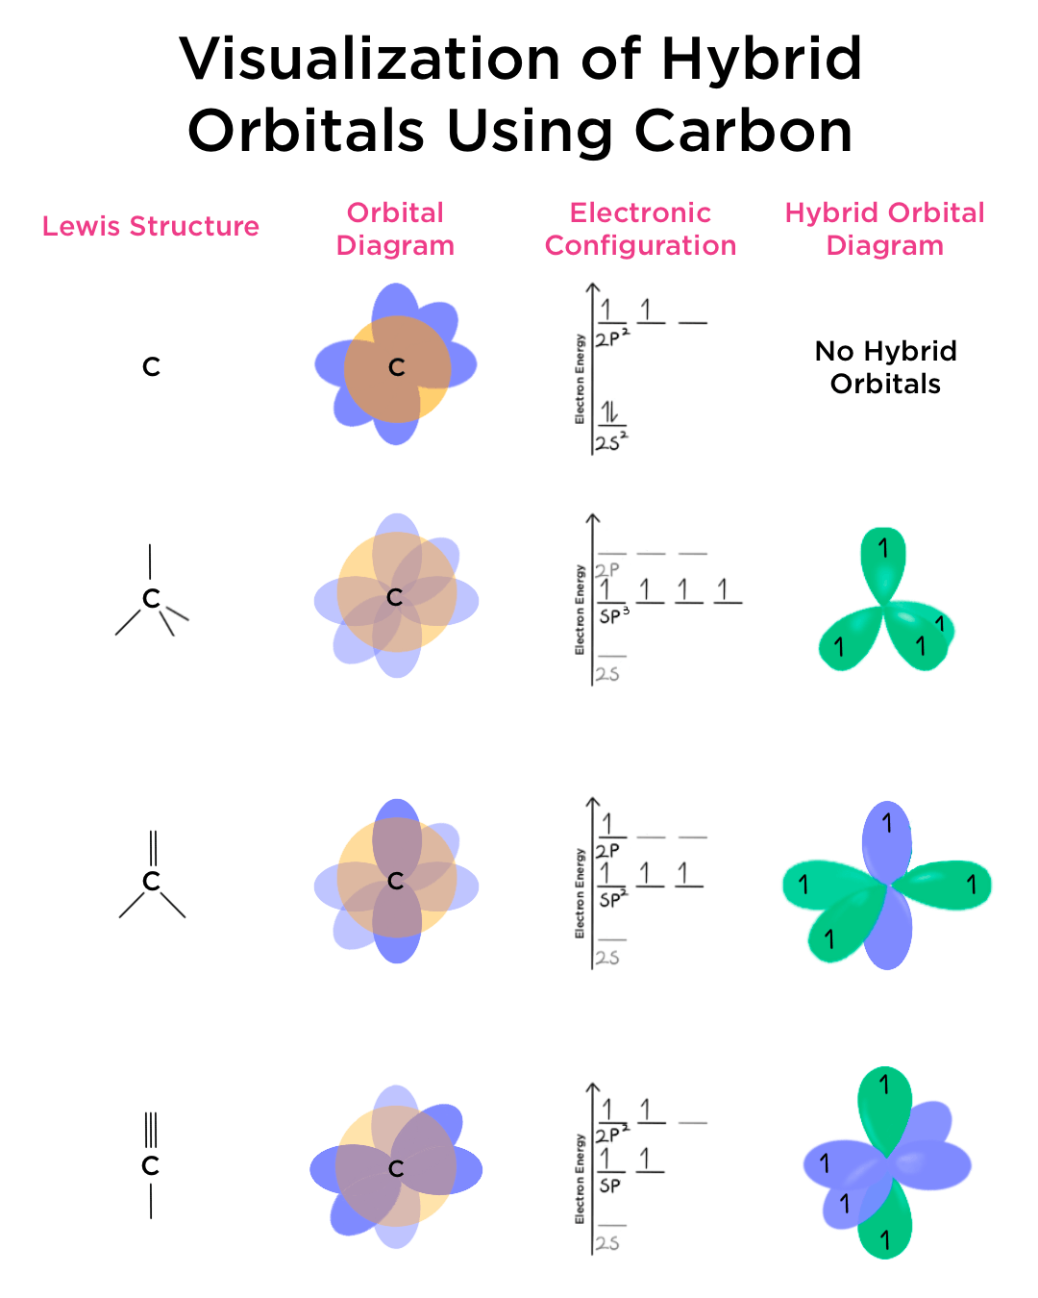
Carbon. Electronic structure
Notes:
Each sp³-hybridized (хайбридайзд) orbital has an electron, and the electrons repel each other. To minimize repulsion between electrons, the four sp³-hybridized orbitals are arranged around the carbon nucleus so that they are as far away as possible from each other, resulting in the tetrahedral arrangement of the four sp³-hybridized orbitals around the carbon nucleus
To minimize repulsion between electrons, the three sp²-hybridized orbitals are arranged around the carbon nucleus so that they are as far apart as possible, resulting in their planar trigonal arrangement. The 2p orbital that did not participate in hybridization has one electron. Again, to minimize the repulsion between electrons, it positions itself to be as far away from each sp2-hybridized orbital as possible, which results in the 2p orbital perpendicular to each sp2-hybridized orbital.
To minimize repulsion between electrons, the two sp-hybridized orbitals are arranged around the carbon nucleus so that they are as far away as possible, resulting in their linear arrangement. Two 2p orbitals that did not participate in hybridization and are perpendicular to each other have one electron each. Again, to minimize repulsion between electrons, they are arranged to be as far away from each sp-hybridized orbital as possible.
So, now we understand the reason for different types of crystal symmetry formation. And this reason is energy optimization of the system where major component is electrostatic energy. At the same time, we must consider the other components of energy of the system – energy of unsatisfied chemical bonds and surface energy.

Slide 8
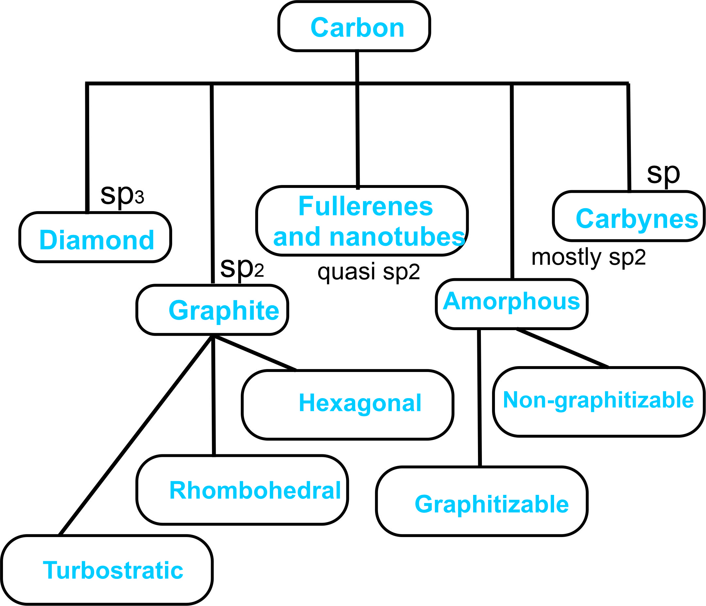
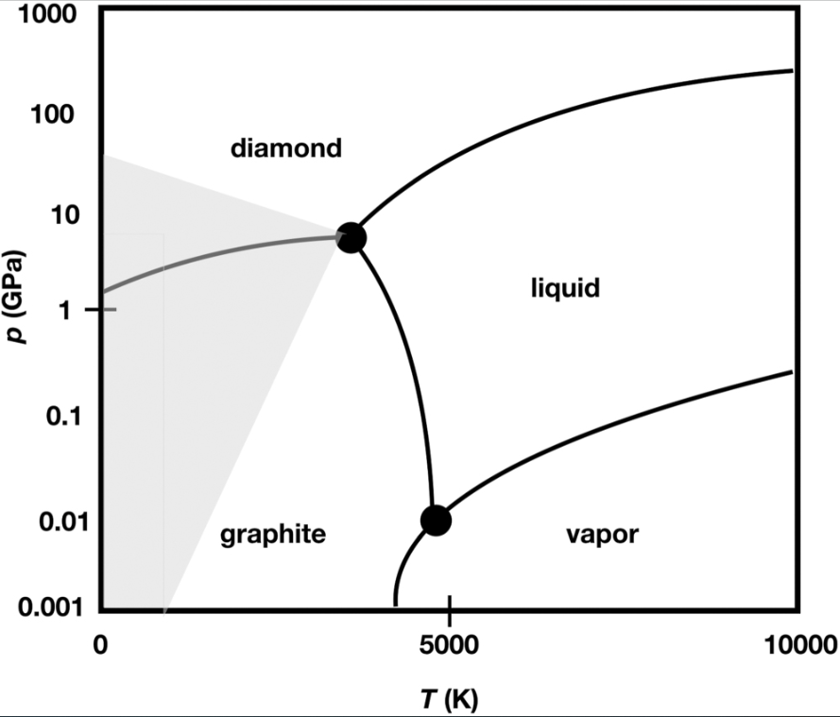
Carbon. Structure of Allotropes
Different geometries of hybridized orbitals result in linear (1-dimensional), planar (2-dimensional), or tetrahedral (3-dimensional) spatial organization of crystalline and amorphous allotropes of carbon.
Two main allotropes: graphite and diamond corresponding to sp² and sp³ hybridization
Notes:
Finding the balance between these kinds of total energy under different condition (temperature, pressure) causes nucleation and growth of nuclei with different crystal structure.
The most stable forms of crystal ordered carbon are graphite and diamond. But the different geometry of the hybridized orbitals can result in linear (1-dimensional), planar (2-dimensional) or tetrahedral (3-dimensional) spatial organization of crystal and amorphous allotropes of carbon. Graphite and diamond correspond to sp2 and sp3 hybridization, respectively, but finding the balance between components of energy can lead to formation of more complex forms like fullerenes or nanotubes.
In some cases, the formation of amorphous form of carbon with mixed type of hybridization is more favorable. So, the phase diagram of carbon that composed of only 4 phase regions is only approximated. The reality is more complicated.

Slide 9
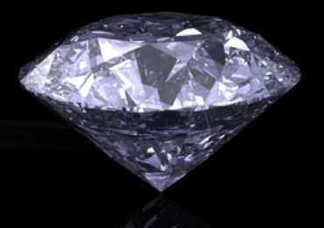
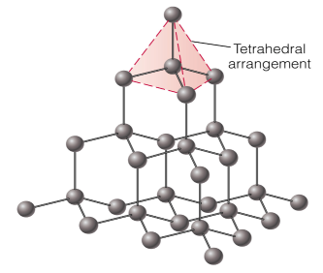
Carbon. Diamond
Properties
Diamond is the densest form of carbon.
Diamond is the hardest natural substance.
The melting point of the diamond is 3843K (approx 3570 ºC).
In diamonds, all valence electrons participate in bond formation. It does not have a lone pair of electrons due to the fact that this diamond has a very low electrical conductivity.
Diamond is insoluble in all solvents.
When heated at 475K in presence of sulfuric acid and potassium dichromate, diamond is oxidized directly into carbon dioxide, leaving no residue.
Diamond has a very high refractive index.
It is a good conductor of heat.
Notes:
Let’s make a brief overview of some most important carbon allotropes.
Let’s start with diamond. As you know, diamond has tetrahedral arrangement of atoms corresponding to sp3-hybridization. As a result, we obtain the densest form of carbon, in which all valance electrons are involved in bond formation.
So, there is no lone pair of electrons, due to this, diamond has a very low electrical conductivity as well as wide band gap. It is transparent for visual range of light spectrum and insoluble in all solvents.
It is unexpected, but these properties – optical and chemical - have the same reason – characteristics of electronic structure.
Diamond is the hardest natural substance. It has quite high melting point of 3843K, but it is flammable (флемабл) and can be oxidized directly into carbon dioxide.
Dimond can be burnt without residue (ресідью).
Diamond has a very high refractive index, and It is a good heat conductor. It is the result of electronic structure too.

Slide 10
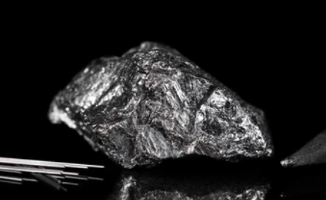
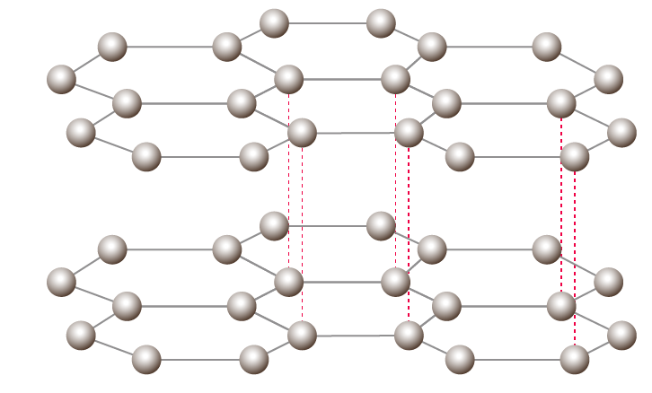
Carbon. Graphite
Properties of graphite:
Graphite is black in color and has a metallic luster.
High melting point: The carbon atoms in each layer are bound by strong covalent bonds, so that the melting point of graphite is high, about 3500°C.
Conductivity: Every carbon in graphite is sp²-hybridized. Thus, one valence electron of each carbon atom can move freely from one point to another. Non-hybrid orbitals containing one electron each overlap in the transverse direction, forming bonds in one layer. These free electrons are delocalized and move under the influence of thermal and electric fields. Thus, it is a good thermal and electrical conductor.
Low density of 2.26 g/cm³ due to large distance between layers.
Graphite is slippery because of its characteristic layered structure. It is often used as a dry lubricant.
Graphite is chemically stable
Notes:
The next one is graphite. Black or dark grey color with metallic luster. It consists of the same atoms, but its properties differ from diamond.
As you know, the light absorbance is a result of photon captured by an electron. And transparent bodies have high energy of valance electron excitation and, as a result, low concentration of free electrons. So, the metal foil is not transparent because excitation energy of valence electrons for metals is very low, which causes good electric conductivity.
Black color and metallic luster of graphite are the manifestation of high density of free electrons. Really, each carbon in graphite is sp² hybridized. Thus, one valence electron of each carbon atom is free to move from one point to another. The unhybridized orbitals containing one electron each overlap laterally to form bonds in the same layer. These free electrons are delocalized and move under the influence of heat and electric field. Thus, it makes a good thermal and electric conductor.
Graphite has lower density compared to diamond due to large distance between the layers. The sp2 hybridization type of carbon atom leads to planar structure of graphite crystal lattice when the carbons (that form the individual layers) are strongly covalently bonded when the separate layers are respectively weakly bonded.
Due to these characteristics, you can produce carbon nanomaterials directly now using only paper and pencil, when you write with a pencil on a paper, the plane fragments of graphite crystals are exfoliated and line drown on the paper consists of a series of carbon nanoparticles (the pencil rod is a polycrystal in reality, but it doesn’t change the case).
Now we first use the word “nano”.

Slide 11
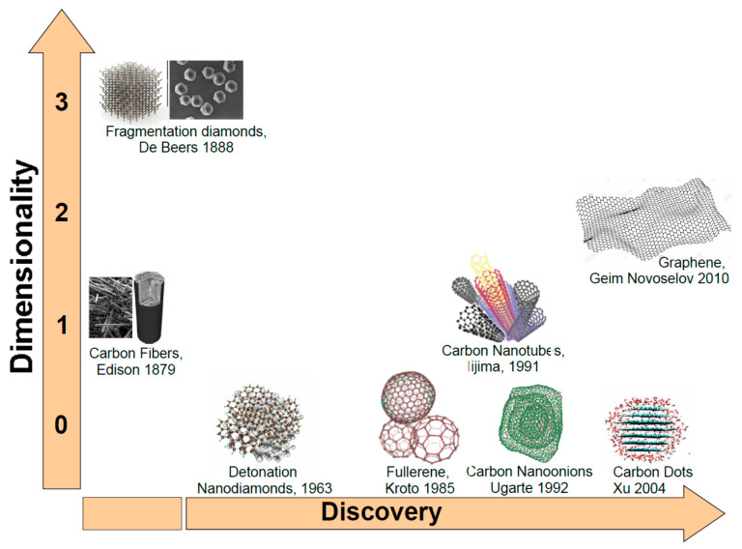
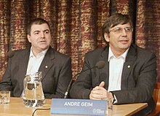
Carbon. Graphene. General
For the discovery of graphene in 2004, the 2010 Nobel Prize in Physics was awarded jointly to Andre Geim and Konstantin Novoselov
"for ground-breaking experiments regarding the two-dimensional material graphene"
Carbon nanostructures ordered following dimensionality and discovery time
Notes:
The term graphene was first used in 1962 (nineteen sixty two), a year in which this material was actually observed for the first time by German chemists Ulrich Hofmann and Hanns-Peter Boehm, who named it graphene because of the graphite junction (джанкшен) with the suffix-ene related to the double bonds existing.
However, it was only four decades later when graphene was isolated (айсолейтід) and first characterized by researchers Geim and Novoselov of the University of Manchester, through the mechanical exfoliation of graphene sheets in individual layers of small plates of pyrolytic graphite.
Novoselov, Geim, and coworkers improved the efficiency of the material obtained, improving its conductivity, and thinning it to the thickness of an atom. To the researchers’ surprise, the ultrafine material presented not only a structure of flat monolayer of carbon atoms connected hexagonally but also excellent (екселент) thermal and electrical conductivity, good mechanical resistance, being light, flexible, and presenting a large specific surface area.

Slide 12
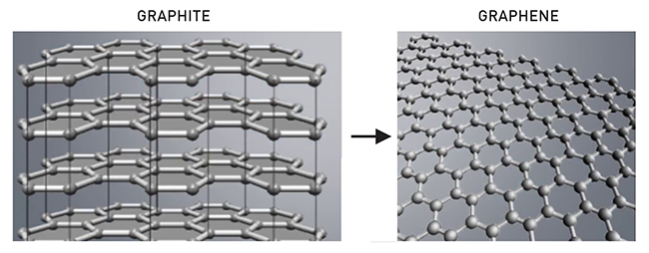
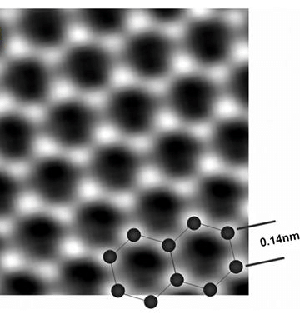
Carbon. Graphene. General
Graphene is a single atom thick sheet of carbon.
What is the advantage of graphene over graphite?
Strength, flexibility, electrical conductivity, exceptional optical properties have opened up new horizons for research in the field of high energy particle physics, as well as for electronic, optical and energy applications.
In graphene, each carbon atom is covalently bonded to three other carbon atoms.
Thanks to the strength of its covalent bonds, graphene boasts great stability and, for example, very high tensile strength (the force you can stretch something before it breaks).
Notes:
What are graphene’s advantages over graphite ?
Strength, flexibility, electrical conductivity, exceptional optical properties have opened new horizons (хорайзознс) for high-energy particle physics research and electronic, optical, and energy applications.
In graphene, each carbon atom is covalently bonded to three other carbon atoms.
Due to the strength of the covalent bonds, graphene has great stability and a for example (ікзампл), very high tensile (тензайл) strength (the force in which you can stretch something before it breaks).
What is the difference between graphite and graphene?
But firstly, about graphene properties.

Slide 13
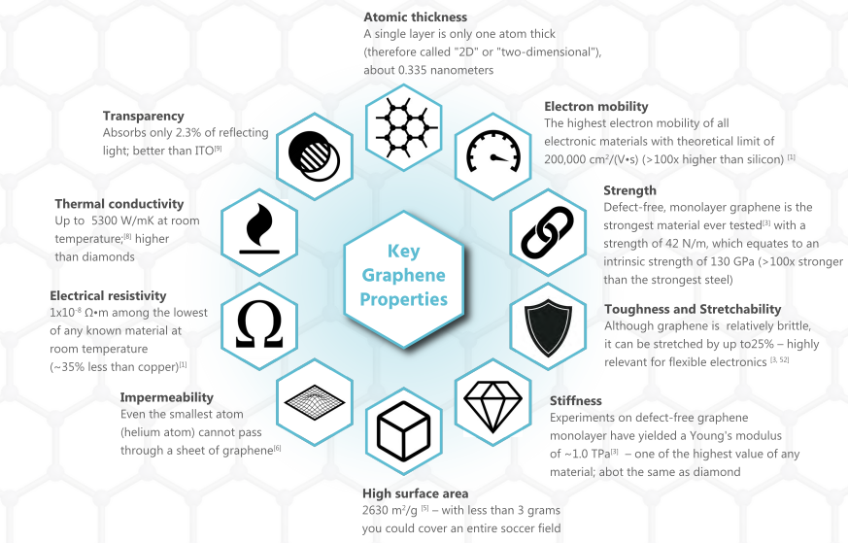
Carbon. Graphene. Unique Properties
Very exiting, but what is a reason for
these properties ?
Notes:
Graphene is transparent with thickness of about 1/3 (one third) of a nanometer, it absorbs only 1/50 (one fiftieth) of incident light.
Graphene has an extremely low electrical resistivity that correspond to highest electron mobility of all conductors.
As a result, this material has exceptionally high thermal conductivity.
The characteristics of crystal and electronic structure cause the unique mechanical properties. For example, monolayer graphene is the strongest material ever tested. More than 100 times stronger than the strongest steel.
Graphene has very high surface area. Theoretical (сіоретікал) limit is more than 2600 m2/g. So, 3 g of graphene has the same area as a football field.

Slide 14
Carbon. Electronic structure-glossary
The electrical and optical properties are due to a very special band structure
Five quite important facts
There are two types of electrons in solid carbon - electrons in the s- and p-shells associated with the atom,
and electrons that have left the shells and transferred to the crystal
2. The energy of all electrons is quantized
3. According to Pauli exclusion principle, only two electrons with opposite spins can have the same energy in the same quantum system; when a system consists of many identical atoms, the individual energy levels of the electrons of individual atoms turn into energy bands
4. The energy of electrons depends on the lattice. The spatial distribution of atoms is the reason for a certain symmetry of the intracrystalline electric field, which determines the allowed energy state of electrons.
5. The grouping of these different energy levels for free and bound electrons forms energy bands.
Valance band consists of energy levels of valence electrons.
Conduction band consists of energy levels of free electrons.
Forbidden energy gap is the energy gap between the valence band and the conduction band.
The valence band and conduction band overlap in the case of a conductor
There is a small band gap between the valence band and the conduction band in the case of semiconductors.
Between the valence band and the conduction band in the case of insulators there is a large band gap.
What’s about graphene ?
Notes:
There are two types of electrons in solid carbon - electrons in the s- and p-shells associated with the atom,
(they can participate in the formation of chemical bonds) and electrons that have left the shells and transferred to the crystal due to thermal excitation of external electric field
2. The energy of all electrons is quantized
3. According to Pauli exclusion principle, only two electrons with opposite spins can have the same energy in the same quantum system (for example, a graphene particle); when a system consists of many identical atoms, the individual energy levels of the electrons of individual atoms turn into energy bands
4. The energy of electrons depends on the lattice (the type of atoms, the number of electrons in atomic shells and protons in nuclei, lattice symmetry and distance). The spatial distribution of atoms is the reason for a certain symmetry of the intracrystalline electric field, which determines the allowed energy state of electrons (according to the Schrödinger equation).
5. The gruping of these different energy levels for free and bound electrons forms energy bands.
Valance band consists of energy levels of valence electrons..
Conduction band consists of energy levels of free electrons.
Forbidden energy gap is the energy gap between the valence band and the conduction band.
The valence band and conduction band overlap in the case of a conductor
There is a small band gap between the valence band and the conduction band in the case of semiconductors.
Between the valence band and the conduction band in the case of insulators there is a large band gap.

Slide 15
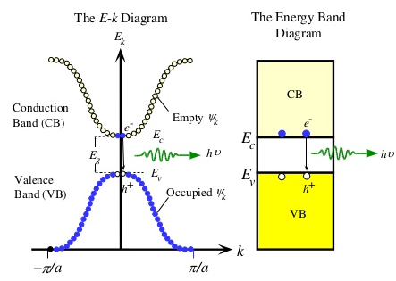
Carbon. Electronic structure-glossary
The wave vector (k-vector) determines the quasi-momentum and energy of an electron in a crystal
Quasimomentum
kinetic energy
of the electron
Empty cells
The space in which an electron exists is quantized and consists of separate cells, each of which can contain a maximum of two electrons with opposite spins at the same time.
Absorption or emission of electromagnetic waves occurs when an electron passes between cells
bandgap determines the class of material - conductor, semiconductor or insulator
Occupied cells
Notes:
As you know, the quasi-momentum of electron in crystal is proportional to its wave vector. So, for the approach of quasi-free electron its kinetic energy is described as
And it means that kinetic energy is proportional to squared quasi-momentum or squared k-vector. Considering that we should use all 3 components of k-vector: kx, ky, and kz, we can predict that the dependence of energy of electron on its k-vector for each of its component has a parabolic shape. We remember that these dependences aren’t continuous but consist of the separate chains, each of which corresponds to individual cells of k-space, which can contain 2 electrons with opposite spins only. We remember that the absorption or emission of EM waves occurs at electron transition between cells belonging to conduction and valance bands. We remember that the highest probability has transition without changing k-vector. This energy range corresponds to optical band gap. The width of the band gap determines the class of material - conductor, semiconductor or insulator.
So, where is graphene in this list?

Slide 16
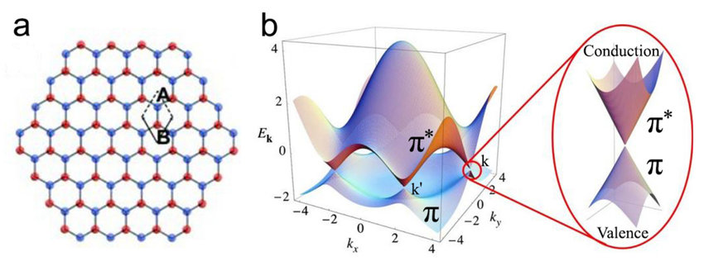
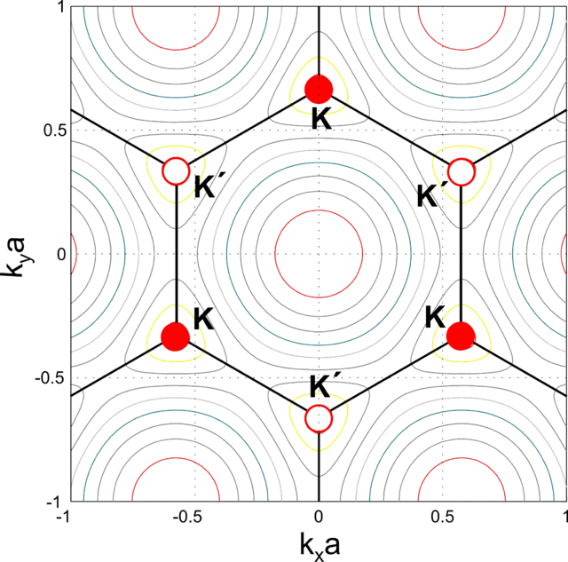
Carbon. Graphene. Electronic structure
Graphene has a special electronic structure:
Each atom in a graphene sheet is connected to three nearest neighbors by σ-bonds and a delocalized π-bond, which contributes to the formation of a valence band that spans the entire sheet.
The valence band touches the conduction band, making graphene a semimetal with unusual electronic properties that are best described by massless relativistic particle theories.
Charge carriers in graphene show a linear rather than quadratic dependence of energy on momentum.
Result: Graphene typically has a zero band gap, which is due to its massless electrons.
Notes:
Graphene has a special electronic structure:
Each atom in a graphene sheet is connected to three nearest neighbors by σ-bonds and a delocalized π-bond, which contributes to the formation of a valence band that spans the entire sheet.
The valence band touches the conduction band, making graphene a semimetal with unusual electronic properties that are best described by massless relativistic particle theories.
Charge carriers in graphene show a linear rather than quadratic dependence of energy on momentum.

Slide 17
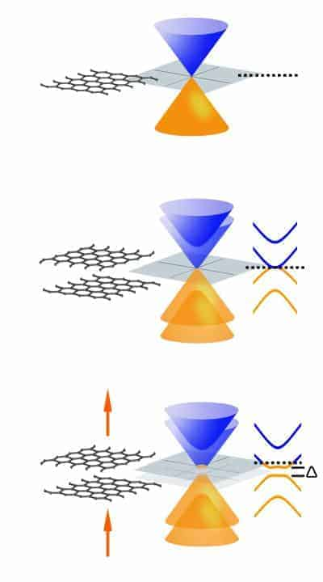
Carbon. Graphene. Electronic structure
Quantum confinement effect is a restriction on the movement of an electron in a material to specific discrete energy levels rather than to quasi-continuum of energy bands when the length of a particle is reduced to the same order as the wave packet (the condition is fulfilled for single and multilayer graphene)
The difference in energy between filled states and the empty states depends on the size of graphene particles, so the band gap can be tuned (band gap typically increases with decreasing particle size)
The transition from single-layer to multilayer graphene makes it possible to vary the electronic properties of the material along with a change in the interlayer distance.
Yes, graphene can be multilayered – up to 10 layers
Notes:
But there is another factor – quantum confinement (конфайнмент)
Quantum confinement effect is a restriction on the movement of an electron in a material to specific discrete energy levels rather than to quasi-continuum of energy bands when the length of a particle is reduced to the same order as the wave packet (the condition is fulfilled for single and multilayer graphene)
The difference in energy between filled states and the empty states depends on the size of graphene particles, so the band gap can be tuned (band gap typically increases with decreasing particle size)
The electronic properties of graphene change with the number of layers and with the relative position of atoms in adjacent (еджейсент) layers determined by the order of stacking. Therefore, graphene should not be considered as a single material, but rather as a family of compounds that can be formed by a single layer of atoms (monoatomic sheet), to materials formed by two, three, four, etc. Graphene sheets are stacked in an organized way. Thus, the electronic structure of the graphene presents different couplings with the increase in the number of layers up to the limit of 10–20 layers (3D limit) when the material is considered graphite

Slide 18
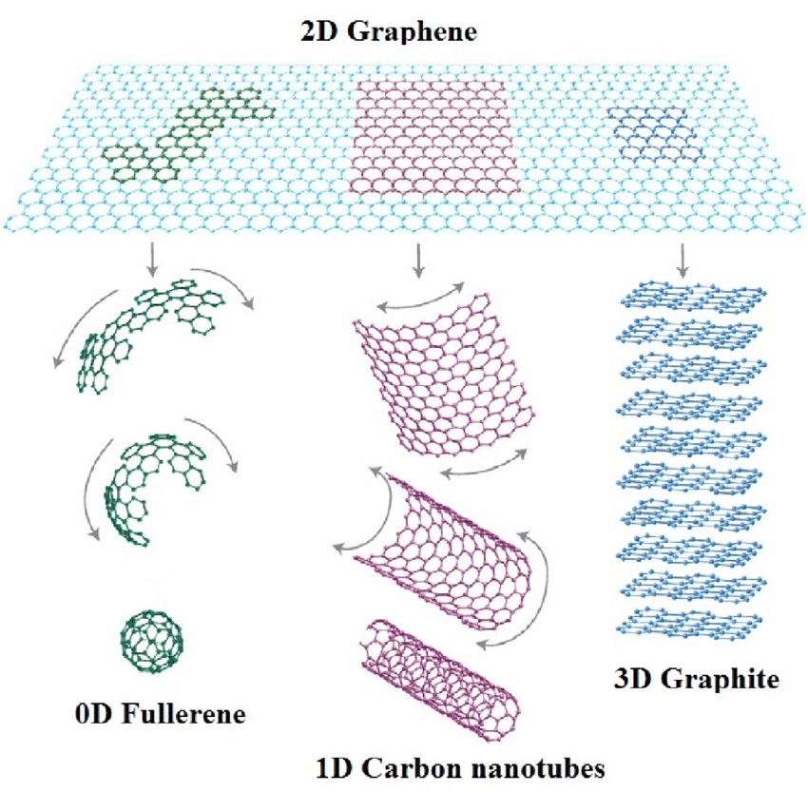
Carbon. Graphene as a building block
Graphene sheets are building blocks for other graphitic materials
Graphene sheets stacked on top of each other make 3D graphite (1 mm thick graphite contains about 3 million layers of graphene)
Graphene sheets rolled up make a carbon nanotube
Graphene sheets cutting and folding into a spherical shape make a fullerene
Yes, the properties of nanotubes and fullerenes
are special and size-sensitive
Notes:
It is very important that graphene sheets – single and multi-layered are the building blocks for other graphitic materials.
When we roll up graphene, we can obtain the carbon nanotube. After cutting and folding the graphene sheets we can obtain closed system formed by carbon atoms – fullerenes. And the properties of nanotubes and fullerenes are special and size-sensitive

Slide 19
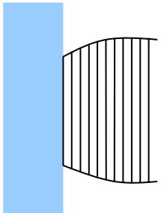

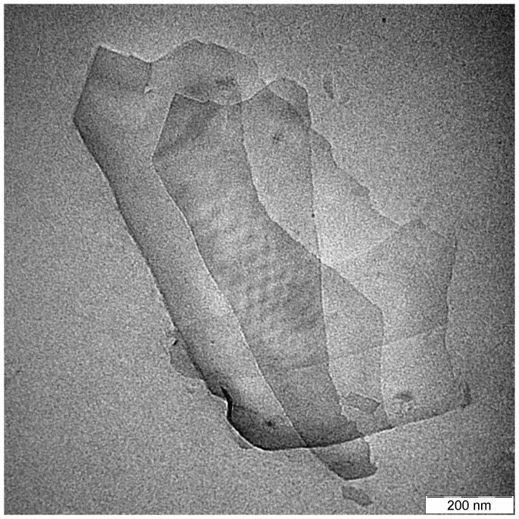
Carbon. Graphene. Obtaining
In micromechanical exfoliation method, graphene is separated from a graphite crystal using adhesive tape. After peeling it off the graphite, multiple-layer graphene remains on the tape. By repeated peeling the multiple-layer graphene is cleaved into several flakes of few-layer graphene.
This simple method was applied by graphene inventors
Notes:
Let’s consider the methods for obtaining graphene.
Mechanical exfoliation is the method that allowed the isolation of graphene for the first time and is used until today. In this method, an adhesive tape is used repeatedly to perform exfoliation of high-purity graphite. Next, some captured flakes are transferred to the surface of a silicon/silicon oxide disk, and it is possible to verify the existence of graphene by an atomic microscope. This approach presents good reliability and provides graphene samples that are practically free of defects. However, its main drawback is that it does not allow the production of graphene on a large scale.

Slide 20
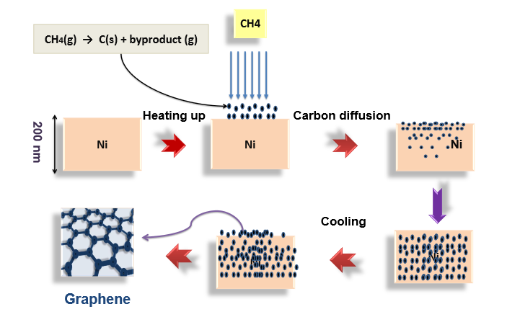
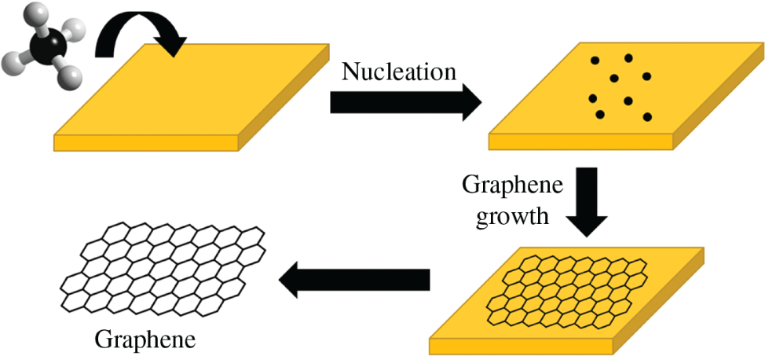
Carbon. Graphene. Obtaining
Chemical vapor deposition (CVD) represents a viable synthesis route to produce good-quality, large-area graphene films. The technique relies on the thermal decomposition of a carbon-rich source and the further deposition of carbon atoms in a honeycomb pattern on top of a metallic catalyst film.
Complicated and expensive, but scalable
Meanwhile, graphene costs less than $0.1 per gram, which can be very profitable, with gold being around $60-65 per gram.
Notes:
Another method is chemical vapor deposition. This method is based on the thermal decomposition of carbon-rich gas with deposition of carbon atoms on the metallic catalyst support. The honeycomb arrangement of carbon atoms is formed because it is energetically favorable. So, this method is complicated and expensive, but allows us to produce good quality graphene films with large surface area.
The advantage of this method is scalability. Meanwhile, what is the price of graphene? Graphene costs less than $0.1 per gram, this can be very profitable, with gold priced at around $60-65 per gram.

Slide 21
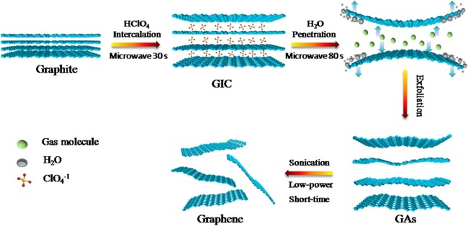
Carbon. Graphene. Obtaining
Chemical exfoliation is a top-down approach to obtain graphene in dispersion from graphite using stages of intercalation , exfoliation, and sonification The advantage of this manufacturing route is that the intercalation compounds spontaneously dissolve in polar solvents.
This method is very close to graphene oxide route
Notes:
The next one is chemical exfoliation method, which allows the graphene synthesis in dispersion from graphite using stages of intercalation, exfoliation, and sonification. The main advantage of this method (especially electrochemical exfoliation) is low price of its production. This method is very close to graphene oxide route.

Slide 22
Graphene
Carbon. Graphene Oxide. General
    Contains epoxy, hydroxyl and carbonyl groups on the basal plane, and carboxylic groups on the edges.
    Higher interlayer spacing than graphene, due to sp³ carbons.
    Higher ability to retain compounds.
    Lower electron mobility compared to graphene.
    Soluble in water.
    Amphiphilicity.
    Surface-functionalization capability and versatility.
    Biocompatibility and ability to interact with biological cells and tissues.
    Highly hydrophilic, forming stable aqueous colloids.
    Substrate-deposition capability.
    Convertible into a conductor.
Graphene
Oxide
Really cheap multifunctional material
Possible functionalization points:
  Hydroxyl groups
  Epoxy groups
  Carboxylic groups
Functional groups are arbitrarily located and randomly aggregated
Notes:
What is the graphene oxide? This is a graphene-based compound that contains epoxy, hydroxyl and carbonyl grups on the basal plane, and carboxylic grups on the edges.
What are the properties of graphene oxide compared to graphene? Higher interlayer spacing than graphene, due to sp³ carbons. Higher ability to retain compounds. Lower electron mobility compared to graphene. Solublity in water. Versatility. It is able to interact with biological cells and tissues. Highly hydrophilic. Substrate-deposition capability. Convertible into a conductor.
The main advantages (едвантаджес) of graphene oxide are hydrophility and biocompatibility in contrast to graphene.
I have an experience to deal with graphene nanosheets and it is very complicated due to its hydrophobic nature.
Graphene oxide is cheap polyfunctional material, soluble in water and bio-friendly.
Another important property of GO is substrate-deposition capability and the possibility of sensitive tunning of bandgap that allows us to fabricate transparent conductive layers for electronics.

Slide 23
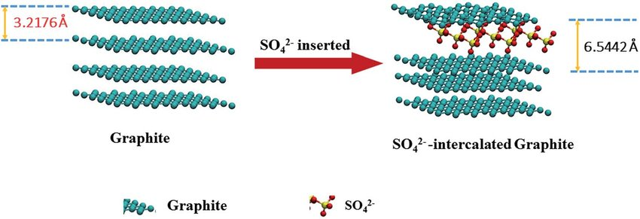
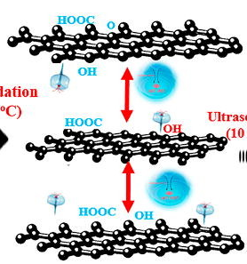
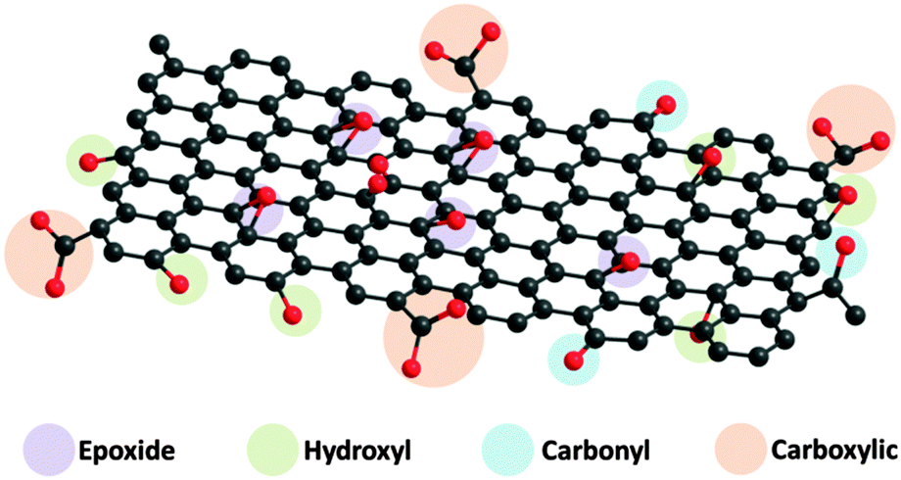




Carbon. Graphene Oxide. Obtaining
KMnO4
Intercalation with
sulfuric acid
Graphite
Intercalated graphite
Graphene oxide
Sonification and exfoliation
Notes:
The graphene oxide synthesis route is based on the sulfate ion intercalation between the layers formed of graphite crystals with the following oxidation, sonification, and resulting exfoliation. So, we finally obtain this light yellow-brown colloidal solution that contains individual fragments of multilayered GO particles.

Slide 24
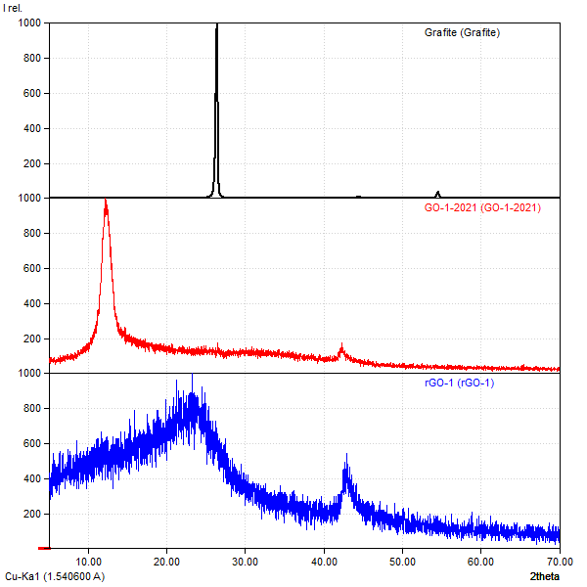
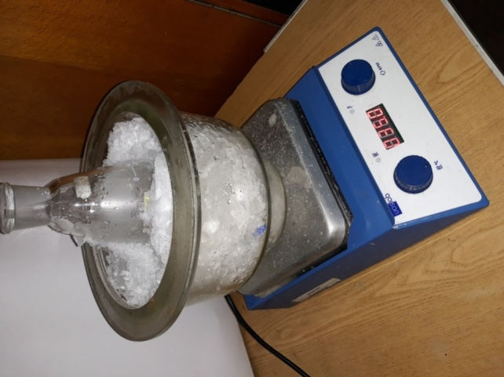
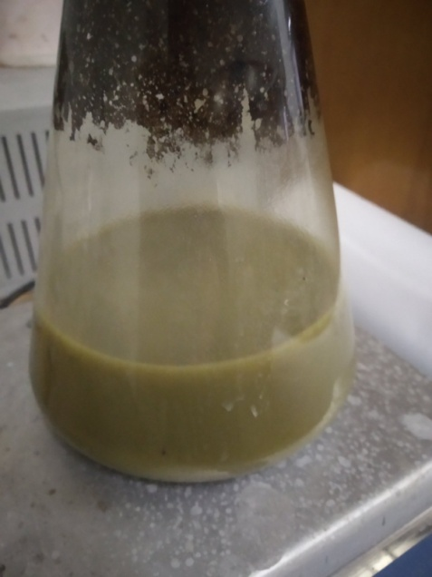
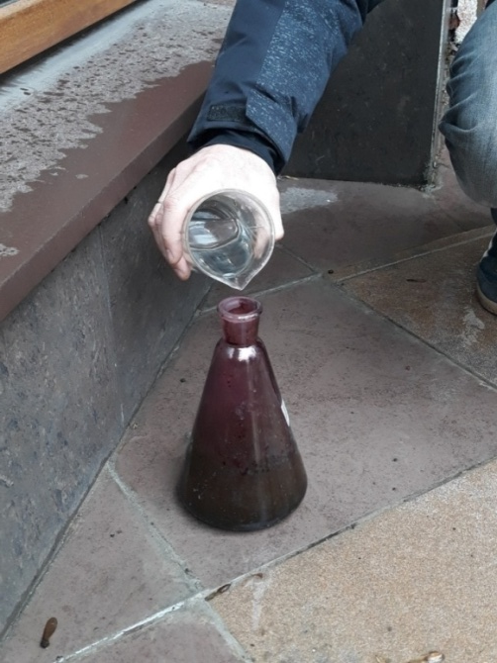
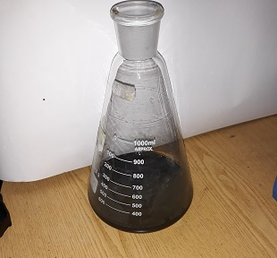
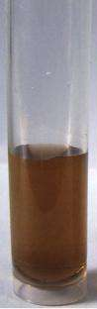
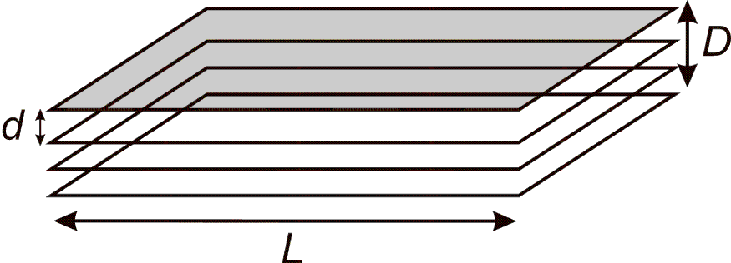
Carbon. Graphene Oxide. Obtaining
Photo from my student’s work
D ≈ 1 nm
D ≈ 10 nm
Notes:
This slide shows the synthesis route evolution filmed by my students, which leads to obtaining GO.
The most common method of structural properties testing is X-ray diffraction, where the atoms of solid become 3d-diffractive lattice.
Using this method, we can trace the evolution of structural transformation from initial graphite to GO by the analysis of the presence of characteristic peaks.
Using this method, we also can estimate the average size of graphene oxide particles. According to the calculation, typical GO particles in our experiments have lateral size (size along the graphene plane) of about 10 nm, when the average thickness is about 1 nm. So, you already understand what is the main problem with the GO.
GO is highly defective material.

Slide 25
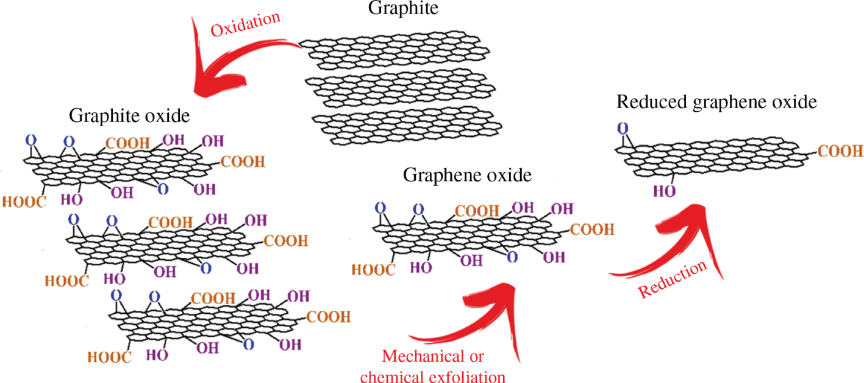
Carbon. Reduced Graphene Oxide
Schematic representation of the reduced graphene oxide production
Notes:
Chemical exfoliation, or chemical reduction, involves the conversion of graphite to graphene by the introduction of functional grups containing oxygen, by reacting graphite with strong oxidizing agents (ейджентс) such as sulfuric acid or nitric acid. This reaction forms graphite oxide, which is chemically reduced to graphene using reducing compounds such as hydrazine (хайдразін) or sodium borohydride (борохайдрайд). The chemical exfoliation from graphite to graphene is possible because of the addition of grups such as OH and COOH that by chemical oxidation reduces the forces of Van der Waals, responsible for keeping the graphene sheets in the structure of the graphite, and the separation takes place. The main advantage of this method is the possibility of obtaining graphene with good uniformity (юніфоміті) and excellent (екселент) yield, when compared to the mechanical methods, allowing its use to obtain graphene on a large scale.

Slide 26
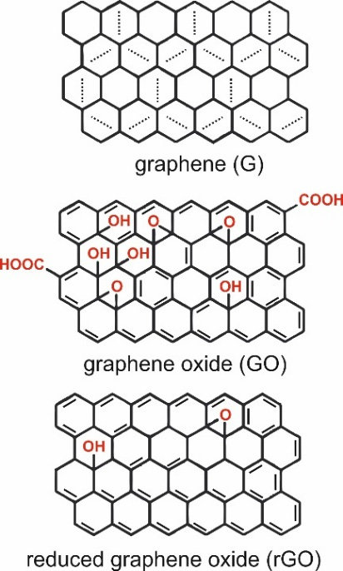
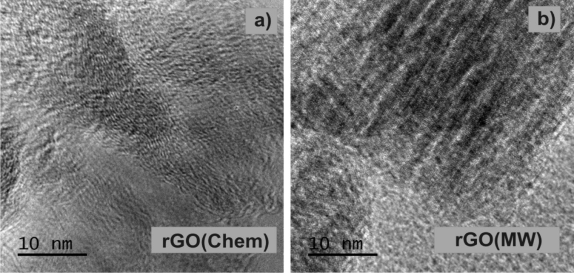
Carbon. Reduced Graphene Oxide
Reduced graphene oxide (rGO) is the form of GO that is processed by chemical, thermal and other methods in order to reduce the oxygen content, while graphite oxide is a material produced by oxidation of graphite which leads to increased interlayer spacing and functionalization of the basal planes of graphite.
One of the most important differences between GO and rGO is the electrical conductivity of these materials. While GO shows insulating or semi-conducting behavior, rGO shows excellent electrical conductivity which is almost as good as graphene.
The main disadvantage of the rGO is defect structure
Photo from my student’s work
Notes:
Reduction of GO allows us to obtain graphene-like material, which is very cheap but with lots of structural defects.
Reduced graphene oxide (rGO) is the form of GO that is processed by chemical, thermal and other methods in order to reduce the oxygen content, while graphite oxide is a material produced by oxidation of graphite which leads to increased interlayer spacing and functionalization of the basal planes of graphite.
One of the most important differences between GO and rGO is the electrical conductivity of these materials. While GO shows insulating or semi-conducting behavior, rGO shows excellent electrical conductivity which is almost as good as graphene.
The main disadvantage of the rGO is defect structure. We can observe these defects using transmission electron microscopy.

Slide 27
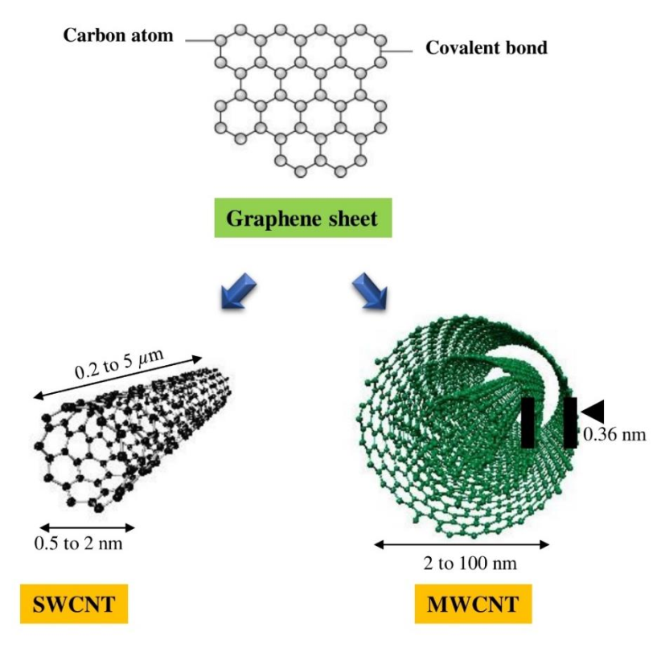
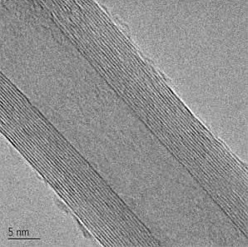
Carbon. Nanotubes. General
CNT is a tubular form of carbon with diameter as small as 1nm (single wall). Length: few nm to microns.
TEM image of an individual MWNTs
Single Wall CNT (SWCNT) and multiple Wall CNT (MWCNT) can be metallic or semiconducting depending on their geometry
Notes:
As you remember, the rolling up the graphene nanosheets allows us to obtain nanotubes with the diameter of 1 nm for single-wall structure with the length from nanometer to several microns. It is very important that nanotubes can be metallic or semiconductor depending on their geometry.
Nowadays, the term “carbon nanotubes” corresponds to a family of compounds that may have different characteristics from each other. CNTs can be divided into two grups: single-walled and multiple-walled carbon nanotubes. SWCNTs are made up of only one sheet of graphene and have a diameter from 1 to 5 nm. However, the synthesis methods currently employed to produce only a small fraction of SWCNT increase its cost and make it difficult to be applied on a large scale. MWCNTs are formed by a set of two or more concentrically coiled graphene sheets, which may have diameters of 10–50 nm.

Slide 28
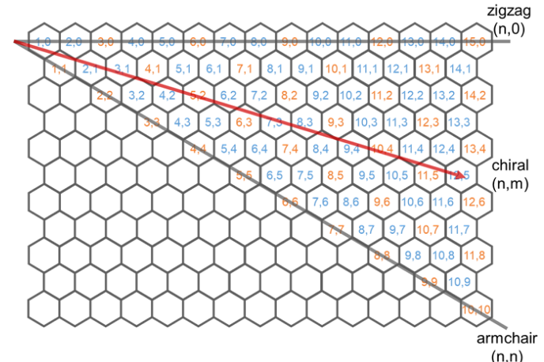
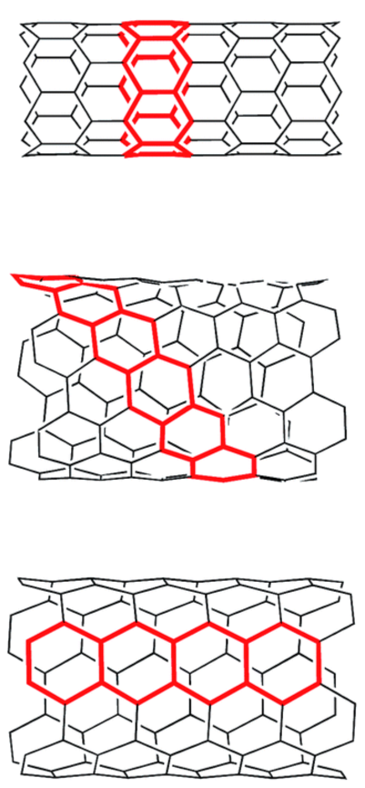
Carbon. Nanotubes. Geometry
A CNT is characterized by its Chiral Vector: C_{h} = na + mb,
Notes:
So, not only size but also geometry matters. There are different options for rolling up graphene nanosheets for formation of nanotubes, which depend on the direction of the axis of the tube relatively to the honeycomb cells of carbon atoms that form graphene sheets. Each CNT is characterized by chiral (кайрал) vector, which defines zigzag and armchair options as well as intermediate chiral option.
Depending on the way the graphene sheet wraps around, CNTs may have different geometries and properties. In this way, the electrical properties of the CNTs depend on how the hexagons are oriented along the axis of the tube
Depending on their diameter and chirality, CNTs may be either (ізе) semi-conducting or semi-metallic. For example, the armchair structure behaves as a metallic material, whereas the zigzag structure has semi-conductor or quasi-metallic properties.

Slide 29
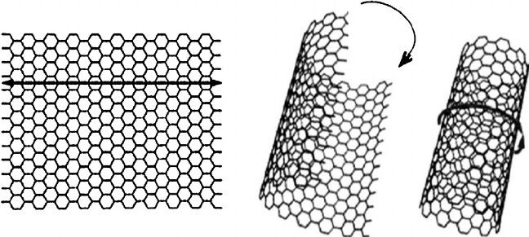
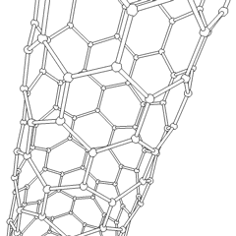
Carbon. Nanotubes. Reason
CNT is configurationally equivalent to a two-dimensional graphene sheet rolled into a tube.
What is the cause of carbon nanotube formation?
Nanotube/Fullerene combines sp² + sp³ hybridized carbon atoms.
Finite size of graphene layer has dangling bonds (an unsatisfied valence of an immobilized atom).
These dangling bonds correspond to high energy states.
Both the elimination of dangling bonds and an increase in the strain energy lead to a decrease in the total energy.
Why does something happen spontaneously?
Because it leads to a decrease in the energy of the system.
Notes:
Nanotube/Fullerene combines sp² + sp³ hybridized carbon atoms.
Finite size of graphene layer has dangling (дангелін) bonds (an unsatisfied valence of an immobilized atom).
These dangling bonds correspond to high energy states.
Both the elimination of dangling bonds and an increase in the strain energy leads to a decrease in the total energy.

Slide 30



Carbon. Nanotubes. Electronic properties
Band structure of CNTs in comparison with band structures of free electrons and graphene
Changing the type of geometry (zigzag, chiral, armchair) makes it possible to tune the CNT band structure from metallic to semiconductor.
Semiconductor CNT
Metallic CNT
Notes:
These are band structures of CNTs in comparison with band structures of free electrons and graphene.
Changing the type of geometry (zigzag, chiral, armchair) makes it possible to tune the CNT band structure from metallic to semiconductor.
So, let’s summing up. We have chemically stable quantum sized unit with the tunable electronic and as a result electric properties.

Slide 31


Carbon. Nanotubes. Properties
CNT electronics
Carrier transport is 1-D.
All chemical bonds are satisfied ⇒ CNT electronics is not obligated to use SiO₂ as an insulator.
High mechanical and thermal stability and resistance to electromigration ⇒ Current densities up to 10⁹ A/cm² can be sustained.
The diameter is controlled by chemistry, not fabrication.
Both active devices and interconnects can be made from semiconductor and metallic nanotubes.
Notes:
CNTs have several attractive and promising properties for various applications because of their structure. The strength of the sp2–sp2 bond gives CNTs high chemical and mechanical resistance. However, even presenting one of the most robust (робаст) structures known, this material has high flexibility and can be bent without destroying its structure. In addition, CNTs have a higher tensile (тенсайл) strength than steel, and excellent (екселент) thermal and electrical conductivity.
CNTs have the extremely high mechanical strength properties – one order of magnitude compared to titanium; very high thermal conductivity; high electrical conductivity – 6th order of magnitude higher than copper.
CNTs are the best materials for the components for the electronics. The application range can be wider using the functionalization techniques.

Slide 32

Carbon. Nanotubes. Synthesis
Arc Discharge (close to Laser Ablation method)
Involves condensation of C-atoms generated from evaporation of solid carbon sources.
Temperature ~ 3000-4000K, close to melting point of graphite.
Both produce high-quality SWNTs and MWNTs.
MWNT: 10’s of μm long, very straight & has 5-30 nm diameter.
SWNT: needs metal catalyst (Ni, Co, etc.).
Produced in form of ropes consisting of 10’s of individual nanotubes close packed in hexagonal crystals.
Electric arc discharge method:
A potential of 20–25 V is applied across the pure graphite electrodes separated by 1 mm distance and maintained at 66.7 kPa pressure of flowing helium gas filled inside the quartz chamber. When the electrodes are made to strike each other under these conditions, it produces an electric arc. The energy produced in the arc is transferred to the anode, which ionizes the carbon atoms of pure graphite anode and produces C⁺ ions and plasma forms (atoms or molecules in vapor state at high temperature).
These positively charged carbon ions move towards cathode, get reduced and deposited and grow as CNTs on the cathode. As the CNTs grow, the length of the anode decreases, but the electrodes are adjusted and always maintain a gap of 1 mm between the two electrodes.
Notes:
What are the methods for nanotube synthesis? The electric arc discharge is very simple approach as you may see. It is based on the graphite electrode burning in the inert gas atmosphere under the applied electric field with the possible catalytic support.
A potential of 20–25 V is applied across the pure graphite electrodes separated by 1 mm distance and maintained at 66.7 kPa pressure of flowing helium gas filled inside the quartz chamber. When the electrodes are made to strike each other under these conditions, it produces an electric arc. The energy produced in the arc is transferred to the anode, which ionizes the carbon atoms of pure graphite anode and produces C⁺ ions and plasma forms (atoms or molecules in vapor state at high temperature).
These positively charged carbon ions move towards cathode, get reduced and deposited and grow as CNTs on the cathode. As the CNTs grow, the length of the anode decreases, but the electrodes are adjusted and always maintain a gap of 1 mm between the two electrodes.

Slide 33

Carbon. Nanotubes. Synthesis
Chemical Vapor Deposition:
The chemical vapor deposition method is to cleave a carbon atom-containing gas continuously flowing through the catalyst nanoparticle to generate carbon atoms and then generate CNTs on the surface of the catalyst or the substrate.
Hydrocarbon gas + Fe/Co/Ni catalyst at 550-1000°C
Steps:
Dissociation of hydrocarbon.
Dissolution and saturation of C atoms in metal nanoparticle.
Precipitation of Carbon.
Notes:
Another method is chemical vapor deposition. The chemical vapor deposition method is to cleave a carbon atom-containing gas continuously flowing through the catalyst nanoparticle to generate carbon atoms and then generate CNTs on the surface of the catalyst or the substrate.

Slide 34

Carbon. Fullerenes. General
Fullerenes consist of 20 hexagonal and 12 pentagonal rings, which form the basis of a closed framework structure with icosahedral symmetry.
Each carbon atom is bonded to three others and is sp² hybridized. The C₆₀ molecule has two bond lengths - 6:6 ring bonds can be considered "double bonds" and are shorter than the 6:5 bonds.
C₆₀ is not "superaromatic" as it tends to avoid double bonds in the pentagonal rings, resulting in poor electron delocalization.
As a result, C₆₀ behaves like an electron deficient alkene, and reacts readily with electron-rich species.
The geometry and electronic bonding factors in the structure determine the stability of the molecule.
Notes:
The final step of geometry optimization of carbon nanostructures is the fullerene formation.
Unlike the other allotropes, the fullerenes are in the molecular form, being considered spheroidal nanometric molecules constituted only by carbon atoms. Since 1966 (nineteen sixty-six), theoretical calculations demonstrated the possibility of the existence of “cages” formed only by carbon atoms. However, only in 1985 (nineteen eighty-five) the existence of fullerenes was proven in the work done by Harold Kroto, Robert Curl, and Richard Smalley
With the help of Curl and Smalley, Kroto performed an experiment in which a graphite plate was subjected to a pulsed high-frequency laser forming agglomerates, which were later analyzed by mass spectrometry. At the end of this experiment, the formation of molecules with 60 carbon atoms was observed, leading researchers to search for molecular structure that gives such stability to these molecules. Kroto had the idea of organizing the atoms in the same form of the geodesic (джіодесік) domes by the architect Richard Buckminster Fuller, in which hexagonal faces construct a spherical structure due to the combination with pentagons. In this way, the structure of the C60 was defined as a polyhedron of 32 (thirty-two) faces, being 20 (twenty) hexagonal and 12 (twelve) pentagonal, and was called buckminsterfullerene in honor of the American architect.
Each carbon atom is bonded to three others and is sp² hybridized. The C₆₀ (sixty) molecule has two bond lengths - 6:6 ring bonds can be considered "double bonds" and are shorter than the 6:5 bonds.
The geometry and electronic bonding factors in the structure determine the stability of the molecule.
Among physical properties we can admit very high resistivity and extremely (екстрімлі) high biochemical stability.

Slide 35


Carbon. Fullerenes. General
Physical properties of C₆₀:
Density: 1.65 g cm⁻³
Standard heat of formation: 9.08 kcal mol⁻¹
Boiling point: sublimes at 800 K
Resistivity: 10¹⁴ ohms m⁻¹
Crystal form: hexagonal cubic
The absorption spectra of the fullerenes change as the size of the conjugated system increases: with slight variations depending on solvent, solutions of C60 are an intense purple color (a), C70 red like wine (b) and C84 a green-yellow (c) (all solutions are in toluene). The gap between the highest occupied molecular orbital and the lowest unoccupied molecular orbital decreases with increasing cage size leading to optical absorptions of lower energy, i.e., longer wavelength
Multi-layer fullerenes
С₆₀ С₇₀
Notes:
Other stable forms of fullerene were already isolated as, for example, C20, C70, C78, and C84. However, in all these forms, C60 fullerene is the most abundant and most stable, with π bonds between the six-membered rings and single bonds between the five-membered rings.
We should understand that the ideal hexagons and pentagons in fullerene structure are only part of a model. These fullerenes are deformed and have structural defects.
In all the studies that were already done on fullerene, one of the interesting discoveries is the ability of the C60 molecule to receive from one to six electrons, even though it is already rich in electrons, forming corresponding anions. Other properties of fullerenes are good chemical stability, large surface area, high mechanical resistance, and the ability to become a superconductor when combined with alkali (алкалай) metals. These properties make this material promising for several types of applications, such as photovoltaic, biomedical applications, transport of antibiotics (антібайотікс), and the development of sensors.

Slide 36


Carbon. Fullerenes. Synthesis
Electric arc discharge method for the production of fullerenes is based on the evaporation of graphite electrodes in a low-pressure helium atmosphere by passing an electrical current through the electrodes, resulting in an arc that produces carbon black containing fullerenes.
These methods usually lead to the production of various fullerenes in various mixtures and other forms of carbon. So, the fullerenes are mainly extracted from the soot using appropriate organic solvents.
During the synthesis, not individual fullerenes are obtained, but their aggregates.
The reason is that the system reduces the excess surface energy, which is proportional to the surface area of the material.
The specific surface area can be very large for carbon nanomaterials - up to 2500 m²/g for graphene,
up to 700 m²/g for fullerenes and
up to 3500 m²/g for microporous carbon
Notes:
The synthesis route of fullerenes is very similar to obtaining nanotubes.
Electric arc process for the production of fullerenes is based on the evaporation of graphite electrodes in a low-pressure helium atmosphere by passing an electrical current through the electrodes, resulting in an arc that produces carbon black containing fullerenes.
These methods usually lead to the production of various fullerenes in various mixtures and other forms of carbon. So, the fullerenes are mainly extracted from the soot using appropriate organic solvents.
At the synthesis not individual fullerenes are obtained, but their aggregates.
The reason is that the system reduces the excess surface energy which is proportional to the surface area of the material.
The specific surface area can be very large for carbon nanomaterials - up to 2500 m²/g for graphene,
up to 700 m²/g for fullerenes and
up to 3500 m²/g for microporous carbon

Slide 37

Carbon Nanostructures
Different CNMs and their physical and chemical properties
Notes:
If in one-dimensional carbon structures we reduce their length to the nanometer size we will obtain nanocages. Fullerenes is a perfectly spherical nanocage formed by a number of pentagonal and hexagonal rings. Carbon nano-onions (CNOs) are cages with spherical or polyhedral shape formed by several fullerene-like overlapped carbon shells which are defective and disordered to a certain degree. They were discovered in 1992 (nineteen ninety two) by Ugarte during electron beam irradiation of an amorphous carbon sample using TEM. Another one-dimensional carbon nanostructure (CNS) is represented by the carbon dots (CDs). Typically, the average dimension of carbon dots is about 5 nm. Quantum confinement effects induce excellent optical properties as highly tunable photoluminescence, high photostability.
Carbon nano-onions remain as one of the most interesting carbon forms, along with graphene and its derivatives, due to their unique chemical and physical properties. Their
high biocompatibility and biosafety make them an attractive choice in a wide range of areas, including biological systems. This nanomaterial displays low toxicity, high dispersity in aqueous solutions, and high pharmaceutical (фармасьютікел) efficiency (ефішенсі). Even though CNOs were discovered almost at the same time as carbon nanotubes, their potential in biomedical applications is unrealized.

Slide 38

Carbon Nanomaterials. Applications
Notes:
Carbon nanomaterials have a potential application in several systems, products, and devices such as, electron emitters for televisions; in composites with polymers, ceramics and metals, diodes, transistors, photovoltaic devices, computer memories, and development of electrochemical sensors and biosensors.
Various reports emphasize the significance of CNTs to support bone growth by changing the mechanical properties of natural and synthetic polymers. The properties of CNTs are affected by their synthesis process. CNTs can widely be used in the fields of a nanosensor for the detection of the pathogens, and other fields, including energy, and water purification. The unique properties of nanomaterials such as small size, large surface area, and reactivity provide good opportunities for its use in the agricultural sector. The applications of CNTs in the agricultural field include seed germination, early plant growth, and biosensor diagnostics and analysis.
Among the different carbon allotropes, CNTs have attracted attention in transporting various drug molecules into the living cells

Slide 39


Carbon Nanomaterials. Applications
Electrochemical and Electronic CNT biosensors for Cancer Detection. (A) Schematic illustration of the folic acid-targeted cytosensing strategy for an enhanced electrochemical detection of cancer cells using polydopamine-coated carbon nanotubes. (B) Schematic representation of an electrochemical DNA biosensor for cancer detection based on gold nanoparticles/aligned CNTs.
Notes:
Due to their ability to conduct electricity (about 100 times that of copper wires), CNTs are used to convert the electrical signals generated by target recognition. Their thermal conductivity is higher than diamond, and their strength approximately 100 times greater than steel. Last but not least, the ability of CNTs to cross biological membranes makes them used in vivo with minimal invasiveness.
Different classes of CNT biosensors have been developed to probe a wide variety of cancer biomarkers.
CNTs could potentially be used in prophylactic medicine for monitoring of fever or hyperthermia caused by specific pathogens.
The biosensors developed with CNTs indicate regular steps of the distinct output signal for all concentration ranges compared with the control.

Slide 40

Carbon Nanomaterials. Applications
Schematic diagram representing different modification processes of CNTs for contaminant removal from water and wastewater (C: carbon; CNT: carbon nanotube; ENVT: environmental; Hg: mercury; KOH: potassium hydroxide)
Notes:
Nanotechnology plays a vital role in water purification. CNTs can be used for the purification of wastewater. Adsorption and degradation is the key (кі) strategy for the removal of contaminant from the samples through CNTs. It is possible to target a specific contaminant through the well-modified CNTs. Design or modification of CNTs' properties may also assist in the separation of materials following the contaminant treatment process. Nanoparticle separation is simplified (сімпліфайд) by incorporating a magnetic component into CNTs. It is easy to control the potential and current in the electrochemical technique for wastewater treatment

Slide 41

Carbon Nanomaterials. Applications
There are many fields of practical application of fullerenes, such as materials for solar cells, fuel cells and supercapacitors, materials for adsorption, gas sensors and catalysis. But the most attractive is the biomedical application of fullerenes for drug and gene delivery.
Currently, most of the studies on biological applications of CNTs-based and other carbon allotropes (graphene, fullerene) as biomaterials are focused on an approach to continuous interactions with living cells and tissues.
Notes:
Fullerenes are also used in the medical field as photosensitizers in photodynamic therapy and antimicrobial agents.
It is also used in several biomedical applications including the design of high-performance MRI contrast agents, X-ray imaging contrast agents, photodynamic therapy, and drug and gene delivery.
C₆₀ is used in drug delivery systems and as a catalyst.
Some types of fullerenes can be used as gas absorbers.
Films based on C₆₀ are used for photovoltaic applications and hydrogen gas storage material.

Slide 42


Carbon Nanomaterials. Applications
Biosensor development timeline
Notes:
Nanomaterials can be used in biosensors to increase sensitivity and lower detection limits. A biosensor is a device that can measure the number of molecules in a solution containing measurable analytes using their reactive properties with a specific substance. The excellent physicochemical potential makes CNMs an ideal material for sensing applications to detect the pathogens. In comparison with the commercially available sensors such as metal oxides or silicon, CNTs-based biosensors have significant advantages, such as high sensitivity, excellent luminescence (люменесенс) properties, fast response time, and high stability.
This improved performance is associated with the small size of nanomaterials, which gives them a large surface/volume ratio. This high specific area allows immobilization of greater concentrations of bioreceptor units relative to biosensor surface/volume.
In recent years, several graphene-based sensors and biosensors, or graphene-related materials, such as graphene oxide and reduced graphene oxide, were reported for analyses of compounds from environmental sources. Some examples are the detection of metal ions such as lead and cadmium, analyses of pesticides, food analyses, clinical applications, such as in the detection of glucose and drugs.
In addition, graphene can form composites with other materials such as polymers, nanoparticles, and biomolecules, such as DNA, by physical adsorption or chemical bonding. As a result, by combining the thermal, electrical, and mechanical properties of graphene with the properties and functions of several other components, new materials and innovative analytical systems can be created, providing the sustainable progress of chemical analyses.
Graphene oxide is capable of dynamically interacting with the probe and for the transduction of a specific response toward the target molecules.

Slide 43


Carbon Nanomaterials. Applications
Besides polyethylene, carbon materials can also be used to provide shielding from cosmic radiation. A full-carbon shield was tested by bombardment with iron nuclei at 1 GeV/nucleon and showed the second-best dose reduction after polyethylene, before aluminum and lead.
Utilizing polyethylene as the low atomic number (low-Z) substance within this composite necessitates its placement at the outermost layer. This positioning allows it to initially come into contact with incoming radiation. Consequently, a multi-layer composite comprising polyethylene and graphite can be constructed, resulting in enhanced radiation shielding. This assertion is supported by simulations conducted using a particle transport simulation code, which accounts for a variety of particles including solar particles, cosmic rays, protons, and electrons, all within the context of a highly elliptical orbit.
Carbon fiber shield
Notes:
Besides polyethylene, carbon materials can also be used to provide shielding from cosmic radiation.
While pure graphite alone has better shielding properties than the often-used aluminum, its mechanical properties are poor, resulting in the necessity to improve them by adding materials with higher atomic number. Polyethylene as the low-Z material in this composite should be at the surface layer and interact firstly with the incident radiation, in this way enabling the building of a multi-layer composite from polyethylene and graphite which gives better radiation shielding, as simulated with a particle transport simulation code, taking into account solar particles, cosmic rays, protons, and electrons along the highly elliptical orbit.

Slide 44

Carbon. Biochar
Biochar is produced by burning organic material in a controlled pyrolysis (burning without oxygen). The energy or heat generated during pyrolysis can be collected and used as clean energy. Biochar is much more efficient at converting carbon into a stable form and cleaner than other forms of charcoal.
Biochar is black, very porous, light, fine-grained and has a large surface area. Approximately 70 percent of its composition is carbon. The rest is made up of nitrogen, hydrogen and oxygen among other elements. The chemical composition of Biochar varies depending on the raw materials used to produce it and the methods used to heat it.
Notes:
The last but not least. A few words about biochar.
Biochar is obtained by burning organic material in a controlled pyrolysis (burning without oxygen). It is eco-friendly polyfunctional nanomaterial with very wide range of application from adsorbents and catalysts to supercapacitors and hydrogen-storage techniques.

Slide 45



Carbon. Porous carbon
A microporous carbon has most of its porosity in pores less than 2 nm wide and has an apparent surface area that is typically in the range of 1000 to 2000 m² g⁻¹.
Materials with pore sizes between 2 and 50 nm are called mesoporous, and materials with pores sizes smaller than 2 nm are called microporous. In addition, the term nanoporous material covers materials that have pores up to 100 nm
There are two methods of preparing activated carbons using biochar as raw material: physical (steam) and chemical (bases or acids, carbon dioxide) activation.
Notes:
Using the biochar in our lab we produce the activated microporous carbon. This carbon mainly contains pores with the size less than 2 nm.
As a result, these materials have surface area in the range from 1000 to 2000 m²/g, when the theoretical limit is about 3700 m²/g.
We use two methods of preparing activated carbons using biochar as raw material: physical (steam) and chemical (bases or acids, carbon dioxide) activation.

Slide 46


Carbon. Porous carbon. Applications
Extremely wide scope -
from medicine and industry to energy storage
An Electrochemical Double Layer Capacitor (EDLC) is an energy storage device based on electrostatic effects occurring between two carbon electrodes with a large specific surface areas. The electrodes are immersed in an electrolyte, and a separator is used between the electrodes.
The mechanism of absorption and desorption of ions by an electrical double layer on carbon electrodes promotes charge and discharge. By applying voltage to the facing electrodes, ions are drawn to the surface of the electrical double layer and are charged with electricity.
The main reasons are the extremely high specific surface area, chemical stability and good electrical conductivity.
Supercapacitors fill the gap between conventional capacitors and batteries in terms of energy density and power.
Notes:
Porous carbon has extremely wide range of application - from medicine and industry to energy storage devices.
Combination of very high surface area and good electric conductivity with chemical stability allow us to fabricate the electrochemical energy storage devices that bridge a gap between conventional capacitors and batteries. Its advantages are low cost and high specific power.

Slide 47




Carbon. Porous carbon. Applications
Griffith Observatory
https://www.britannica.com/science/carbon-chemical-element
Notes:
In this slide, you may see a few photos that I took during research trips.
Here is a periodic table in Griffith Observatory in Los Angeles, California, and carbon in a cell of the table.
There is SEM image of activated carbon. And Cambridge Graphene Center, the mission of which is to investigate the science and technology of graphene, carbon allotropes, layered crystals and hybrid nanomaterials.

Slide 48
References
Ahlawat, Jyoti, et al. “Application of Carbon Nano Onions in the Biomedical Field: Recent Advances and Challenges.” Biomaterials Science, vol. 9, no. 3, Royal Society of Chemistry (RSC), 2021, pp. 626–44. Crossref, https://doi.org/10.1039/d0bm01476a.
Avouris, Phaedon. “Graphene: electronic and photonic properties and devices.” Nano letters vol. 10,11 (2010): 4285-94. https://doi.org/10.1021/nl102824h
“Carbonaceous Composite Materials.” Materials Research Foundations, 2018, https://doi.org/10.21741/9781945291975
“Chemistry of the Main Group Elements (Barron).” Chemistry LibreTexts, 8 Sept. 2020, https://chem.libretexts.org/Bookshelves/Inorganic_Chemistry/Chemistry_of_the_Main_Group_Elements_(Barron)
Gao, Wei. “Graphene Oxide.” Springer eBooks, 2015, https://doi.org/10.1007/978-3-319-15500-5
“Graphene, Nanotubes and Quantum Dots-Based Nanotechnology.” Elsevier eBooks, 2022, https://doi.org/10.1016/c2020-0-01826-8
Hybrid Orbitals — Overview & Examples https://www.expii.com/t/hybrid-orbitals-overview-examples-8366
Kasap, S.O. “Optoelectronics” (Prentice Hall), 1999
Maiti, Debabrata, et al. “Carbon-Based Nanomaterials for Biomedical Applications: A Recent Study.” Frontiers in Pharmacology, vol. 9, Frontiers Media, Mar. 2019, https://doi.org/10.3389/fphar.2018.01401
Matsumoto, Kazuhiko. “Frontiers of Graphene and Carbon Nanotubes.” Springer eBooks, 2015, https://doi.org/10.1007/978-4-431-55372-4
Mbayachi, V.B., et al. “Graphene Synthesis, Characterization and Its Applications: A Review.” Results in Chemistry, vol. 3, Elsevier BV, Jan. 2021, p. 100163. https://doi.org/10.1016/j.rechem.2021.100163
Neto, A. H. Castro, et al. “The Electronic Properties of Graphene.” Reviews of Modern Physics, vol. 81, no. 1, American Physical Society, Jan. 2009, pp. 109–62. https://doi.org/10.1103/revmodphys.81.109
Notes:
To find more about carbon materials, particularly graphene materials, you may use these references.

Slide 49
References
Orbital Hybridization: sp1, sp2, and sp3 Hybridization, Examples https://researchtweet.com/orbital-hybridization-sp1-sp2-sp3-hybridization/
Patel, Dinesh Kumar, et al. “Carbon Nanotubes-Based Nanomaterials and Their Agricultural and Biotechnological Applications.” Materials, vol. 13, no. 7, Multidisciplinary Digital Publishing Institute, Apr. 2020, p. 1679. https://doi.org/10.3390/ma13071679
Porto, Laís Sales, et al. “Carbon Nanomaterials: Synthesis and Applications to Development of Electrochemical Sensors in Determination of Drugs and Compounds of Clinical Interest.” Reviews in Analytical Chemistry, vol. 38, no. 3, De Gruyter, Jan. 2020, https://doi.org/10.1515/revac-2019-0017
Sireesha, Merum, et al. “Functionalized Carbon Nanotubes in Bio-world: Applications, Limitations and Future Directions.” Materials Science and Engineering: B, vol. 223, Elsevier BV, Sept. 2017, pp. 43–63. https://doi.org/10.1016/j.mseb.2017.06.002
Speranza G. “Carbon Nanomaterials: Synthesis, Functionalization and Sensing Applications.” Nanomaterials, vol. 11, no. 4, MDPI, Apr. 2021, p. 967. https://doi.org/10.3390/nano11040967
Tîlmaciu, Carmen, and May Morris. “Carbon Nanotube Biosensors.” Frontiers in Chemistry, vol. 3, Frontiers Media, Oct. 2015, https://doi.org/10.3389/fchem.2015.00059
Wu, W., et al. “Fast Chemical Exfoliation of Graphite to Few-layer Graphene With High Quality and Large Size via a Two-step Microwave-assisted Process.” Chemical Engineering Journal, vol. 381, Elsevier BV, Feb. 2020, p. 122592. https://doi.org/10.1016/j.cej.2019.122592
Zhu, Jiadeng, et al. “A Sustainable Platform of Lignin: From Bioresources to Materials and Their Applications in Rechargeable Batteries and Supercapacitors.” Progress in Energy and Combustion Science, vol. 76, Elsevier BV, Jan. 2020, p. 100788. https://doi.org/10.1016/j.pecs.2019.100788

Slide 50
Thank you for attention!
Volodymyra Boichuk

