Slide 1
Business strategies in high-innovation potential areas (Nanotechnology, Industry 4.0, Artificial intelligence)
Valentyna Yakubiv

Slide 2
Business strategies in high-innovation potential areas (Nanotechnology, Industry 4.0, Artificial intelligence)
Business strategies: the role and key terms
2. Top AI technology business strategies in 2023
3. Business strategy process

Slide 3
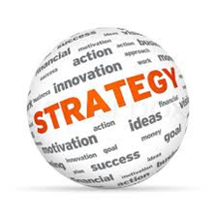
1.Business strategies: the role and key terms
The term “strategy” originated in the Greek military lexicon. The Greek word “strategos” (στρατηγία) consists of “stratos”, i.e. “army, and “ago”, i.e. “leading”. At that time the term meant the art of understanding the nature of war and the principles of leading an army.
The modern meaning of strategy in business appeared in the middle of the 20th century. In 1962, the economist Alfred Chandler Jr. used the term “strategy” in his work “Strategy and Structure” with reference to running a company/a business. He proved that business structure is determined by its strategy, and that environmental changes lead to strategic alternatives, which may, in turn, cause changes in organizational structure.

Slide 4
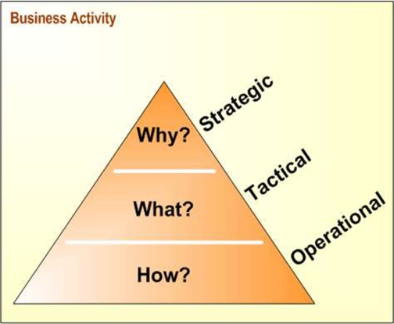
1.Business strategies: the role and key terms

Slide 5
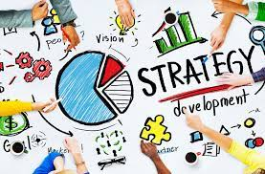
1.Business strategies: the role and key terms
competitive advantage
strategists
vision and mission statements
external opportunities and threats
internal strengths and weaknesses
long-term objectives
strategies
annual objectives
policies

Slide 6
Competitive Advantage
Strategic management is all about gaining and maintaining competitive advantage
This term can be defined as “anything that a firm does especially well compared to rival firms” When a firm can do something that rival firms cannot do, or owns something that rival firms desire, that can represent a competitive advantage.

Slide 7
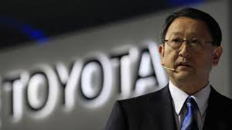
Strategists
Strategists are the individuals who are most responsible for the success or failure of an organization.
They track industry and competitive trends, develop forecasting models and scenario analyses, evaluate corporate and divisional performance, spot emerging market opportunities, identify business threats, and develop creative action plans.
Strategists differ as much as organizations themselves, and these differences must be considered in the formulation, implementation, and evaluation of strategies. Some strategists will not consider some types of strategies because of their personal philosophies.
Strategists differ in their attitudes, values, ethics, willingness to take risks, concern for social responsibility, concern for profitability, concern for short-run versus long-run aims, and management style.

Slide 8
Vision and Mission Statements
Mission statements are “enduring statements of purpose that distinguish one business from other similar firms. A mission statement identifies the scope of a firm’s operations in product and market terms.”
A mission statement is a constant reminder to its employees of why the organization exists and what the founders envisioned when they put their fame and fortune at risk to breathe life into their dreams.

Slide 9
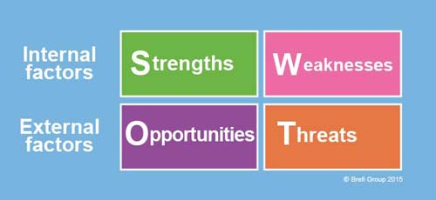
External Opportunities and Threats
External Opportunities and Threats refer to economic, social, cultural, demographic, environmental, political, legal, governmental, technological, and competitive trends and events that could significantly benefit or harm an organization in the future.

Slide 10
Internal Strengths and Weaknesses
Internal Strengths and Weaknesses are an organization’s controllable activities that are performed especially well or poorly.
Strengths and weaknesses are determined relative to competitors.
Internal factors can be determined in a number of ways, including computing ratios, measuring performance, and comparing to past periods and industry averages. Various types of surveys also can be developed and administered to examine internal factors such as employee morale, production efficiency, advertising effectiveness, and customer loyalty.

Slide 11
Long-Term Objectives
Objectives can be defined as specific results that an organization seeks to achieve in pursuing its basic mission.
Objectives should be challenging, measurable, consistent, reasonable, and clear. In a multidimensional firm, objectives should be established for the overall company and for each division.

Slide 12
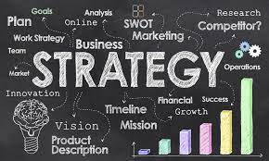
Strategies
Strategies are the means by which long-term objectives will be achieved.
Business strategies may include geographic expansion, diversification, acquisition, product development, market penetration, retrenchment, divestiture, liquidation, and joint ventures.
In addition, strategies affect an organization’s long-term prosperity, typically for at least five years, and thus are future-oriented.

Slide 13
Annual Objectives
Annual Objectives are short-term milestones that organizations must achieve to reach long-term objectives. Like long-term objectives, annual objectives should be measurable, quantitative, challenging, realistic, consistent, and prioritized. They should be established at the corporate, divisional, and functional levels in a large organization.
Annual objectives should be stated in terms of management, marketing, finance/accounting, production/operations, research and development, and management information systems (MIS) accomplishments.
A set of annual objectives is needed for each long-term objective.

Slide 14
Policies
Policies are the means by which annual objectives will be achieved. Policies include guidelines, rules, and procedures established to support efforts to achieve stated objectives.
Policies are guides to decision making and address repetitive or recurring situations.
Policies allow consistency and coordination within and between organizational departments.

Slide 15
3 Top AI business strategies in 2023
OpenAI
In November 2022, OpenAI launched ChatGPT, a chat aimed at natural language answering questions, translating, and generating improvised text. It reached over a million signups within the first five days and projected a US$200 million revenue for 2023 and US$1 billion for 2024.

Slide 16
3 Top AI business strategies in 2023
Observe.AI
Observe.AI provides natural language tools to track voice and text conversations. Its Intelligent Workforce Platform transforms contact centers by embedding AI into customer conversations, optimizing agent performance, and automating repeatable processes that drive revenue and retention.
In March 2022, the company stated that ARR was up 150%, with customer interactions analysed by its AI up 3x, a 426% increase in AI-powered agent evaluations, and a 201% increase in AI-powered agent coaching sessions.
Observe.AI has raised US$213mn in funding

Slide 17
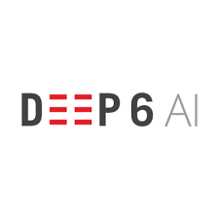
3 Top AI business strategies in 2023
Deep 6 AI
Deep 6 AI is a healthcare AI startup that is revolutionizing the way medical professionals diagnose and treat patients. The company’s AI algorithms can analyze large amounts of medical data, helping medical professionals make more informed decisions and improve patient outcomes.

Slide 18
3 Top AI business strategies in 2023

Slide 19
3 Top Industry 4.0 business strstegy in 2023
Robco
Robco is a German startup that develops modular robot kits and software-based automation solutions. The startup’s robot-as-a-service solution provides 2 to 7-axis robots with changeable modules for high uptime and flexibility. Besides, the startup’s robotic automation guide proposes the most suitable robot setup along with virtual training based on lidar scans of the production environment.

Slide 20
3 Top Industry 4.0 business strstegy in 2023
i4Twins facilitates Digital Twin Creation
i4Twins is a Canadian startup that makes a no-code digital twin platform to build, validate, simulate, and test industrial designs. It features status twins, operational twins, and simulation twins through an online browser-based electronic prototyping workspace. Besides, the open platform supports multiple operating systems, uses artificial intelligence (AI), and contains a repository to share and manage designs and descriptions. As a result, i4Twins’ platform enables engineers and factory designers to create and experiment on different physical topologies.

Slide 21
3 Top Industry 4.0 business strstegy in 2023
iSIMplatform aids Factory Management
Turkish startup iSIMplatform makes a software platform to digitize factory equipment and operations. It manages smart and integrated industrial systems through 2D and 3D maps and models. The platform’s other features include on-premise and cloud installation, fully web-based architecture, as well as adaptive and simultaneous updatable workflows. This way, the startup’s solution allows factory owners and operators to monitor equipment in real time and receive instant notifications and reports.

Slide 22
3 Top Industry 4.0 business strstegy in 2023

Slide 23
Let’s think about your startup in Nanotechnology, Industry 4.0, Artificial intelligence

Slide 24
How to Get a Startup Idea: 10 Actionable Frameworks
1) Look for Founder-Market Fit
A great way to find the right startup idea is to think about your unique skills, expertise, and relationships and how those could be used to build a product. By creating a startup around these unique personal advantages, you’re finding what’s called founder-market fit.
If you already have a co-founder or a team, think about your collective knowledge and what your team is particularly good at.
Paul Allen and Bill Gates, co-founders of Microsoft, are an example of a founding team who had a perfect founder-market fit for the company they built. They studied computer programming and computer science, and their idea for their startup utilized both of their skills perfectly.

Slide 25
How to Get a Startup Idea: 10 Actionable Frameworks
2) Solve a Personal Problem (Bottom-Up Approach)
Some of the most successful startups have been created to solve their founders’ personal problems.
For example, DoorDash’s founders built their vastly successful food delivery app because they couldn’t get Thai food delivered to them in the suburbs, and they saw the need for an easy-to-use delivery app that functioned everywhere.

Slide 26
How to Get a Startup Idea: 10 Actionable Frameworks
3) Consider Your Passions
Whether it’s applied to finding a career or coming up with a startup idea, “follow your passions” is a piece of generic advice you’ve probably heard a lot. But, there is some value to be had from it in terms of coming up with a business idea.
The most successful startups succeed because their founders are passionate about the projects, so they stay committed to working on them through all the ups and downs (of which there will be many when you’re working on a startup).
A good example of a startup that was founded because of a passion is Duolingo, the free language learning app. Duolingo’s founders, Luis von Ahn and Severin Hacker, were passionate about education and wanted to give people a free way to learn languages as an alternative to expensive courses, tutors, and textbooks.

Slide 27
Let’s think about your startup in Nanotechnology, Industry 4.0, Artificial intelligence

Slide 28
Business strategy process
“Business strategy process is a method by which managers conceive of and implement a strategy that can lead to a sustainable competitive advantage”
“It is a process by which an organization establishes its objectives, formulates actions (strategies) designed to meet these objectives in the desired timescale, implements the actions, and assesses progress and results”

Slide 29
Business strategy process
Business strategies often fail. This is well-know by now: According to studies, some 60–90% of strategic plans never fully launch.

Slide 30
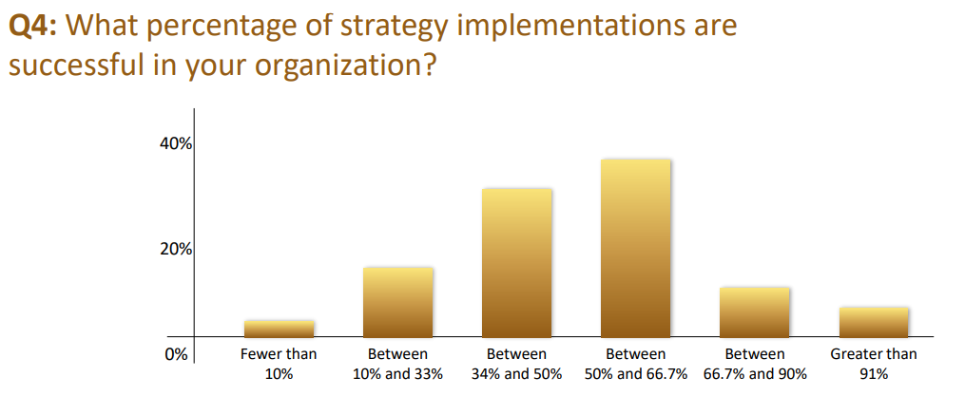
Business strategy process

Slide 31
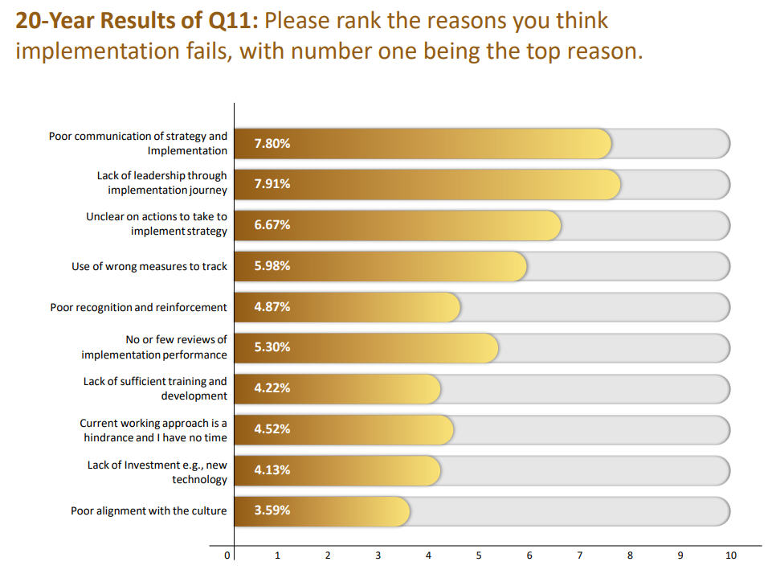
Business strategy process

Slide 32
Business strategy process
There are many components of the process which are spread throughout strategic planning stages.
Most often, the strategic planning process has 4 common phases:
Situation Analysis
Strategy Formulation
Strategy Implementation
Strategy Monitoring

Slide 33
The first phase - Strategic Analysis
Business analysis models are useful tools and techniques that can help you understand your organizational environment and think more strategically about your business. Dozens of generic techniques are available, but some are used more frequently than others do. These include:
PESTLE (political, economic, social, technological, legal and environmental) analysis
SWOT (strengths, weaknesses, opportunities, threats) analysis
Stakeholder analysis

Slide 34
PESTLE analysis

Slide 35
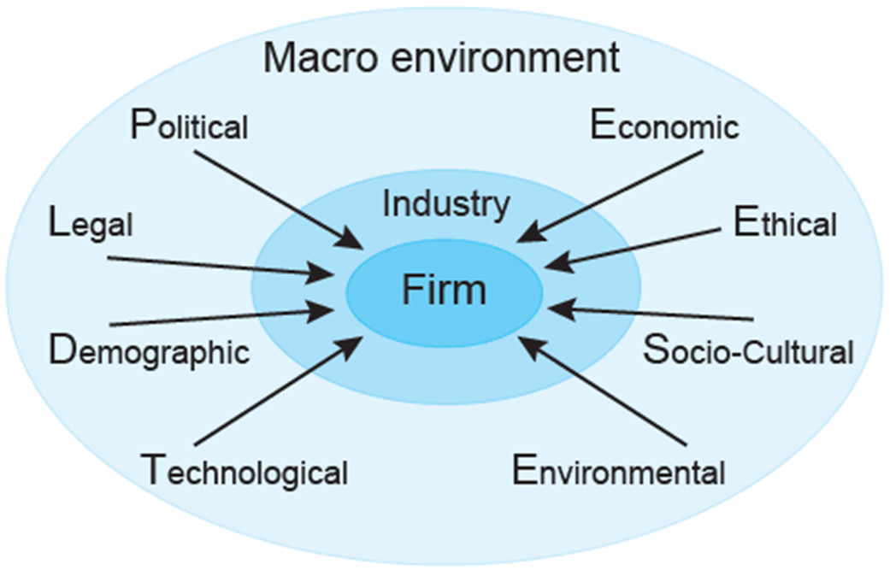
Understanding the tool
The aim of doing PESTLE is to:
find out the current external factors affecting an organization;
identify the external factors that may change in the future;
to exploit the changes (opportunities) or defend against them (threats) better than competitors would do

Slide 36
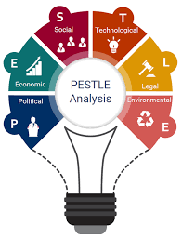
PESTLE Analysis is useful for four main reasons:
It helps you to spot business or personal opportunities, and it gives you advanced warning of significant threats.
It reveals the direction of change within your business environment. This helps you shape what you're doing, so that you work with change, rather than against it.
It helps you avoid starting projects that are likely to fail, for reasons beyond your control.
It can help you break free of unconscious assumptions when you enter a new country, region, or market; because it helps you develop an objective view of this new environment.

Slide 37
PESTLE analysis

Slide 38
PESTLE analysis

Slide 39
PESTLE analysis

Slide 40
PESTLE analysis

Slide 41
PESTLE analysis. Step 1

Slide 42
PESTLE analysis. Step 2

Slide 43
Stakeholders’ analysis in strategic planning
Stakeholder Management is an important discipline that successful people use to win support from others. It helps them ensure that their strategy succeed where others fail.
The benefits of using a stakeholder-based approach are that:
You can use the opinions of the most powerful stakeholders to shape your projects at an early stage. Not only does this make it more likely that they will support you, their input can also improve the quality of your project
Gaining support from powerful stakeholders can help you to win more resources – this makes it more likely that your strategy will be successful
By communicating with stakeholders early and frequently, you can ensure that they fully understand what you are doing and understand the benefits of your project – this means they can support you actively when necessary
You can anticipate what people's reaction to your project may be, and build into your plan the actions that will win people's support.

Slide 44
Stakeholders’ analysis in strategic planning
The first step in Stakeholder Analysis is to identify who your stakeholders are.
The next step is to work out their power, influence and interest, so you know who you should focus on.
The final step is to develop a good understanding of the most important stakeholders so that you know how they are likely to respond, and so that you can work out how to win their support – you can record this analysis on a stakeholder map.

Slide 45
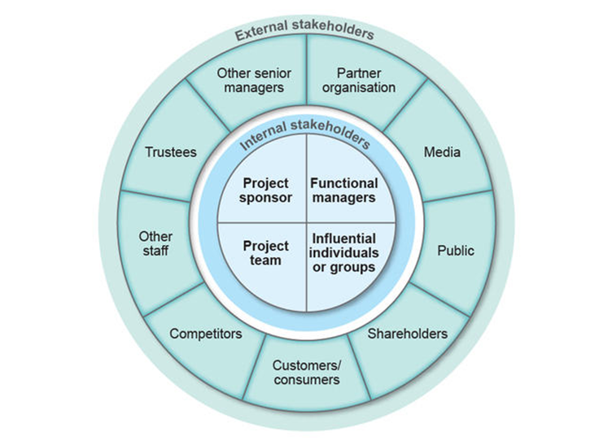
Stakeholders’ analysis in strategic planning
The image represents a possible classification of company’s stakeholders. This includes:
all the people whose work is changed in any way by the project
those who are affected by it
those who provide resources for the project
those who can obstruct, block or stall the work in any way.
Stakeholders may have conflicting or contradictory needs and demands: the client may want changes to the products, while the parent organisation wants profits, which may be reduced if those changes are made.

Slide 46
Step 1. Identify Your Stakeholders
The first step in your Stakeholder Analysis is to brainstorm who your stakeholders are. As part of this, think of all the people who are affected by your work, who have influence or power over it, or have an interest in its successful or unsuccessful conclusion.
The table below shows some of the people who might be stakeholders in your job or in your strategy:

Slide 47
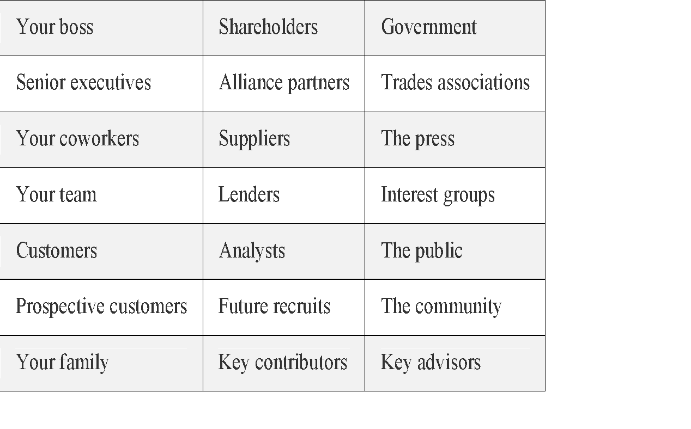
Step 1. Identify Your Stakeholders
These questions may help you to identify company’s stakeholders:
Who is affected positively or negatively by the strategy?
Who might want the strategy to succeed and who might want it to fail?
Who has the power to cause the strategy to succeed or fail?
Who controls or provides the resources and facilities that will be needed?
Who has the special skills needed to make it succeed?
Who are the positive and negative opinion leaders?
Who exercises influence over other stakeholders?
Who are the less obvious stakeholders you have not considered yet?

Slide 48
Step 1. Identify Your Stakeholders
 | Main stakeholders
1
2
3
4
5
6
7
8
9

Slide 49
Step 2. Prioritize Your Stakeholders
Someone's position on the grid shows you the actions you have to take with them:
High power, interested people: these are the people you must fully engage and make the greatest efforts to satisfy.
High power, less interested people: put enough work in with these people to keep them satisfied, but not so much that they become bored with your message.
Low power, interested people: keep these people adequately informed, and talk to them to ensure that no major issues are arising. These people can often be very helpful with the detail of your project.
Low power, less interested people: again, monitor these people, but do not bore them with excessive communication.

Slide 50
SWOT Analysis
SWOT analysis technique was found by Albert Humphrey who led a research project at Stanford University in the 1960s and 1970s.
He used the data from Fortune 500 companies to identify why corporate planning failed.
His research identified a number of key areas that were critical to corporate planning and the tool used to explore each of the critical areas was called SOFT analysis.
Albert Humphrey and the original research team used the following categories:
“What is good in the present is Satisfactory, good in the future is an Opportunity; bad in the present is a Fault and bad in the future is a Threat.”
In 1964, at a conference the F in ‘SOFT’ was changed to a W, and thus, the emergence of ‘SWOT’ Analysis as we know it today came into existence.

Slide 51
What is SWOT Analysis?
SWOT Analysis enables a group/individual to handle everyday problems and look at traditional strategies from a new perspective.
It is used as framework for organizing and using data and information gained from situation analysis of internal and external environment.
SWOT
SWOT Analysis is a planning tool used to understand Strengths, Weaknesses, Opportunities and Threats involved in a project/business.

Slide 52
Strengths
S
W
W
Strengths are:
Characteristics of the business or team that give it an advantage over others in the industry.
Positive, tangible and intangible attributes, internal to an organization.
Beneficial aspects of the organization or the capabilities of an organization, which includes human competencies, process capabilities, financial resources, products and services, customer goodwill and brand loyalty.
O
O
T
T

Slide 53
Strengths
S
S
Some of the examples of organizational strengths are as follows:
Abundant financial resources
Established brand name
Economies of scale
Lower production costs
Superior management
Excellent marketing skills
Good supply chain distribution
Great Employee commitment
W
W
O
O
T
T

Slide 54
Weaknesses
S
S
W
Weaknesses are:
Characteristics that place the organization at a disadvantage relative to others.
Detract the organization from its ability to attain the core goal and influence its growth.
Factors which do not meet the standards set in the organization.
O
O
T
T

Slide 55
Weaknesses
S
S
Some of the examples of organizational weaknesses are as follows:
Limited financial resources
Low R & D Budget
Narrow product line
Weak supply chain distribution
Higher production costs
Obsolete or Out-of-date products/technology
Poor market image
Poor marketing skills
Weak management skills
Under-trained employees
W
W
O
O
T
T

Slide 56
Opportunities
S
S
W
W
Opportunities are:
Chances to make greater profits in the environment.
External attractive factors that represent the reason for an organization to exist and develop.
Condition of the environment that benefits the organization in planning and executing strategies that enable it to become more profitable.
Organization should be careful and recognize the opportunities and grasp them whenever they arise. Opportunities may arise from market, competition, industry/government and technology.
O
T
T

Slide 57
Opportunities
S
S
Some of the examples of opportunities for an organization are as follows:
Rapid market growth
Complacent rival firms
Changing customer needs/tastes
New uses discovered for existing product
Economic boom,
Government deregulation
Decline in demand for a substitute product
W
W
O
O
T
T

Slide 58
Threats
S
S
W
W
Threats are:
External elements in the environment that could cause trouble for the business.
External factors, beyond an organization’s control, which could place the organization’s mission or operation at risk.
Conditions in external environment that jeopardize the reliability and profitability of the organization’s business.
Threats compound the vulnerability when they relate to the weaknesses. Threats are uncontrollable. When a threat comes, the stability and survival can be at stake.
O
T
O
!
!

Slide 59
Threats
S
S
Some of the examples of threats for an organization are as follows:
Entry of foreign competitors
Introduction of new substitute products
Decline in product life cycle
Changing customer needs/tastes
New strategies adopted by rival firms
Increased government regulation
Economic slowdown
W
W
O
O
T
T

Slide 60
The second phase - Strategy Formulation
The starting point of the process is initial assessment of the firm. At this phase managers must clearly identify the company’s vision and mission.
Vision is the ultimate goal for the firm and the direction for its employees.
In addition, mission describes company’s business.

Slide 61
Step 1. STRATEGY FORMULATION
Definition
“Vision is a statement that expresses organization’s ultimate objectives.”
Vision is closely related with a term ‘strategic intent’ – a desired leadership position that is currently unachievable due to the lack of resources and capabilities.
The Vision Statement focuses on the future; it is a source of inspiration and motivation. Often it describes not just the future of the organization but the future of the industry or society in which the organization hopes to effect change.

Slide 62
Benefits
Step 1. STRATEGY FORMULATION
Motivates and inspires employees
Provides one purpose to work for
Sets the stretch goals (goals that are impossible to achieve with current resources and capabilities)
Guides managers in effectively allocating resources

Slide 63
Vision statement
An effective vision statement must have following features
It must be unambiguous.
It must be clear.
It must harmonize with organization’s culture and values.
The dreams and aspirations must be rational/realistic.
Vision statements should be shorter so that they are easier to memorize.

Slide 64
These steps and guidelines to help you write an effective Vision statement
Step 1. Gather a team of managers, employees and shareholders.
Step 2. Ask everyone to write their own version of vision.
Step 3. Revise the statement and present the final version.

Slide 65
What's in a Vision Statement?
When developing a vision statement, it should be seen that the following questions are answered:
What do we want to do going forward?
When do we want to do it?
How do we want to do it?

Slide 66
Practical skills “HOW TO WRITE A GOOD VISION STATEMENT”
There are a few common rules that pretty much all good Vision Statements should follow:
short
specific to your business
do not use words that are open to interpretation
simple
ambitious
align to the Values

Slide 67
Vision statement examples
Good examples
Chevron: To be the global energy company most admired for its people, partnership and performance.
Feeding America: A hunger-free America
Habitat for Humanity: A world where everyone has a decent place to live.
Microsoft: A computer on every desk and in every home
Save the Children: Our vision is a world in which every child attains the right to survival, protection, development and participation.

Slide 68
Vision statement examples
Bad examples
General Motors: To design, build and sell the world’s best vehicles. (Best in what? GM should have specified their objective)
Ikea: At Ikea our vision is to create a better everyday life for the many people. (This is impossible to achieve)
Samsung: Inspire the World, Create the Future. (The statement is too vague and doesn’t set any objectives)
Toyota: Toyota will lead the way to the future of mobility, enriching lives around the world with the safest and most responsible ways of moving people. Through our commitment to quality, constant innovation and respect for the planet, we aim to exceed expectations and be rewarded with a smile. We will meet our challenging goals by engaging the talent and passion of people, who believe there is always a better way. (It is too long and sounds more like a mission than a true vision)

Slide 69
Step 1. STRATEGY FORMULATION
Mission statement is the statement of the role by which an organization intends to serve it’s stakeholders.
It describes why an organization is operating and thus provides a framework within which strategies are formulated.
It describes what the organization does (i.e., present capabilities), who all it serves (i.e., stakeholders) and what makes an organization unique (i.e., reason for existence).

Slide 70
Step 1. STRATEGY FORMULATION
Definition
“Mission statement is a description of what an organization actually does – what its business is – and why it does it.”
The Mission statement concentrates on the present; it defines the customer(s), critical processes and it informs you about the desired level of performance.

Slide 71
Why creating a mission is important?
Benefits:
Informs organization’s stakeholders about its plans and goals;
Unifies employees’ efforts in pursuing company goals;
Serves as an effective public relations tool;
Provides basis for allocating resources;
Guides strategic or daily decision making;
Shows that a company is proactive.
Features of a Mission
Mission must be feasible and attainable. It should be possible to achieve it.
Mission should be clear enough so that any action can be taken.
It should be inspiring for the management, staff and society at large.
It should be precise enough, i.e., it should be neither too broad nor too narrow.
It should be unique and distinctive to leave an impact in everyone’s mind.
It should be analytical,i.e., it should analyze the key components of the strategy.
It should be credible, i.e., all stakeholders should be able to believe it.

Slide 72
What to Include in a Mission Statement?
When developing a mission statement, it should be seen that the following questions are answered:
What do we do today?
For whom do we do it?
How we do it?

Slide 73
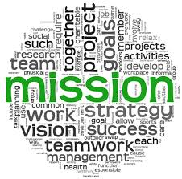
Facebook Facebook’s mission is to give people the power to share and make the world more open and connected.
Mission statement examples

Slide 74
Google Google’s mission is to organize the world‘s information and make it universally accessible and useful.
Mission statement examples

Slide 75
Microsoft Microsoft’s mission is to enable people and businesses throughout the world to realize their full potential.
Mission statement examples

Slide 76
Yahoo! Yahoo!’s mission is to be the most essential global Internet service for consumers and businesses
Mission statement examples

Slide 77
Apple Apple is committed to bringing the best personal computing experience to students, educators, creative professionals and consumers around the world through its innovative hardware, software and Internet offerings.
Mission statement examples

Slide 78
Step 3. STRATEGY FORMULATION
A goal is a desired future state or objective that an organization tries to achieve.
Goals specify in particular what must be done if an organization is to attain mission or vision.
Goals make mission more prominent and concrete.
They co-ordinate and integrate various functional and departmental areas in an organization.

Slide 79
PURSUING THE GOALS THROUGH SMART

Slide 80
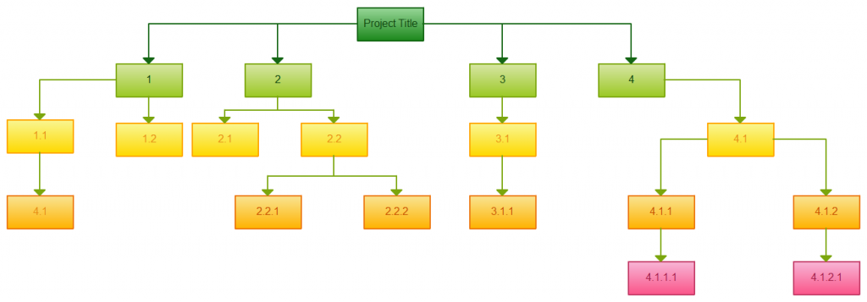
Strategy Road Map or Work breakdown structure (WBS)
A tool used to define and group a project's discrete work elements (tasks) in a way that helps organize and define the total work scope of the project.
The project is divided into hierarchical groups of tasks (work packages, and work units).
Tasks, work packages and work units should be budgetable (money, labour hours, and other resources).
The technique of creating a WBS is non-uniform.

Slide 81
Road Map in business strategy
Possible levels in a Road Map:
Goals
Sub-goals
Deliverables
Sub-deliverables
Work packages
Work units

Slide 82
Road Map example

Slide 83
GANTT chart example

Slide 84
The third phase - Strategy Implementation
The strategy implementation process consists of following 6 steps:
Setting annual objectives;
Revising policies to meet the objectives;
Allocating resources to strategically important areas;
Changing organizational structure to meet new strategy;
Managing resistance to change;
Introducing new reward system for performance results if needed.

Slide 85
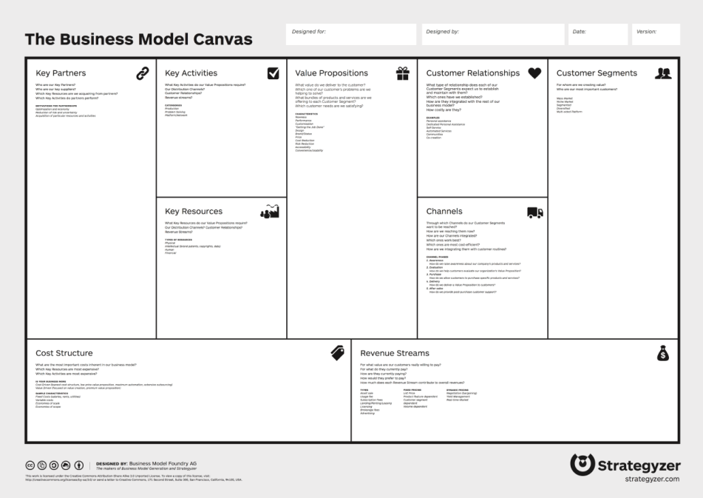
Business Model Canvas
Business Model Canvas is a strategic management and lean startup template for developing new or documenting existing business models.
It is a visual chart with elements describing a firm's or product's value proposition, infrastructure, customers, and finances. It assists firms in aligning their activities by illustrating potential trade-offs.
The Business Model Canvas was initially proposed by Alexander Osterwalder based on his earlier work on Business Model Ontology. Since the release of Osterwalder's work in 2008, new canvases for specific niches have appeared.

Slide 86
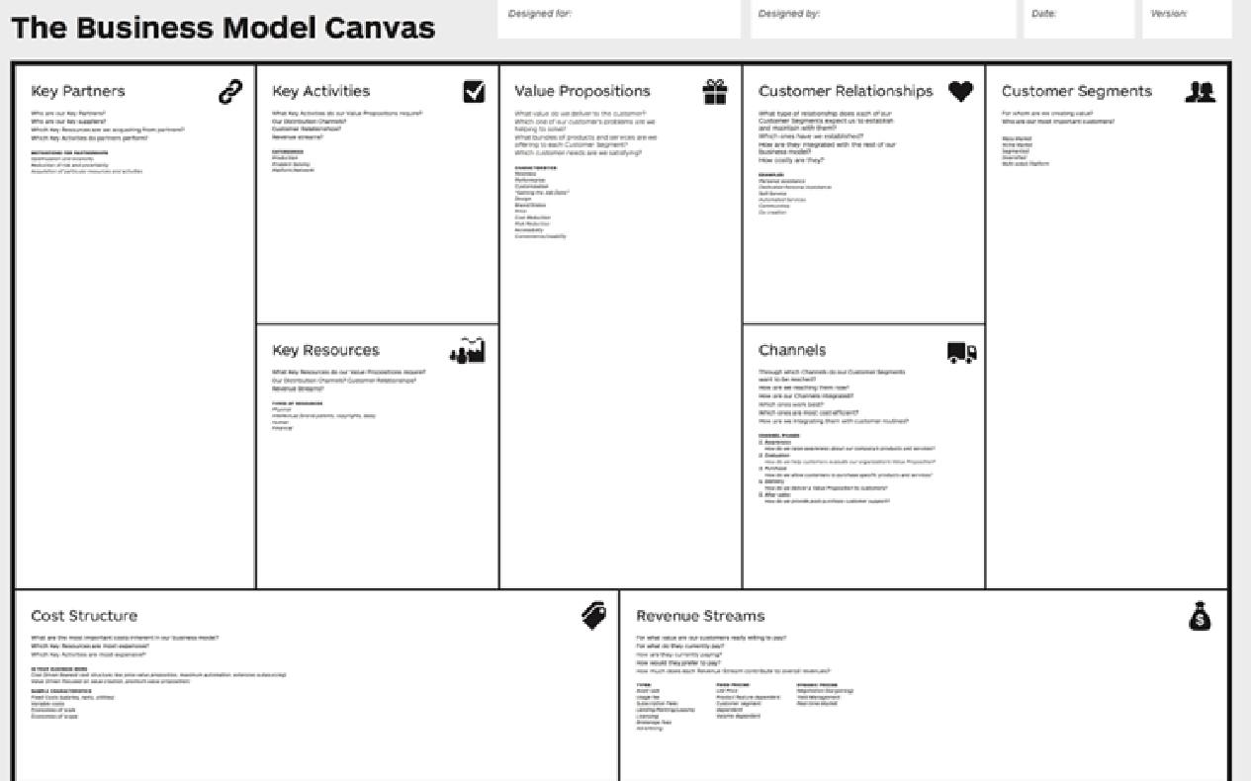
Business Model Canvas

Slide 87
Efficiency of the Strategic-Planning Process

Slide 88
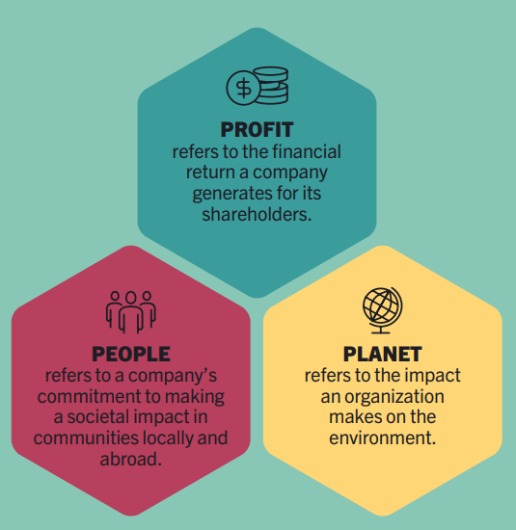
Efficiency of the Strategic-Planning Process

Slide 89
The forth phase - Strategy Monitoring
Implementation must be monitored to be successful.
Performance has to be measurable and comparable. Managers have to compare their actual results with estimated results and see if they are successful in achieving their objectives. If objectives are not met managers should:
Change the reward system.
Introduce new or revise existing policies.

Slide 90
Seventeen Guidelines for the Strategic-Planning Process to Be Effective
1. It should be people-oriented, not paper-oriented.
2. It should be a learning process for all managers and employees.
3. It should present ideas clearly and support them by numbers.
4. It should be simple and creative.
5. It should have variety in assignments, team memberships, meeting formats, and even the planning calendar.
6. It should allow employees to disagree with the present corporate strategy.
7. It should accept bad news.
8. It should welcome open-mindedness and the wish to learn.

Slide 91
Seventeen Guidelines for the Strategic-Planning Process to Be Effective
9. It should not be bureaucratic.
10. It should not become like a ritual; it should allow changes.
11. It should not be too formal, predictable, or rigid.
12. It should not contain jargon.
13. It should not be a formal system for control.
14. It should not disregard qualitative information.
15. It should not be controlled by “technicians.”
16. Do not use too many strategies at once.
17. Use the following approach: “Good ethics is good business”

Slide 93
Thank you
Valentyna Yakubiv

