Slide 1
A case study of the application of Tourism 4.0 technology in Odesa, Ukraine
Paul Goriup
NGO Agricola, Odesa, Ukraine

Slide 2
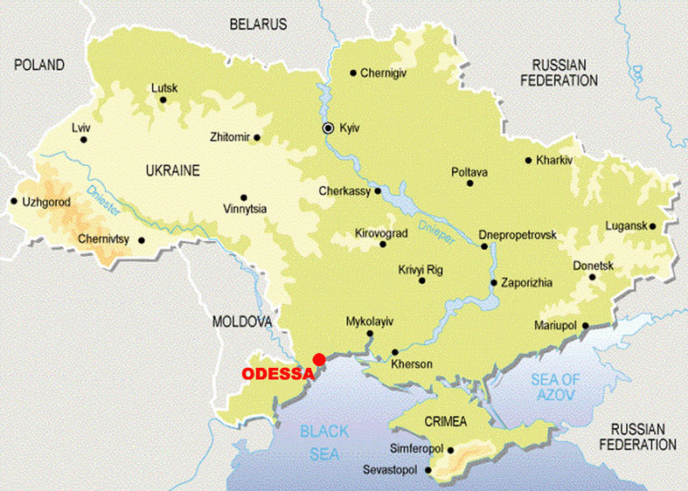

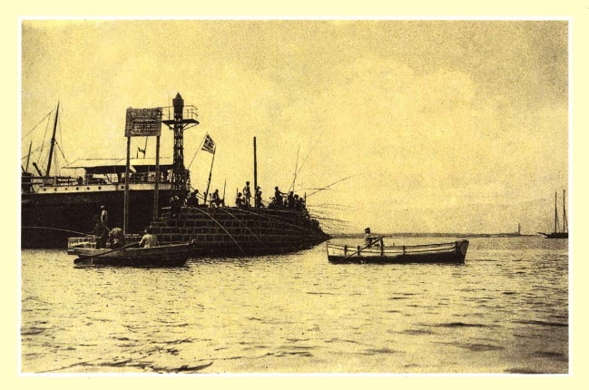
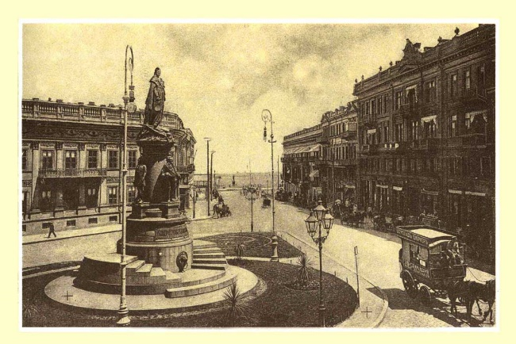
A little bit about Odesa
Founded by Tatars around 1240 as a small fishing settlement, Odesa was incorporated in Tsarist Russia in 1794 after the defeat of the Ottoman Turks
Established under a Charter from Catherine the Great, the city was planned and built by Renaissance architects, military officers, traders and a multitude of labourers: Ukrainians, Jews, Greeks, Bulgarians, Romanians, Italians, French, British, Germans, Poles, Armenians …. But remaining under Russian governance

Slide 3
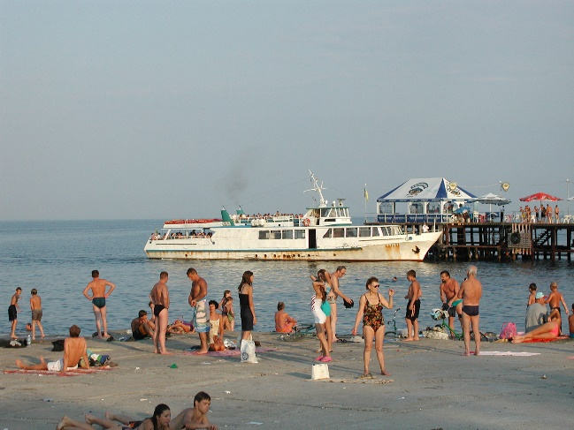
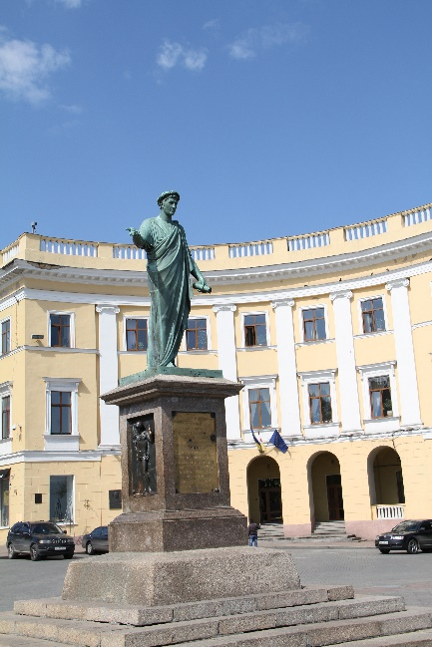
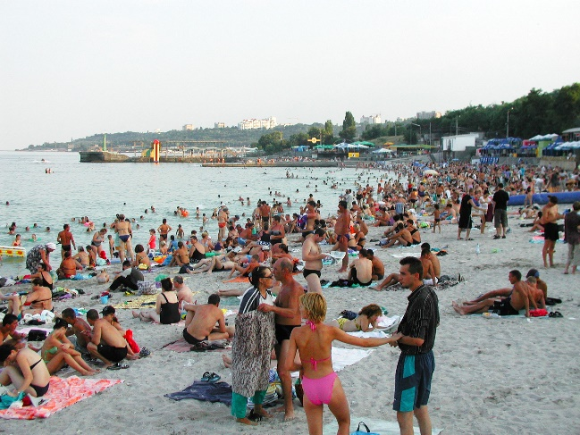

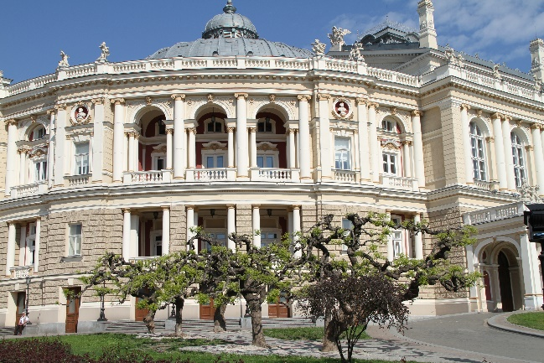
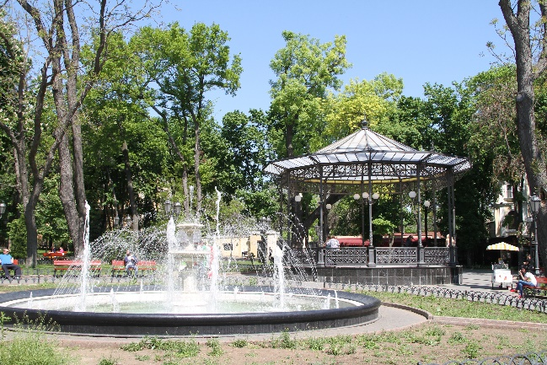
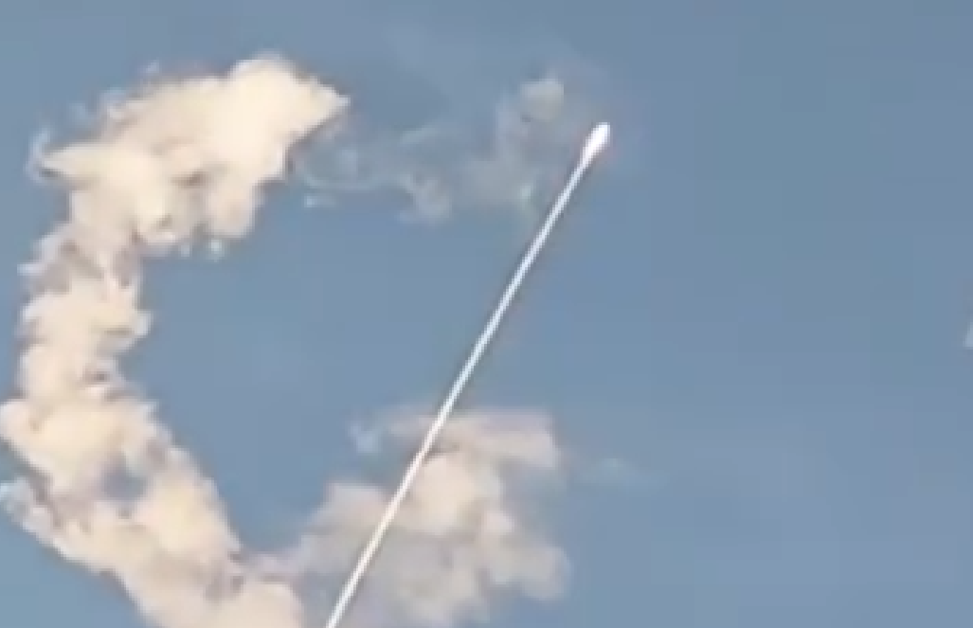
A little bit about Odesa
Thanks to the rich agricultural hinterland and access to the Black Sea, Odesa became (and remains) the largest maritime settlement on the Black Sea coast (over 1 million inhabitants) and one the wealthiest cities in the Empire and later the Soviet Union
This heritage and wealth conferred a unique cosmopolitan culture on the city with a great variety of private mansions and palaces, public buildings, institutions and a thriving artistic community. Combining all this with a temperate climate and beaches made Odesa a top tourist destination, known as "pearl of the Black Sea“, during the 20th century up to the 2010s.
Since then, the Russian annexation of Crimea in 2014, impact of COVID-19 from 2020 to 2022 and then the Russian invasion in 2023 have had a severe impact on the tourism sector in the city, and of course the whole of modern Ukraine.

Slide 4


Co-creating tourism for the future with data analytics 2019 – 2021 (EMFF)
Two data-driven components discussed in this presentation
Big data analytics to profile the tourist sector in and around Odesa city
Assessment of impacts (positive and negative) affecting the environmental, social and economic sustainability of Odesa city through development of a Tourism Impact Model (TIM)

Slide 5
Big data analytics
Data Analytics performed on the tourism-related data for Odesa and adjacent resorts obtained in collaboration with the Department of Culture and Tourism of Odessa city from
• Booking.com
• TripAdvisor
• Skyscanner
• KyivStar mobile phone data

Slide 6
Analysis tool - Microsoft Power BI
The tool used in this data analysis was Microsoft’s Power BI (business intelligence). It provides multiple tools for interactive visualizations and can connect to a wide range of data sets and clean the data in a way that it can be better digested and understood. Power BI allowed us to interactively run reports and elicit insights of the presented tourism data about Odesa.

Slide 7
Booking.com data
Booking.com is an online agency for making accommodation reservations with providers such as hoteliers and private apartment owners. Because Booking.com displays search results with filter options that are selected by visitors, much information is gathered from every user (guest and service provider). Guests can also leave feedback of their booking and travel experience through written comments, rating stars, and other quality ratings.
The data structure compiled was an excel table with rows for each guest rating and columns with different attributes linked with this rating. The information extracted from the website had the following attributes for about 90,000 guest rows:
hotel data (hotel name, address, hotel rating (1-10), hotel rating average),
location data (district name, geo-location with longitude and latitude, distance to the city center in meters, location rating average),
guest data (nationality, type of guest (group, family, couple, solo traveler),
guest accommodation data (room type, check-in date and time, number of nights spent),
guest rating data (given hotel rating score, date of rating).

Slide 8
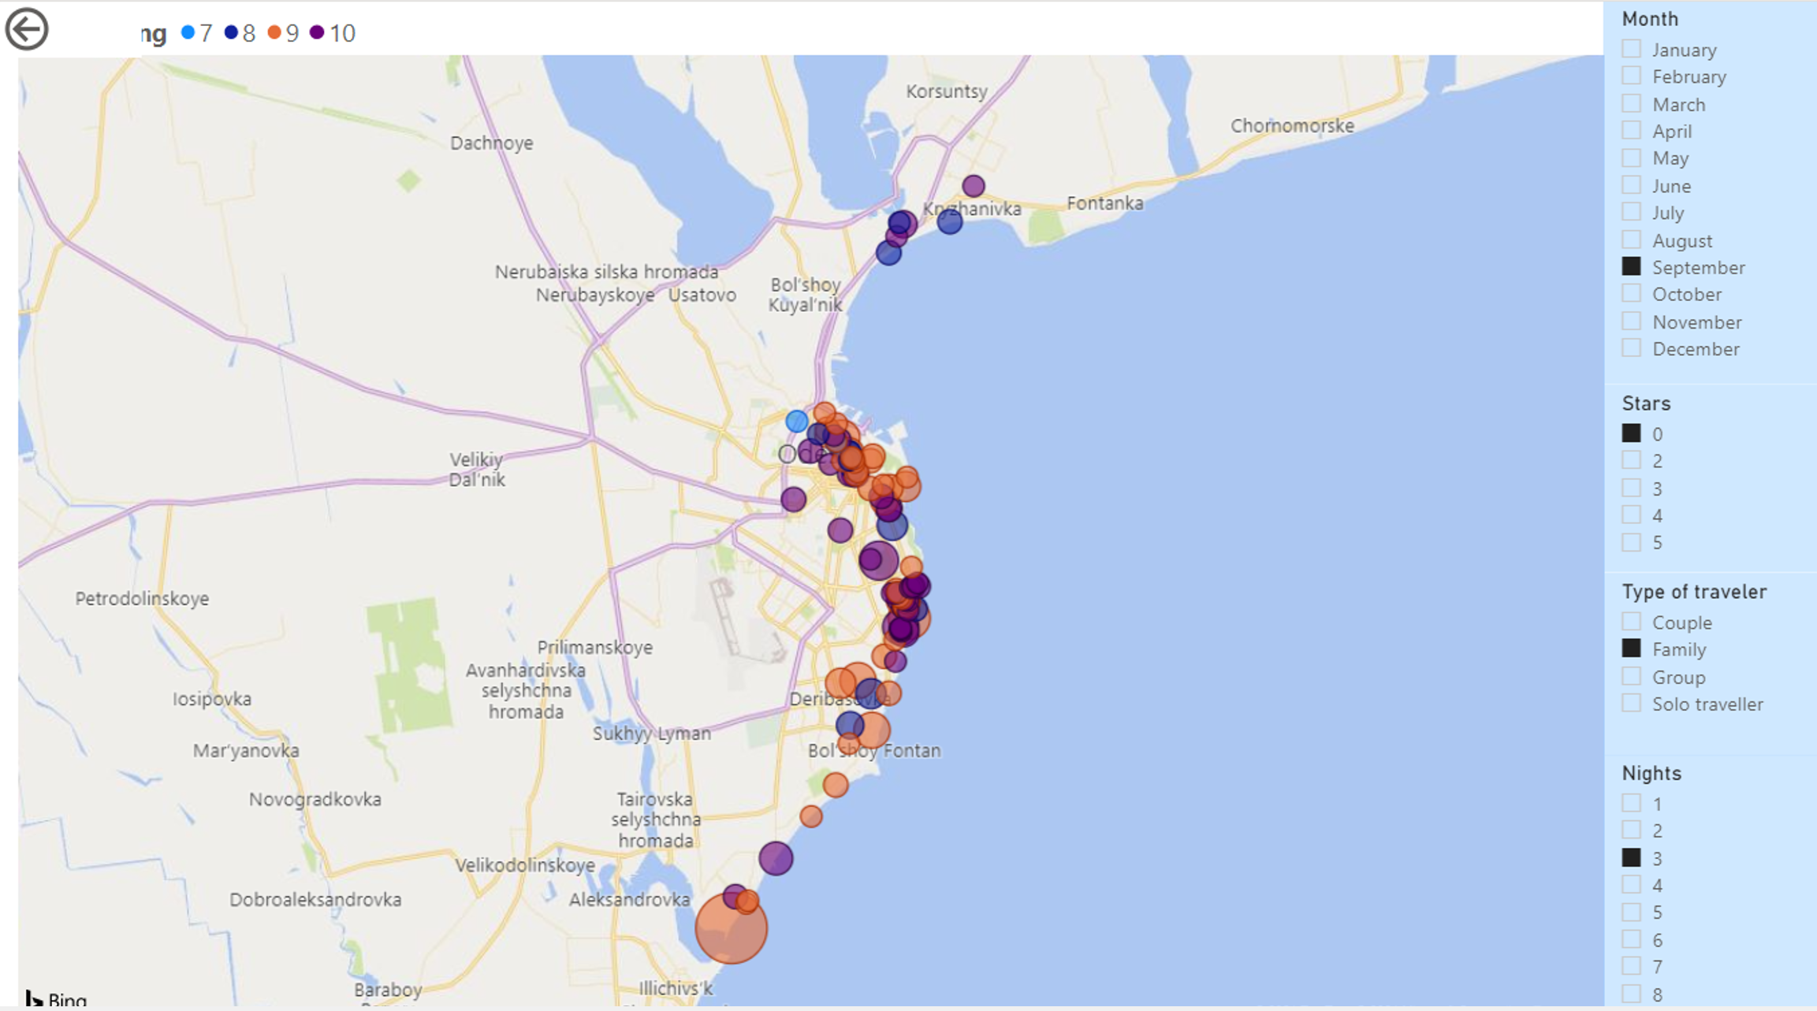
Booking.com data filtered for accommodation ratings given by families in September

Slide 9
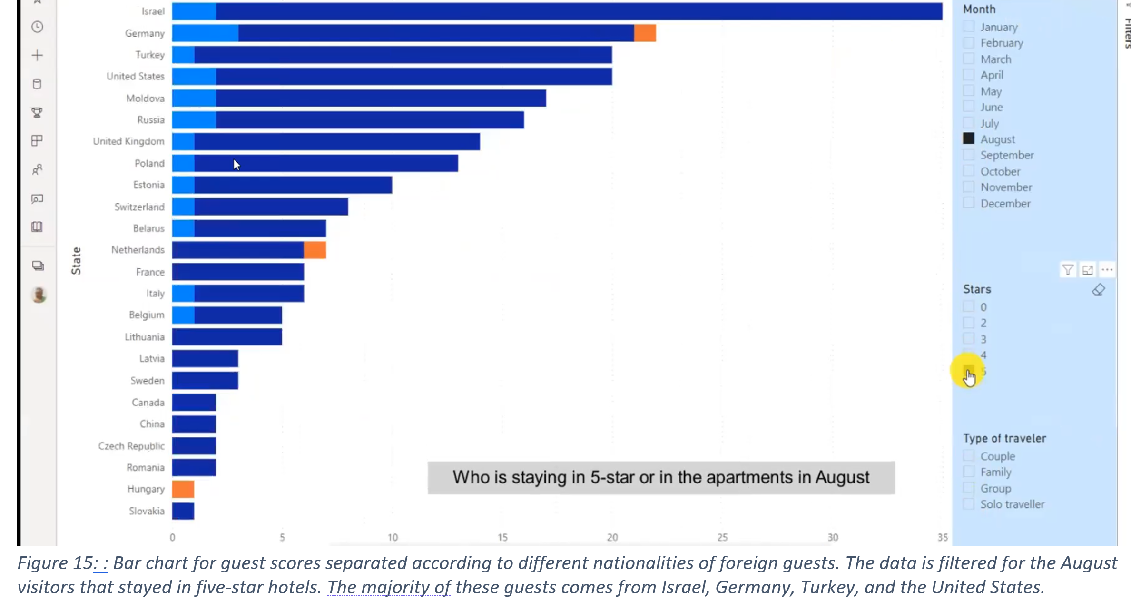
Booking.com data filtered to show nationality of guests staying in 5 star hotels in August

Slide 10
TripAdvisor data
TripAdvisor displays user-generated content and has a comparison-shopping website that offers online travel services. Users can leave comments and/or quality ratings of tourist attractions, events, locations, restaurants, stores, accommodations, etc.
The data structure of the information collected about Odesa from TripAdvisor was again an excel table with about 14,000 rows for individual ratings and columns with different attributes linked with each rating. The information had the following attributes for each user input row:
location data (location name, geo-location with longitude and latitude, all location’s scores, location rating average),
user data (user »name«, date of location experience),
user rating data (given location rating score (1-5), date of rating).

Slide 11
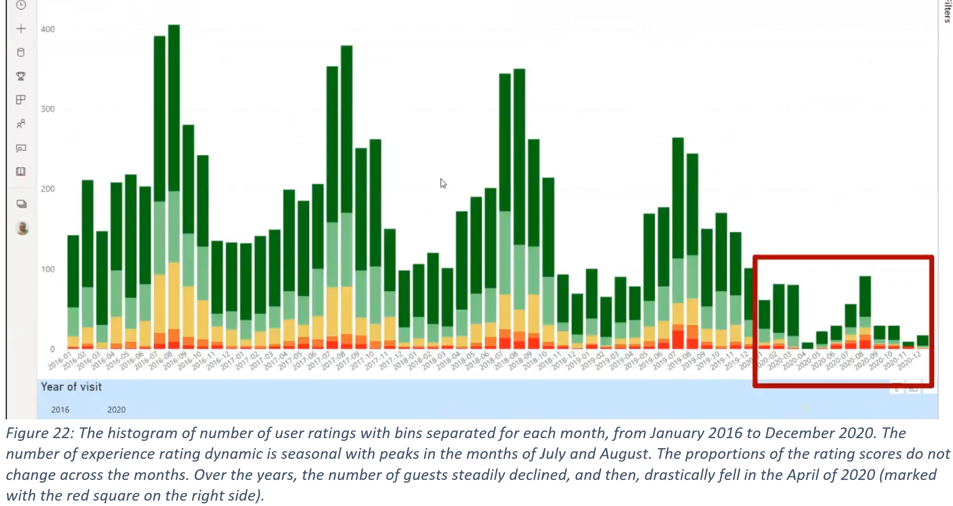
Number of monthly ratings posted to TripAdvisor from 2016 to 2020

Slide 12
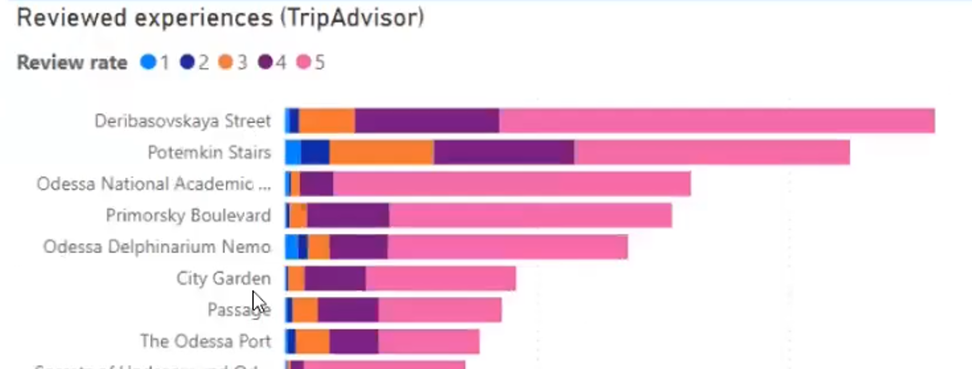
Experiences in Odesa rated on TripAdvisor

Slide 13
Skyscanner.com
Skyscanner is a highly popular air travel booking site. We collected data on the searches and bookings of flights from foreign countries to Odesa airport. This allowed us to chart from where people flying to Odessa originated.

Slide 14
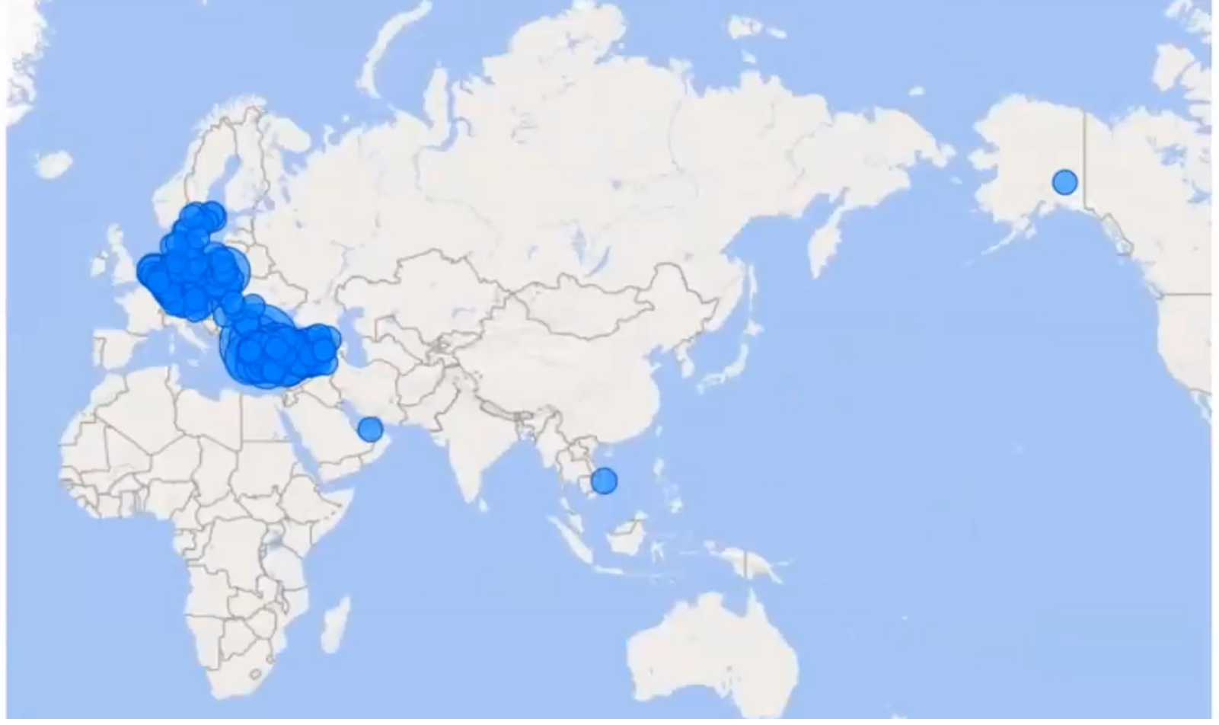
Skyscanner – popular flight searches from airports to Odesa

Slide 15
Mobile data
In order to get a more detailed picture of daily (and even hourly) tourist flow in Odesa we purchased anonymized data from one of the biggest Ukrainian mobile providers.
The data came in several files/data tables that have input rows for each anonymized mobile phone user. Table columns had various attributes linked with each user. All of the data files contained information about the location and time of a mobile user, while other information was specific for each file. The files were of different sizes that spanned from about 200.000 to more than 12,000,000 inputs:
location data (area and region name, geo-location with longitude and latitude),
time data (event date, event time, number of days of stay),
user’s data (nationality, age interval, income standard, gender).

Slide 16
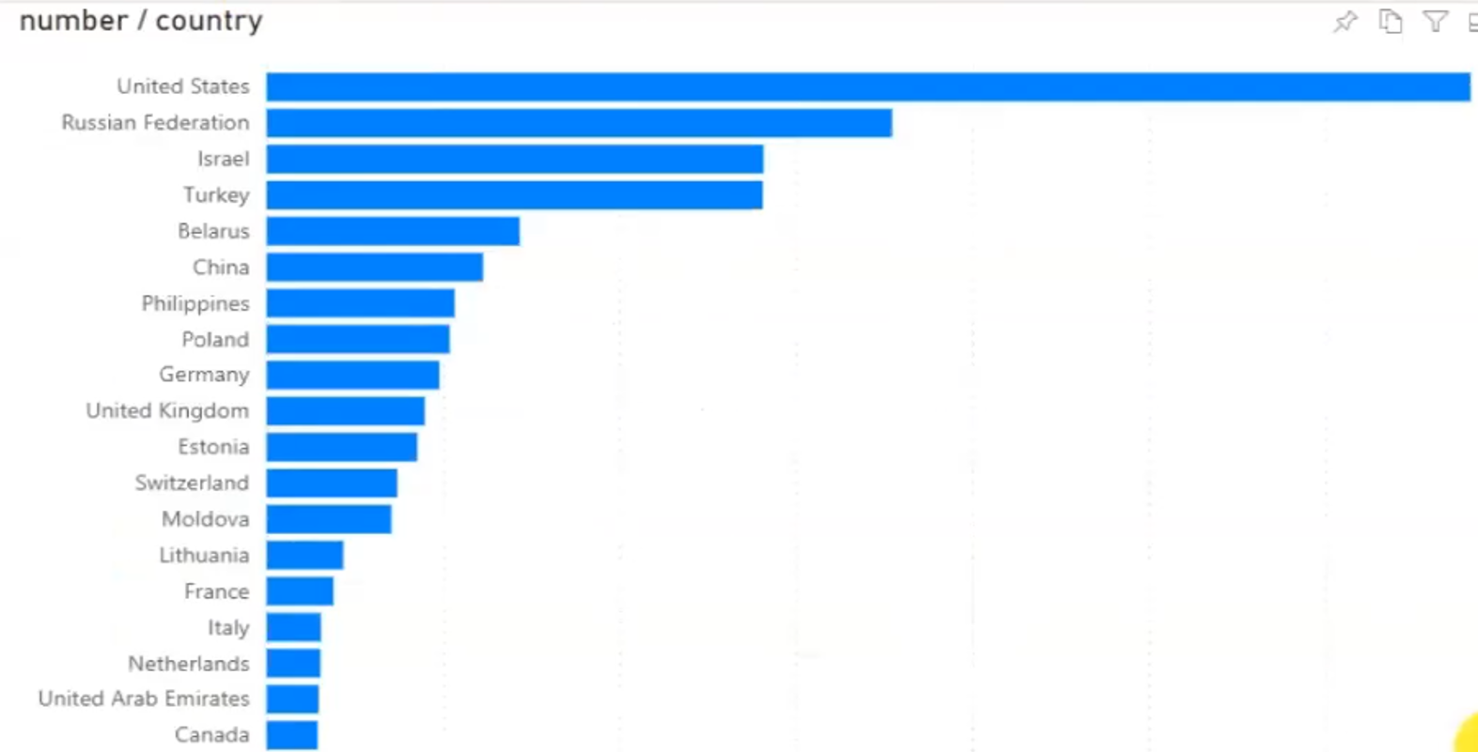
Mobile data – where visitors mostly come from

Slide 17
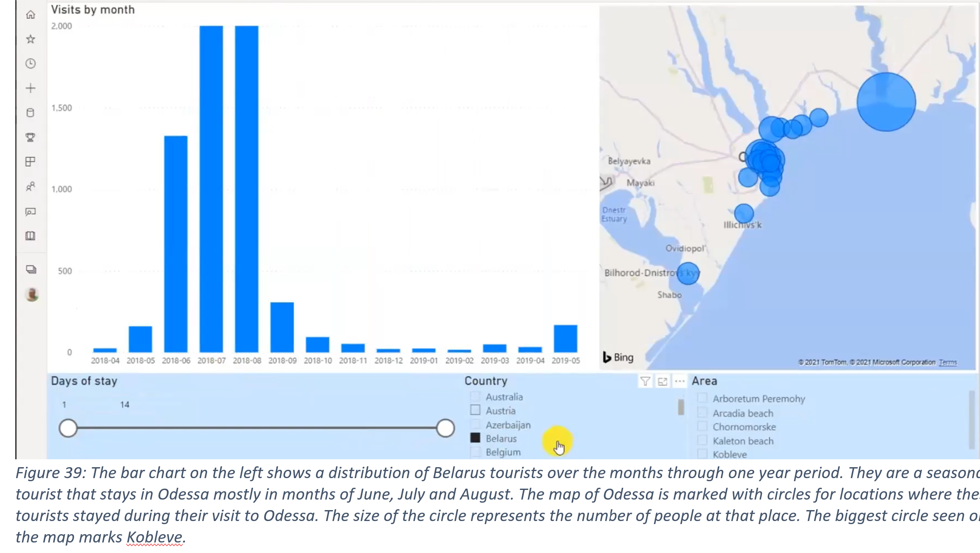
Mobile data – who is going where, when

Slide 18
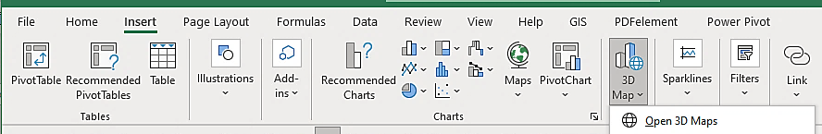
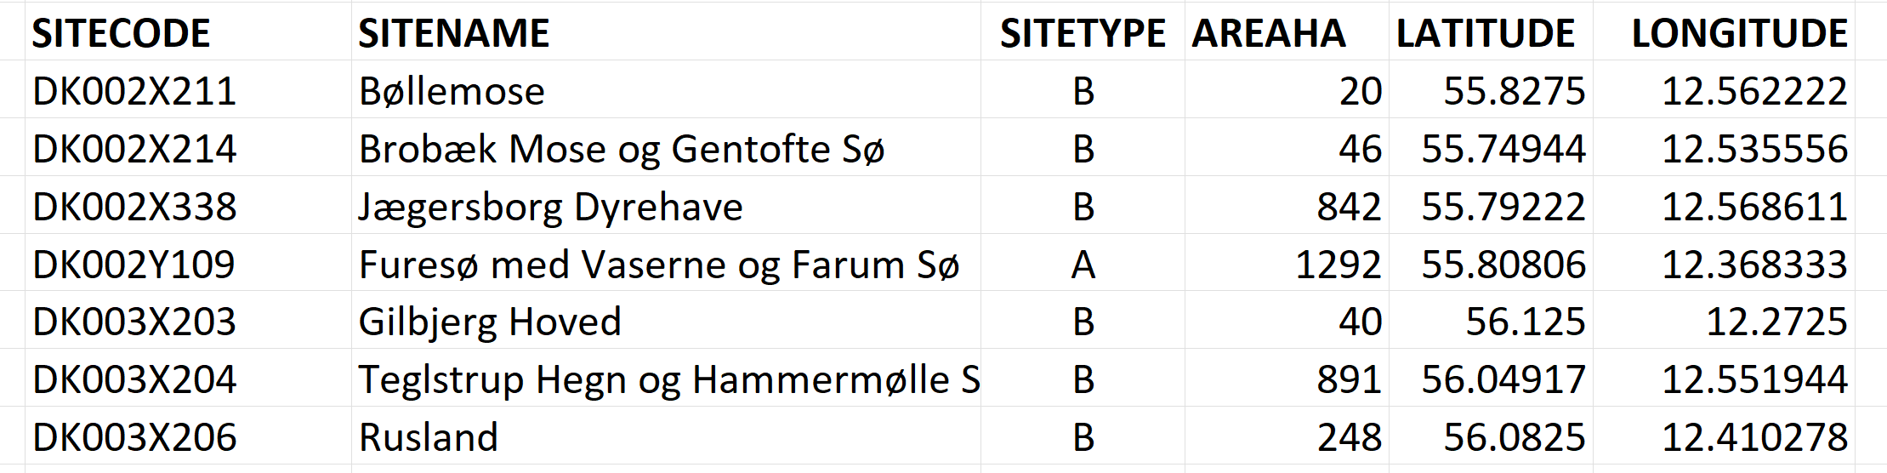
Practice with Excel 3D Maps (ecological example)
Any excel table with spatial data can be easily mapped and filtered in 3D maps

Slide 19
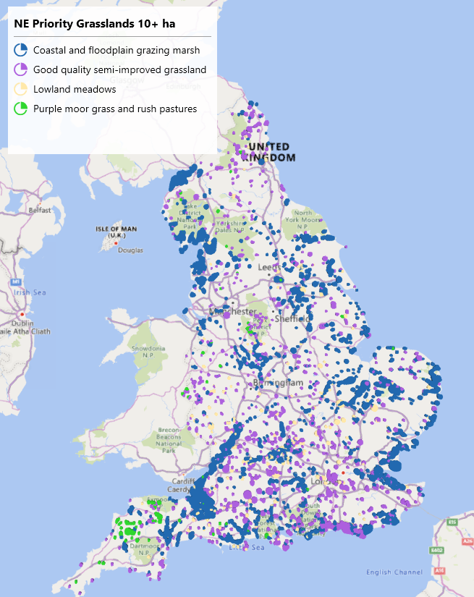
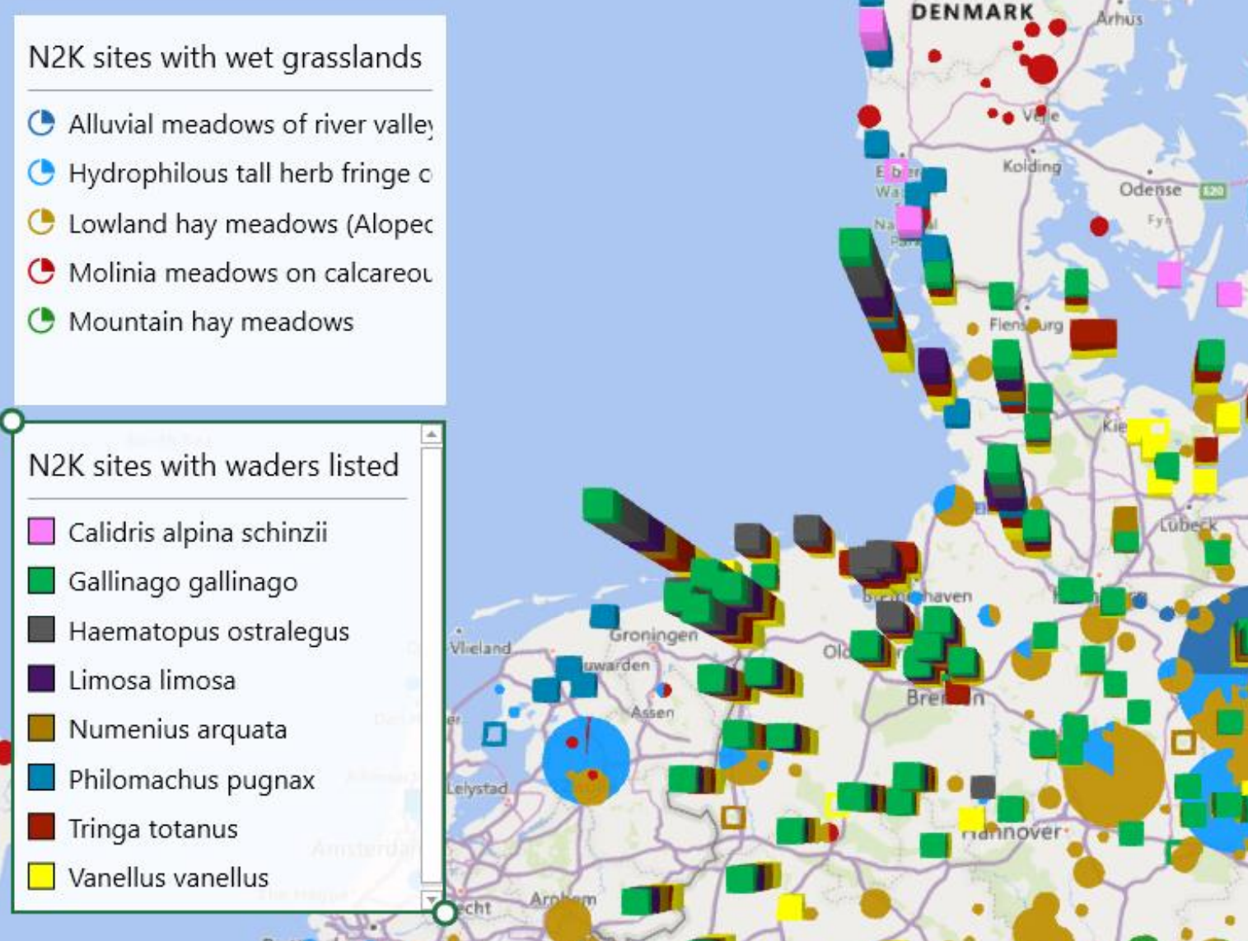
Practice with Excel 3D Maps

Slide 20
TOURISM IMPACT MODEL
Strategic data-driven process
Based on indicators for sustainable tourism (EU Directives, UN Sustainable Development Goals)
Use of AI and high-performance data analytics to combine datasets from different sources
State-of-art planning for a specific location
Scenario testing of impact of tourism by manipulating various indicators
A vital tool for setting tourism management priorities
Active monitoring and forecasting
Digitalization of processes and iterative modelling
Real time alerts and responses

Slide 21

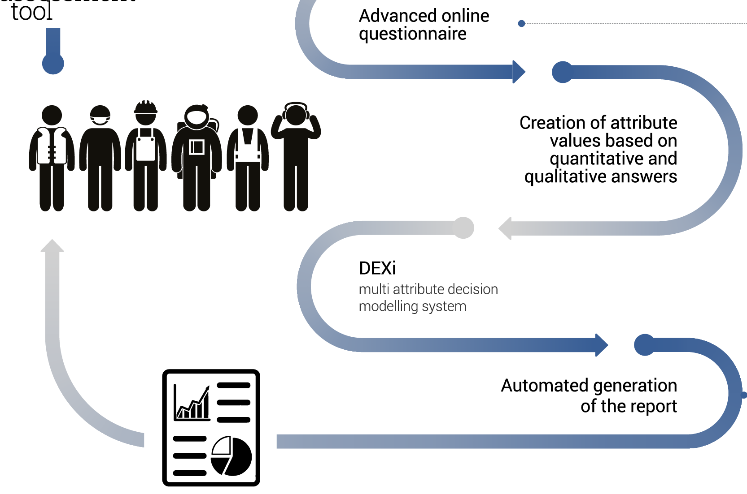

Slide 22
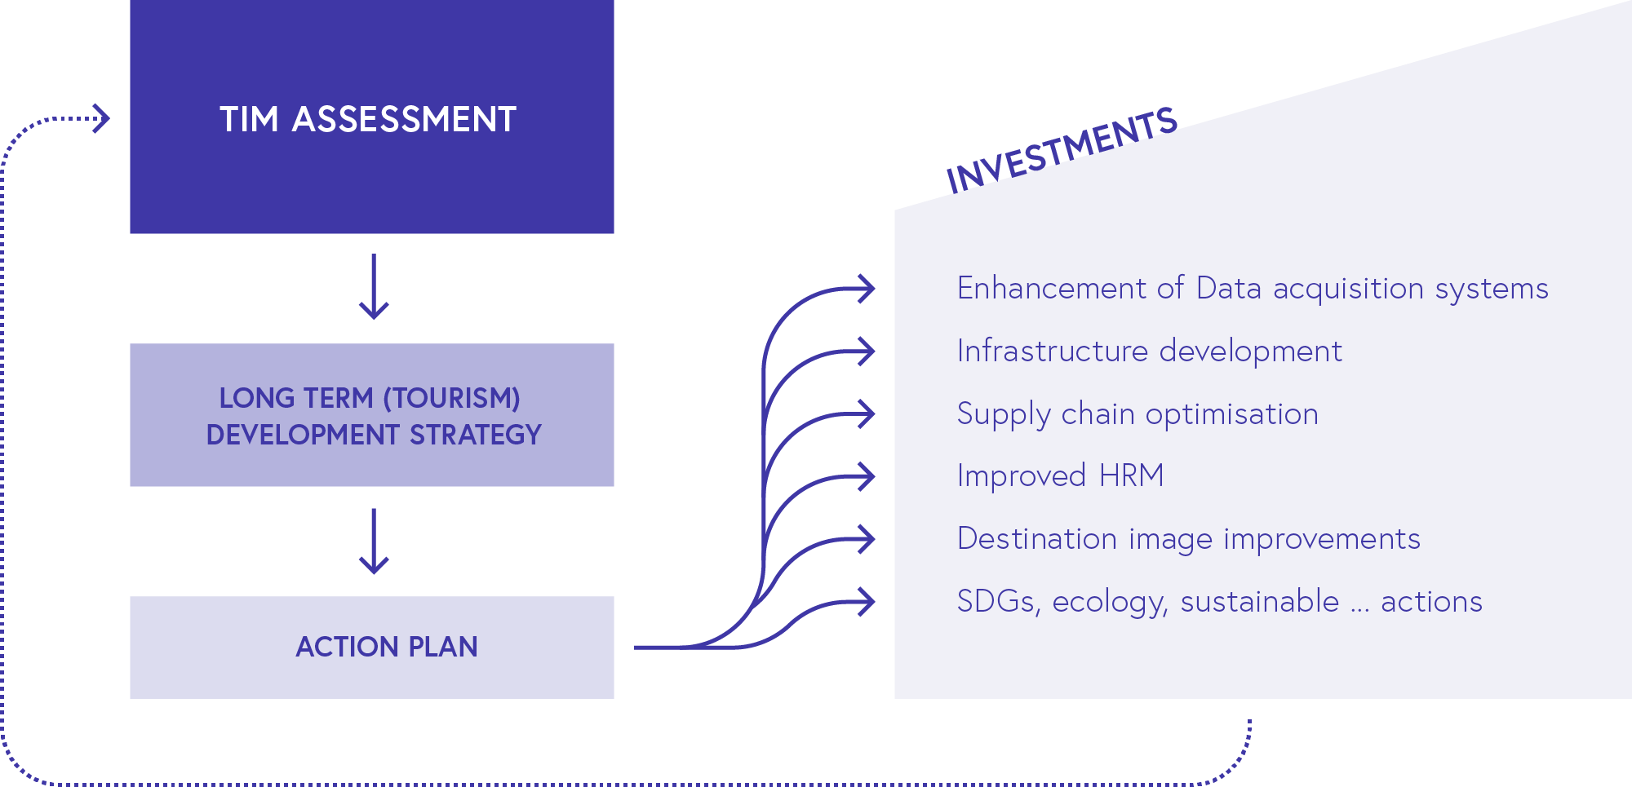
TIM – Generator of sustainable progress

Slide 23
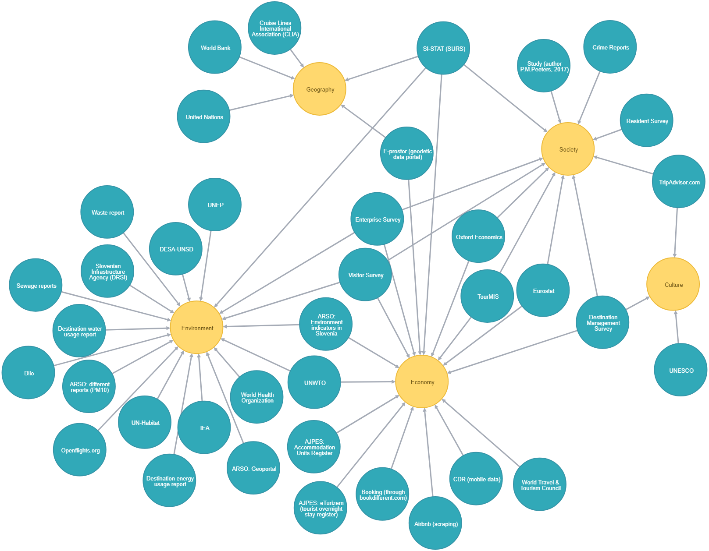
Data sources - categories
Geography
Environment
Society
Culture
Economy

Slide 24
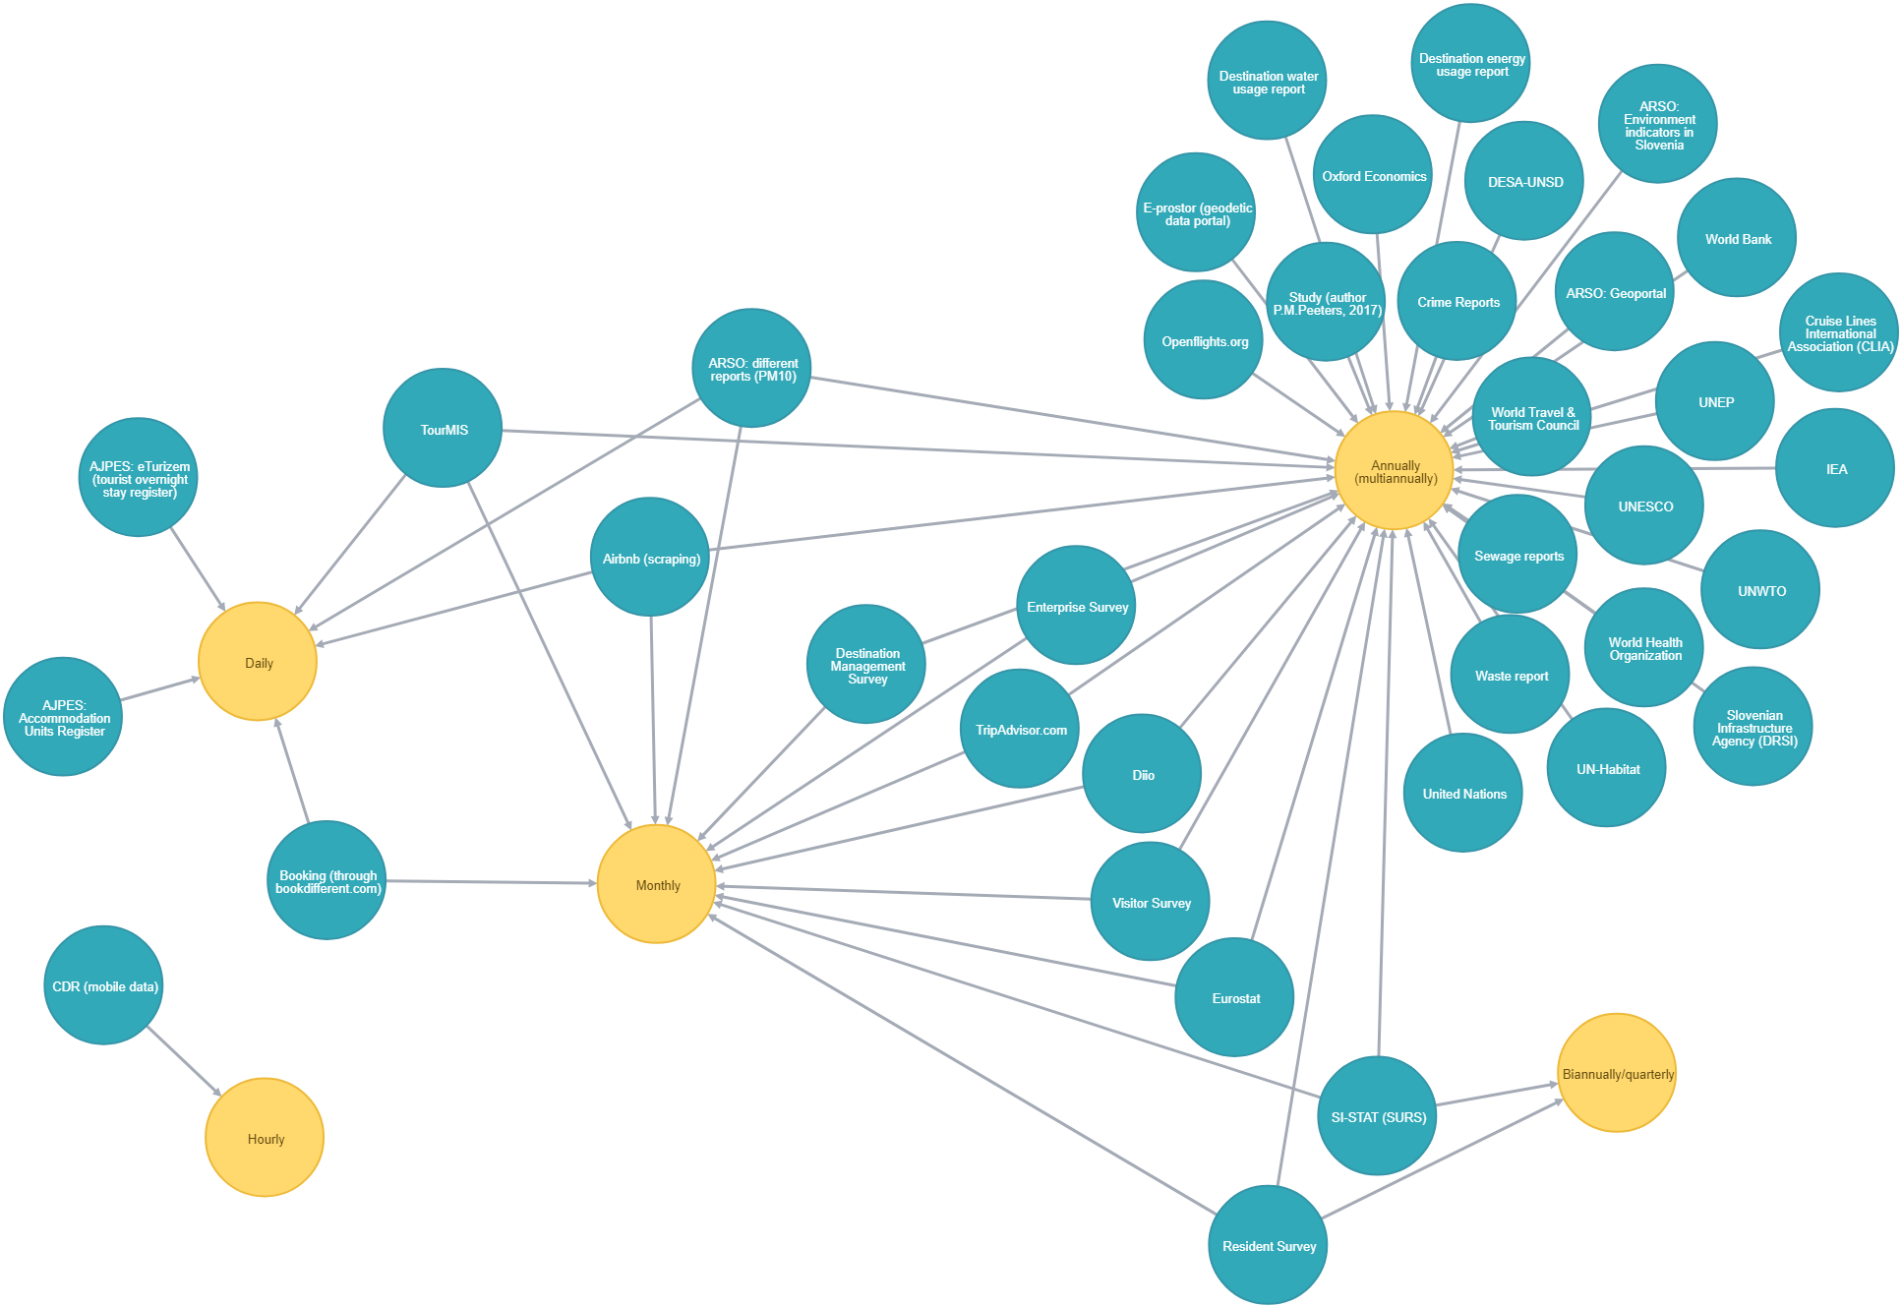
Data sources - frequency
Hourly
Daily
Monthly
Biannually/
quarterly
Annually
(multiannually)

Slide 25
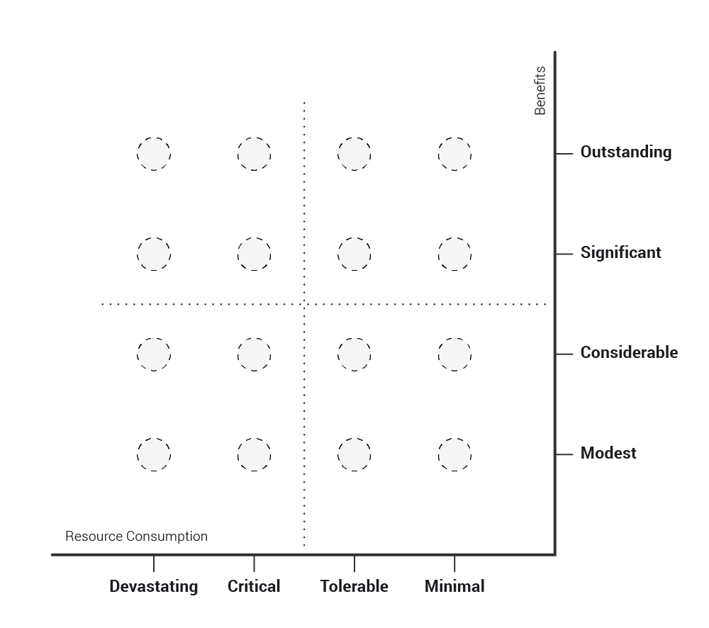
TIM positioning chart

Slide 26
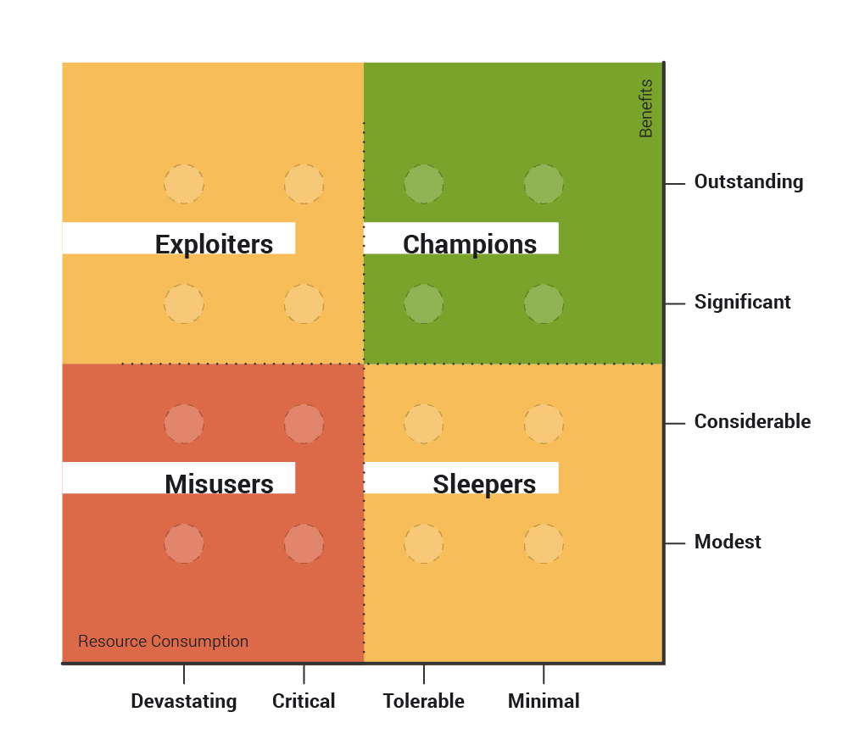
TIM positioning chart

Slide 27
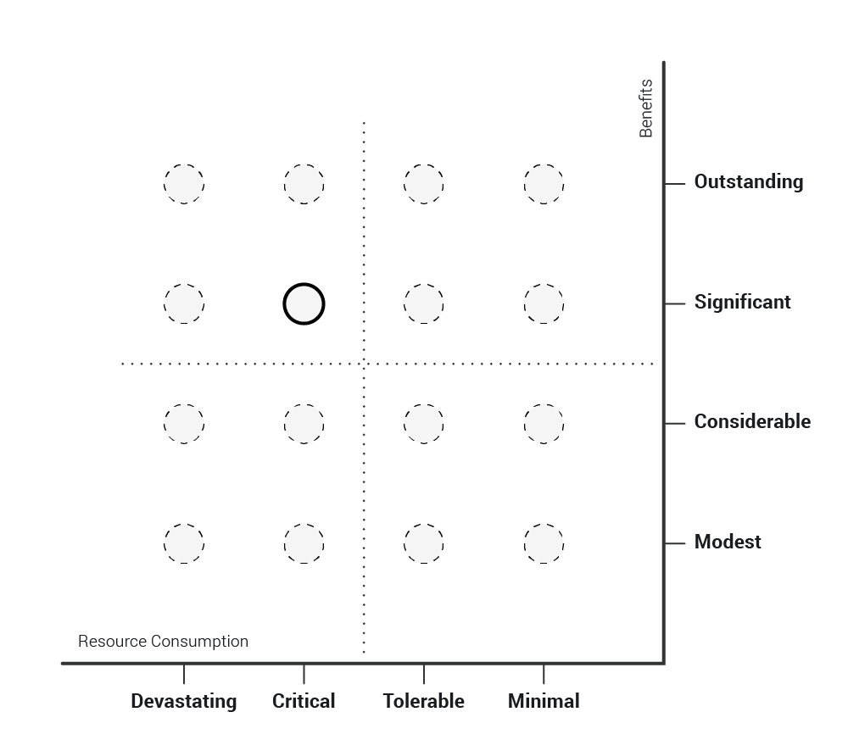
TIM positioning chart

Slide 28
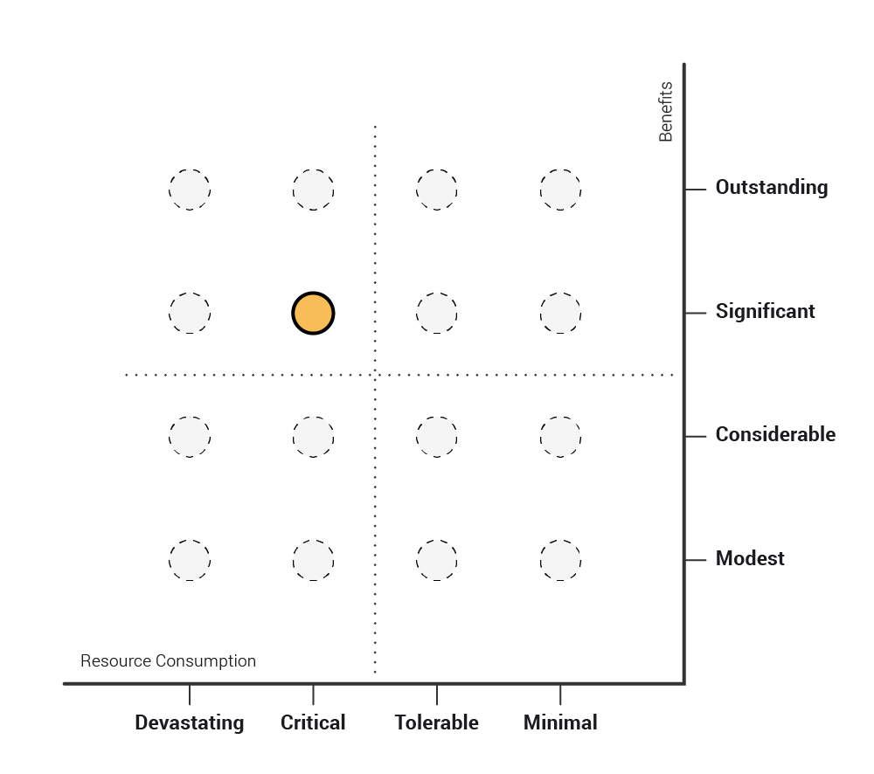
TIM positioning chart
Colour of the circle presents the general condition of the location:
red - poor,
orange - mediocre,
green - great.

Slide 29
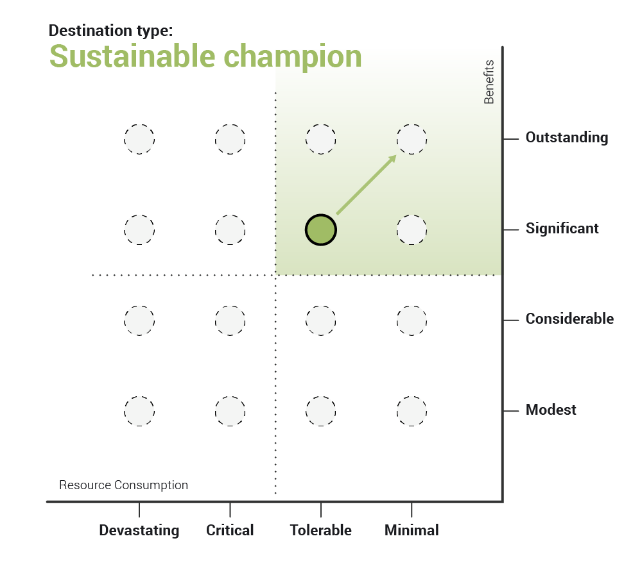
TIM positioning chart
Final result

Slide 30
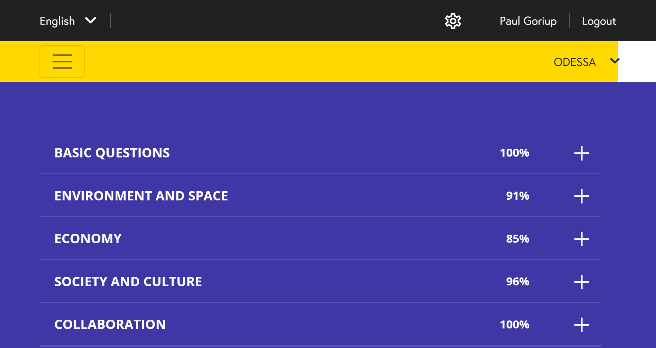

Slide 31
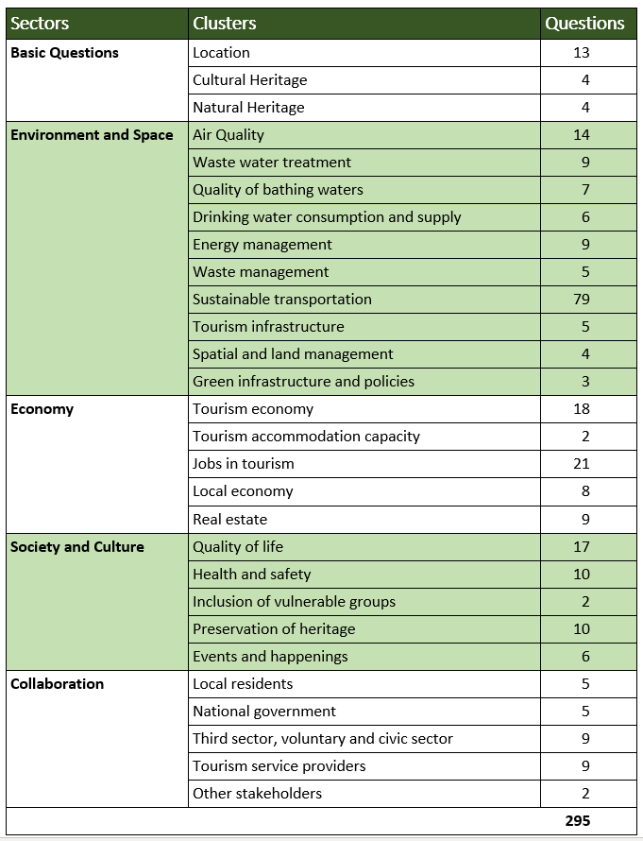

Slide 32
Odesa Data Providers
Department of Culture and Tourism
Department of Architecture and Urban Planning
Department of Ecology and Development of Recreational Areas
Department of Economic Development
Department of Municipal Economy
Department of Transport, Communications and Traffic Management
Division of Land Resources of the Department of Communal Property
Municipal Enterprise "Odessa International Airport"
Odessa Seaport

Slide 33
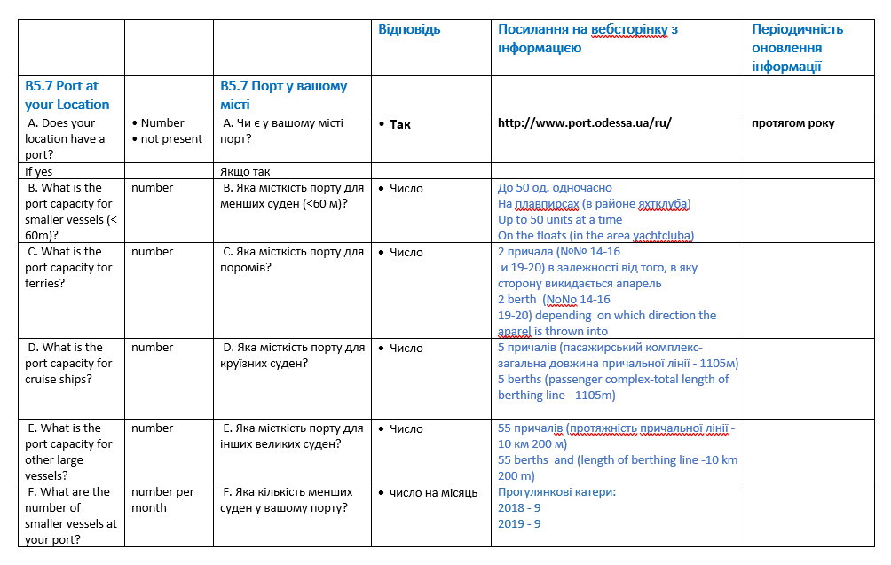

Slide 34
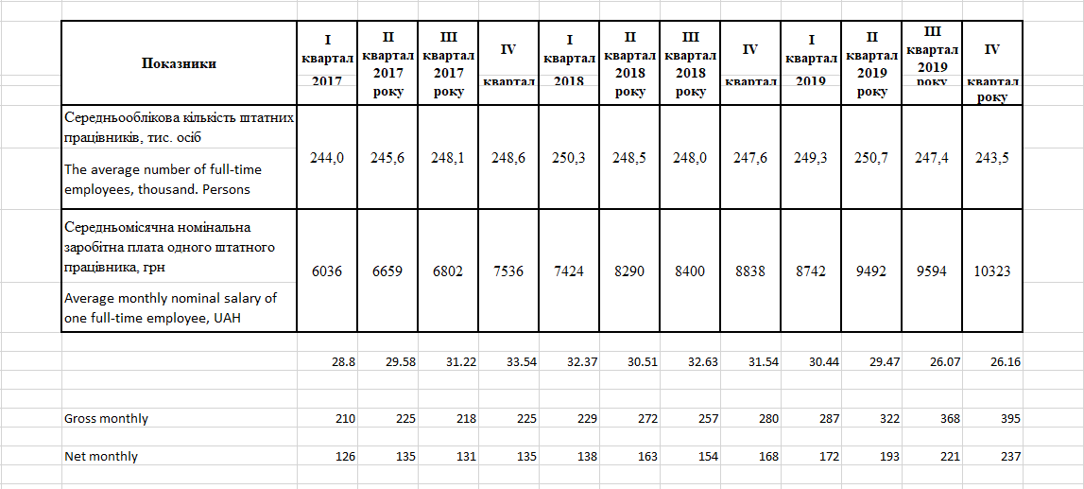

Slide 35
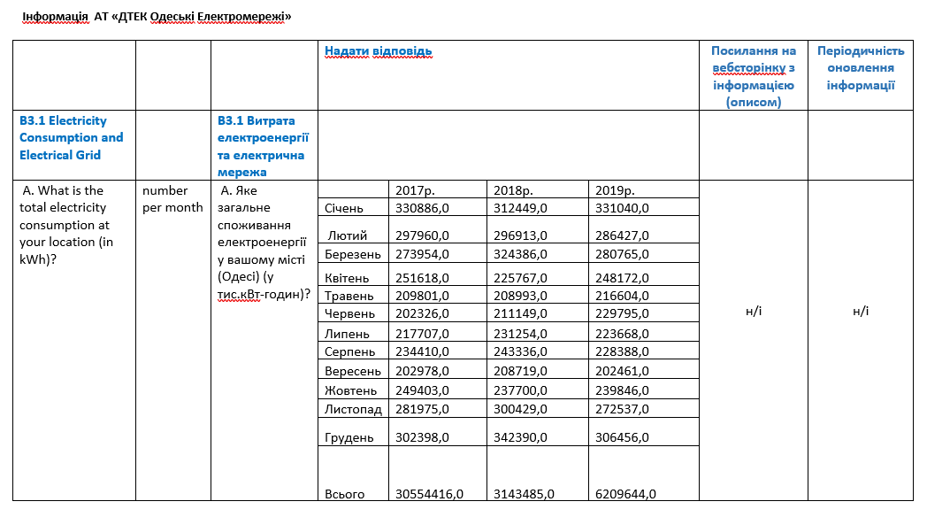

Slide 36
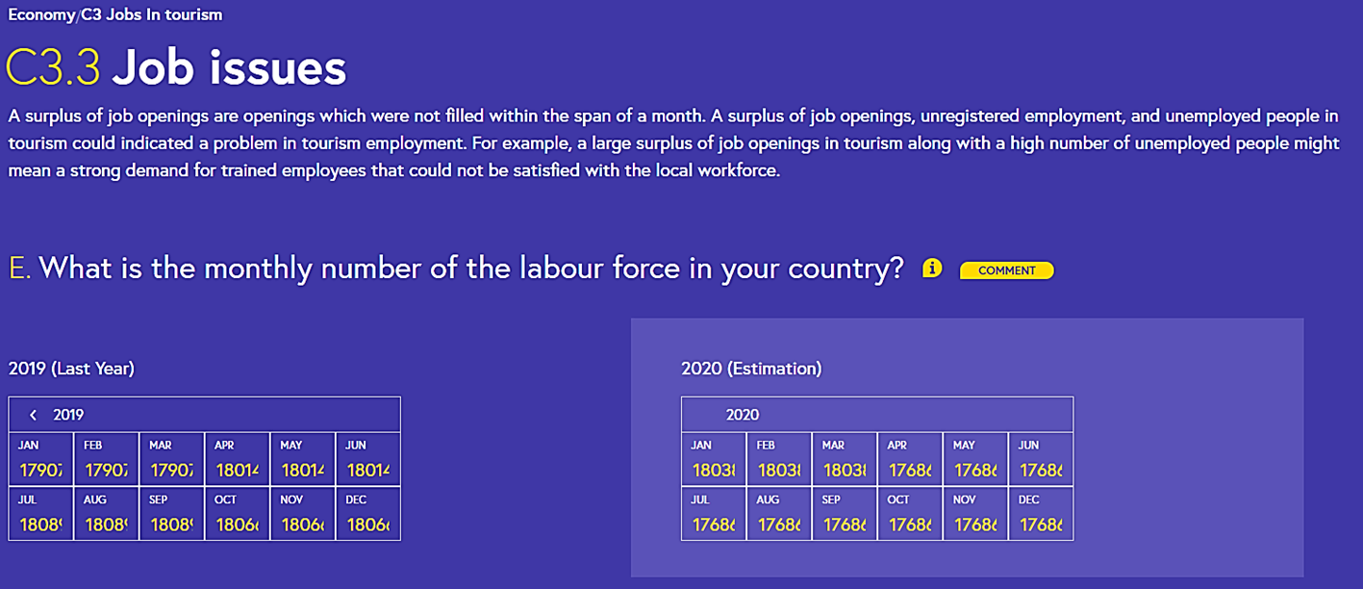

Slide 37
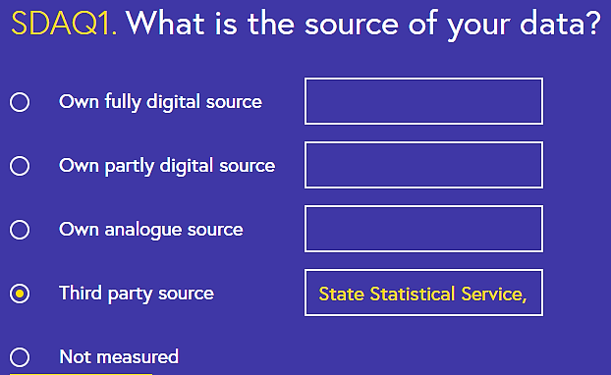
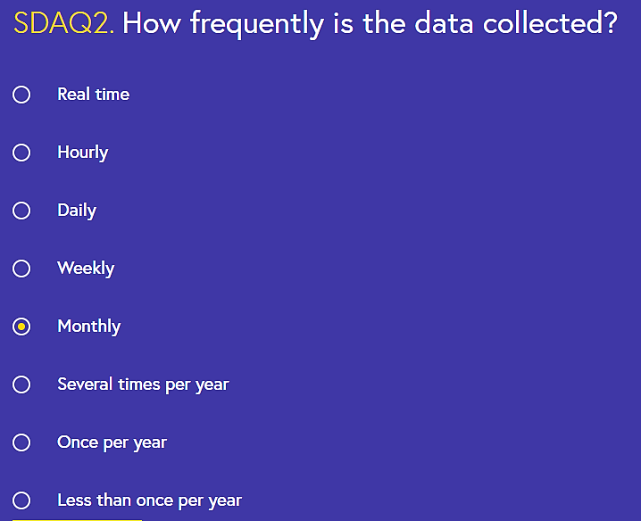
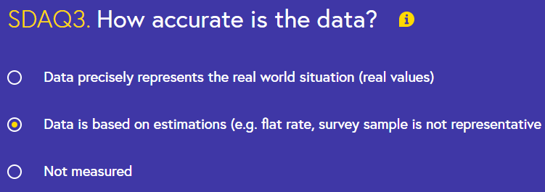

Slide 38
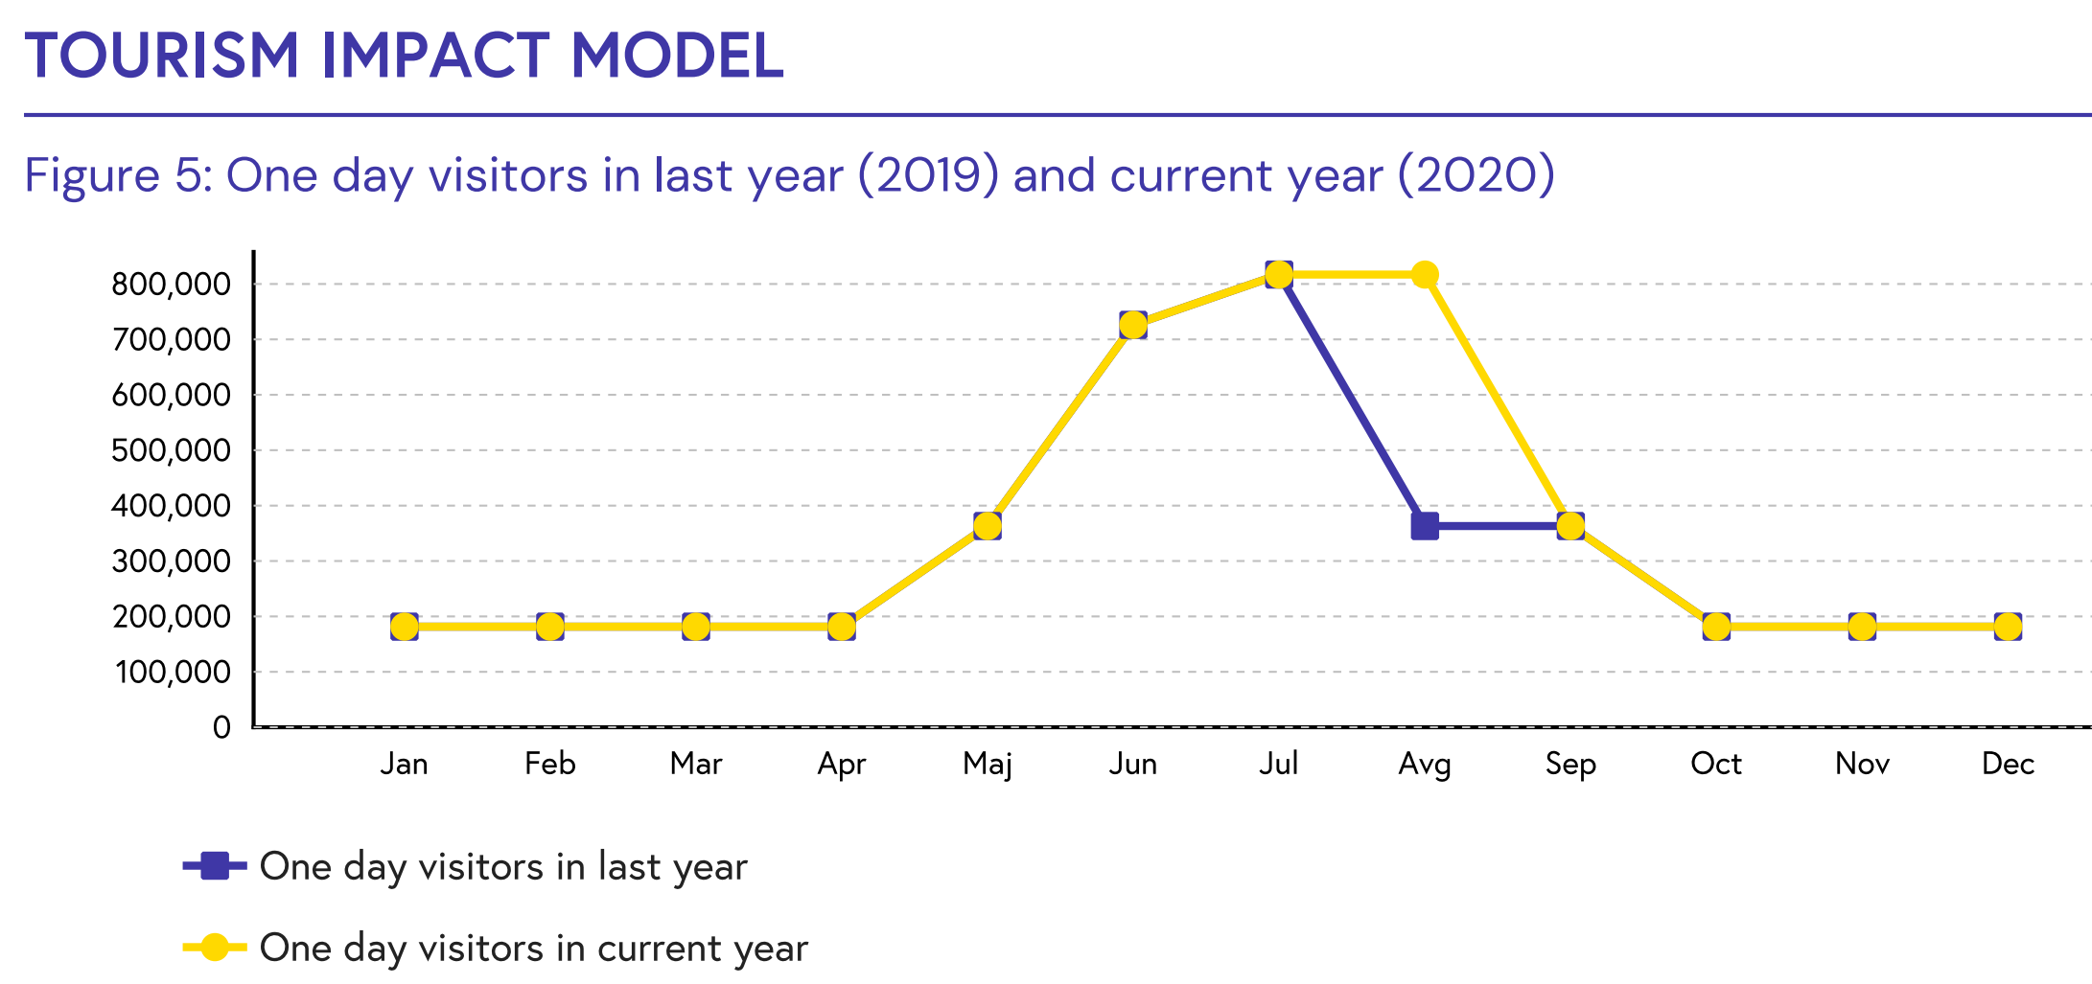
Annual visitor days

Slide 39
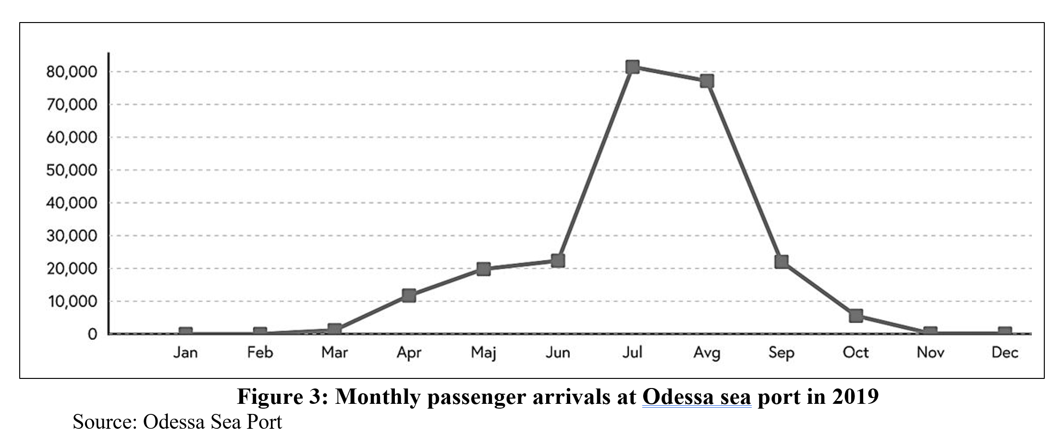
Passenger arrivals at Odesa sea port

Slide 40
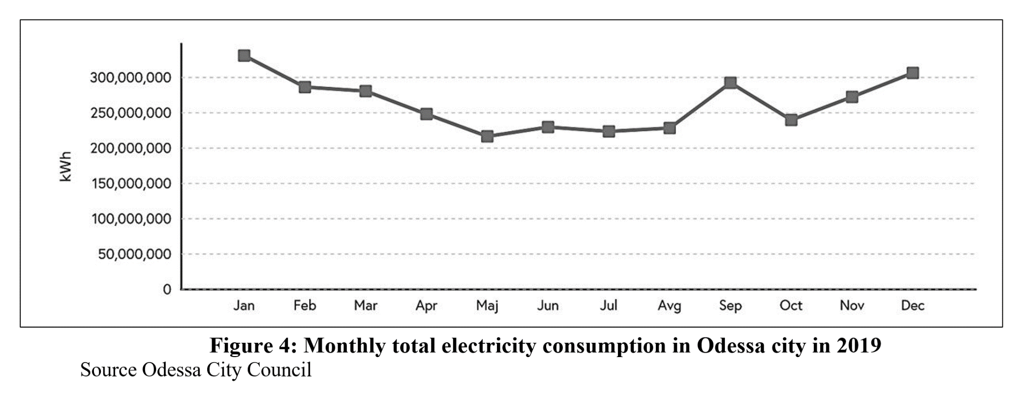
Monthly electricity consumption

Slide 41
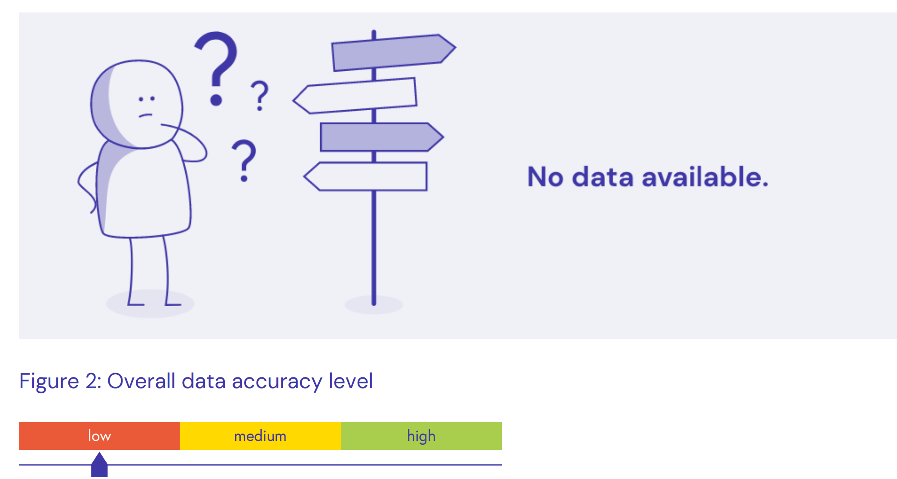
Overall result

Slide 42
Conclusions
The current implementation of TIM was not very successful in Odesa as it requires data that is locally not collected, too incomplete or inaccessible so that only partial results could be obtained. There needs to be a big improvement in tourism digitalisation locally, but also more flexibility incorporated in TIM to cope with missing data and ability to detect the “real signal” of tourism impact in destinations with large populations and diverse economic sectors.
The big data analytics case study proved more valuable for the Odesa Department of Culture and Tourism in the short term. The development of customer-led tourism big data dashboards would be a useful means for improving tourism planning in many destinations.
Local stakeholders were broadly engaged with the project and appreciated the significance of Tourism 4.0 approaches in achieving more sustainable tourism outcomes.

Slide 43
Paul Goriup
NGO Agricola, Odesa, Ukraine

