Slide 1
Innovation on the field from invention to innovation
Simon Mokorel

Slide 2
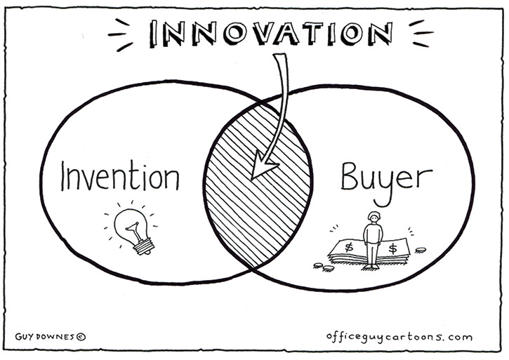
iNVENTION <-> bUYER
An invention is a novel and innovative creation, process, product, or idea that is the result of human ingenuity and problem-solving. Inventions are typically characterized by their originality and the way they contribute to solving a specific problem, improving an existing technology, or creating something entirely new. Here are some key aspects of inventions:

Slide 3
Novelty: An invention must be new and different from existing solutions or ideas. It introduces something that has not been previously known or used.
Usefulness: Inventions are designed to serve a practical purpose or address a specific need. They are often created to make tasks easier, improve efficiency, enhance quality of life, or provide new capabilities.
Inventorship: Inventors are the individuals or teams who conceive and develop the invention. They are responsible for its creation and are often granted intellectual property rights, such as patents, for their innovations.
Problem-Solving: Many inventions arise from the identification of a problem or a challenge and the development of a creative solution to address it.
kEY ASPECTS OF INVENTIONS:

Slide 4
Intellectual Property: To protect inventors' rights and provide them with exclusive control over their creations, many countries offer legal mechanisms such as patents, copyrights, or trademarks.
Impact: Inventions can have a significant impact on various aspects of society, including technology, healthcare, industry, transportation, communication, and more.
Iterative Process: The process of inventing often involves multiple iterations, refinements, and improvements. Inventors may need to test, prototype, and refine their creations before achieving a final, market-ready product.
Historical Significance: Many inventions throughout history have had profound effects on society, leading to advancements, innovations, and changes in how people live and work.
kEY ASPECTS OF INVENTIONS:

Slide 5
nOTABLE iNVENTIONS tHAT cHANGED tHE wORLD

Slide 6
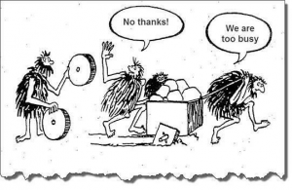
nOTABLE iNVENTIONS tHAT cHANGED tHE wORLD
WHEEL
"The stroke of brilliance was the wheel-and-axle concept,"

Slide 7
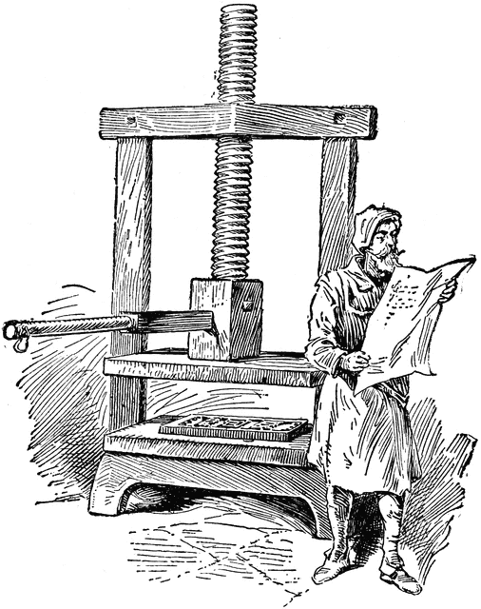
nOTABLE iNVENTIONS tHAT cHANGED tHE wORLD
PRINTING PRESS
German inventor Johannes Gutenberg invented the printing press sometime between 1440 and 1450.

Slide 8
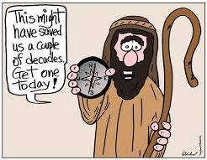
nOTABLE iNVENTIONS tHAT cHANGED tHE wORLD
COMPASS
Ancient mariners used the stars for navigation, but this method didn’t work during the day or on cloudy nights, making it dangerous to travel far from land.

Slide 9
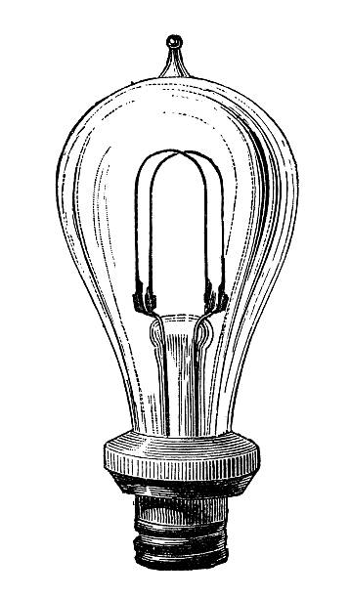
nOTABLE iNVENTIONS tHAT cHANGED tHE wORLD
LIGHT bULB
The invention of the light bulb transformed our world by removing our dependence on natural light, allowing us to be productive at any time, day or night.

Slide 10
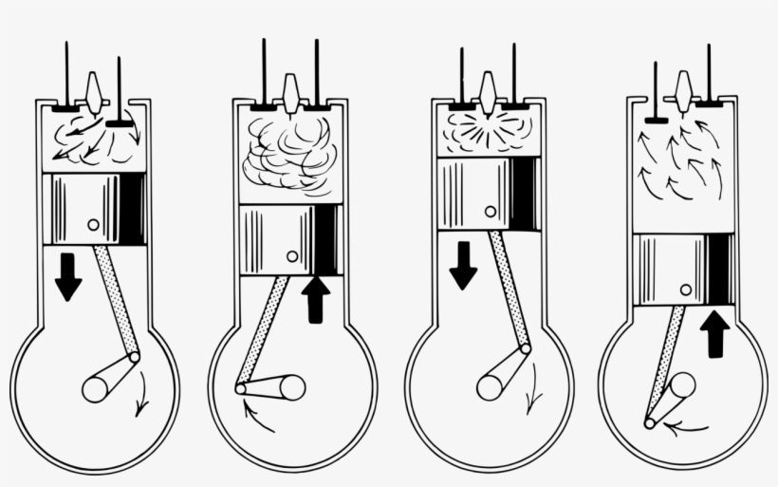
nOTABLE iNVENTIONS tHAT cHANGED tHE wORLD
INTERNAL COMBUSTION ENGINE
In these engines, the combustion of fuel releases a high-temperature gas, which, as it expands, applies a force to a piston, moving it.

Slide 11
nOTABLE iNVENTIONS tHAT cHANGED tHE wORLD
AND MANY OTHERS
PENICILLIN
TELEPHONE
INTERNET
NAILS
USE OF FIRE
CONCRETE
MAGNIFYING GLASS
BATTERIES
AIRPLANE
REFRIGERATOR
NUCLEAR ENEGY
VACCINES
X- RAYS

Slide 12
nOTABLE iNVENTIONS tHAT cHANGED tHE wORLD
DANGERES TO HEALTH OR ENVIRNOMENT
LEAD IN GASOLINE
PRO
The world started adding lead to gasoline in the 1920s. The reason was that it is an 'antiknock agent' which improved the efficiency of vehicles and the performance of the engine. It turned clunky engines into smoothly running engines.
CONS
Leaded petrol has caused more exposure to lead than any other source worldwide. By contaminating air, dust, soil, drinking- water and food crops, it has caused harmfully high human blood lead levels around the world, especially in children.

Slide 13
nOTABLE iNVENTIONS tHAT cHANGED tHE wORLD
DANGERES TO HEALTH OR ENVIRNOMENT
CFC
PRO
Chlorofluorocarbons (CFCs) are nontoxic, nonflammable chemicals containing atoms of carbon, chlorine, and fluorine. They are used in the manufacture of aerosol sprays, blowing agents for foams and packing materials, as solvents, and as refrigerants.
CONS
Chlorofluorocarbons (CFCs), contain chlorine atoms. Releasing chlorine atoms into the atmosphere destroys ozone. A single chlorine atom can destroy thousands of ozone molecules.
The ozone layer in the stratosphere absorbs a portion of the radiation from the sun, preventing it from reaching the planet's surface. Most importantly, it absorbs the portion of UV light called UVB. UVB is a kind of ultraviolet light from the sun (and sun lamps) that has several harmful effects.

Slide 14
iNTRODUCTION ON INNOVATION
Innovation can be defined as the process of creating and implementing new ideas, products, services, or processes that bring about significant improvement, change, or value.
Innovation is driven by users problems/chalanges and by invetions
Innovations have a positive impact on societry, envirnoment, business, ….

Slide 15
Why we innovate, why the innovation is important?
tECHNOLOGY: Innovation drives advancements in technology, leading to groundbreaking inventions and transformative changes in how we live, work, and communicate. I1.0 to I4.0 (I5.0)
hEALTHCARE: Innovation in healthcare plays a vital role in improving patient outcomes, enhancing diagnostics and treatments, and addressing complex medical challenges.
eNVIRONMENT: Innovation is critical for addressing environmental challenges and achieving sustainability.
sOCIAL eNTREPRENEURSHIP: Innovation in social entrepreneurship combines business principles with a focus on creating positive FINANCIAL impact.

Slide 16
Cases of innovations
Mobile Banking and Digital Payments
3D Printing
Renewable Energy Technologies
Telemedicine
Social Media and Online Networking
Electric Vehicles
Precision Agriculture
Assistive Technologies
Online Learning Platforms
Water Purification Technologies
Blockchain Technology

Slide 17
Invetions:
Internet
Big data
Money
Buyers:
Ease of use
Quick translactions
Control ower my money
Mobile banking and payments

Slide 18
Invetions:
New materials
new injection molding technologies
Buyers:
Precise protoype of idea
Quick test on the market
3D printing

Slide 19
Invetions:
Internet
Technology that brings data in every house
Buyers:
Noumerous posibility of courses
Learn from home whenever you want
Online Learning Platforms

Slide 20
ARTTHINKING
I
DESIGN THINKING
I
PROTOTYPING
I
BUSINESS PLAN
The innovation process

Slide 21
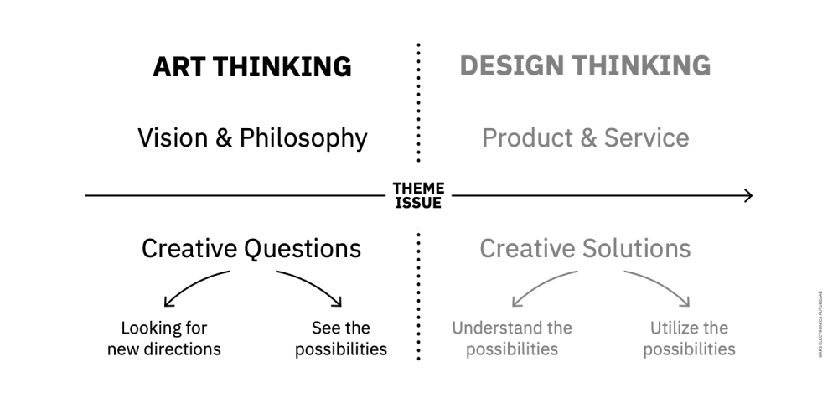
aRT tHINKING
Generating a wide range of ideas without judgment.
dESIGN tHINKING
Generating a business proof of an idea.

Slide 22
aRT tHINKING
Generating a wide range of ideas without judgment.
A lot of cars in town:
Ordinary thinking: more slots for cars
Art Thinking: less cars
dESIGN tHINKING
Generating a business proof of an idea.
A lot of cars in town:
Ordinary thinking: building new car garages
Art Thinking: building green areas instead of park slots and set up a good public transport

Slide 23
Bussines plan

Slide 24
Thank you!
Simon.mokorel@rra-sp.si

