Slide 1

Social and environmental value assessment of AI/ML technologies
Brigita Jurisic
International Iberian Nanotechnology Laboratory
Braga, Portugal
Notes:
Why this lecture? What are your expectations? (Gather inputs from attendees on what it means to assess social and environmental value of technology in general, and what it means in AI/ML tech.)
Ethics review form filling in best practice.
As humans, we are very good at innovating. We have a history of deploying new technology a long time before we fully comprehend how it can affect our physical and mental well-being and the society in which we live.
Emerging technologies generate new challenges for which we have no established and accepted ethical standards and no metrics for assessing their impact. As a consequence, we must not only attempt to assess the potential impacts, but we may also have to develop new normative ethical standards.

Slide 2
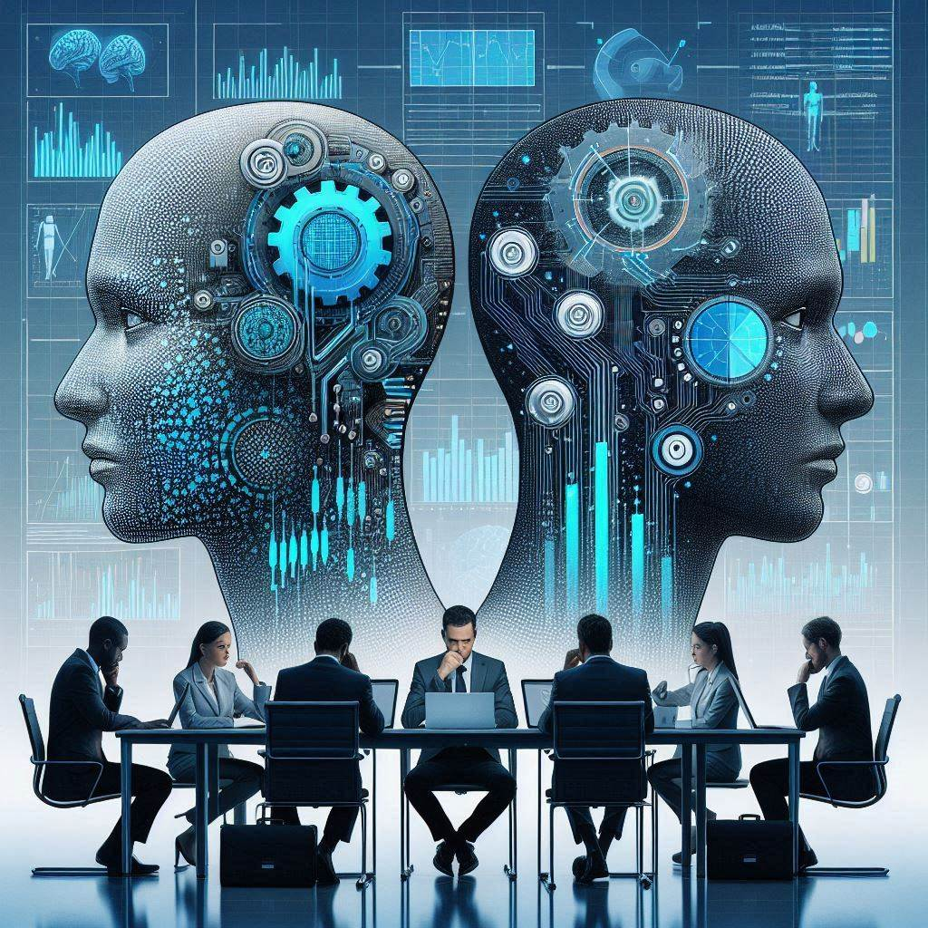
What will we cover?
INL & the FORGING project
Responsible Research and Innovation
Ethics, morals, laws and values
Ethics of AI & ML technologies
4.1 Privacy and data protection
4.2 Fairness and bias
4.3 Role of human judgement
5. Guidelines, policy and legal frameworks

Slide 3
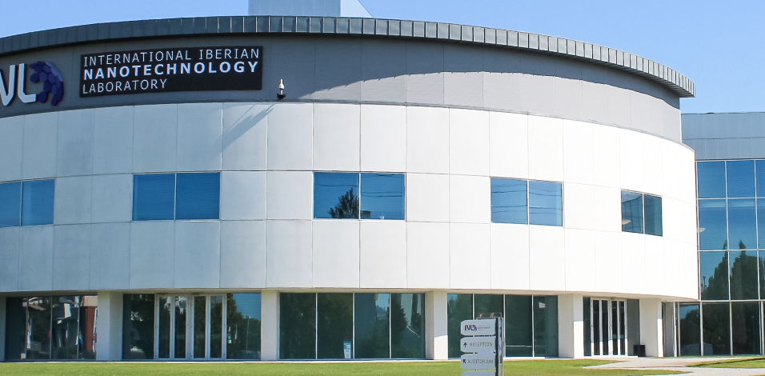
Notes:
Brief introduction on INL: INL is an international organization performing interdisciplinary research, deploying and articulating nanotechnology, for the benefit of society. Aligned with INL´s purpose is FORGING project, a 3-year CSA INL is coordinating looking at responsible innovations for digital and green transition.

Slide 4


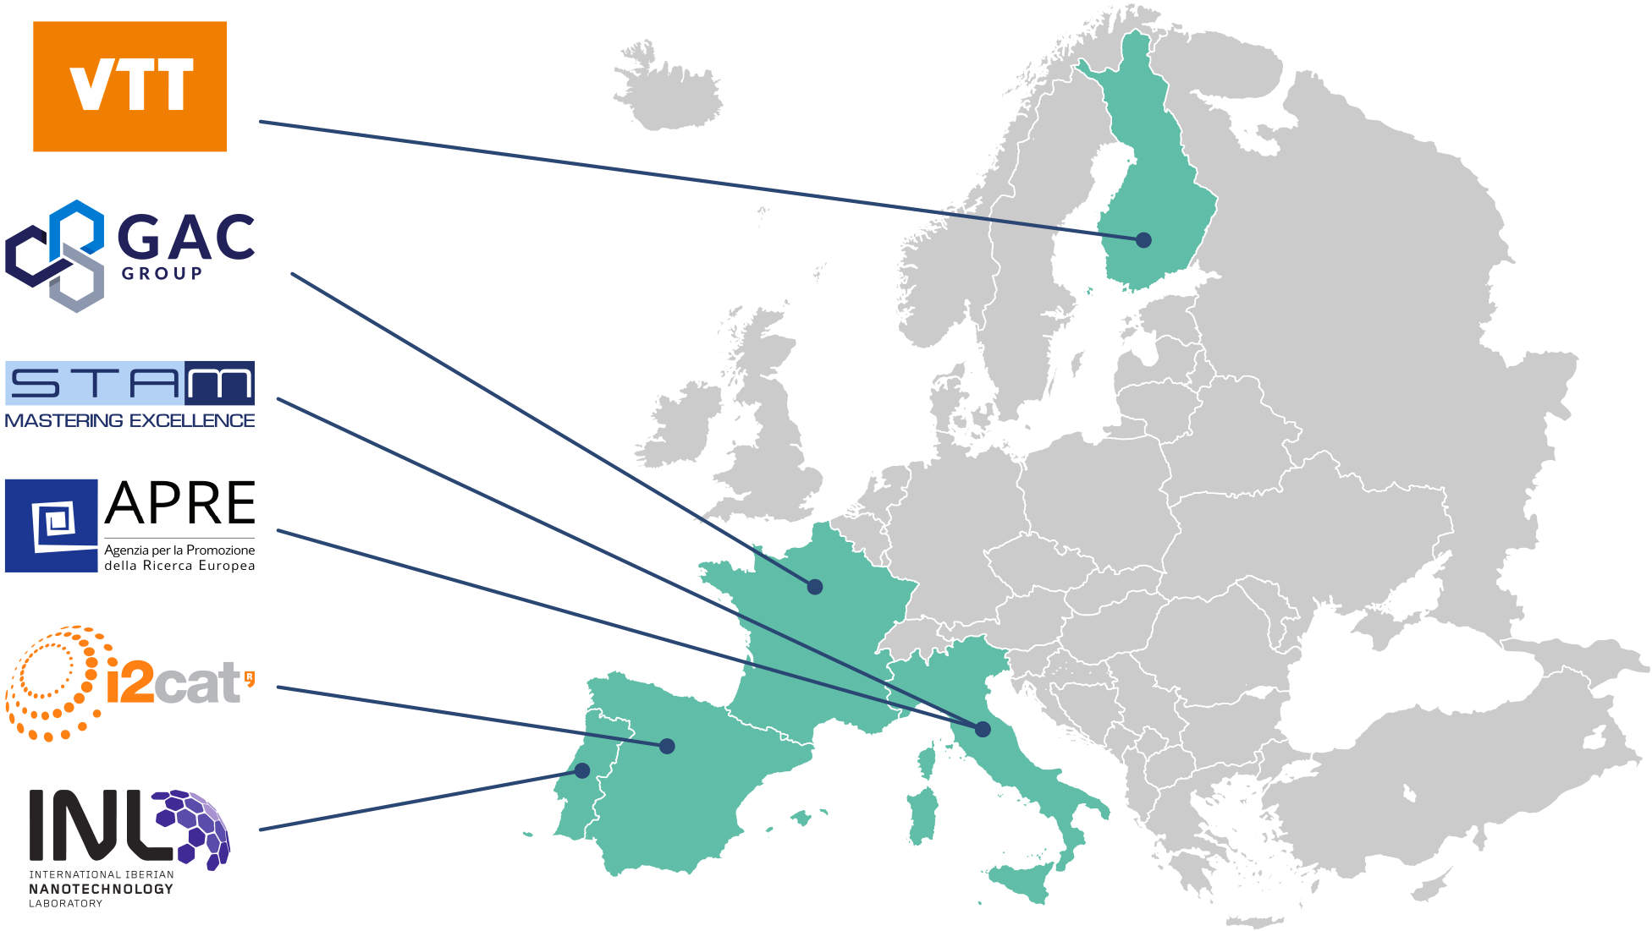
Responsible innovation for digital and green transition
Build the bridge between research and industry
Enable cross-sectorial thinking
Use foresight as a creativity enabling tool
Notes:
Join the FORGING FORUM:
https://forms.office.com/r/VeXUAdhjhE

Slide 5







Society is facing many challenges today…
Health, demographic change, and wellbeing
Food, agriculture and forestry, and water
Secure, clean and efficient energy
Smart, green and integrated transport
Climate action, environment, and resources
Europe in a changing world: inclusive, innovative and reflective societies
Secure societies: freedom and security of Europe and its citizens
Responsible Research and Innovation tackles these challenges by aligning values, needs and expectations of all actors involved in Research and Innovation
Notes:
Why Responsible Research & Innovation?

Slide 6






And there is also a large consensus that changes
are needed throughout the R&I system
Certain key issues (or policy agendas) need to be taken into account:
ETHICS
Research integrity and ethical acceptability of the R&I outcomes
GENDER EQUALITY
Human resources, decision bodies and research dimension
GOVERNANCE
Structural changes to include all these issues in the R&I system
OPEN ACCESS
To results from publicly funded research, privacy issues and even more: open science
PUBLIC ENGAGEMENT
Towards a more open and inclusive R&I
SCIENCE EDUCATION
Provide competences for the responsible citizens society needs
Notes:
Within the R&I system there have been examples of controversies and failures in fulfilling societal expectations such as food safety, GMOs, affordable medication… in part because not all key actors (policy makers, research community, education community, business & industry, civil society organisations) were engaged.

Slide 7
Therefore more complex and multifaceted societies demand
more democracy in science and more science in democracy
Ensure R&I addresses societal challenges
Responsible Research & Innovation is a new governance and values framework to build a new path where these requests can blossom
RRI
Open R&I to
all actors and
at all levels
Align R&I with societal values, needs and expectations

Slide 8













The RRI Toolkit: A wealth of resources
to help you implement RRI
TOOLS
Use manuals, guidelines, and ‘how tos’ to implement RRI.
HOW TOs
Get concrete examples on how to put RRI into practice in different contexts.
HOW TOs
Get concrete examples on how to put RRI into practice in different contexts.
INSPIRING PRACTICES
Find inspiration in RRI success stories across Europe.
SELF-REFLECTION TOOL
Reflect on how RRI your own professional practice is.
SELF-REFLECTION TOOL
Reflect on how RRI your own professional practice is.
PROJECTS
Get to know other projects on RRI and find potential partners.
TRAINING MATERIALS
Organise trainings in RRI using showcases and presentations.
TRAINING MATERIALS
Organise trainings in RRI using showcases and presentations.
LIBRARY
Learn of RRI from articles, reports, cross-analyses, and more.
COMMUNICATION MATERIALS
Spread the word on RRI with videos and presentations.
COMMUNICATION MATERIALS
Spread the word on RRI with videos and presentations.
Notes:
https://rri-tools.eu/
Responsible Research & Innovation: The developing role of interdisciplinarity
02-Literature-Briefs_Interdisciplinarity-and-RRI.pdf (sshcentre.eu)

Slide 9
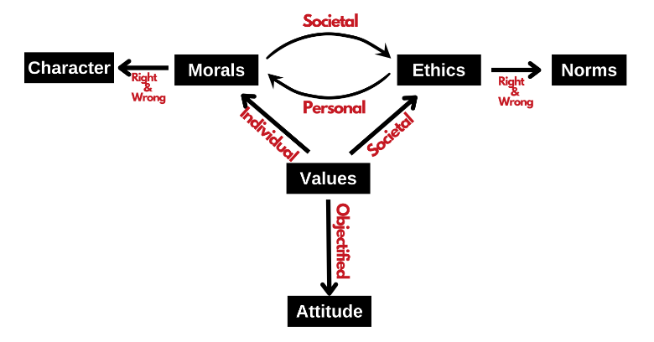
Ethics, Morals, Laws and Values
Reason
Dignity
Responsibility
Freedom
Action
Civilization
Continuous development
Democracy
Human-technology co-evolution
Transformation
Participation
Protection of future generations
Values, Ethics, Morals and Attitude - civilspedia.com
Notes:
Values, Ethics, Morals and Attitude - civilspedia.com
To define the values of humanism (and transfer them to digital humanism) we look
into those definitions and fundamental concepts – reason, dignity, responsibility, freedom, and action. As to
“digital humanism” – for example, in the Vienna Manifesto on Digital Humanism or the edited volume “Perspectives
on Digital Humanism” (Werthner, Prem, Lee & Ghezzi, 2022), we see further values emerging – civilisation,
continuous development, democracy, human-technology co-evolution, transformation, participation, protection of
future generations, etc.
Ethics, morals, and laws are essentially concepts and beliefs of what constitutes right and wrong behavior.

Slide 10

Ethics and AI/ML technologies
Three Laws of Robotics
1. May not injure a human being, or, through inaction, allow a human being to come to harm.
2. Must obey the orders given by human beings, except where such orders would conflict with the First Law.
3. Must protect their own existence, as long as such protection does not conflict with the First or Second Law.
©Bronasbooks.com
Notes:
In the 1940s, American science fiction author Isaac Asimov developed the “Three Laws of Robotics,” in which he argued that intelligent robots should be programmed ethically so that they:…
“AI presents three major areas of ethical concern for society: privacy and surveillance, bias and discrimination, and perhaps the deepest, most difficult philosophical question of the era, the role of human judgment.”
Michael Sandel, a political philosopher and a Harvard University Professor of Government
Bicentennial Man (1999) – IMDb with Robin Williams
Asimov, I., The Bicentennial Man. Philosophy and Science Fiction (Philips, M., ed), pp. 183-216, Prometheus Books, Buffalo, NY, 1984.

Slide 11
Major ethical concerns of AI/ML technologies
Privacy and surveillance
Fairness and bias
Role of human judgement
Notes:
AI as an externalization of human intelligence offers us in amplified form everything that is both moral and ethical, or immoral and unethical.
The Alan Turing Institute described AI ethics as “a set of values, principles, and techniques that employ widely accepted standards of right and wrong to guide moral conduct in the development and use of AI technologies.

Slide 12
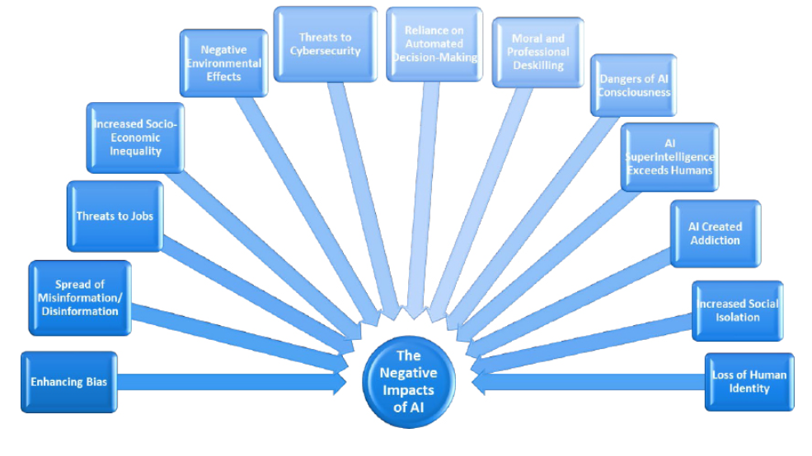
Mehan, Julie (2024). Artificial Intelligence - Ethical, social, and security impacts for the present and the future, Second edition
Notes:
Those ethical concerns stem from the following potential negative impacts of AI. Recognizing that AI systems are built for good, we should be mindful that there may be unintended consequences of the systems developed, once deployed and in use.

Slide 13
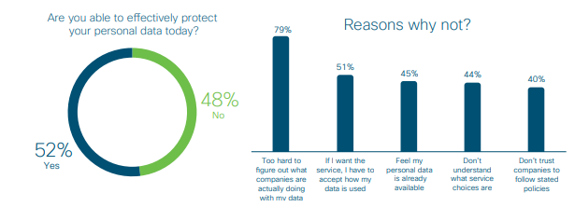
Privacy and Data Protection
Cisco, 2020. Consumer Privacy Survey: Protecting Data Privacy to Maintain Digital Trust
Data privacy - an individual’s right of self-determination regarding when, how, and to what extent personal information about them is collected, shared with, or communicated to others.
Notes:
Cisco’s June 2020 worldwide survey found that just under half of those interviewed felt they were not able to effectively protect their personal data, primarily because it is too hard to figure out how companies and agencies were actually using it. Individuals also resented being asked to accept the terms of use without a choice.
“AI’s ‘transparency paradox’ – while generating more information about AI might create real benefits, it may also create new risks.” Burt, A. (December 13, 2019). The AI Transparency Paradox. Harvard Business Review. Available at https://hbr.org/2019/12/the-ai-transparency-paradox.
AI deals with massive amounts of data, and as a consequence, a breach in an AI could be catastrophic for both business and privacy reasons. This leaves organizations with the problematic decision of deciding if it is more vital to be transparent regarding the use of AI and its algorithms, or to safeguard data.

Slide 14
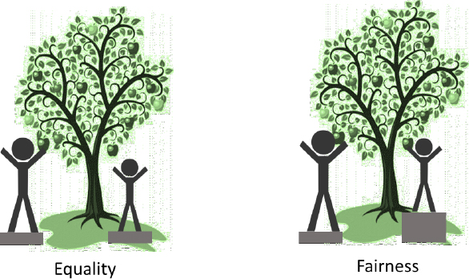
Fairness and bias
Mehan, Julie (2024). Artificial Intelligence - Ethical, social, and security impacts for the present and the future, Second edition
Notes:
- Unconscious bias in human decision-making
- Human and societal biases incorporated in the training data
Although equality might be easier for AI to incorporate, since it’s a simpler A-B decision, fairness is not. When conceptually developing an AI, the different permutations and requirements for fairness are rarely considered. Even if fairness is part of the initial considerations, there is not always a “right” answer for any particular AI system. In addition, various actors are involved in the AI life cycle (from data set identification and collection, development of algorithms, to use of AI systems), all of which might have dissimilar understanding and interpretation of exactly what constitutes fairness and how to achieve it.

Slide 15
Fairness and bias tools
IBM’s AI Fairness 360 Toolkit: a Python toolkit focusing on technical solutions through fairness metrics and algorithms to help users examine, report, and mitigate discrimination and bias in ML models.
Google’s What-If Tool: a tool to explore a models’ performance on a dataset, including examining several preset definitions of fairness constraints (e.g., equality of opportunity).
Microsoft’s fairlean.py: a Python package that implements a variety of algorithms that seek to mitigate “unfairness” in supervised machine learning.
Facebook´s “Fairness Flow” internal tool to identify bias in ML models.
Co-designed AI checklist listing what needs to be considered at different stages of an AI system’s development and deployment life cycle (i.e. envision, define, prototype, build, launch, and evolve)
Notes:
Quantitative and qualitative fairness tools

Slide 16
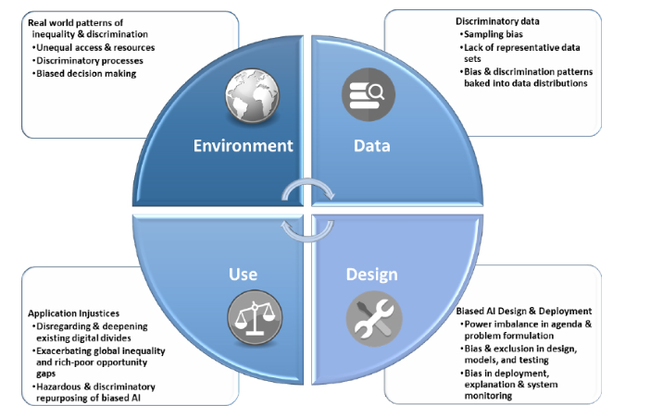
Where does bias come from?
Mehan, Julie (2024). Artificial Intelligence - Ethical, social, and security impacts for the present and the future, Second edition
Notes:
Where does AI/ML bias come from?
Make special comment on the DATA. Data management protocols, sourcing of data, role of AI/ML coder and responsibility for data integrity – messing with one´s data & the model – cyber attacks

Slide 17
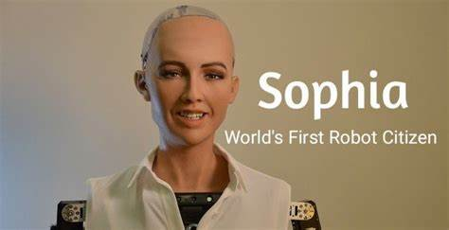
Role of human judgement
Reliance on automated decision making and AI dependency
Job threats and increase in socio-economic inequality
Moral and professional deskilling
Evolution of self-aware AI
Accountability and responsibility
AI as moral agent – artificial moral agents
Notes:
Impact of AI on society and workforce:
Surveillance - Use of AI for workplace monitoring
Evolution of self-aware AI
Loneliness and isolation, AI-created addiction, human identity, sense of purpose
Interview with Floridi, from “The Dissenter”: “#329: Luciano Floridi: Information, Knowledge, Science, and AI”: https://www.youtube.com/watch?v= jgmdEk7rTxU. Floridi discusses his views about artificial moral agents and responsibility just after the 38:03 mark.
Technologies Regarded as Moral Agents – Humanoid robot Sophia (e.g., giving honorary citizenship to the robot, inviting it to appear on talk shows, taking selfie photos with it, or allowing it to speak in front of important political bodies). When Sophia was made into an honorary citizen of Saudi Arabia, for example, this might have seemed to bestow certain rights and some important form of social status onto Sophia, since citizens are typically regarded as having certain rights and an important status.
The ultimate goal of machine ethics … is to create a machine that itself follows an ideal ethical principle or set of principles; that is to say, it is guided by this principle or those principles in decisions it makes about possible courses of action it could take.
(Anderson & Anderson 2007: p. 15)

Slide 18
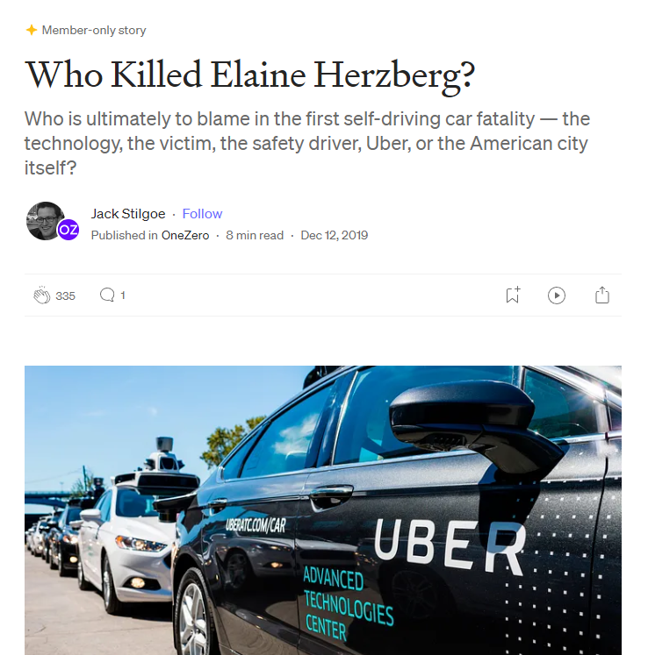
Notes:
What is the role of the coders? What moral obligations do the system’s programmers have to prevent their creation from taking a human life?
Systems can also make errors of judgment when confronted with unfamiliar scenarios.

Slide 19

© Whats-on-Netflix.com
Notes:
Do you know who is this? What does it portray? Can we sum up the three major ethical concerns related to AI&ML technologies within this episode?
Privacy
Bias and fairness – focusing on Joan´s negative traits and exacerbating them
Role of human judgement
The episode explores how technology can distort reality and manipulate perception, raising ethical questions about the boundaries of technological influence.

Slide 20
Ethical approaches
Utilitarian ethics is about maximizing overall happiness, while minimizing overall suffering.
Kantian ethics is about adopting a set of basic principles (“maxims”) fit to serve as universal laws, in accordance with which all are treated as ends‐in‐themselves and never as mere means.
Virtue ethics is about cultivating and then fully realizing a set of basic virtues and excellences.
Confucian ethics is similar to virtue ethics, and also places emphasis on the creation and maintenance of social harmony.
Ubuntu ethics, which we also mentioned above, is about relating to each other in communal ways that allow us to fully realize our humanity.
Nyholm, Sven (2023). This is Technology Ethics: An Introduction, John Wiley & Sons
Notes:
How do we approach this case from ethical perspective?
Ubuntu ethics has increasingly started making a mark within technology ethics. And we will get back to it later in the book when we discuss whether robots could ever have moral rights.
Reflective equilibrium as methodology of philosophers.
Michael Taylor (2016) “Self‐Driving Mercedes‐Benzes Will Prioritize Occupant Safety Over Pedestrians,” Car and Driver: https://www.caranddriver.com/news/a15344706/self‐driving‐mercedes‐will‐prioritize‐occupant‐safety‐over‐pedestrians

Slide 21
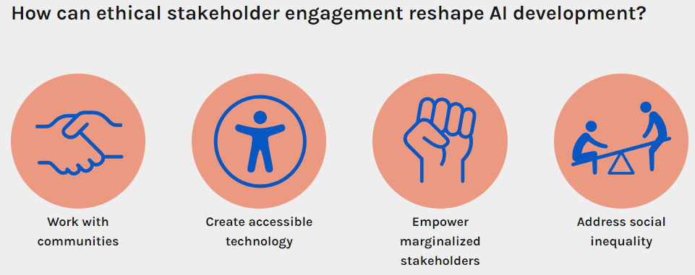
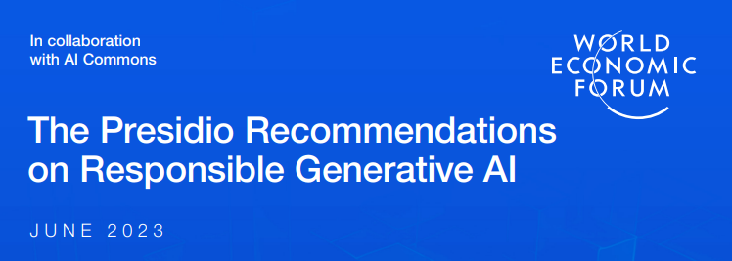
Guidelines, policy and legal frameworks
A European strategy for data | Shaping Europe’s digital future (europa.eu) (2020)
European Declaration on Digital Rights and Principles | Shaping Europe’s digital future (europa.eu) (2022)
The EU’s Digital Services Act (europa.eu) (2022)
Data Act enters into force: what it means for you - European Commission (europa.eu) (2023)
AI Act | Shaping Europe’s digital future (europa.eu) (2024)
Inclusive Research & Design - Partnership on AI
Design of transparent and inclusive AI systems - AI Governance Alliance (weforum.org)
Notes:
The speed of technological development is an order of magnitude greater than the speed of society to cope with these sometimes revolutionary and disrupting changes, resulting in a “policy gap.”
Partnership on AI
Inclusive Research & Design - Partnership on AI
PAI is developing two crucial resources to advance responsible AI development: Inclusive AI Learning Modules and Inclusive AI Guidelines. These initiatives, set to release in 2024, aim to bridge the gap between community aspirations and industry realities in AI development.

Slide 22
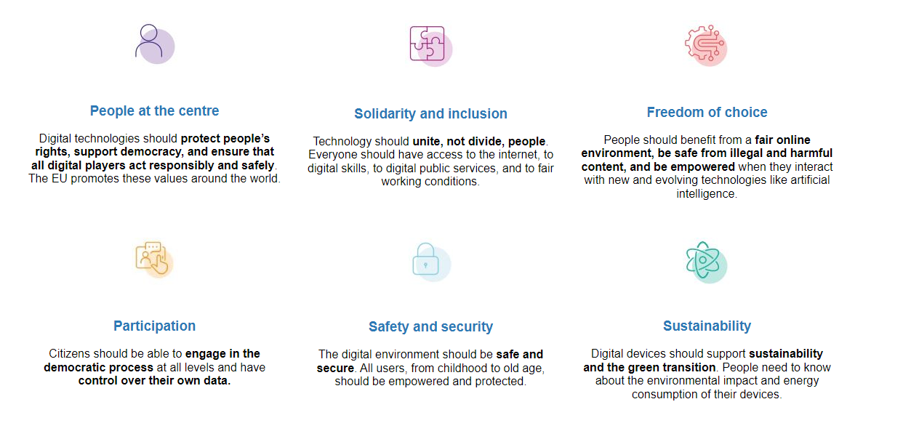
European Digital Rights and Principles
Notes:
The Commission has proposed a Declaration on digital rights and principles for a human-centred digital transformation in January 2022, which was signed in December 2022.
“We aim to promote a European way for the digital transformation, putting people at the centre, built on European values and EU fundamental rights, reaffirming universal human rights, and benefiting all individuals, businesses, and society as a whole.”

Slide 23
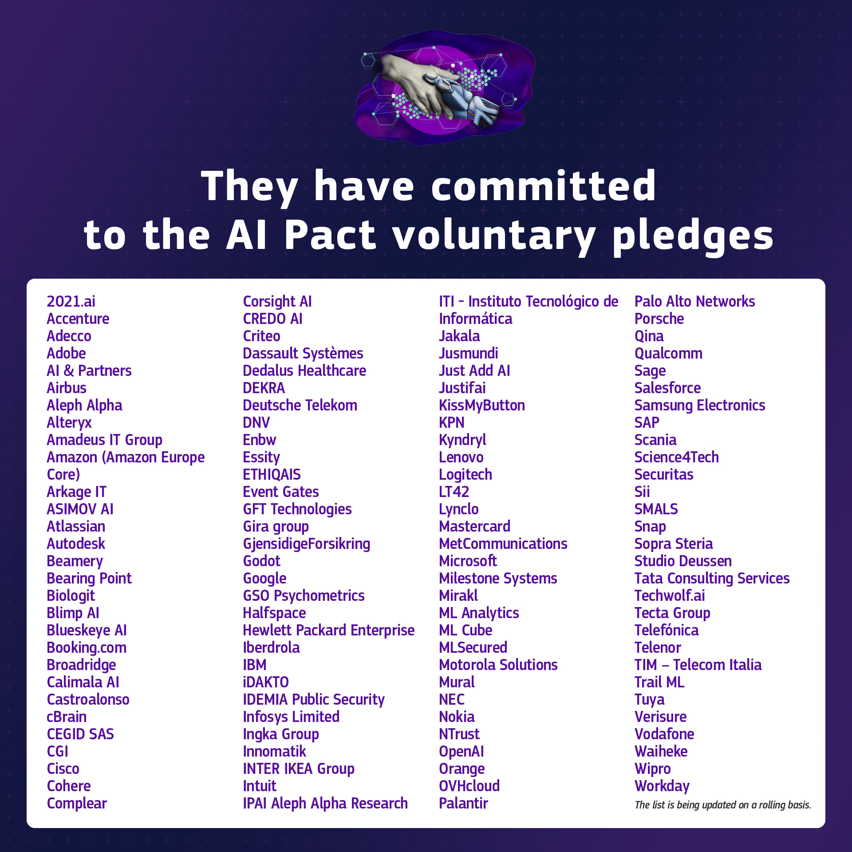
AI Pact
Adopting AI governance strategy
High-risk AI systems 'mapping
Promoting AI literacy
Notes:
114 companies signed
AI Pact https://europa.eu/!kfCcBK

Slide 24

OECD Declaration on a Trusted, Sustainable and Inclusive Digital Future
The Vision for the OECD for the Next Decade, which directs the OECD to support countries in harnessing the potential of digitalisation for economic growth and social inclusion to support open societies in the digital and data driven age and to advance responses to the challenges of digitalisation, including:
guarding against threats to democracy,
digital security and
digital privacy and
combatting disinformation online, as well as to seek initiatives that
enhance and promote data free flow with trust.
Notes:
Documents (oecd-events.org)

Slide 25
Ethics washing
“The Trustworthy AI story is a marketing narrative invented by industry, a bedtime story for tomorrow's customers. The underlying guiding idea of a “trustworthy AI” is, first and foremost, conceptual nonsense. Machines are not trustworthy; only humans can be trustworthy (or untrustworthy).” Metzinger, 2019
Notes:
Metzinger presents his criticisms in his 2019 article “Ethics Washing Made in Europe,” in Der Tagesspiegel, available here: https://www.tagesspiegel.de/politik/eu‐guidelines‐ethics‐washing‐made‐in‐europe/24195496.html
The Alan Turing Institute´s The AI Standards Hub - AI Standards Hub

Slide 26
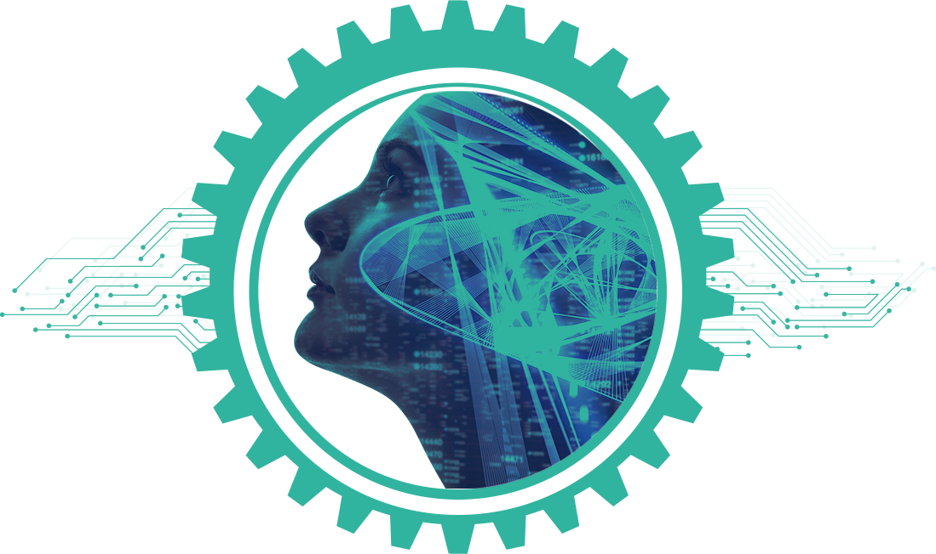
What are the problems AI/ML technologies should solve?
Notes:
Digitalisation and with it AI & ML technologies have profound and transformational implications for our societies and economies, including immense potential to contribute to inclusive economic and social prosperity, well-being and sustainability.
AI/ML technologies have the ability to amplify certain aspects of society – bias, extremist beliefs,… therefore I ask you what are the right problems AI/ML technologies should solve?

Slide 27
For the curious
Werthner, Prem, Lee & Ghezzi (2022). Perspectives on digital humanism Perspectives on Digital Humanism | SpringerLink
Leslie, D. (2019). Understanding artificial intelligence ethics and safety: A guide for the responsible design and implementation of AI systems in the public sector. Zenodo. https://doi.org/10.5281/zenodo.3240529.
WEF global risks report (2023). Available at WEF_Global_Risks_Report_2023.pdf (weforum.org)
Zerilli, J., Knott, A., Maclaurin, J., and Gavaghan, C. (December 11, 2019). Algorithmic Decision-Making and the Control Problem. SpringerLink. Available at https://link.springer.com/article/10.1007/s11023-019-09513-7
Smith, G. (2020). What does “fairness” mean for machine learning systems? Center for Equity, Gender & Leadership (EGAL) at Berkeley Haas. Available at https://haas.berkeley.edu/wp-content/uploads/What-is-fairness_-EGAL2.pdf
Burt, A. (December 13, 2019). The AI Transparency Paradox. Harvard Business Review. Available at https://hbr.org/2019/12/the-ai-transparency-paradox
Zerilli, J., Knott, A., Maclaurin, J., and Gavaghan, C. (December 11, 2019). Algorithmic Decision-Making and the Control Problem. SpringerLink. Available at https://link.springer.com/article/10.1007/s11023-019-09513-7
NSCAI (March 1, 2021). Final Report. National Security Commission on Artificial Intelligence. Available at www.nscai.gov/wp-content/uploads/2021/03/Full-Report-Digital-1.pdf
Moor, J. (1985) What is Computer Ethics? Available at https://web.cs.ucdavis.edu/~rogaway/classes/188/spring06/papers/moor.html
Nyholm, Sven (2023). This is Technology Ethics: An Introduction, John Wiley & Sons
Anderson, M. and Anderson, S.L. (2007). Machine Ethics: Creating an Ethical Intelligent Agent. AI Magazine 28 (4): 15–26
OECD Declaration on a Trusted, Sustainable and Inclusive Digital Future (2022). Available at Documents (oecd-events.org)
Decision - 2022/2481 - EN - EUR-Lex (europa.eu) - Decision (EU) 2022/2481 of the European Parliament and of the Council of 14 December 2022 establishing the Digital Decade Policy Programme 2030
Europe’s digital decade: 2030 targets | European Commission (europa.eu)
European Commission: Directorate-General for Communications Networks, Content and Technology, Study to support the monitoring of the Declaration on Digital Rights and Principles – Final report, Publications Office of the European Union, 2024, https://data.europa.eu/doi/10.2759/875696
EU's high‐level expert group's “Ethics Guidelines for Trustworthy AI” can be downloaded here: https://ec.europa.eu/futurium/en/ai‐alliance‐consultation. 1.html.

Slide 28

Notes:
A little extra: David Dao´s Awful AI list of AI misuses in society can be found here: GitHub - daviddao/awful-ai: 😈Awful AI is a curated list to track current scary usages of AI - hoping to raise awareness

