Slide 1
Coarse reconstruction with iterative refinement network for sparse spatio-temporal satellite data
Matjaž Zupančič Muc¹, Vitjan Zavrtanik¹, Alexander Barth², Aida Alvera-Azcarate², Matjaž Ličer^{3,4} and Matej Kristan¹
¹Faculty of Computer and Information Science, Visual Cognitive Systems Lab, University of Ljubljana, Ljubljana, Slovenia
²Department of Astrophysics, Geophysics and Oceanography, Geohydrodynamics and Environment Research, University of Liège, Liège, Belgium
³Slovenian Environment Agency, Office for Meteorology, Hydrology and Oceanography, Ljubljana, Slovenia
⁴National Institute of Biology, Marine Biology Station, Piran, Slovenia

Slide 2
Sea Surface Temperature (SST)
SST provides fundamental information on the global climate system.
Key applications [1]:
weather forecasting models,
geophysical analysis (e.g., climate and ocean circulation modeling).
[1] https://oceanservice.noaa.gov/facts/sea-surface-temperature.html
Notes:
Sea surface temperature provides fundamental information on the global climate system. It is an important input for weather forecasting models and geophysical analysis.

Slide 3
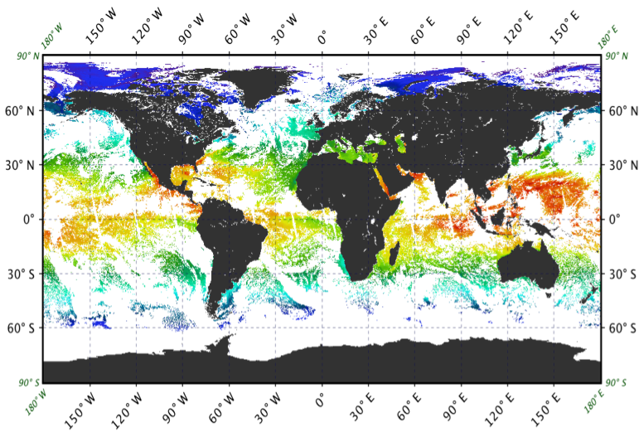
SST acquisition challenges
Measured by (many) moving satellites.
A daily measurement “field” obtained by aggregating all measurements from last 24h.
Challenges:
measurements come in swats,
limited satellite coverage,
sensors cannot penetrate clouds.
Geophysical models require dense fields for subsequent calculation.
Reconstruction methods required!
[2] https://oceancolor.gsfc.nasa.gov/resources/atbd/sst/
Global SST field, with white areas representing missing data [2]
Notes:
SST is measured by many moving satellites. A daily measurement “field” is obtained by aggregating all measurements from the last 24 hours. However the measurement fields are incomplete due to challenges such as swath-based measurements, limited satellite coverage, and cloud obstruction. As a consequence almost all measurement "fields" obtained from satellites are incomplete. For example: the image on the right shows a global SST field. The white areas represent missing data. We can see that the temperature of almost half of the Earth's ocean is unknown. It turns out that geophysical models require dense fields for subsequent calculation, therefore reconstruction methods are required!

Slide 4
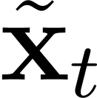
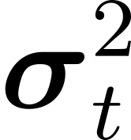
SST reanalysis setup
Objective of reanalysis for SST reconstruction:
Estimate the missing values in image at time t, considering several measured images before and after the image (i.e., off-line setup).
Input:
A sequence of SST fields with missing values.
Output:
Reconstructed central SST field .
Uncertainty estimate .
Notes:
Let's examine the SST reanalysis setup: The goal is to estimate missing values in an image at time step t, considering several measured images from before and after. The input to a reconstruction method is a sequence of SST fields with missing values. As shown in the image below SST fields for three consecutive days, are used as input. The output is the estimated reconstruction of the central SST field, along with its associated uncertainty.

Slide 5
Current state-of-the-art:
Deep-learning-based methods:
DINCAE2 [3] (UNet [5] architecture),
MAESSTRO [4] (MAE [6] architecture).
Limitations of existing methods:
Their finite receptive field limits long-range spatio-temporal dependency exploitation, potentially compromising reconstruction accuracy.
Reconstructions lack high-frequency components that are essential for downstream geophysical models, and analysis.
[3] Alexander Barth et al. (2022) DINCAE 2.0: multivariate convolutional neural network with error estimates to reconstruct sea surface temperature satellite and altimetry observations. Geoscientific Model Development, 15(5), 2183-2196.
[4] Edwin Goh et al. “MAESSTRO: Masked Autoencoders for Sea Surface Temperature Reconstruction under Occlusion”. In: EGUsphere 2023 (2023), pp. 1–20.
[5] Olaf Ronneberger, Philipp Fischer, and Thomas Brox. “U-net: Convolutional networks for biomedical image segmentation”. In: Medical image computing and computer-assisted
intervention–MICCAI 2015: 18th international conference, Munich, Germany, October 5-9, 2015, proceedings, part III 18. Springer. 2015, pp. 234–241.]
[6] Kaiming He et al. “Masked autoencoders are scalable vision learners”. In: Proceedings of the IEEE/CVF conference on computer vision and pattern recognition. 2022, pp. 16000–16009.
Notes:
Current state-of-the-art approaches rely on deep learning, including DINCAE2 and MAESSTRO. However, these approaches have several limitations: (1) Their finite receptive field restricts the exploitation of long-range spatio-temporal dependencies, potentially compromising reconstruction accuracy, (2) Reconstructions often lack fine-grained details, which are essential for downstream geophysical models and analysis. The figure below illustrates the limitations of the DINCAE2 method. The first column shows an input with simulated missing values, the second column shows the ground truth SST field, and the third column shows the reconstruction. If we focus on the region within the red square, we can see that the model failed to to reconstruct the fine-grained details of missing values. Additionally, if we focus on the yellow region, we can see that the model smooths out the observed measurements, instead of preserving them.

Slide 6
Motivation for two-stage reconstruction methods
Current Approaches [3, 4]: A Single-Stage Reconstruction:
Overview: Input observations are mapped to full reconstruction in a single step.
Key limitation: The single step estimate focuses on minimizing the most prominent error, which is primarily due to low-frequency components of the target!
Our Approach: A Two-Stage Reconstruction
Key-idea:
A network trained to predict an initial (coarse) reconstruction.
A second network trained to predict the residual of the target signal (i.e., the part of the signal not captured by the initial estimate).
The final output is obtained by combining the initial estimate and the residual.
Key Advantage: The residual network focuses on minimizing the residual error, which primarily consists of high-frequency components of the target!
[3] Alexander Barth et al. (2022) DINCAE 2.0: multivariate convolutional neural network with error estimates to reconstruct sea surface temperature satellite and altimetry observations. Geoscientific Model Development, 15(5), 2183-2196.
[4] Edwin Goh et al. “MAESSTRO: Masked Autoencoders for Sea Surface Temperature Reconstruction under Occlusion”. In: EGUsphere 2023 (2023), pp. 1–20.
Notes:
Current methods use a single-stage approach, where input observations are directly mapped to a full reconstruction in one step. This approach prioritizes minimizing the most prominent error, which is typically dominated by low-frequency components of the target. As a result, the reconstruction may not accurately capture high-frequency details.
In contrast, our method uses a two-stage approach, which leverages the strengths of each stage to improve overall performance. The key idea is as follows:
Initial Estimate: A pre-trained network generates an initial estimate of the reconstruction.
Residual Estimation: A second network, trained to predict the residual of the target signal, focuses on estimating the high-frequency components that were not well captured in the initial estimate.
Final Output: The final reconstruction is obtained by combining the initial estimate and the residual.
The two-stage approach offers a significant advantage: by dedicating the second network to estimating residual information, we can effectively capture high-frequency components that may be lost in the initial reconstruction. This leads to a more accurate and detailed reconstruction.

Slide 7
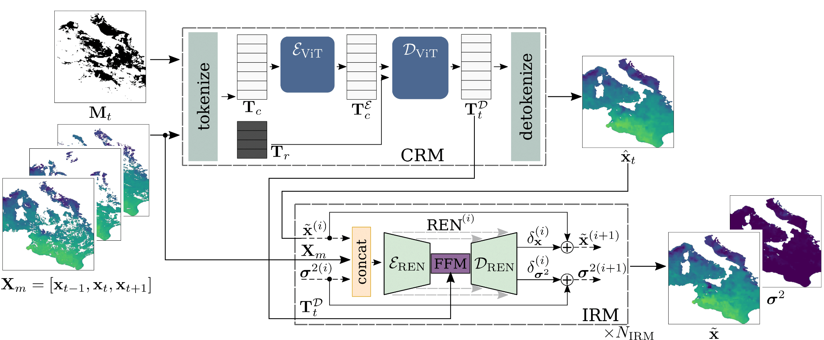
Our approach: Coarse Reconstruction with ITerative Refinement network (CRITER)
A two-stage method:
Coarse Reconstruction Module (CRM): Estimates low-frequency components.
Iterative Refinement Module (IRM): Recovers high-frequency content.
Notes:
To address the limitations of existing methods, we propose CRITER, a two-stage model that consists of:
A Coarse Reconstruction Module (CRM), which estimates the low-frequency components.
An Iterative Refinement Module (IRM), which aims to recover the high-frequency content by refining the initial CRM estimate.

Slide 8
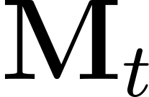
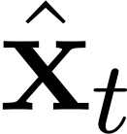
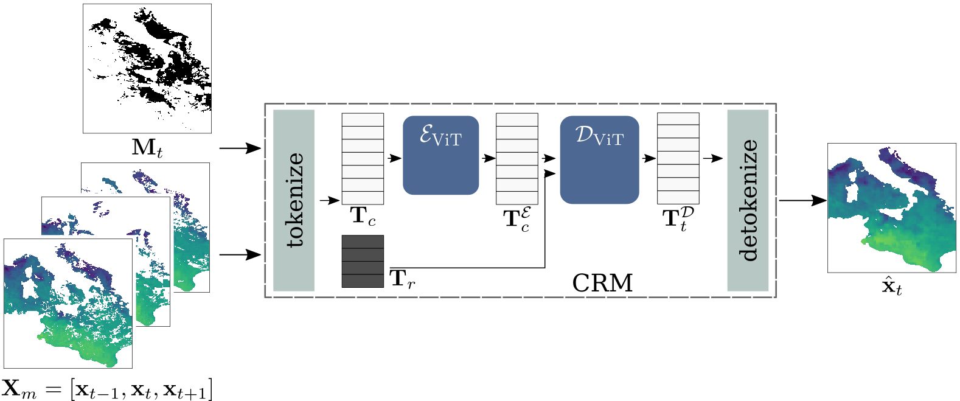
Coarse Reconstruction Module (CRM)
Input:
Sequence of three consecutive SST fields .
Missing data mask .
Output:
Coarse reconstruction .
Key mechanism: Global spatio-temporal attention [7]
A single missing value is reconstructed using all available measurements in the input!
[7] Feichtenhofer, C., Li, Y., He, K., et al.: Masked autoencoders as spatiotemporal learners, Advances in neural information processing systems, 35, 35 946–35 958, 2022.
Notes:
CRM takes as input a sequence of three SST fields and a missing mask, which denotes with zero the measurements that are missing in the central SST field. The output is the coarse reconstruction. The CRM utilizes a global spatio-temporal attention mechanism.

Slide 9
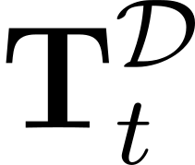
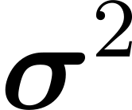
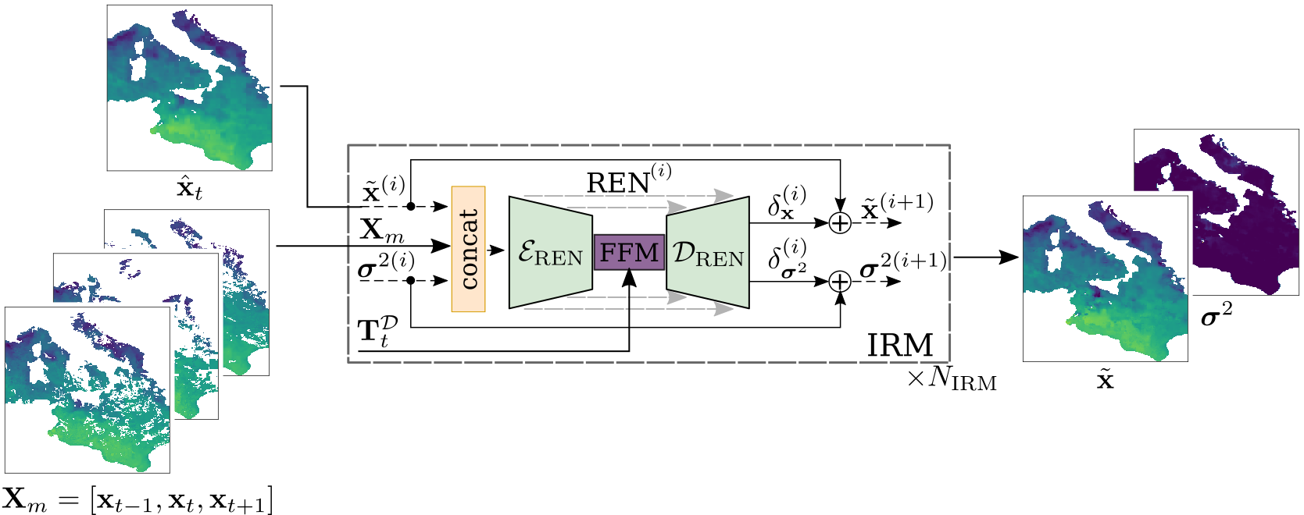
Iterative Refinement Module (IRM)
Input:
Coarse reconstruction .
Decoded tokens .
Sequence of SST fields .
Output:
Final reconstruction .
Variance .
Key mechanism: Sequential refinement using Residual Estimation Networks (RENs).
Notes:
To refine the initial reconstruction, the Iterative Refinement Module (IRM) takes as input the coarse reconstruction, decoded tokens, and the original observation. The output is the final reconstruction estimate and its corresponding variance. IRM consists of a sequence of Residual Estimation Networks (RENs).

Slide 10
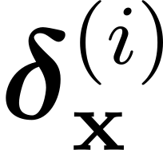
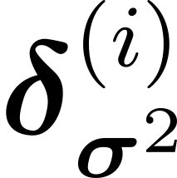
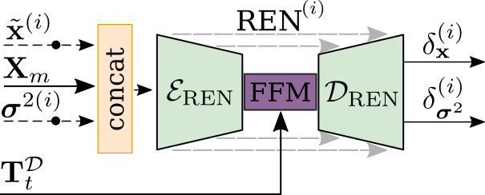
IRM: Residual Estimation Network (REN)
input:
Reconstruction estimate from the i’th iteration .
Variance estimate from the i’th iteration .
Original observations and tokens .
output:
Reconstruction residual .
Variance residual .
Notes:
Lets take a look at the i‘th REN. It takes as input the current estimate of the reconstruction and its variance and generates a reconstruction residual and uncertainty residual.

Slide 11
IRM: Update rule
The refined estimates, at the (i+1)’th iteration are given by:
Notes:
These residuals are then added to the initial input to form the updated reconstruction and variance estimates at the (i+1)‘th iteration.

Slide 12
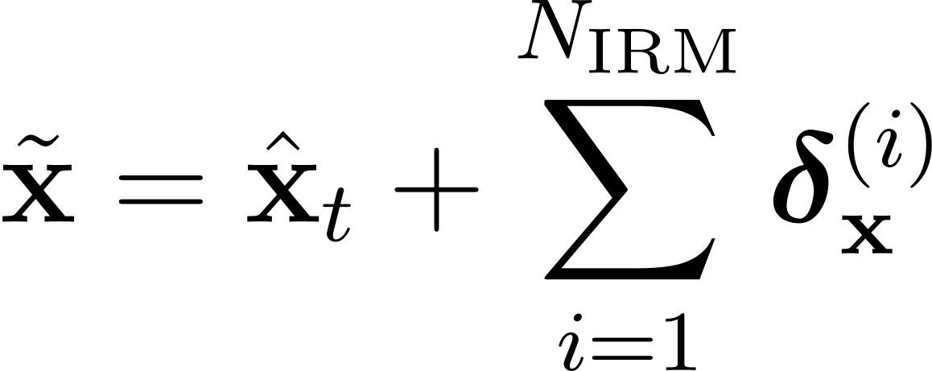
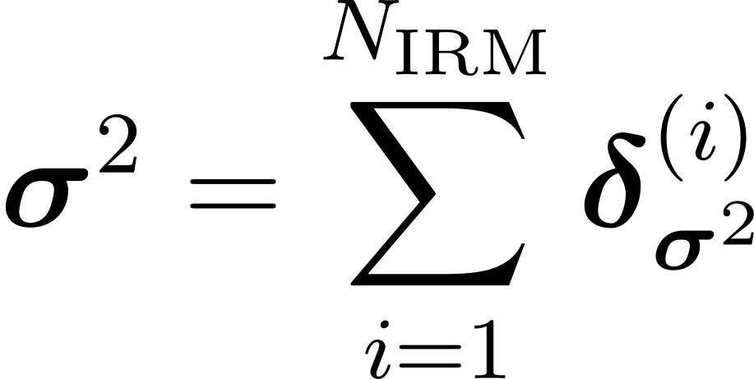
IRM: Final estimates
The final reconstruction and variance are given by summing up all residuals:
Notes:
The final estimates are given by summing up all N_IRM residuals.

Slide 13
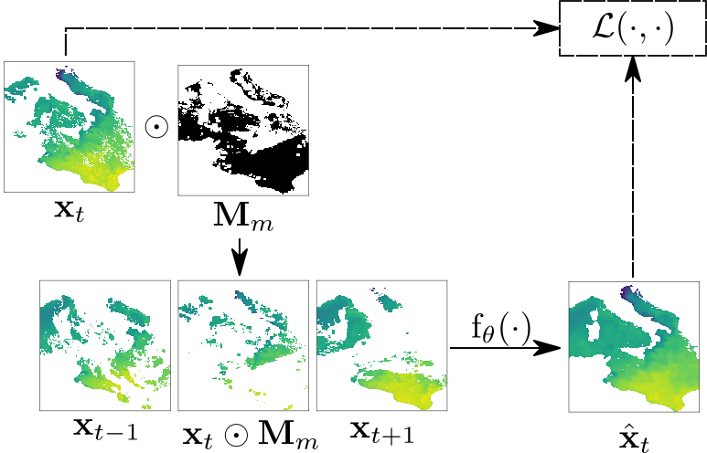
Training strategy
Self-supervised learning:
A triplet of consecutive observation fields is sampled .
The central observation is corrupted by a random missing data mask (sampled from a random time-step different from t).
The model is tasked to reconstruct the original SST field given the corrupted observations .
Notes:
Both modules are trained using self-supervised learning. The input and target signals are generated as follows: (1) A triplet of consecutive observations is sampled, (2) The central observation is corrupted by
a random missing data mask, sampled from a random time-step different from t, (3) the model is tasked to reconstruct the original (uncorrupted) SST field, given the corrupted observations.

Slide 14
Training strategy
Each module is trained independently:
CRM is first trained with the MSE loss:
IRM is trained with the negative log-likelihood of a Gaussian loss [3] (CRM parameters frozen):
[3] Alexander Barth et al. (2022) DINCAE 2.0: multivariate convolutional neural network with error estimates to reconstruct sea surface temperature satellite and altimetry observations. Geoscientific Model Development, 15(5), 2183-2196.
Notes:
Each modules is trained independently. First CRM is trained to minimize the MSE between the target SST field and coarse reconstructions. Secondly IRM is trained with neg. Log-likelihood of a Gaussian loss — between the target SST field and the final full reconstruction and variance estimate.

Slide 15
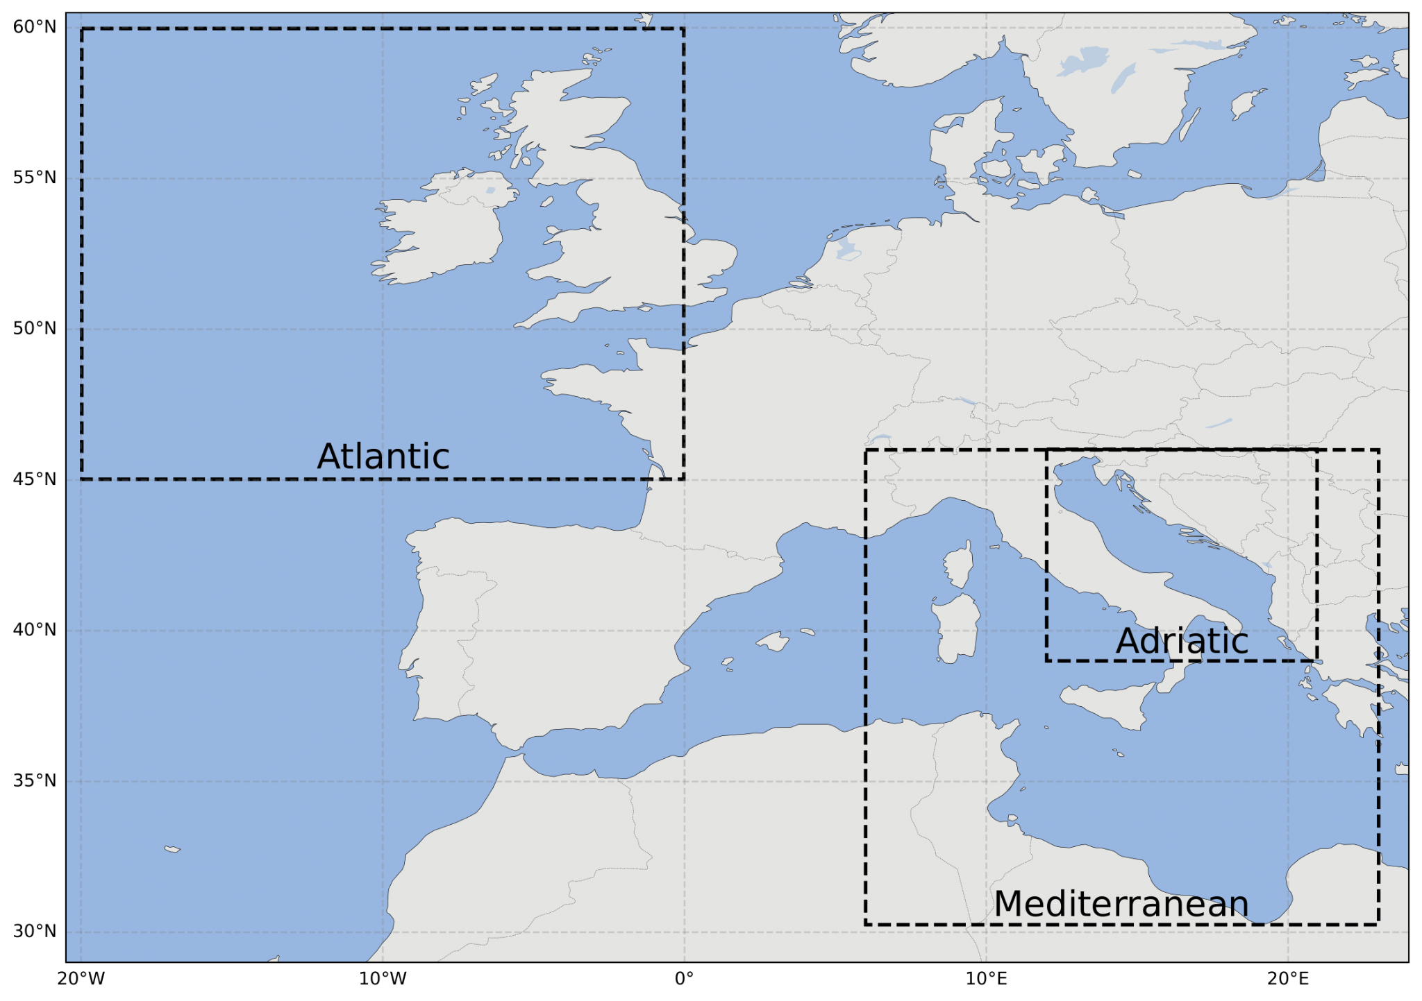
Experiments: datasets
Methods evaluated on Level 3 (L3) satellite observations, on three different geographic regions:
Adriatic dataset [12, 13]: 7800 daily samples,
Mediterranean dataset [8]: 5114 daily samples,
Atlantic dataset [14]: 3454 daily samples.
Temporal split:
training set (first 90%),
validation set (next 5%),
testing set (last 5%).
[8] Mediterranean Sea - High Resolution and Ultra High Resolution L3S Sea Surface Temperature. https://doi.org/10.48670/moi-00171
[12] A. Pisano et al. “The new Mediterranean optimally interpolated pathfinder AVHRR SST Dataset (1982-2012)”. In: Remote Sensing of Environment 176 (2016), pp. 107–116. doi: 10.1016/j.rse.2016.01.019. url: http://pathfinder.nodc.noaa.gov.
[13] K.S. Casey et al. “The Past, Present and Future of the AVHRR Pathfinder SST Program”. In: Oceanography from Space: Revisited. Ed. by V. Barale, J.F.R. Gower, and L. Alberotanza. Springer, 2010. doi: 10.1007/978-90-481-8681-5_16.
[14] Product User Manual for Level 3 ODYSSEA Sea Surface Temperature multi-year products over the European North West Shelf/Iberia Biscay Irish Seas, v1.0. Accessed: 2023-06-30. Nov. 2022.
Notes:
Next, I‘ll present the experimental results of our method. We utilize daily SST measurements over the three different geographic regions: (1) Adriatic Sea, (2) Mediterranean Sea (3) Atlantic ocean. The datasets contain a varying number of daily observations, which are temporally split into training, validation and testing.

Slide 16
Experiments: Evaluation Protocol
Missing values simulated by copying real clouds, i.e., same as in training.
Performance metrics:
: RMSE over hidden data,
: RMSE over observed data,
: RMSE over all measurements.
Notes:
The missing values are simulated as during trainig. We report three metrics based on the Root Mean Squared Error (RMSE), specifically:
RMSE_mis: the error over hidden data (i.e., missing values)
RMSE_vis: the error over observed data
RMSE_all: the error over all ground truth measurements

Slide 17
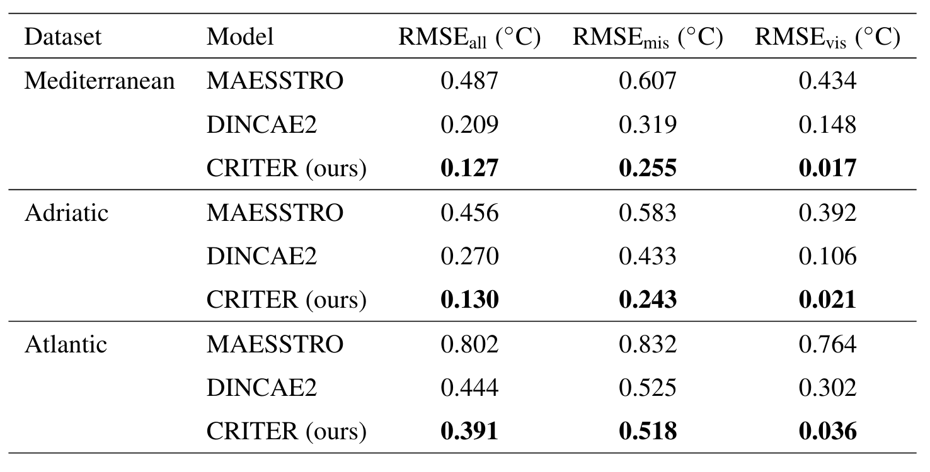
Experiments: Comparison with the current state-of-the-art
CRITER significantly outperforms all current SOTA by 20% - 89% !
20%
89%
44%
89%
1%
88%
Notes:
CRITER significantly outperforms current state-of-the-art approaches.

Slide 18
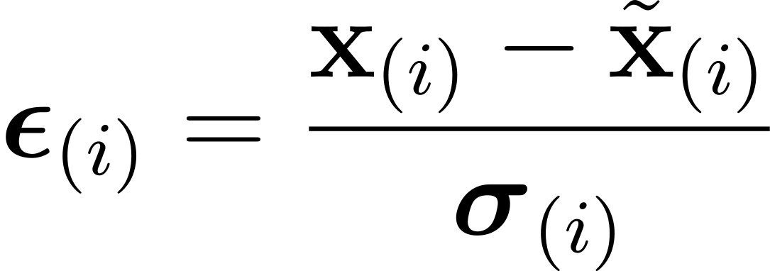
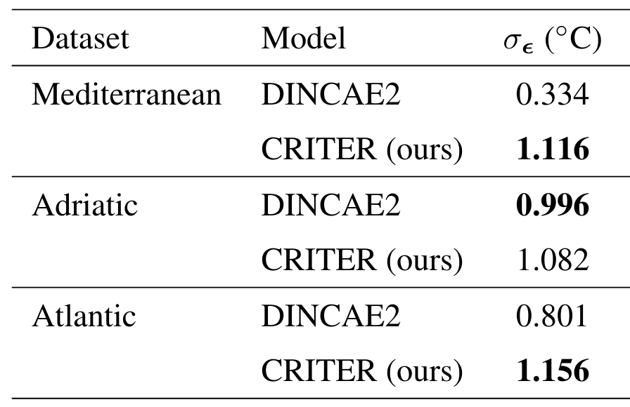
Experiments: Uncertainty analysis
Reliability of the estimated uncertainty is assessed by computing the standard deviation of the scaled error metric [9]:
Ideal model: (per-pixel disparities match the predicted uncertainties).
DINCAE2 significantly overestimates (on-average) the standard deviation!
CRITER delivers the best uncertainty estimate (only slightly underestimates the std).
[9] Alexander Barth et al. “DINCAE 1.0: a convolutional neural network with error estimates to reconstruct sea surface temperature satellite observations”. In: Geoscientific Model Development 13.3 (2020), pp. 1609–1622.
Notes:
Recall that CRITER and DINCAE2 estimate the reconstruction and the uncertainty, specified by the standard deviation. We assess the reliability of the estimated standard deviation by computing the standard deviation of the scaled error metric. An ideal model would have standard deviation of the scaled error equal to one (per-pixel disparities match the predicted uncertainties). We observe that DINCAE2 (on averagae) significantly overestimates the standard deviation, while CRITER slightly underestimates it.

Slide 19
Experiments: (Mediterranean) Reconstruction visualization
CRITER
DINCAE2
Notes:
This video shows reconstructions generated by CRITER. We can see that the model is robust to various cloud shapes and capable of reconstructing fine grained details

Slide 20
Future work
Development of a multimodal CRITER: models dependencies between different environmental variables (e.g., wind patterns, chlorophyll-a concentrations, sea surface height).
CRITER’s CRM is memory-intensive.
Memory-efficient CRM architecture, allowing larger spatial token resolution and a wider temporal horizon.
Notes:
We envision two possible directions for future work: Firstly, we propose the development of a multimodal CRITER, which would model dependencies between different geophysical variables. Secondly, we suggest the implementation of a memory-efficient variant, allowing for the utilization of a larger temporal horizon.

