Slide 1



Upgrading Particulate matter Source apportIonment through Data sciencE
Dr. Marta Via (Centre of Atmospheric Research, University of Nova Gorica).
Supervision: Dr. Griša Močnik (Centre of Atmospheric Research, University of Nova Gorica).
Dr. Kaspar Daellenbach (Laboratory of Atmospheric Chemistry, Paul Scherrer Institute).

Slide 2


















Particulate Matter
…
Notes:
In my research I focus on air pollution specifically on the particulate matter.
Both natural and anthropogenic emissions contribute to their emission and formation.
These particles can be directly emitted as particles called primary or formed through atmospheric processing of volatile compounds called secondary.
When PM is emitted

Slide 3
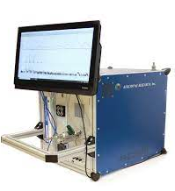
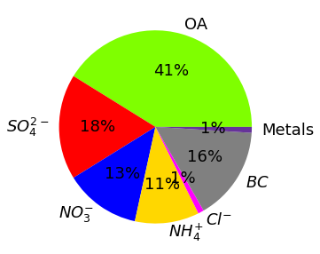
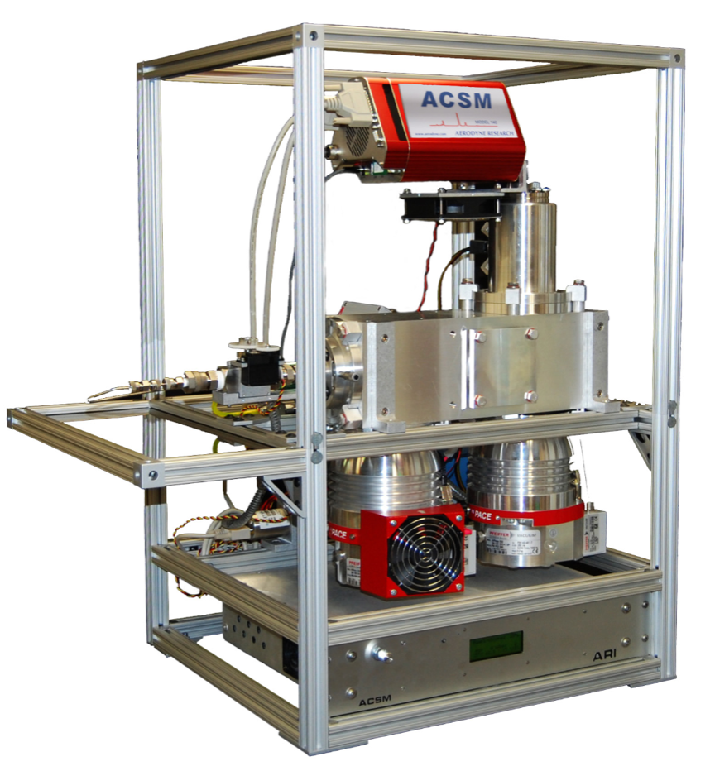
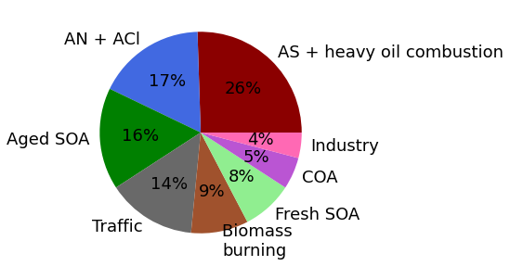











PM measurements
Compounds
Sources
SOURCE APPORTIONMENT
Receptor models
ACSM
Aerosol Chemical Speciation Monitor
F
G
X
time
Composition profile
Time series
Factor 1
·
Positive Matrix Factorisation (PMF)
+
Paatero and Tapper, 1994
m/z
=
Factor 2
·
…
+
$$X= F·G+E$$
Factor 3
·
+
MLS
minimisation
k =3
Error
E

Slide 4
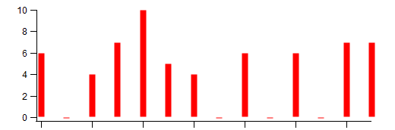
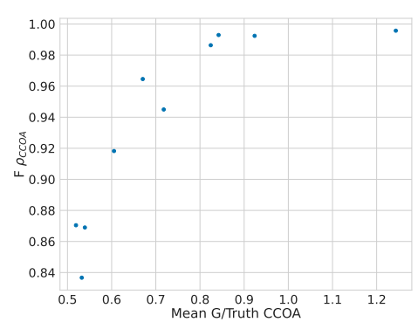
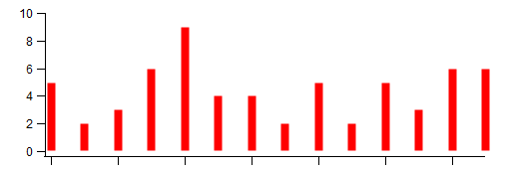
PMF
BAMF
1994
2024
Paatero and Tapper, 1994
Rusanen et al. (2024) AMT.
PMF source apportionment
Bayesian Autocorrelation Matrix Factorisation (BAMF)
✓ Better source description — AUTOCORRELATION
✘ Source disentanglement — Profiles
Expected:
Accuracy in G
Obtained:
Accuracy in F
Adapted from
Rusanen et al. (2024) AMT.

Slide 5
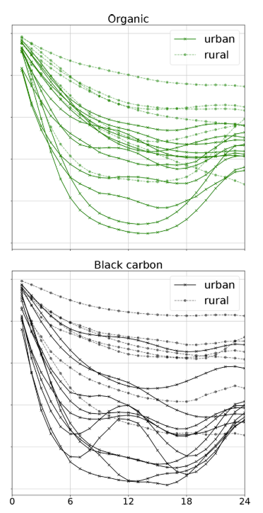
D: Data
M: Model
θ: Model parameter
Probabilistic approach: Bayesian models
P(D|M) · P(M)
P(D|M,θ) · P(θ|M) · P(M)
Bayes theorem:
P(M|D) =
=
~ (D|M,θ) · P(θ|M) · P(M)
P(D)
P(D)
Posterior probability
Likelihood
Priors
Solver: Hamiltonian Markov Chain Montecarlo (HMCM)
BAMF
Priors:
Mass reconstruction: X ~ F · G
Autocorrelation term: G_{i+1}~ Cauchy⁺(location = G_{i}, scale= α·Δt + β )
Auto-correlation
No prior for F!
Lag (h)

Slide 6

Research objectives
DISENTANGLEMENT OF PROFILES
Profile denoising through regularisation tools
Before:
4
3
2
1
Species
After:
3
4
Profile sparsity prior
1
Species
F_{jk}
Horseshoe prior
Global, local shrinkage
Polson and Sokolov (2019) WIRES Comput. Stat.

Slide 7
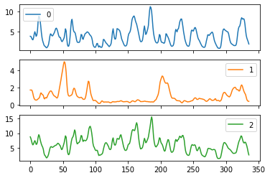
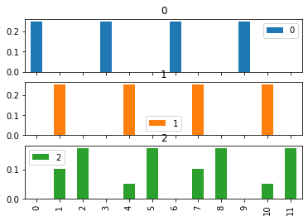

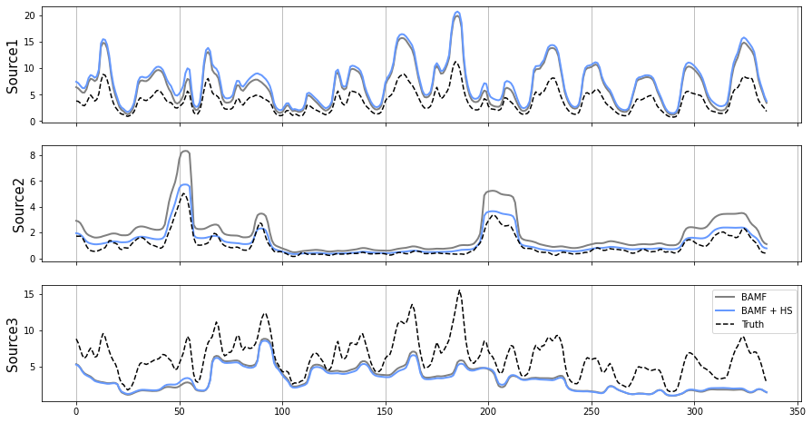
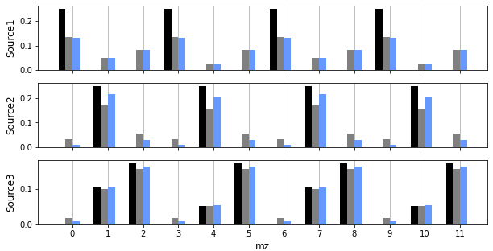

Preliminar results
Horseshoe Shrinkage (I)
Toy dataset
G
F
k=3
Sparse profiles
(zeros)
G
F

Slide 8
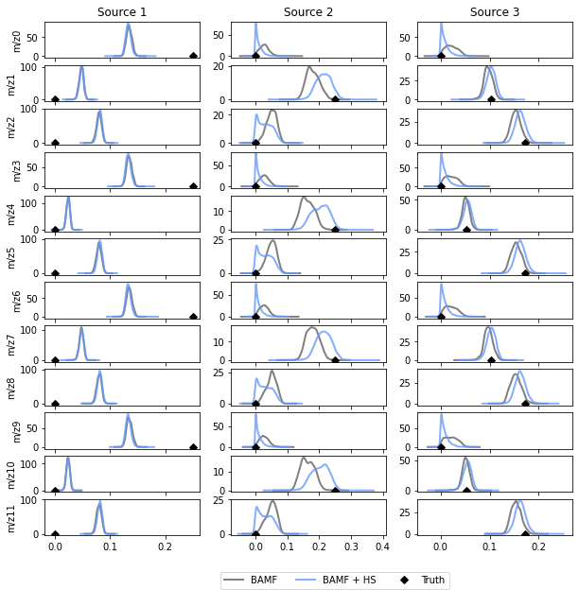
Preliminar results
Horseshoe Shrinkage (II)
F_{jk}

Slide 9
Next steps
Explore the shrinkage strength dynamic range.
Apply BAMF + HS on synthetic datasets and perform sensitivity analysis on horseshoe parameters.
Apply BAMF + HS on real-world datasets.

Slide 10






Thank you for your attention.

