Slide 1
Machine Learning analysis for absorption measurements correction schemes – A test study
Jesús Yus-Díez¹, Jorge Pérez², Luka Drinovec^{1,3}, Lucas Alados-Arboledas⁴, Gloria Titos⁴ and Griša Močnik^{1,3}
¹Center for Atmospheric Research, University of Nova Gorica, 5270 Ajdovščina, Slovenia
²Nextail Labs SLU
³Haze instruments d.o.o.
⁴Andalusian Institute for Earth System Research (IISTA-CEAMA), University of Granada, Granada, Spain

Slide 2
MEGLICA: ML for Earth Sciences within SMASH
MEGLICA
Machine lEarning applications for constraining the warminG effects of aerosoL partIcles on ClimAte
4.2. Role of anthropogenic and natural aerosols and their contribution to climate warming (UNG-CAR)

Slide 3
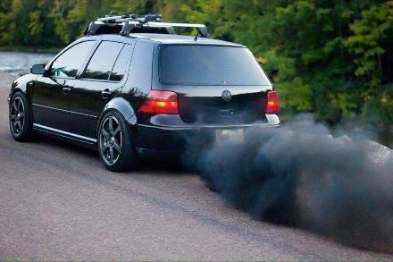
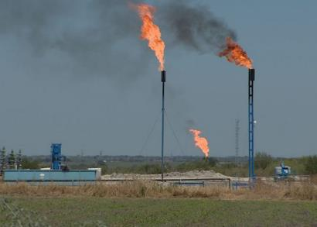
Introduction: Aerosol contribution to climate warning
Still high uncertainty of the effect of aerosol particles on climate
BC and light absorbing aerosols (LAA) are very important due to their warming capacity
(LAA) warm the atmosphere and modify the thermodynamic structure, introducing indirect & semidirect climate changes (cloud formation, precipitation rates, etc.)
socimage.net
Environ. Defense Fund
+1
atmosphere
+2,6
BC total:
+1,1 ± 0,7 W/m²
+0,6
surface
-1,7
Bond et al., 2013
CO₂
BC (direct)
+1,6 W/m²
+0,9 W/m²

Slide 4
Main Objective
Novel correction technique based on a reference absorption instrument and laboratory experiments
&
Application of advanced corrections using both classical and ML
Lack of an established reference absorption measurement & large influence of artefacts

Slide 5
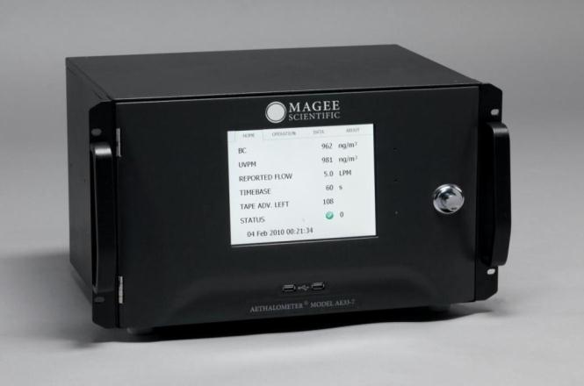
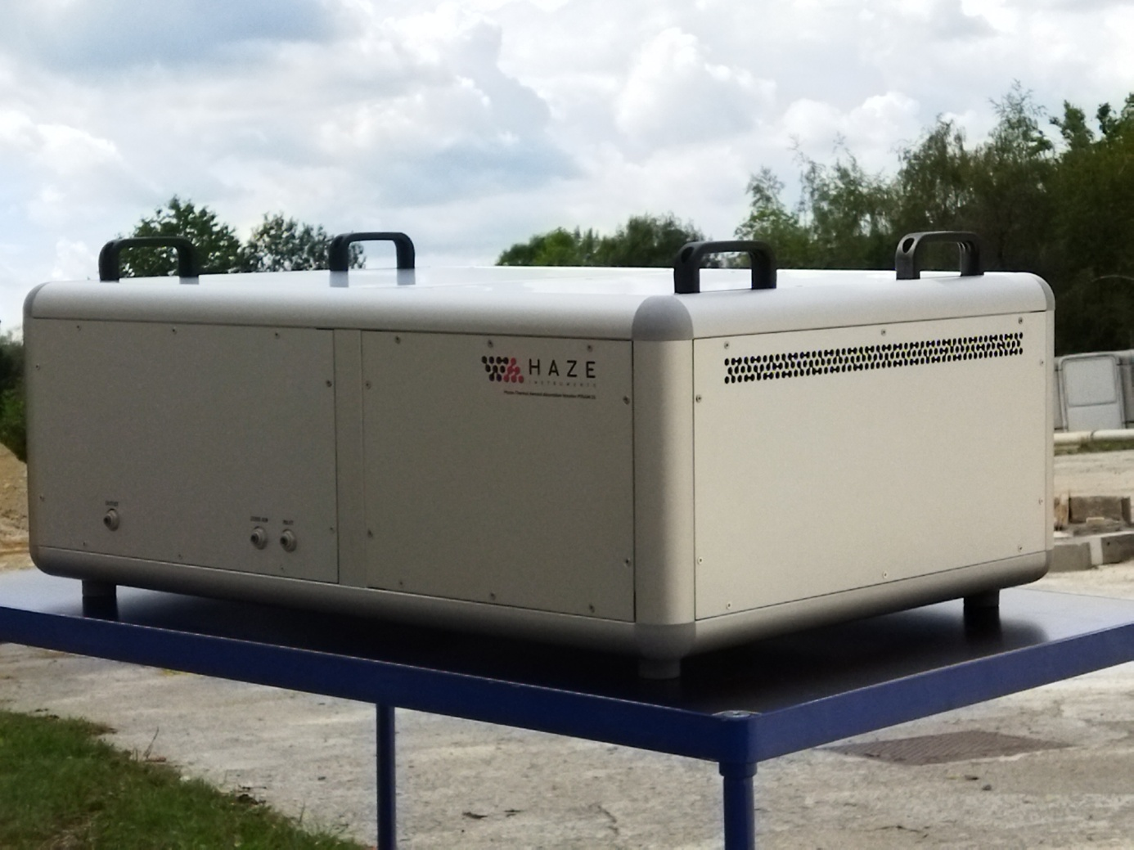
Methodology: Measurements
Site-specific corrections for Filter Photometers measurements via a reference measurements
AE33
PTAAM
Size-specific correction for different backgrounds via a ML model
AMBIENT MEASUREMENTS
+
Physical aerosol characterization:
Scattering
Particle Size Distribution

Slide 6
Methodology: Ambient measurement campaign
Summer 2023 campaign over Granada, Spain
Period: June - September 2023
Collocated measurements:
PTAAM2𝛌: reference absorption
AE33/MAAP: Attenuation & absorption
Nephelometer Aurora 3000: Integrating scattering and backscattering
APS: Particle size distribution
Events:
Background pollution
Wildfire particles
Saharan Dust oubreaks

Slide 7
Methodology: Compensation algorithms
Problem
Filter Photometers, especially AE33, suffer from cross-sensitivity to scattering of the particles, that is mainly due to:
Capacity to scatter light, described through (SSA)
Their penetration capacity, described by their size
Yus-Diez et al. (2021)
Drinovec et al. (2022)
Notes:
Data availability: Not all the stations have all the measurements required to perform compensation algorithms and reference measurements
Know-how: It requires skilled and knowledge to perform compensations so that the data keeps its physical meaning

Slide 8
Methodology: Compensation algorithms
Traditional approach limitations
ML algorithm objective
Cover for the lack of data availability by allowing correction using either Particle size and/or scattering.
Provide an easy to use algorithm that data provider can use to correct data
Data availability
Reference absorption measurements
Know-how
Notes:
Data availability: Not all the stations have all the measurements required to perform compensation algorithms and reference measurements
Know-how: It requires skilled and knowledge to perform compensations so that the data keeps its physical meaning

Slide 9
Methodology: Compensation algorithms
constraining variables
date | x_{objective} | x_{cor} | x₁ | x_{i} | x_{n}
 | … | … | … | … | …
 | … | … | … | … | …
 | … | … | … | … | …
 | … | … | … | … | …
 | … | … | … | … | …
 | … | … | … | … | …
 | … | … | … | … | …
Correct Attenuation
Collocated measurements:
Reference absorption objective variable
Attenuation prediction variable(s)
Scattering constraining variables*
Particle size dist. constraining variable*
date
* Not always both available

Slide 10
Methodology: Machine Learning
A multi-linear regression, as baseline model
A Machine Learning model: gradient boosting ensemble of decision trees.
Evaluate the effect of data availability of physically descriptive variables on the correction
We introduce the constraining variables as features, to improve the model training
Notes:
Given the multiple cross-sensibility, two main approaches are used

Slide 11
Methodology: Machine Learning
A more advanced ML model: gradient boosting ensemble of decision trees.
A decision tree:
Looks for the feature (variable) that best splits the data
Repeat for n times
Each leaf is assigned a value which is the average of the target variable considering only the leaf’s points
Once trained, we just need to follow the new point until the last leaf and use the value as prediction
E.g.:, for a measurement of batn_950 = 1, will end up in the 5th leaf, and will be assigned a prediction of b_abs_450 = 5.306
We combine 100 decision trees, where each one is trained on the errors of its predecessor tree (Boosting).
Notes:
A more advanced Machine Learning model: gradient boosting ensemble of decision trees.
A decision tree:
looks for the feature (variable) that best (according to some criterion, e.g., R^2) splits the data (branches)
repeats for a number of times
each leaf is assigned a value which is the average of the target variable considering only the leaf’s points
Once trained, we just need to follow the new point until the last leaf and use the value as prediction
For example, a new measurement with batn_950.jy = 1, will end up in the 5th leaf, and will be assigned a prediction of babs_450_v2 = 5.306
We combine 100 decision trees, where each one is trained on the errors of its predecessor tree (Boosting).

Slide 12
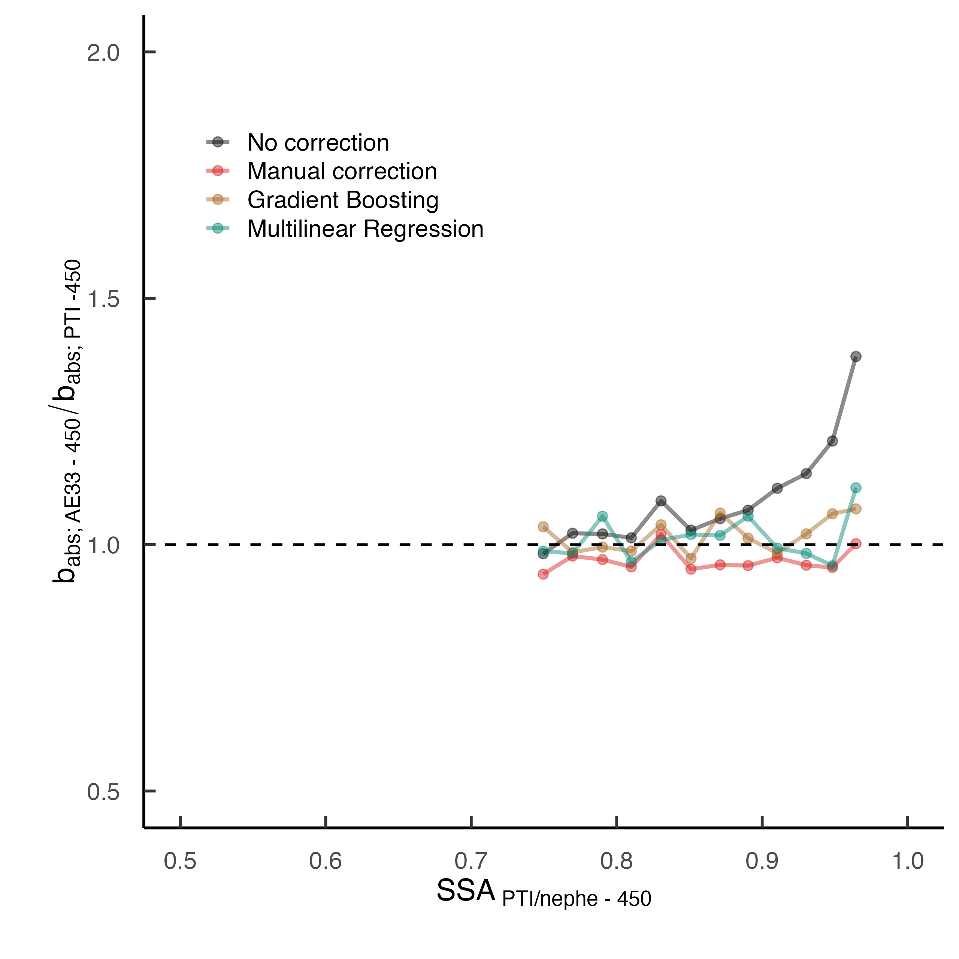
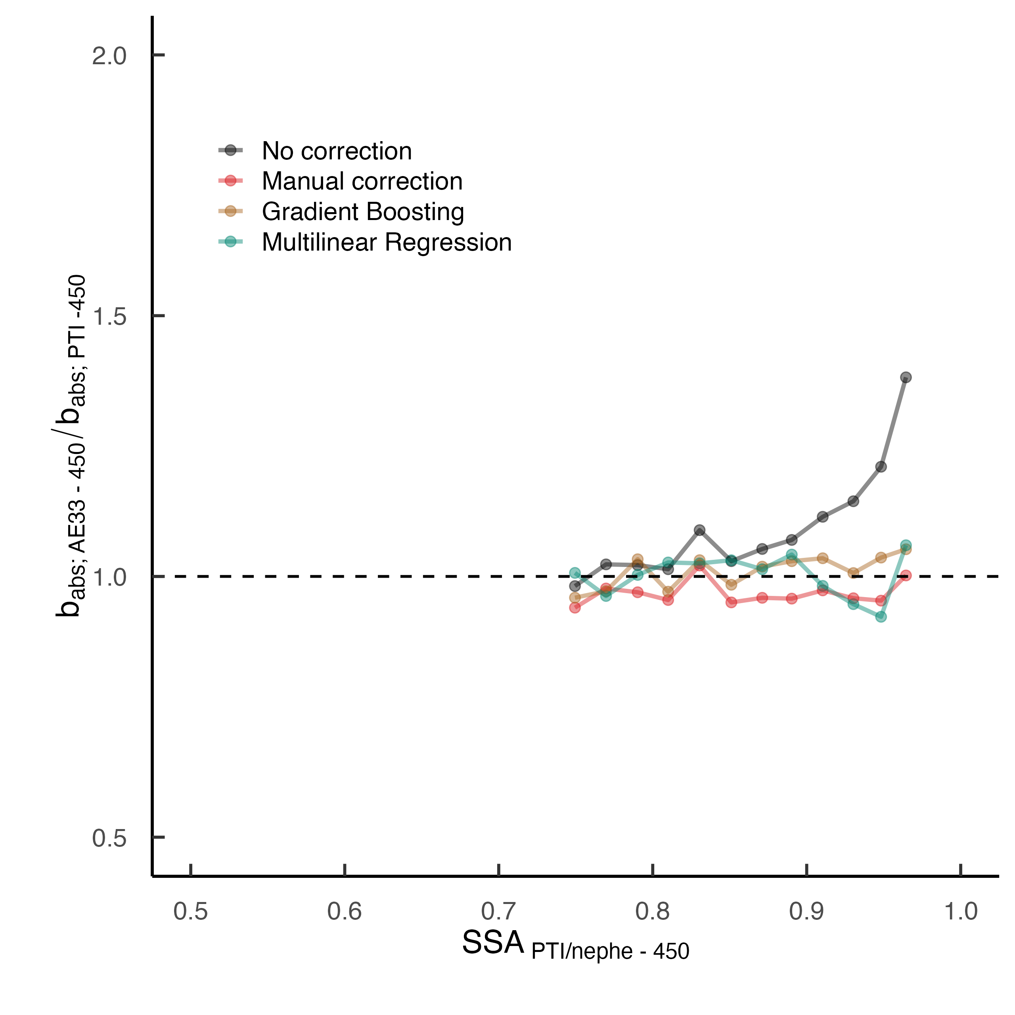
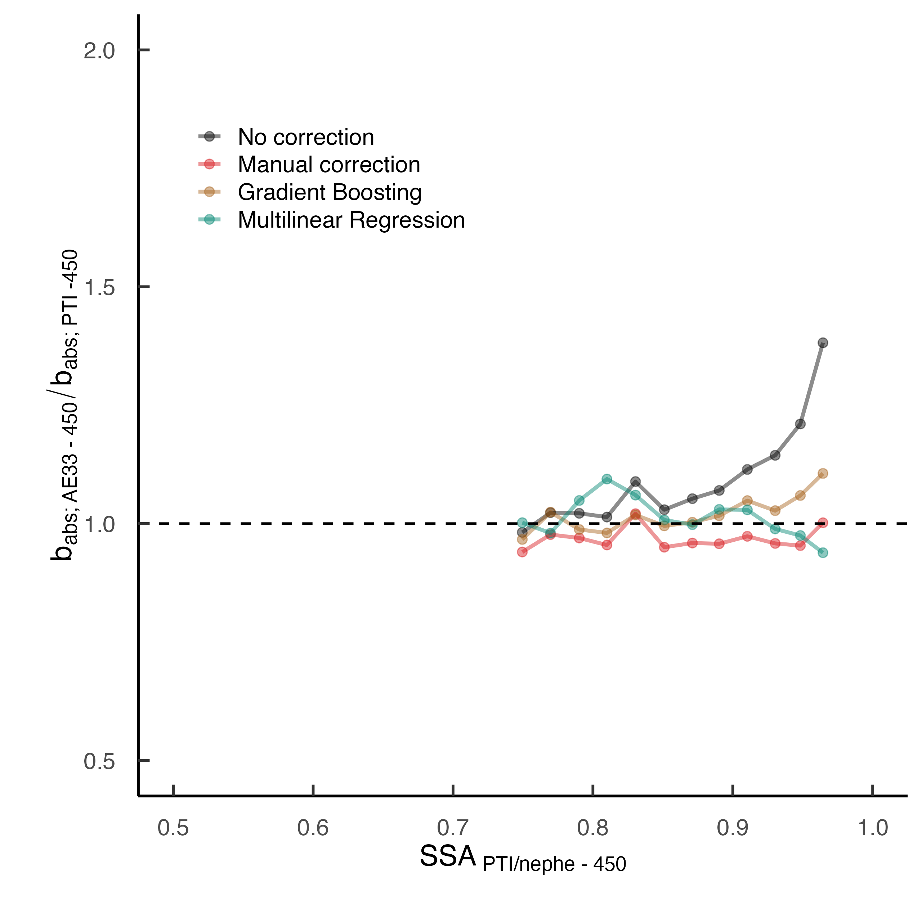
Results: ML vs mlr vs traditional correction
w PSD & w/o scat
w scattering & w/o PSD
w PSD & scattering
w/o scattering & PSD

Slide 13
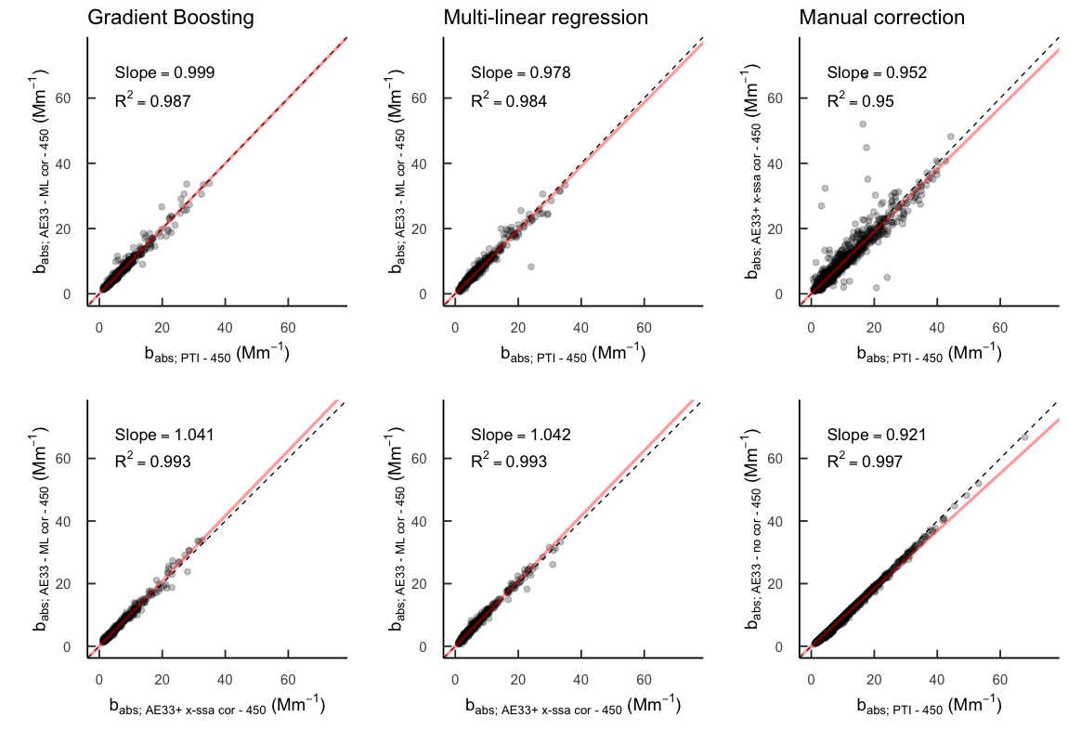
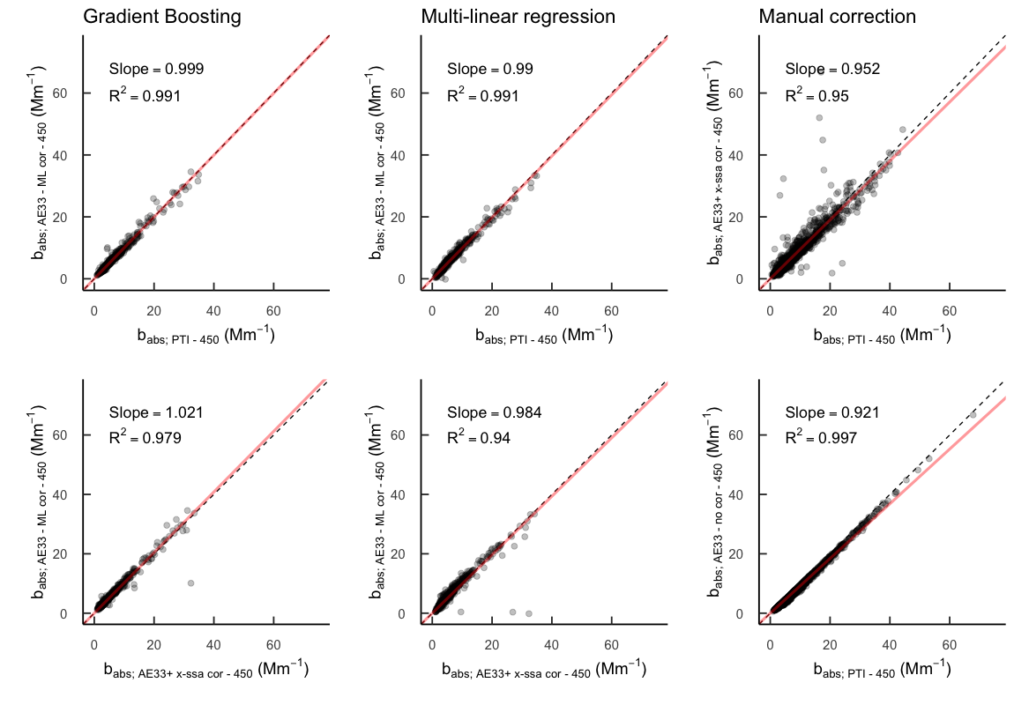
Results: ML vs mlr vs traditional correction
w PSD & w/o scat
w PSD & scattering

Slide 14
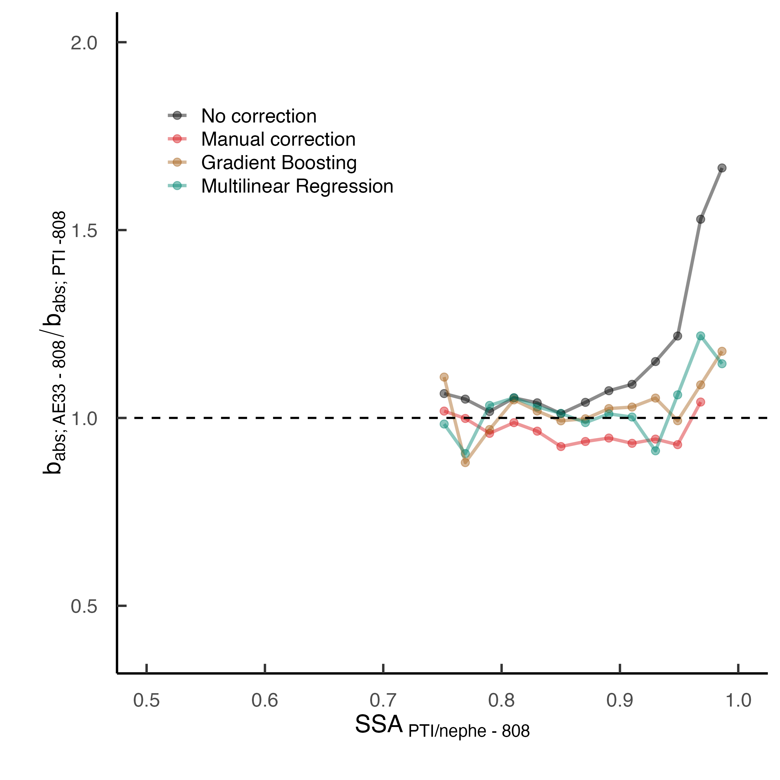
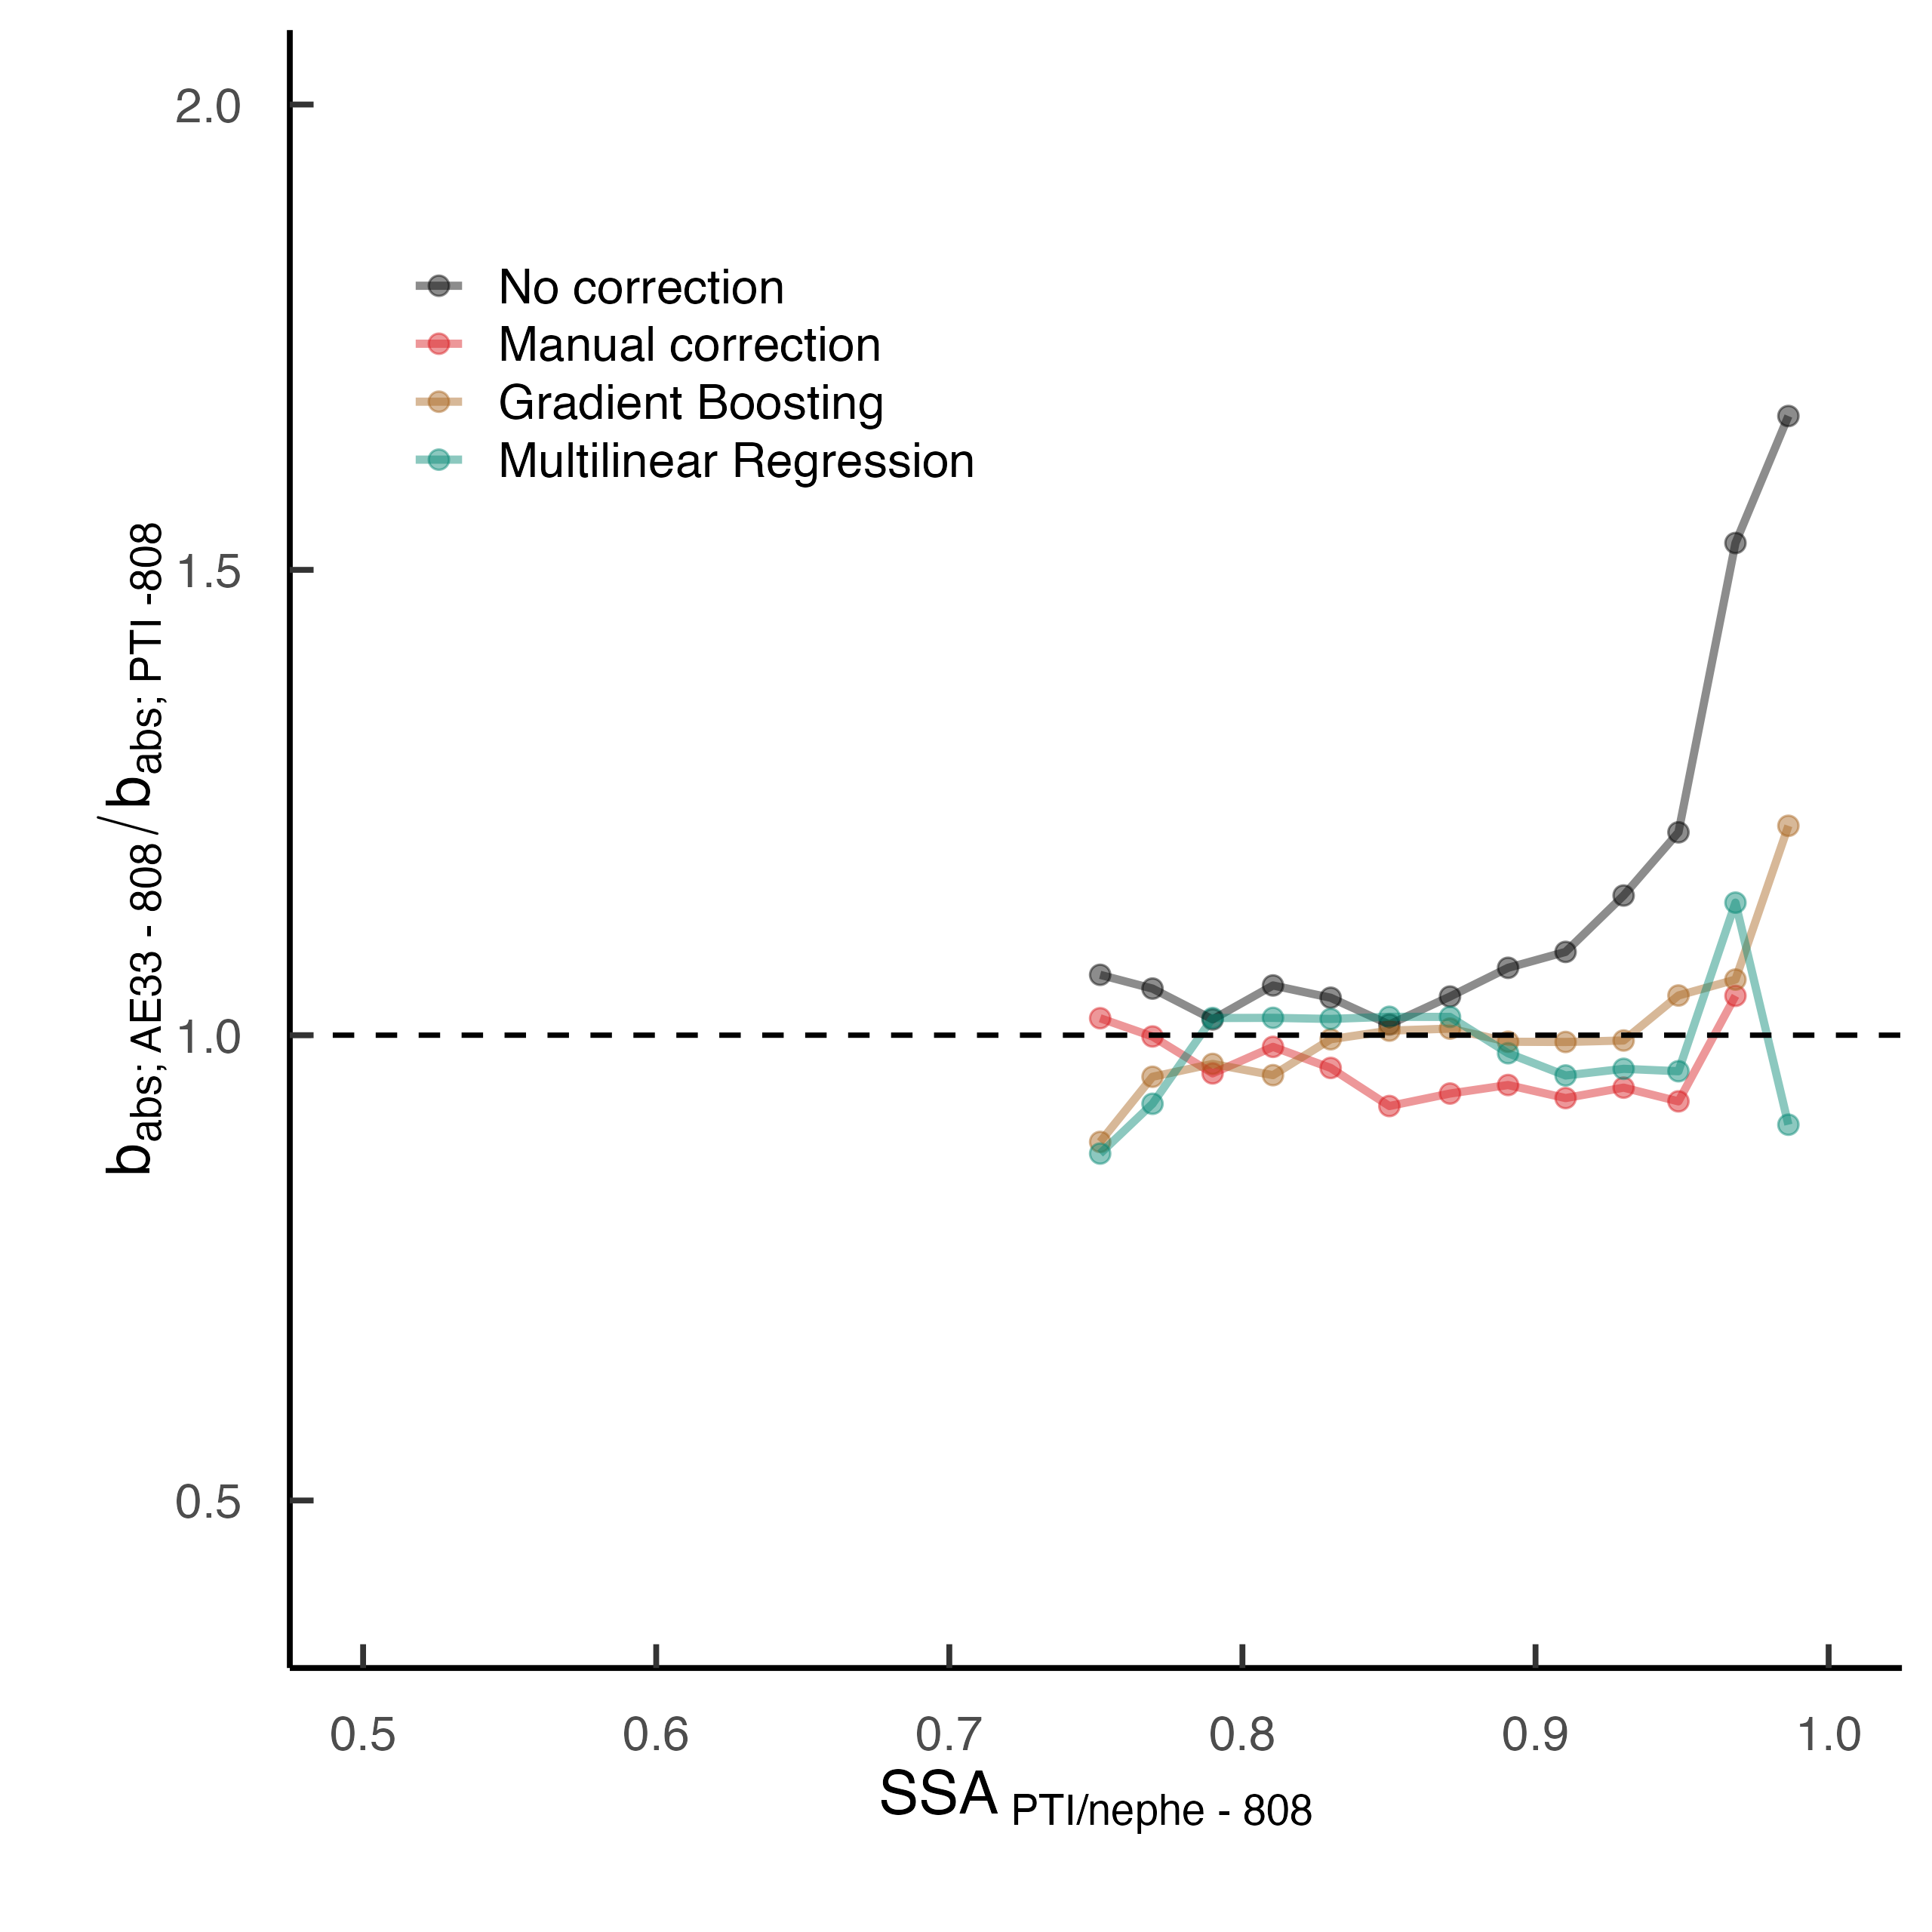
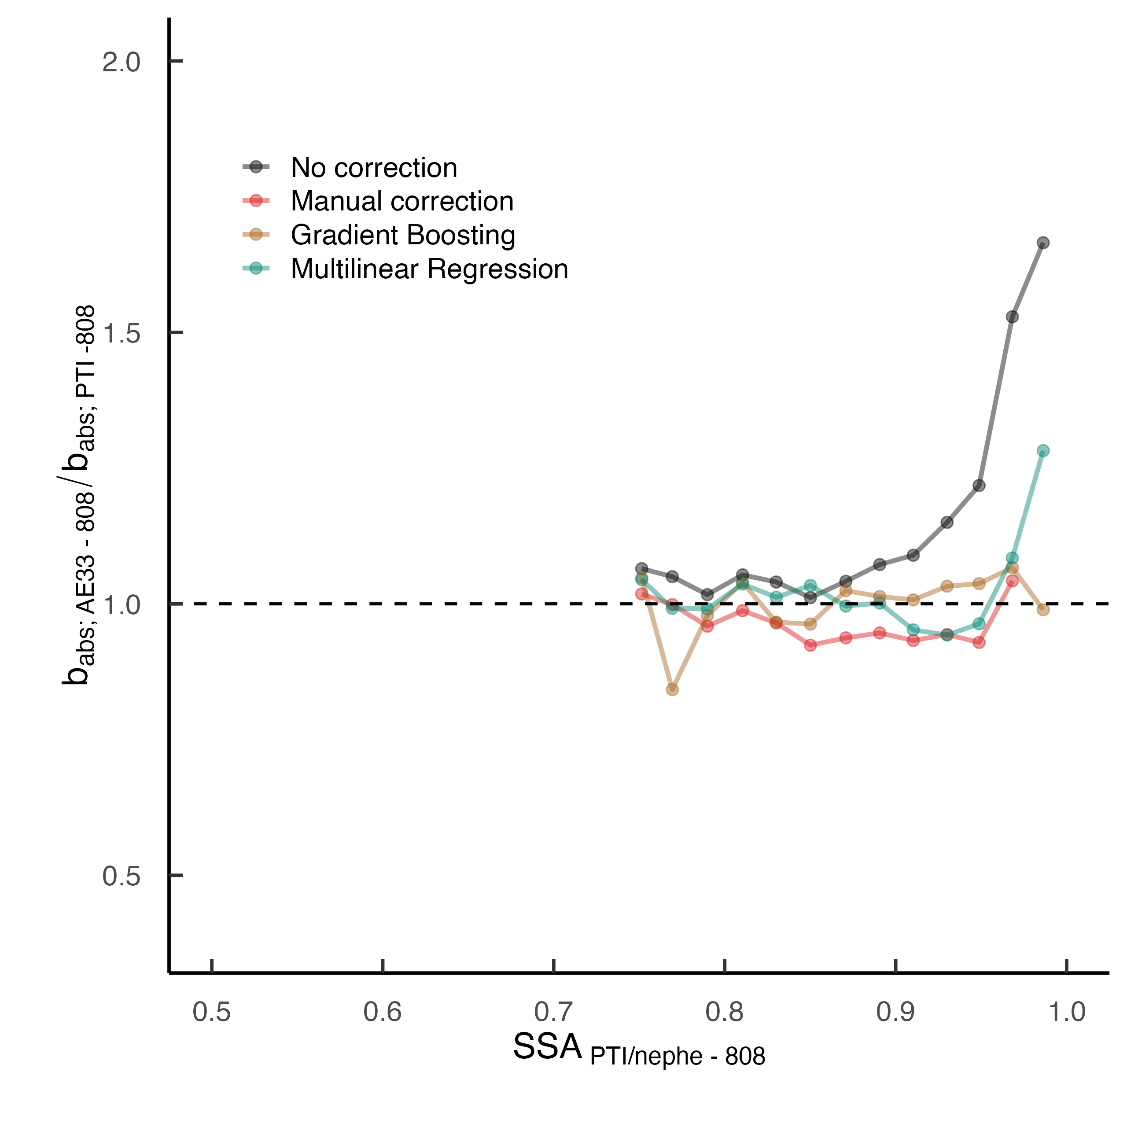
Results: Redo analysis for 808 nm
w PSD & w/o scat
w scattering & w/o PSD
w PSD & scattering
Despite the higher error than can be introduced at this wavelength due to the higher noise-to-signal ratio, ML still provide a good correction when all options available, MLR is noisier

Slide 15
Future steps
Within AGORA:
Expand analysis for all all available wavelengths
Check if the model predicts well using the traditional correction as a reference, for extrapolation purposes of the model to other datasets
EU data:
Check if the model predicts well using the traditional correction as a reference for other EU stations
Retrain model using data from other EU stations, amplifying the background variability input into the model
Use of particle source and chemical composition to improve prediction, if available, test whether it improves the outcome
Check other ML algorithms if necessary, possible use of synthetic data generation to fill data gaps

Slide 16
Conclusions
Both MLR and Gradient Boosting algorithms provide a high-quality correction of the absorption data
Gradient Boosting outperforms MLR, especially under scenarios where scattering is not available
However, a more simple MLR gives a similar result under scenarios with higher data availability
Since the exploratory analysis has provided good results, application to datasets across Europe to be accomplished in the next step

Slide 17
THANK YOU FOR YOUR ATTENTION!
This project has received funding from the European Union's Horizon Europe research and innovation programme under the Marie Sklodowska-Curie grant agreement No. 101081355.
The operation (SMASH project) is co-funded by the Republic of Slovenia and the European Union from the European Regional Development Fund.

Slide 18
References
Yus-Díez, Jesús, et al. "Determination of the multiple-scattering correction factor and its cross-sensitivity to scattering and wavelength dependence for different AE33 Aethalometer filter tapes: a multi-instrumental approach." Atmospheric measurement techniques 14.10 (2021): 6335-6355.
Drinovec, Luka, et al. "A dual-wavelength photothermal aerosol absorption monitor: design, calibration and performance." Atmospheric Measurement Techniques 15.12 (2022): 3805-3825.

Slide 19
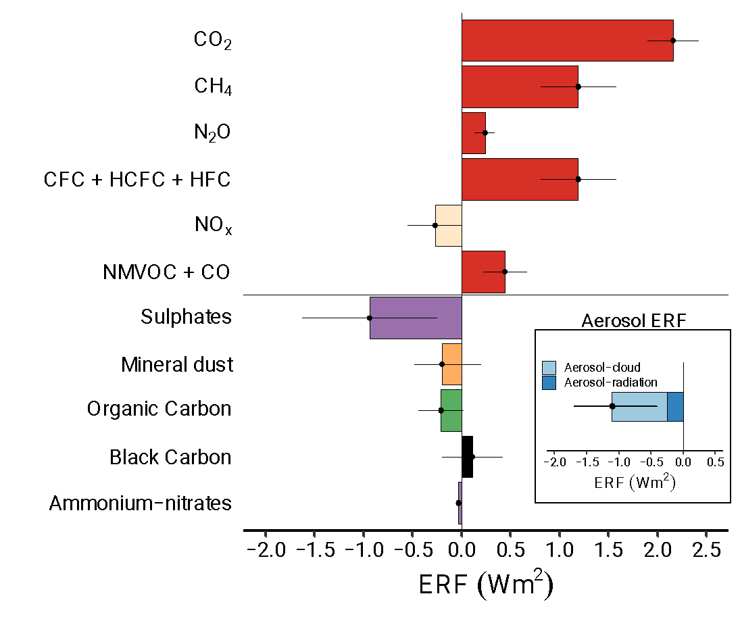
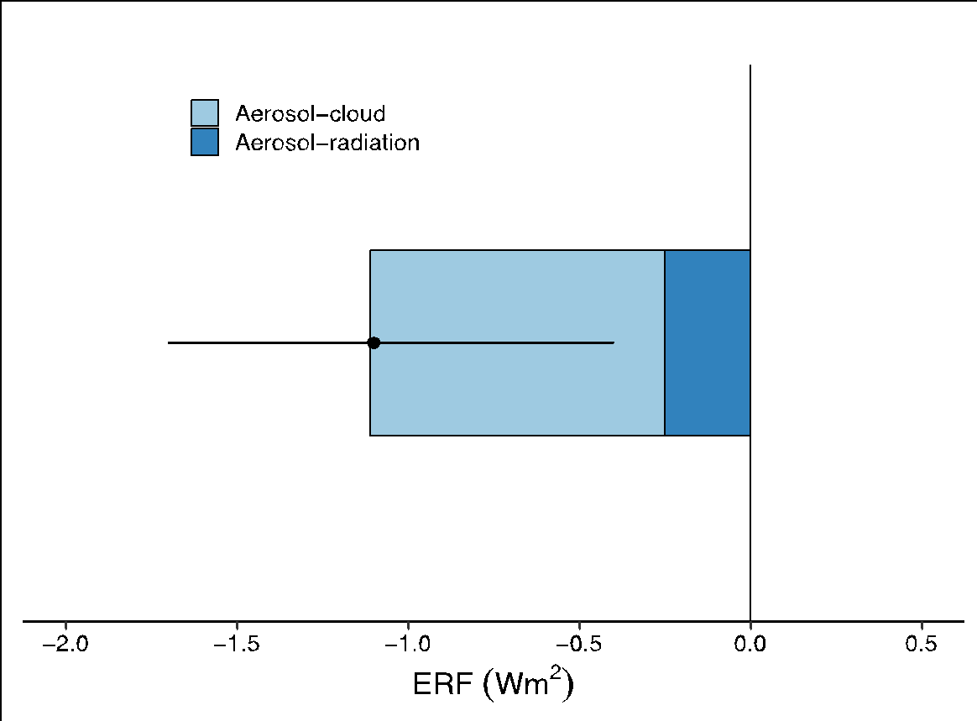
Introduction: Aerosol contribution to climate warning
High uncertainty!
Net cooling effect on Earth’s climate
Overall small reduction of the warming effect of the greenhouse gases
Direct
Cloud interaction
-2.0
-1.5
-1.0
-0.5
0.0
-1.5
0.0
1.5
ERF (Wm⁻²)
ERF (Wm⁻²)
Adapted from IPCC (2021)

