Slide 1
Unlocking
European-level
HPC Support
Žiga Zebec
Teo Prica
Samo Miklavc
IZUM - Institute of Information Science
This project has received funding from the European High-Performance Computing Joint Undertaking under grant agreement No.101139786.

Slide 2
Introduction
Public institution, approx. 120 employees (7 dedicated to HPC)
Library automation information system
Slovenian Current Research Information System
UNESCO Regional Category II Centre
Operation & Consortium
HPC RIVR <-> SLING
HPC experts from IZUM
Notes:
Institute of Information Science, IZUM, is a public institution established by the goverment of Slovenia.
Our greatest responsibility is research and development of library automation information system called COBISS.
We provide collaboration platform with system and application infrastructure and supported services to more then one thousand libraries across several countries in Balkans.
We are also developing and maintaining Current Research Information System for Slovenia and other countries.
Back in 2018, our Ministry gave us opportunity to establish the HPC Center in the Nort-Eastern Slovenia. Operation HPC RIVR was performed together with our partners University of Maribor and Faculty of Information Studies from Novo Mesto. We also colaborate with Slovenian supercomputing network consortium SLING, where all major institutions and companies from Slovenia are joined to collaborate within HPC area on the national level.
The most valuable property of this project is supercomputer Vega, named after Slovenian mathematician.
My colleagues and experts from Jožef Stefan Institute and Arnes procured and help to implement and install HPC Vega, supplied by Atos.

Slide 3
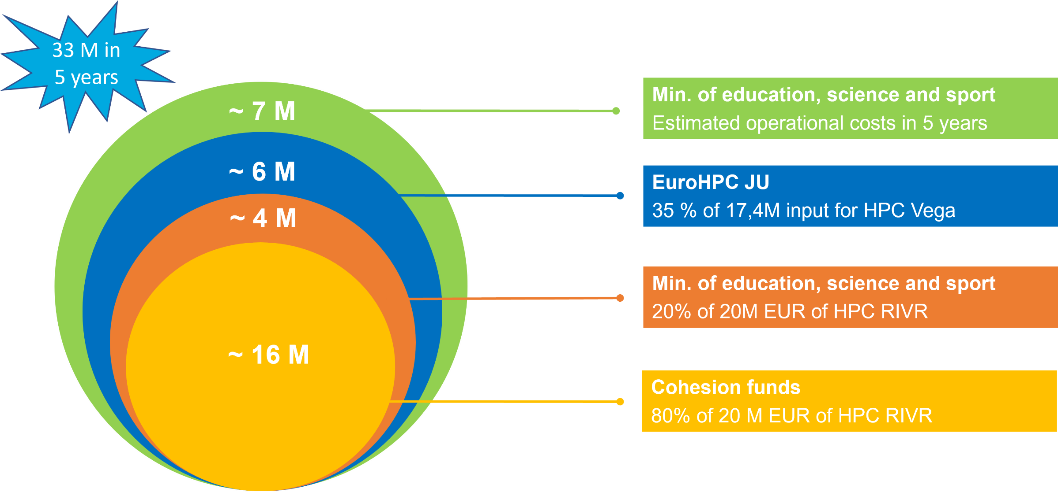
HPC Vega quick facts
1st operational EuroHPC JU system
In production since April 2021
Performance 6.9 PFLOPS
Atos Sequana XH2000
1020 Compute nodes, Infiniband 100Gb/s
18 PB Large Capacity Storage Ceph
1 PB High Performance Storage Lustre
Notes:
Named after the greatest Slovenian Mathematician – Baron Jurij Bartolomej Vega (Latin: Georgius Bartholomaei Vecha) in April 2021 it became the 1st operational EuroHPC JU system!
Based on the Atos Sequana XH2000 cabinets, connected via an Infiniband HDR network, its total of 1020 compute nodes sustain a performance of 6.9PFLOPs (R_max) with peaks even exceeding 10PFLOPs (R_peak). »Pioneering« with its 20 PB of storage capacity and its 600Gb/s high-throughput broadband connection into the world it runs efficiently, consuming less than 1MW of power.

Slide 4
Involvement in international projects
Notes:
InterTwin: recently the environment on HPC Vega was reconfigured to meet the requirements of the consortium (Slurm rebuild, integrating dCache mount points, migration from Singularity to apptainer, increased log retention to 180 days / 25 weeks,..
SMASH: 3rd call for postDoc fellows was opened this summer on 3.7.2024. In conjunction with SMASH, HPC Vega organized the second Introductory Workshop for SMASH fellows. In addition, we will participate at the 1st SMASHING WORKSHOP (7. - 11.10.2024).
EPICURE: We have just successfully concluded supporting our first project within EPICURE. The project (Anthropogenic Stressors and Future Changes of the North West European Shelf ecosystem) is using the GETM code. We have managed to reduce computing time on real-life examples (which was provided by the user) by 7%. Currently there are many more projects asking for support from EPICURE. The support offered by the EPICURE project will be highlighted also at the 1st SMASHING WORKSHOP (7. - 11.10.2024).
EUMaster4HPC: Our internship program is open to students of the EUMaster4HPC program. Students from II. Cohort will have the opportunity to use Portugal’s most powerful supercomputer, Deucalion. We are actively seeking mentors to supervise the students, helping them with Benchmarks using the Quantum Monte Carlo simulation package.

Slide 5
Context
Mission
Main Goals
Expected Outcomes
Support Services
Access the Resources
Consortium

Slide 6
Context
HPC has enabled technologies with a positive impact on society
More precise climate and weather modelling
Reduced healthcare research costs through simulation
Planning and yield prediction of renewable energy resources
Train larger and more complex Artificial Intelligence models
…
Installation of supercomputers in multiple countries reflects a commitment to HPC's technological potential
EuroHPC JU has been instrumental in elevating European supercomputing

Slide 7
Context
3
Pre-Exascale
5
Petascale
2
Future Exascale
LEONARDO
KAROLINA
JUPITER
LUMI
VEGA
JULIO VERNE
MARE NOSTRUM 5
MELUXINA
DISCOVERER
DEUCALION

Slide 8
Context
Mission
Main Goals
Expected Outcomes
Support Services
Access the Resources
Consortium

Slide 9
Mission
EPICURE utilizes the experience and knowledge of the current and future EuroHPC hosting organisations and to provide better user support
Adequate code installation and porting to different architectures (Level 2)
Intra- and inter-node optimisation, focusing on accelerators and scalability (Level 3)
Knowledge exchange through the organisation of hardware-specific training,, hackathons,, webinars, and workshops in several EU countries
Promotes sharing of expertise among hosting organisations
Provides users with a wide pool of knowledge

Slide 10
Context
Mission
Main Goals
Expected Outcomes
Support Services
Access the Resources
Consortium

Slide 11
Main Goals
To establish a four-year operation bringing together Application Support Teams (ASTs) of EuroHPC JU family and offer EU wide support;
To reach a large pool of users;
To develop a European HPC Application Support portal;
To contribute to the development and improvement of the European HPC Application Support Service;
To collaborate with the Centers of Excellence to develop an HPC-skilled workforce.

Slide 12
Context
Mission
Main Goals
Expected Outcomes
Support Services
Access the Resources
Consortium

Slide 13
Expected Outcomes
Publish best practice guidelines on how to code applications that use supercomputers adequately;
Create a knowledge pool of publicly available training and webinar activities;
Provide the community with optimised codes for various scientific domains;
Foster an educated HPC user community;
Provide a wide range of support services across all EuroHPC JU centers.

Slide 14
Context
Mission
Main Goals
Expected Outcomes
Support Services
Access the Resources
Consortium

Slide 15
Services NOT provided by EPICURE
First level support for EuroHPC Vega is provided by SLING
support@sling.si
General information: how to generate SSH key, etc.
Help for login and access to HPC Vega
Help setting up an environment
Preparation of workflows
Software
Building containers (Singularity/Apptainer)
Help to set up SBATCH scripts
Help to submit jobs

Slide 16
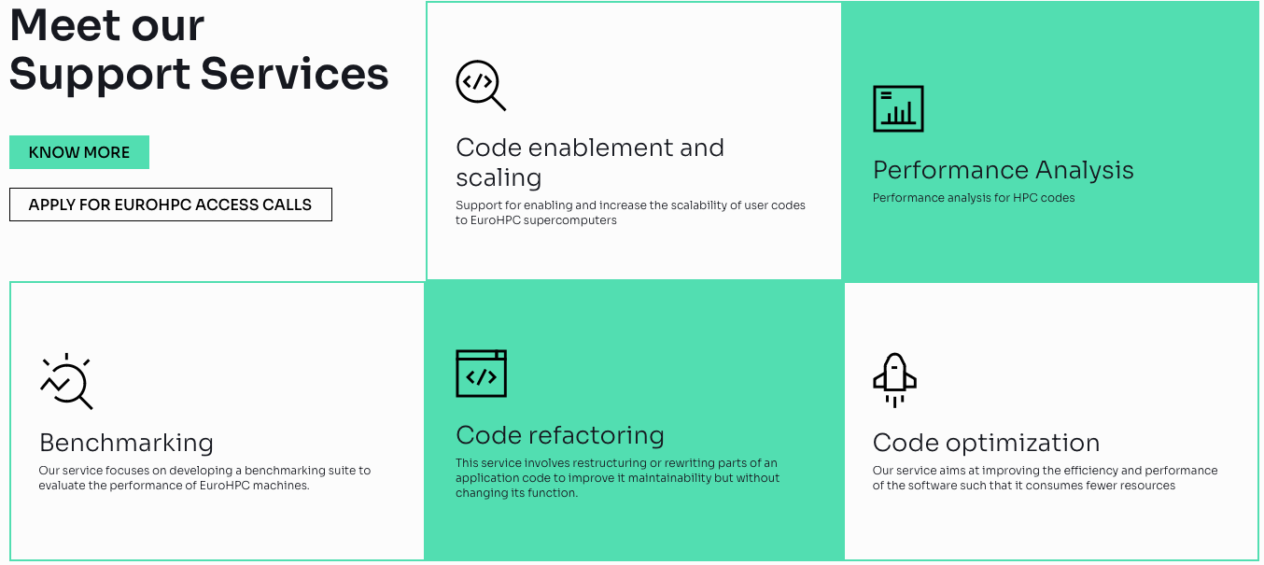
Support Services

Slide 17
Context
Mission
Main Goals
Expected Outcomes
Support Services
Access the Resources
Consortium

Slide 18
Access the Resources
https://pracecalls.eu/
Access to EuroHPC JU supercomputers through open calls
Development, Regular, Extreme Scale, and AI call
Accepted projects are matched to adequate supercomputers
Accepted projects get access to EPICURE support
Users choose the level of support needed
A team of experts will work closely with users to achieve set goals
^{1.} https://eurohpc-ju.europa.eu/access-our-supercomputers/eurohpc-access-calls_en

Slide 19
Context
Mission
Main Goals
Expected Outcomes
Support Services
Access the Resources
Consortium

Slide 20
Consortium

Slide 21
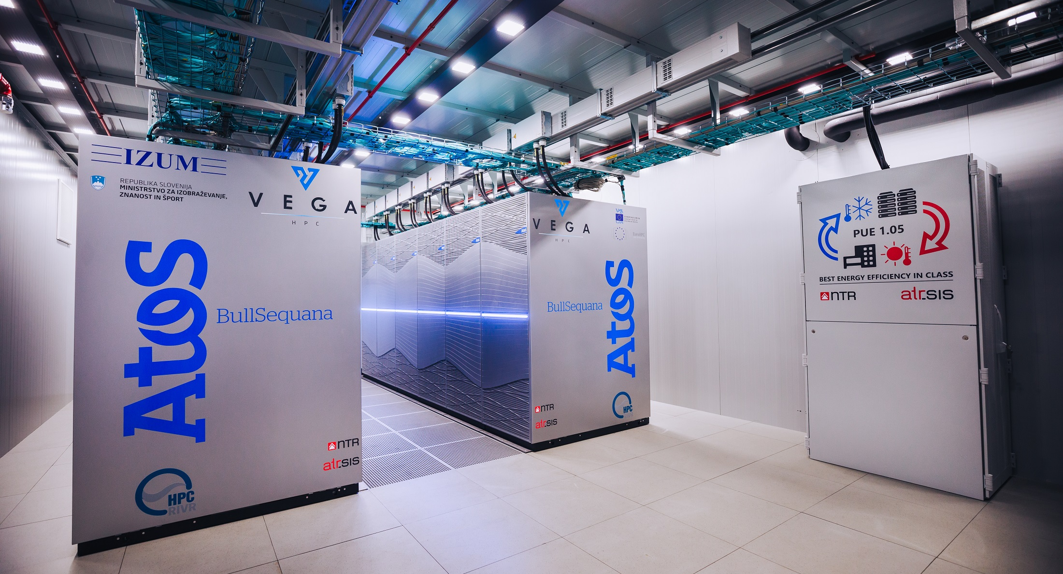
RIVR1
VEGA VIRTUAL TOUR
https://www.izum.si/virtualni-sprehod/VEGA.html
Notes:
And here you can see, how RIVR1 room looks today. Although I must say that virtual tour of this room is already possible, you are welcome see all facilities on our location, of course when this pandemic situation will be behind us some day.

Slide 22
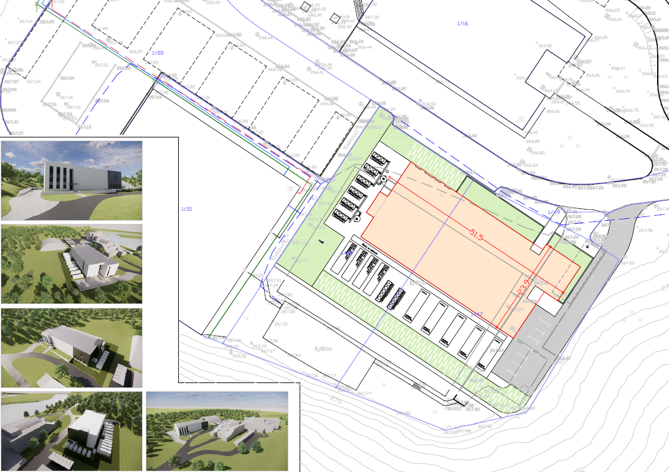
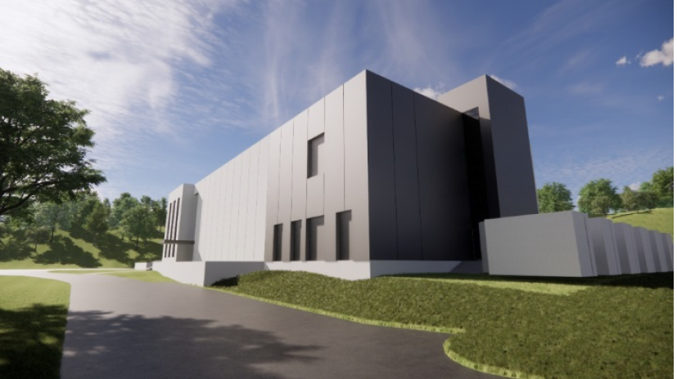
Outlook: new data center

Slide 23
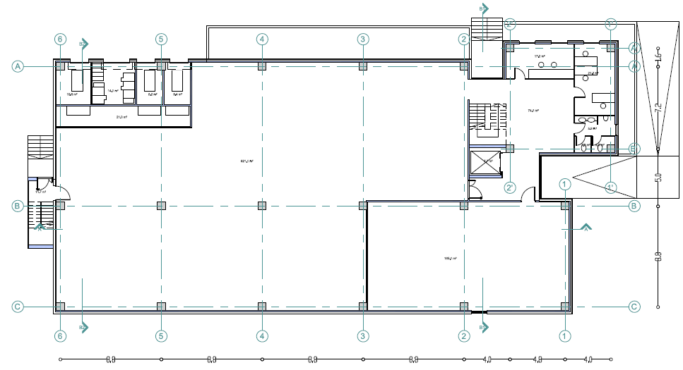
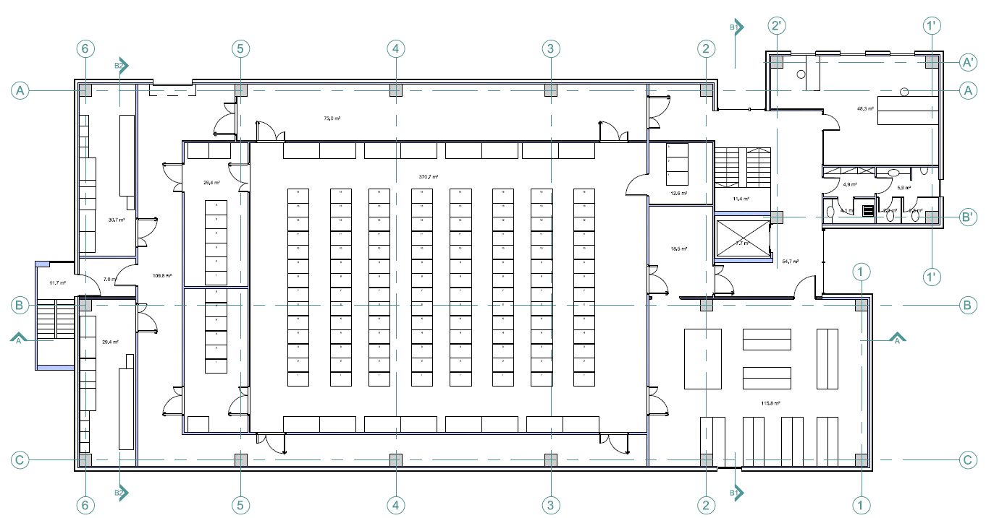
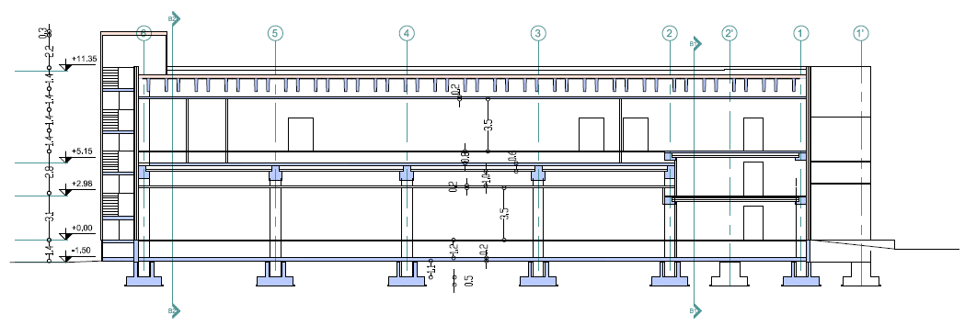
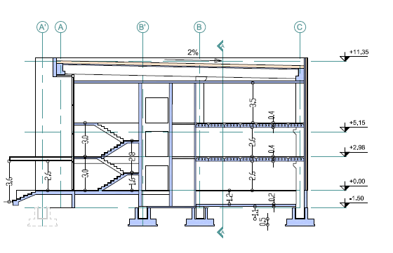
Lower floor dedicated for the HPC

