Slide 1
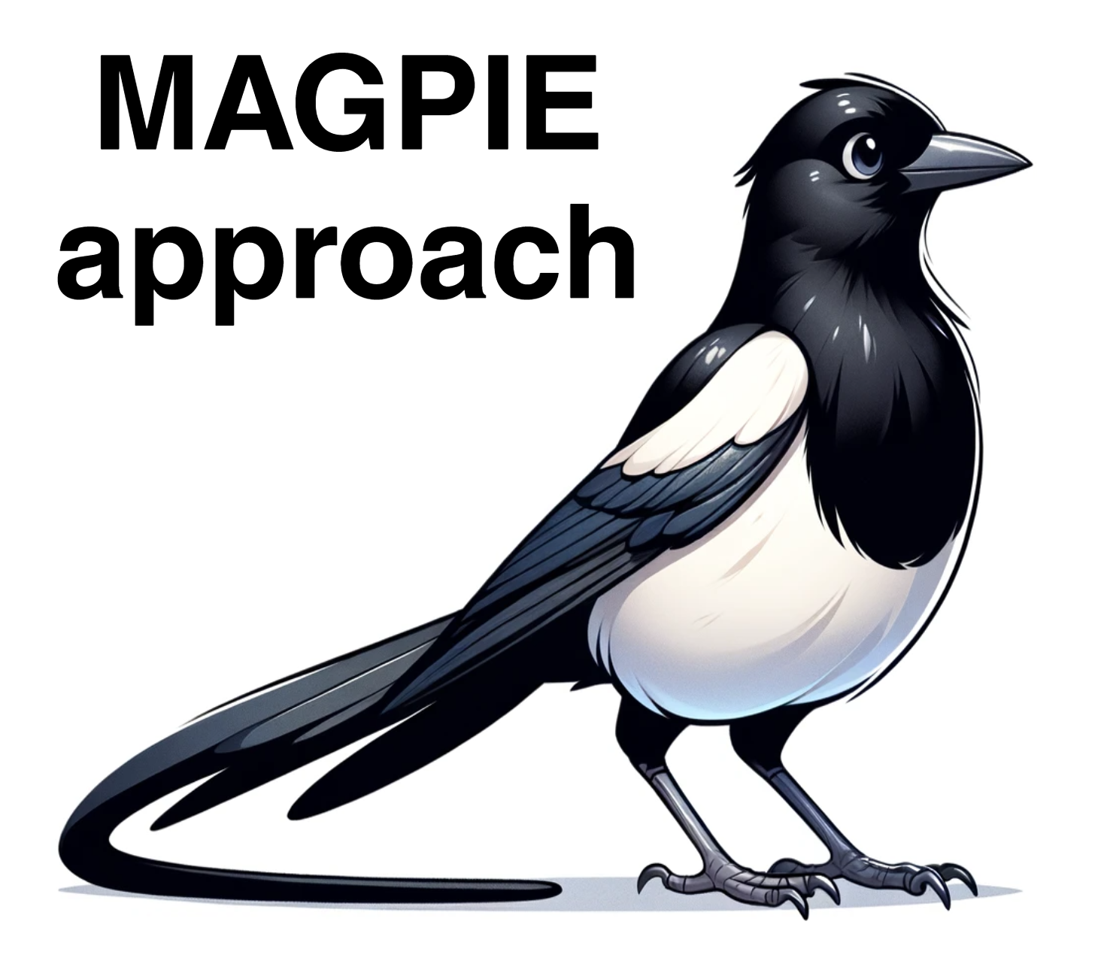


Machine-Learning Guided Binder Discovery for Advancing Pathology Biomarker Research
Klara Kropivšek
SMASH Fellow, staring 21 October 2024, Prof. Ario de Marco Lab
Vipava, 7 - 11 October 2024
1st SMASHing workshop

Slide 2
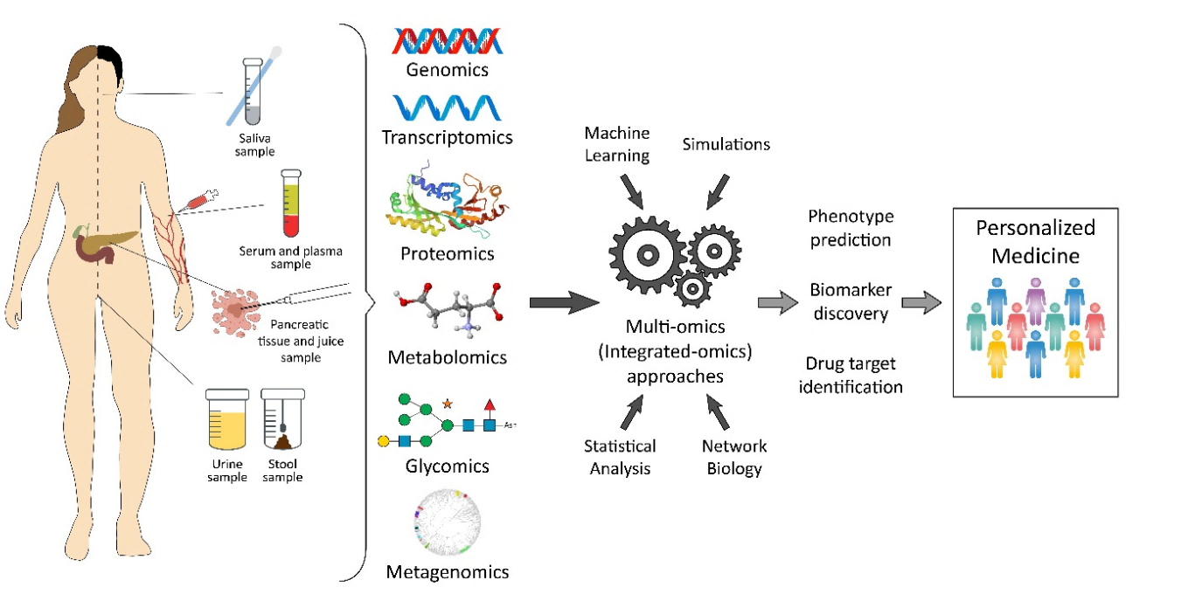
Introduction to Biomarkers and Current Challenges
What are biomarkers?
Measurable indicators in blood, urine, or tissues that signal disease presence or progression.
Why are biomarkers important?
Key for early diagnosis, tracking disease progression, and monitoring treatment effectiveness.
Challenges in cancer detection:
Late-stage detection: Many cancers (i.e., head and neck cancers) lack reliable early screening​.
Old treatment methods: Pediatric osteosarcomas, glioblastomas, and many other cancers still rely on outdated chemotherapy.
Need for better binders: Effective detection relies on molecules (binders) that attach to biomarkers with high specificity.
Image adapted from Turanli, B., et al. “Current State of “Omics” Biomarkers in Pancreatic Cancer.” Journal of Personalized Medicine 11 (2021).

Slide 3
Introduction to Biomarkers and Current Challenges
What are biomarkers?
Measurable indicators in blood, urine, or tissues that signal disease presence or progression.
Why are biomarkers important?
Key for early diagnosis, tracking disease progression, and monitoring treatment effectiveness.

Slide 4
Introduction to Biomarkers and Current Challenges
What are biomarkers?
Measurable indicators in blood, urine, or tissues that signal disease presence or progression.
Why are biomarkers important?
Key for early diagnosis, tracking disease progression, and monitoring treatment effectiveness.
Challenges in cancer detection:
Late-stage detection: Many cancers (i.e., head and neck cancers) lack reliable early screening​.
Old treatment methods: Pediatric osteosarcomas, glioblastomas, and many other cancers still rely on chemotherapy.
Need for better binders: Effective detection relies on molecules (binders) that attach to biomarkers with high specificity.

Slide 5
Binders and Why They Matter
What are binders?
Binders are molecules (e.g., antibodies) that attach to biomarkers (antigens), helping detect or treat diseases.

Slide 6
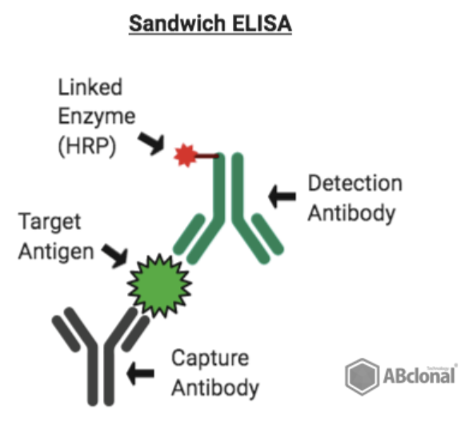
Binders and Why They Matter
What are binders?
Binders are molecules (e.g., antibodies) that attach to biomarkers (antigens), helping detect or treat diseases.
Viral antigen: SARS-Cov2
Sandwich ELISA: https://blog.abclonal.com/blog/featured-product-weekly-sars-cov-2-elisa-kits
Molecule of the month: HER2 with Trastuzumab<. https://pdb101.rcsb.org/motm/268

Slide 7
Binders and Why They Matter
What are binders?
Binders are molecules (e.g., antibodies) that attach to biomarkers (antigens), helping detect or treat diseases.
HER2 (antigen)
Trastuzumab (anti-HER2 antibody)
Viral antigen: SARS-Cov2
Sandwich ELISA: https://blog.abclonal.com/blog/featured-product-weekly-sars-cov-2-elisa-kits
Molecule of the month: HER2 with Trastuzumab<. https://pdb101.rcsb.org/motm/268

Slide 8
Binders and Why They Matter
What are binders?
Binders are molecules (e.g., antibodies) that attach to biomarkers, helping detect or treat diseases.
Challenges with current binders:
Size and stability: Traditional antibodies are large and may not penetrate dense tissues effectively.
Cost and production: Antibodies are expensive and require complex, timely manufacturing.

Slide 9
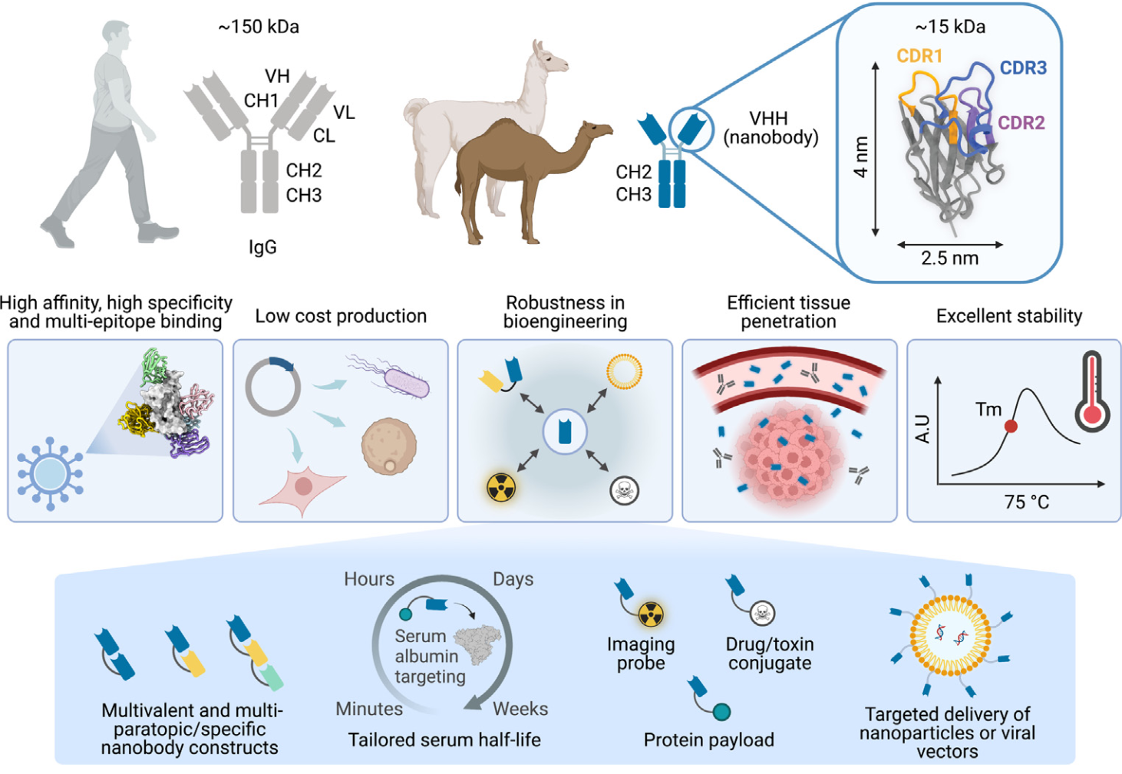
Binders and why they matter
Why nanobodies as binders?
Small and stable: Nanobodies are smaller, penetrate tissues better, and remain stable in harsh conditions.
Cost-effective: Nanobodies are cheaper to produce via microbial systems.
Broad applications: Useful in early detection and therapy for various diseases​.
Image adapted from: Shen Z, Sang Z, Shi Y. Nanobodies as a powerful platform for biomedicine. Trends Mol Med. 2022 Nov;28(11):1006-1007. doi: 10.1016/j.molmed.2022.08.007. Epub 2022 Sep 6. PMID: 36075813.

Slide 10
Binders and why they matter
Why nanobodies as binders?
Small and stable: Nanobodies are smaller, penetrate tissues better, and remain stable in harsh conditions.
Cost-effective: Nanobodies are cheaper to produce via microbial systems.
Broad applications: Useful in early detection and therapy for various diseases​.
Image adapted from: Shen Z, Sang Z, Shi Y. Nanobodies as a powerful platform for biomedicine. Trends Mol Med. 2022 Nov;28(11):1006-1007. doi: 10.1016/j.molmed.2022.08.007. Epub 2022 Sep 6. PMID: 36075813.

Slide 11
Binders and why they matter
Why nanobodies as binders?
Small and stable: Nanobodies are smaller, penetrate tissues better, and remain stable in harsh conditions.
Cost-effective: Nanobodies are cheaper to produce via microbial systems.
Broad applications: Useful in early detection and therapy for various diseases​.
Image adapted from: Shen Z, Sang Z, Shi Y. Nanobodies as a powerful platform for biomedicine. Trends Mol Med. 2022 Nov;28(11):1006-1007. doi: 10.1016/j.molmed.2022.08.007. Epub 2022 Sep 6. PMID: 36075813.

Slide 12
Binders and why they matter
Why nanobodies as binders?
Small and stable: Nanobodies are smaller, penetrate tissues better, and remain stable in harsh conditions.
Cost-effective: Nanobodies are cheaper to produce via microbial systems.
Broad applications: Useful in early detection and therapy for various diseases​.
Image adapted from: Shen Z, Sang Z, Shi Y. Nanobodies as a powerful platform for biomedicine. Trends Mol Med. 2022 Nov;28(11):1006-1007. doi: 10.1016/j.molmed.2022.08.007. Epub 2022 Sep 6. PMID: 36075813.

Slide 13
Aims of This Project
Main goal: Optimize nanobody (binder) detection using a machine learning (ML)-based approach.

Slide 14


Slide 15
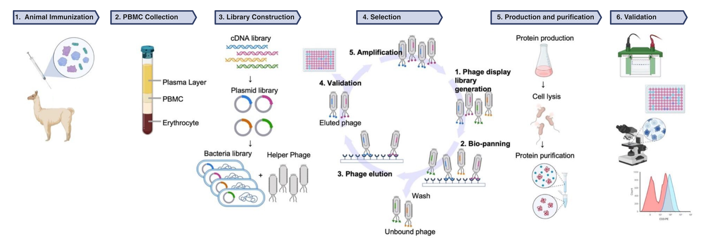
Aims of This Project
Main goal: Optimize nanobody (binder) detection using a machine learning (ML)-based approach.
Avoid traditional approaches: Binders are usually identified using an immunized library (specific search for one antigen).

Slide 16
Aims of This Project
Main goal: Optimize nanobody (binder) detection using a machine learning (ML)-based approach.
Avoid traditional approaches: Binders are usually identified using an immunized library (specific search for one antigen).
Aspect | Naive Library | Immunized Library | Synthetic Library
Source | Non-immunized animals | Immunized animals | Artificially constructed in the lab
Specificity | Broad (wide range of antigens) | High (specific to the antigen used for immunization) | Variable (depends on design)
Diversity | High (natural immune diversity) | Moderate (focused on the immunizing antigen) | Variable (limited by design choices)
Evolutionary Selection | Yes (naturally selected for stability and function) | Yes (evolutionary refinement against a specific antigen) | No (not naturally selected)
Time Investment | Low (no immunization required) | High (time required for immunization) | Moderate (time for design and synthesis)
Application | Ideal for novel antigen discovery | Best for targeting specific antigens | Useful for tailored designs or known targets

Slide 17
Aims of This Project
Main goal: Optimize nanobody (binder) detection using a machine learning (ML)-based approach.
Avoid traditional approaches: Binders are usually identified using an immunized library (specific search for one antigen).
Aspect | Naive Library | Immunized Library | Synthetic Library
Source | Non-immunized animals | Immunized animals | Artificially constructed in the lab
Specificity | Broad (wide range of antigens) | High (specific to the antigen used for immunization) | Variable (depends on design)
Diversity | High (natural immune diversity) | Moderate (focused on the immunizing antigen) | Variable (limited by design choices)
Evolutionary Selection | Yes (naturally selected for stability and function) | Yes (evolutionary refinement against a specific antigen) | No (not naturally selected)
Time Investment | Low (no immunization required) | High (time required for immunization) | Moderate (time for design and synthesis)
Application | Ideal for novel antigen discovery | Best for targeting specific antigens | Useful for tailored designs or known targets

Slide 18
Aims of This Project
Main goal: Optimize nanobody (binder) detection using a machine learning (ML)-based approach.
Avoid traditional approaches: Traditional approach: Binders are usually identified using an immunized library (specific search for one antigen).
Our approach: Machine-Learning Based Binder Discovery
Start with a naïve library, covering a broad range of potential binders.
Target any antigen: to find binders for any possible antigen, particularly human proteins, without being limited to one target (unsupervised biomarker discovery approach).

Slide 19
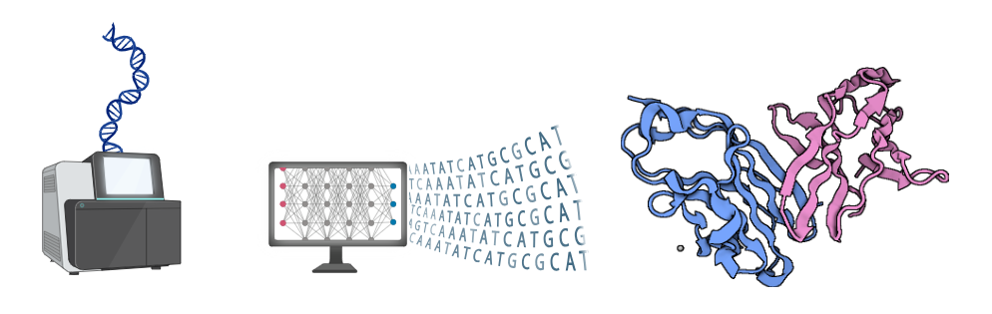
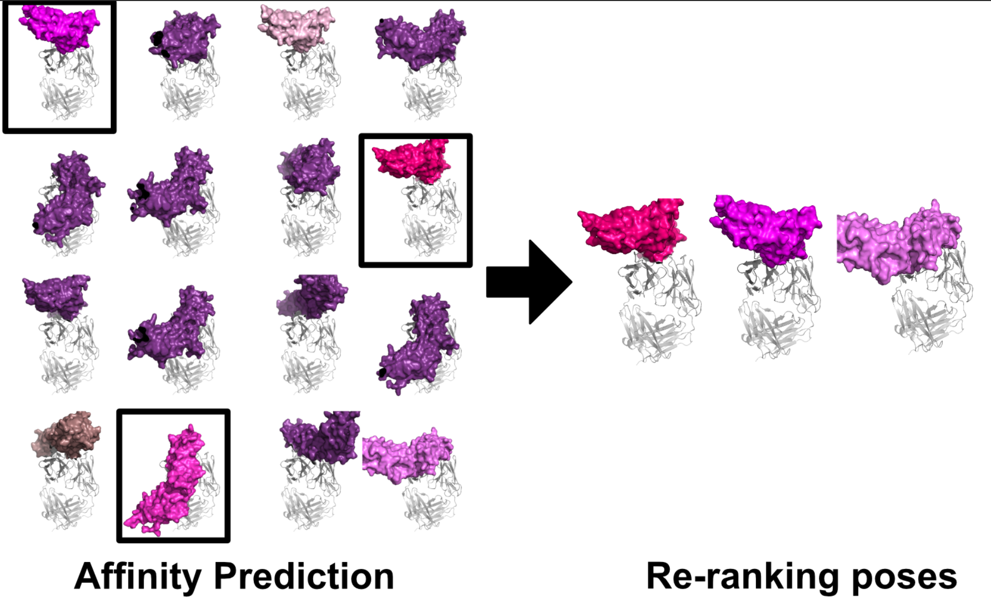
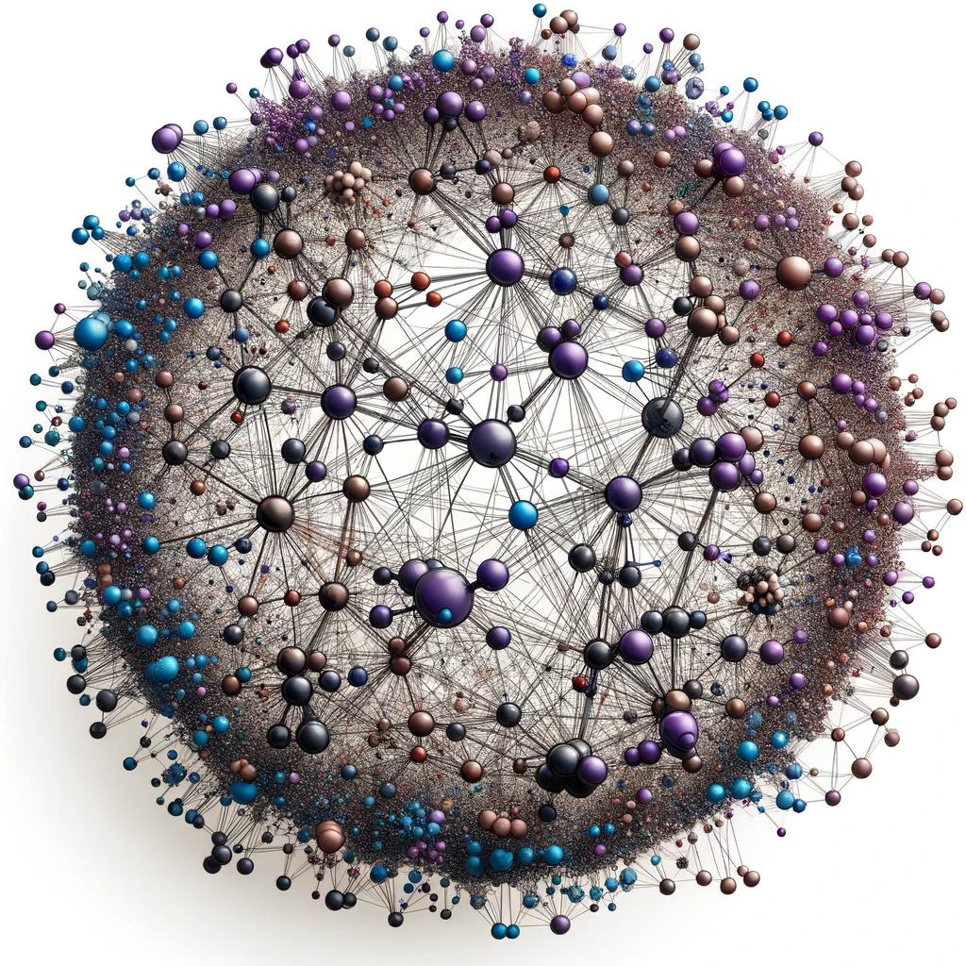




Methods and Technologies
The Hidden Human Epitopome
Sequencing and Data Acquisition:
NGS-Sequencing & Bioinformatic analysis of the FASTQ sequencing data of a representative portion of a naïve Nb library.
Structural Prediction:
Employing ML (ImmuneBuilder) to predict the 3D structures of Nbs. Selection of the best algorithm in terms of speed and accuracy. Ranking of structures (stability, precision).
Molecular Docking:
Using deep learning-enhanced docking simulations to predict binding affinities between Nbs and target epitopes.
Data Integration and Analysis: Aggregating data from various omic technologies to map the epitopes of human body and identify key biomarkers: mapping “the Hidden Human Epitopome”
2.5 Proof-of-Principle
Identification of potential ligands by ML-based docking against (known) antigens already used for in vitro panning. Testing of possible docking outcomes using deep learning algorithms. Focus on immune checkpoint inhibitors (PD1, PDL1, CTLA4, LIG3), as well as some biomarkers targeting cancer antigens (CD20, HER2, VEGF, EGFR). Cloning, production, and functional validation of the proposed ligands. Comparison of the candidates from docking and the clones from in vitro panning.
Image #4: Adapted from Biosig Lab:https://biosig.lab.uq.edu.au/csm_ab/
Notes:
Core aims: Discovering new Nbs and mapping the Hidden Human Epitopome.
Extensive screening: Purpose: Identifying nanobodies for binding with biomarkers.
Sructural Prediction: Process: Creating precise 3D models of nanobody-epitope interactions. Significance: Understanding binding mechanisms.
Molecular docking: - Importance: Enhancing binding prediction accuracy.
Bioinformatic analysis of the FASTQ sequencing data of a representative portion of a naïve Nb library (2.5 x10^7 clones on 10^9 clones obtained from the genetic material of 20 pre-immune animals).
Selection of the best performing algorithm regarding speed and accuracy (RMSD criteria and TM criteria, structural overlap of the predetermined Nb structures).

Slide 20
Methods and Technologies
Sequencing and Data Acquisition:
NGS-Sequencing & Bioinformatic analysis of the FASTQ sequencing data of a representative portion of a naïve Nb library.
Structural Prediction:
Employing ML (ImmuneBuilder) to predict the 3D structures of Nbs. Selection of the best algorithm in terms of speed and accuracy. Ranking of structures (stability, precision).
Abanades, B., Wong, W.K., Boyles, F. et al. ImmuneBuilder: Deep-Learning models for predicting the structures of immune proteins. Commun Biol 6, 575 (2023).
Modified from Jumper, J., Evans, R., Pritzel, A. et al. Highly accurate protein structure prediction with AlphaFold. Nature 596, 583–589 (2021). and
Notes:
Core aims: Discovering new Nbs and mapping the Hidden Human Epitopome.
Extensive screening: Purpose: Identifying nanobodies for binding with biomarkers.
Sructural Prediction: Process: Creating precise 3D models of nanobody-epitope interactions. Significance: Understanding binding mechanisms.
Molecular docking: - Importance: Enhancing binding prediction accuracy.
Bioinformatic analysis of the FASTQ sequencing data of a representative portion of a naïve Nb library (2.5 x10^7 clones on 10^9 clones obtained from the genetic material of 20 pre-immune animals).
Selection of the best performing algorithm regarding speed and accuracy (RMSD criteria and TM criteria, structural overlap of the predetermined Nb structures).

Slide 21
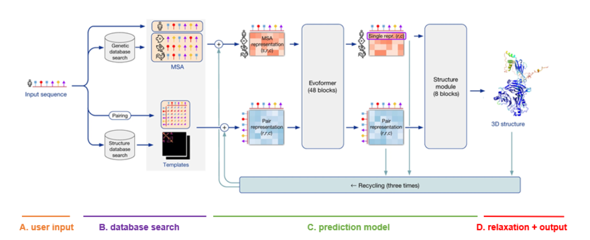
Methods and Technologies
AlphaFold2 architecture
Transformer layers
Invariant point attention
Geometric transformations
Sequencing and Data Acquisition:
NGS-Sequencing & Bioinformatic analysis of the FASTQ sequencing data of a representative portion of a naïve Nb library.
Structural Prediction:
Employing ML (ImmuneBuilder) to predict the 3D structures of Nbs. Selection of the best algorithm in terms of speed and accuracy. Ranking of structures (stability, precision).
25 mio Nb sequences
Modified from Jumper, J., Evans, R., Pritzel, A. et al. Highly accurate protein structure prediction with AlphaFold. Nature 596, 583–589 (2021). and
https://elearning.vib.be/courses/alphafold/lessons/the-alphafold-pipeline/topic/overview-of-the-architecture/
Notes:
Evoformer is designed using transformer layers
The Evoformer consists of two main stacks that handle two types of data representations:
MSA Stack: Processes evolutionary data from multiple sequence alignments.
Pair Representation Stack: Processes pairwise residue relationships for spatial reasoning.
Each stack has specialized deep learning layers, combining attention mechanisms with geometric transformations to model how protein residues interact.

Slide 22
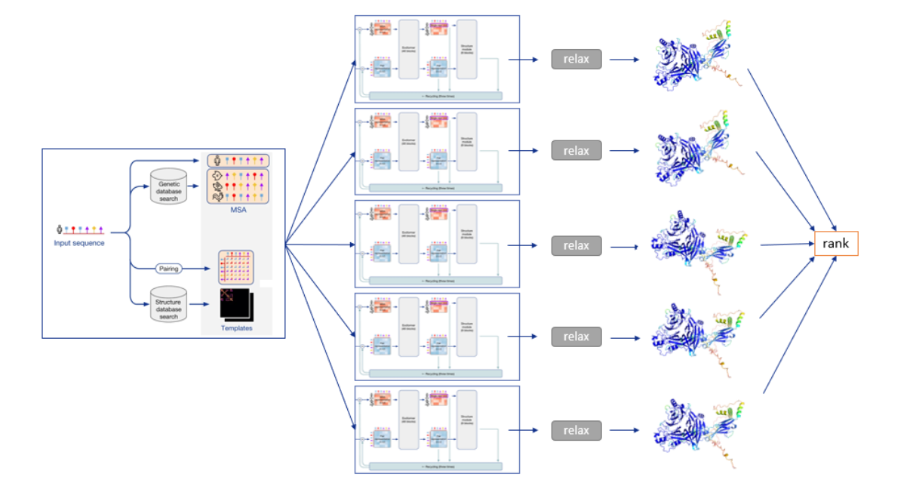
Methods and Technologies
AlphaFold2 architecture
Modified from Jumper, J., Evans, R., Pritzel, A. et al. Highly accurate protein structure prediction with AlphaFold. Nature 596, 583–589 (2021). and
https://elearning.vib.be/courses/alphafold/lessons/the-alphafold-pipeline/topic/overview-of-the-architecture/

Slide 23
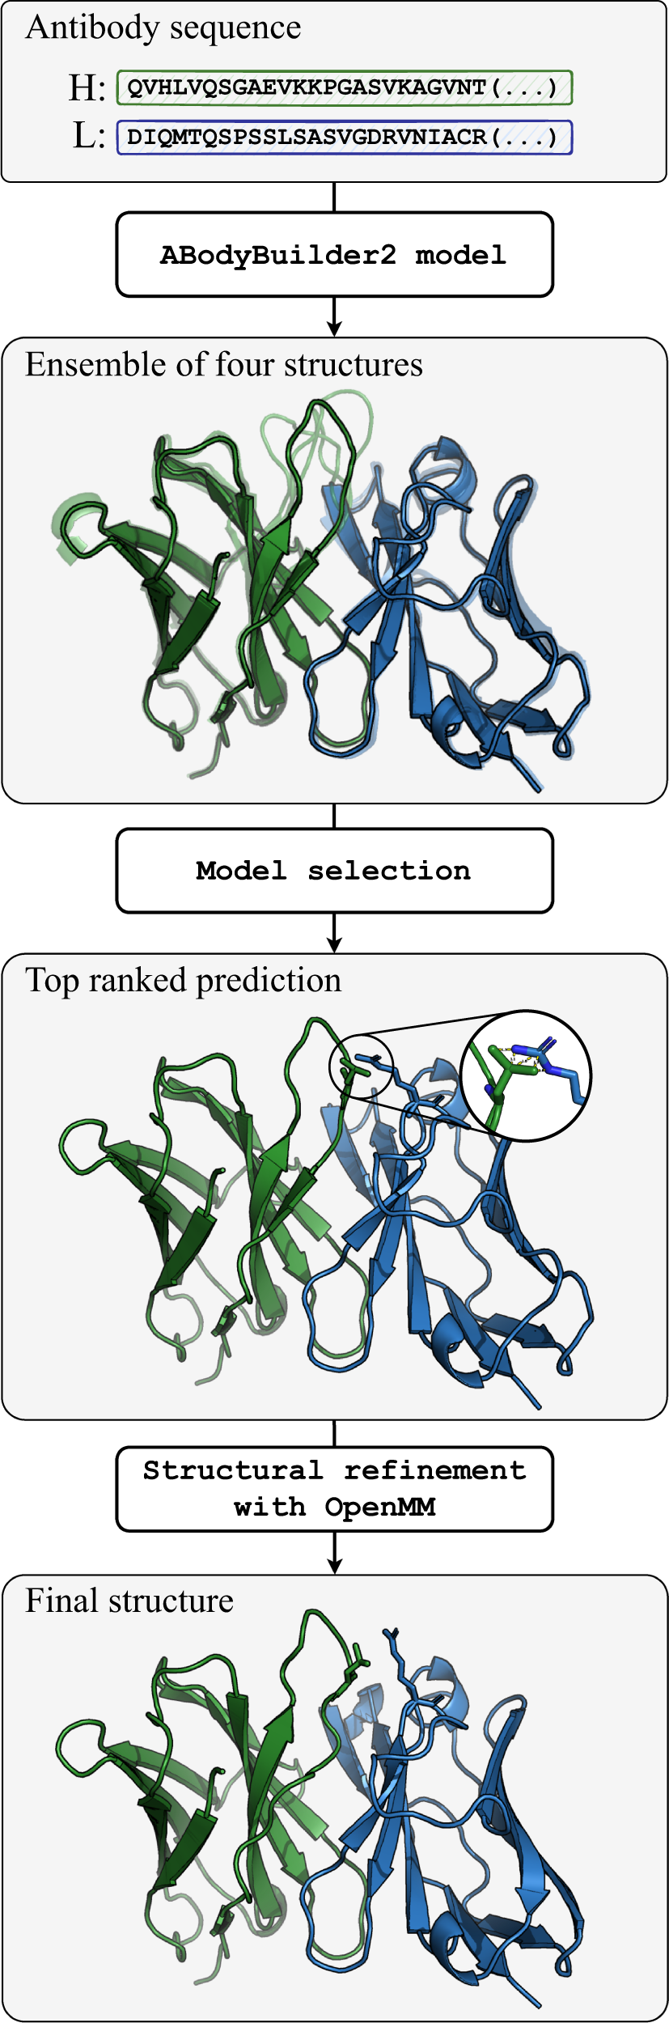
Methods and Technologies
AlphaFold2 architecture: changes to obtain ImmuneBuilder - NanoBodyBuilder2 architecture
Antibody-specific adaptation of AlphaFold-Multimer with eight independent update blocks.
Residues treated as rigid bodies with 3D coordinates and orientation matrices.
Modified Frame Aligned Point Error (FAPE) loss: 30 Å clamp for framework-CDR, 10 Å for other residues.
Structural violation penalty reduced by one order of magnitude for improved accuracy.
Torsion angles predicted from node features to reconstruct all-atom structures.
Two-stage training: dropout (10%) and no structural violation term in stage 1; fixed LR and gradient clipping in stage 2.
Model selection: four independent models; final structure closest to average alignment.
Post-prediction refinement via energy minimization using OpenMM; cis-peptide bonds corrected and D-stereoisomers flipped to L.
Abanades, B., Wong, W.K., Boyles, F. et al. ImmuneBuilder: Deep-Learning models for predicting the structures of immune proteins. Commun Biol 6, 575 (2023).
Modified from Jumper, J., Evans, R., Pritzel, A. et al. Highly accurate protein structure prediction with AlphaFold. Nature 596, 583–589 (2021). and
https://elearning.vib.be/courses/alphafold/lessons/the-alphafold-pipeline/topic/overview-of-the-architecture/

Slide 24
Methods and Technologies
Sequencing and Data Acquisition:
NGS-Sequencing & Bioinformatic analysis of the FASTQ sequencing data of a representative portion of a naïve Nb library.
Structural Prediction:
Employing ML (ImmuneBuilder) to predict the 3D structures of Nbs. Selection of the best algorithm in terms of speed and accuracy. Ranking of structures (stability, precision).
Molecular Docking:
Using physics-based and deep learning-enhanced docking simulations to predict binding affinities between Nbs and target epitopes.
2.5 Proof-of-Principle
Identification of potential ligands by ML-based docking against (known) antigens already used for in vitro panning. Testing of possible docking outcomes using deep learning algorithms. Focus on immune checkpoint inhibitors (PD1, PDL1, CTLA4, LIG3), as well as some biomarkers targeting cancer antigens (CD20, HER2, VEGF, EGFR). Cloning, production, and functional validation of the proposed ligands. Comparison of the candidates from docking and the clones from in vitro panning.
Image #4: Adapted from Biosig Lab:https://biosig.lab.uq.edu.au/csm_ab/

Slide 25
Methods and Technologies
The Hidden Human Epitopome
Sequencing and Data Acquisition:
NGS-Sequencing & Bioinformatic analysis of the FASTQ sequencing data of a representative portion of a naïve Nb library.
Structural Prediction:
Employing ML (ImmuneBuilder) to predict the 3D structures of Nbs. Selection of the best algorithm in terms of speed and accuracy. Ranking of structures (stability, precision).
Molecular Docking:
Using physics-based and deep learning-enhanced docking simulations to predict binding affinities between Nbs and target epitopes.
Data Integration and Analysis: Aggregating data from various omic technologies to map the epitopes of human body and identify key biomarkers: mapping “the Hidden Human Epitopome”
2.5 Proof-of-Principle
Identification of potential ligands by ML-based docking against (known) antigens already used for in vitro panning. Testing of possible docking outcomes using deep learning algorithms. Focus on immune checkpoint inhibitors (PD1, PDL1, CTLA4, LIG3), as well as some biomarkers targeting cancer antigens (CD20, HER2, VEGF, EGFR). Cloning, production, and functional validation of the proposed ligands. Comparison of the candidates from docking and the clones from in vitro panning.
Image #4: Adapted from Biosig Lab:https://biosig.lab.uq.edu.au/csm_ab/
Notes:
Core aims: Discovering new Nbs and mapping the Hidden Human Epitopome.
Extensive screening: Purpose: Identifying nanobodies for binding with biomarkers.
Sructural Prediction: Process: Creating precise 3D models of nanobody-epitope interactions. Significance: Understanding binding mechanisms.
Molecular docking: - Importance: Enhancing binding prediction accuracy.
Bioinformatic analysis of the FASTQ sequencing data of a representative portion of a naïve Nb library (2.5 x10^7 clones on 10^9 clones obtained from the genetic material of 20 pre-immune animals).
Selection of the best performing algorithm regarding speed and accuracy (RMSD criteria and TM criteria, structural overlap of the predetermined Nb structures).

Slide 26
Expected Outcomes
Nanobody 3D structure prediction and refinement
Build a library of 3D Nb structures.
Mapping «the human epitopome»:
Build a comprehensive catalog of nanobodies for unexplored biomarkers (epitopes on antigens).
Novel biomarker discovery:
Identify new biomarkers for better diagnostic and therapeutic interventions.
Clinical applications:
Nanobodies can be used for diagnostics (biosensors) and personalized therapies.
Image generated using DALL-E, Open-AI, 2024.

Slide 27
Conclusion
Summary: Combining ML and nanobody research offers a new approach for discovering biomarkers and treating diseases:
  Improved diagnostics: Faster, more accurate detection of cancer biomarkers in fluids (e.g., blood, urine).
  Personalized therapies: Nanobodies allow for targeted treatments that improve effectiveness and reduce side effects.
  Clinical relevance: Particularly valuable for cancers with poor early detection and for diseases (i.e., paediatric osteosarcomas, glioblastomas) that need better treatment options.
Key takeaway: Mapping the “hidden human epitopome” using nanobodies provides more precise tools for diagnostics and personalized medicine.

Slide 28

Thank you for your attention!
Acknowledgements:
Prof. Dr. Ario de Marco, UNG, Slovenia
Prof. Dr. Ajasja Ljubetic, NIC, Slovenia
Prof. Dr. Charlotte Dean, Oxford University, UK
Prof. Dr. Victor Greiff, University of Oslo, Norway
Prof. Dr. Berend Snijder, ETH, Switzerland

Slide 29
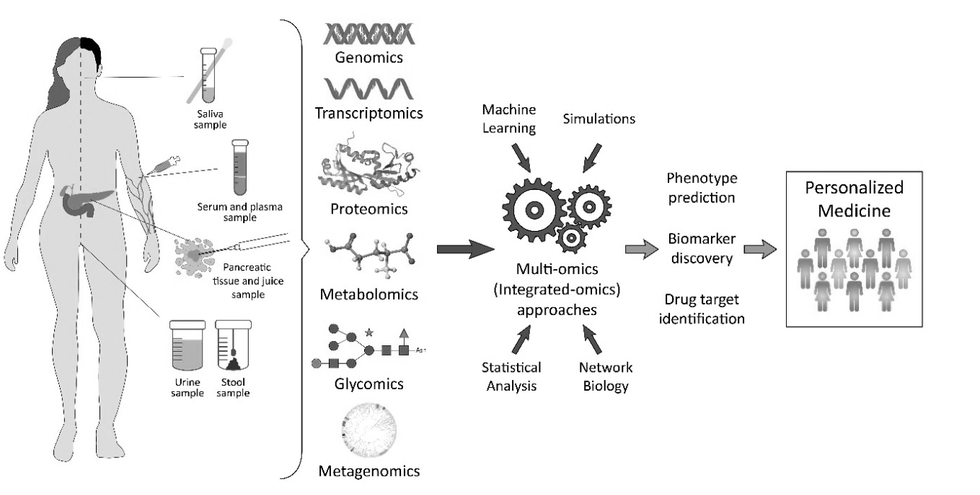
Introduction to Biomarkers and Current Challenges
What are biomarkers?
Measurable indicators in blood, urine, or tissues that signal disease presence or progression.
Why are biomarkers important?
Key for early diagnosis, tracking disease progression, and monitoring treatment effectiveness.
Challenges in cancer detection:
Late-stage detection: Many cancers (i.e., head and neck cancers) lack reliable early screening​.
Old treatment methods: Pediatric osteosarcomas, glioblastomas, and many other cancers still rely on outdated chemotherapy.
Need for better binders: Effective detection relies on molecules (binders) that attach to biomarkers with high specificity.
By biological information:
DNA (mutations, genetic variants, chromosomal aberrations),
RNA,
Proteins,
Metabolites,
Glycosylated proteins.
Image adapted from Turanli, B., et al. “Current State of “Omics” Biomarkers in Pancreatic Cancer.” Journal of Personalized Medicine 11 (2021).

Slide 30
Introduction to Biomarkers and Current Challenges
What are biomarkers?
Measurable indicators in blood, urine, or tissues that signal disease presence or progression.
Why are biomarkers important?
Key for early diagnosis, tracking disease progression, and monitoring treatment effectiveness.
Challenges in cancer detection:
Late-stage detection: Many cancers (i.e., head and neck cancers) lack reliable early screening​.
Old treatment methods: Pediatric osteosarcomas, glioblastomas, and many other cancers still rely on outdated chemotherapy.
Need for better binders: Effective detection relies on molecules (binders) that attach to biomarkers with high specificity.
By biological information:
DNA (mutations, genetic variants, chromosomal aberrations),
RNA,
Proteins,
Metabolites,
Glycosylated proteins,…
By use in the clinic:
Susceptibility/risk
Diagnostic,
Monitoring,
Prognostic,
Predictive,
Pharmacodynamic/response,
Safety.
Image adapted from Turanli, B., et al. “Current State of “Omics” Biomarkers in Pancreatic Cancer.” Journal of Personalized Medicine 11 (2021).

Slide 31
Methods and Technologies
PD1 in complex with PDL1
The Hidden Human Epitopome
Sequencing and Data Acquisition:
NGS-Sequencing & Bioinformatic analysis of the FASTQ sequencing data of a representative portion of a naïve Nb library.
Structural Prediction:
Employing ML (ImmuneBuilder) to predict the 3D structures of Nbs. Selection of the best algorithm in terms of speed and accuracy. Ranking of structures (stability, precision).
Molecular Docking:
Using deep learning-enhanced docking simulations to predict binding affinities between Nbs and target epitopes.
Data Integration and Analysis: Aggregating data from various omic technologies to map the epitopes of human body and identify key biomarkers: mapping “the Hidden Human Epitopome”
2.5 Proof-of-Principle
Identification of potential ligands by ML-based docking against (known) antigens already used for in vitro panning. Testing of possible docking outcomes using deep learning algorithms. Focus on immune checkpoint inhibitors (PD1, PDL1, CTLA4, LIG3), as well as some biomarkers targeting cancer antigens (CD20, HER2, VEGF, EGFR). Cloning, production, and functional validation of the proposed ligands. Comparison of the candidates from docking and the clones from in vitro panning.
Image #4: Adapted from Biosig Lab:https://biosig.lab.uq.edu.au/csm_ab/
Notes:
Core aims: Discovering new Nbs and mapping the Hidden Human Epitopome.
Extensive screening: Purpose: Identifying nanobodies for binding with biomarkers.
Sructural Prediction: Process: Creating precise 3D models of nanobody-epitope interactions. Significance: Understanding binding mechanisms.
Molecular docking: - Importance: Enhancing binding prediction accuracy.
Bioinformatic analysis of the FASTQ sequencing data of a representative portion of a naïve Nb library (2.5 x10^7 clones on 10^9 clones obtained from the genetic material of 20 pre-immune animals).
Selection of the best performing algorithm regarding speed and accuracy (RMSD criteria and TM criteria, structural overlap of the predetermined Nb structures).

Slide 32
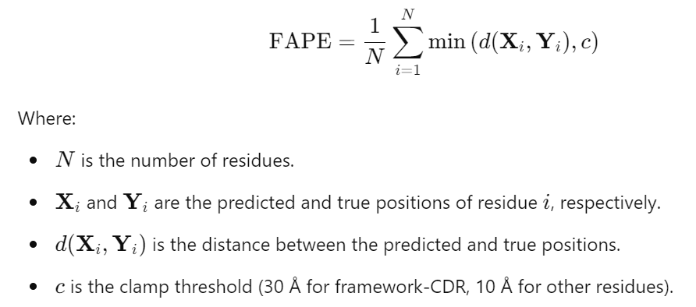
Methods and Technologies
AlphaFold2 architecture: changes to obtain ImmuneBuilder - NanoBodyBuilder2 architecture
Antibody-specific adaptation of AlphaFold-Multimer with eight independent update blocks.
Residues treated as rigid bodies with 3D coordinates and orientation matrices.
Modified Frame Aligned Point Error (FAPE) loss: 30 Å clamp for framework-CDR, 10 Å for other residues.
Abanades, B., Wong, W.K., Boyles, F. et al. ImmuneBuilder: Deep-Learning models for predicting the structures of immune proteins. Commun Biol 6, 575 (2023).
Modified from Jumper, J., Evans, R., Pritzel, A. et al. Highly accurate protein structure prediction with AlphaFold. Nature 596, 583–589 (2021). and
https://elearning.vib.be/courses/alphafold/lessons/the-alphafold-pipeline/topic/overview-of-the-architecture/
Notes:
Core aims: Discovering new Nbs and mapping the Hidden Human Epitopome.
Extensive screening: Purpose: Identifying nanobodies for binding with biomarkers.
Sructural Prediction: Process: Creating precise 3D models of nanobody-epitope interactions. Significance: Understanding binding mechanisms.
Molecular docking: - Importance: Enhancing binding prediction accuracy.
Bioinformatic analysis of the FASTQ sequencing data of a representative portion of a naïve Nb library (2.5 x10^7 clones on 10^9 clones obtained from the genetic material of 20 pre-immune animals).
Selection of the best performing algorithm regarding speed and accuracy (RMSD criteria and TM criteria, structural overlap of the predetermined Nb structures).

Slide 33
Methods and Technologies
Docking Using HADDOCK with Refined Docking
HADDOCK Docking:
  Data-Driven: Uses ambiguous restraints for flexible CDR loops.
  Molecular Dynamics: Allows conformational flexibility during binding for nanobody-antigen complexes.
Refinement with DeepRank:
  Deep Neural Network: Evaluates interaction features (hydrogen bonds, electrostatic interactions, hydrophobic contacts) to rank docked conformations.
  Refined Scoring: Uses patterns learned from protein-protein interaction datasets to improve docking accuracy.
Image #4: Adapted from Biosig Lab:https://biosig.lab.uq.edu.au/csm_ab/
Notes:
Core aims: Discovering new Nbs and mapping the Hidden Human Epitopome.
Extensive screening: Purpose: Identifying nanobodies for binding with biomarkers.
Sructural Prediction: Process: Creating precise 3D models of nanobody-epitope interactions. Significance: Understanding binding mechanisms.
Molecular docking: - Importance: Enhancing binding prediction accuracy.
Bioinformatic analysis of the FASTQ sequencing data of a representative portion of a naïve Nb library (2.5 x10^7 clones on 10^9 clones obtained from the genetic material of 20 pre-immune animals).
Selection of the best performing algorithm regarding speed and accuracy (RMSD criteria and TM criteria, structural overlap of the predetermined Nb structures).

Slide 34
Methods and Technologies
Nanobody screening:
NGS sequencing identifies a broad set of nanobodies (> 25mio sequences).
3D structural modeling:
Use of deep learning to model nanobody structures and predict interactions.
Molecular docking:
ML-driven predictions of nanobodies binding to antigens (biomarkers) across human proteins (with a known 3D structure – cca 20,000 proteins in the PDB database).

Slide 35
Foreseen Challenges
Data load:
3D structure determination for over 25 million sequences, and precision ranking will be a challenge.
Combinatorial problem in molecular docking:
Docking nanobodies against known human 3D structures is computationally intense due to the vast combinations.
Affinity scoring:
Current methods for scoring Nb-antigen interactions are inconsistent and may lack reproducibility in lab settings. Better scoring functions are still needed.

Slide 36
Application of Nanobodies in Early Detection and Therapy
Nanobodies for early detection:
Head and neck cancers: Nanobodies can enhance non-invasive urine tests for early detection​.
Blood-based detection: Nanobodies used to detect early tumor markers in cancers like colorectal and prostate​.
Nanobodies in cancer therapy:
Pediatric osteosarcoma: Nanobodies could be used in CAR T-cell therapy for more targeted treatments​.
Other cancers: Research shows nanobodies can target tumor-specific markers, improving treatment precision​.

