Slide 1







Behind the Scenes of AI Literature Search: From Evidence to Answers
Yun Wang
Notes:
this talk is tailored

Slide 2








Have you ever used them for searching literature / writing text?
Notes:
show your hands if you have used any of the tools in the top box, like Consensus or Elicit?
And how about using ChatGPT or Claude to find literature ?
If many hands go up:
“Great! Then hopefully this talk will give you a better idea of what's happening behind the scenes.”
If only a few hands go up:
“Oh, fewer hands than I expected! That's actually fine, because I've kept this talk quite introductory.”
Then continue:
“Today, I'll talk about AI tools for searching scientific literature, and a little about how they work behind the scenes.

Slide 3
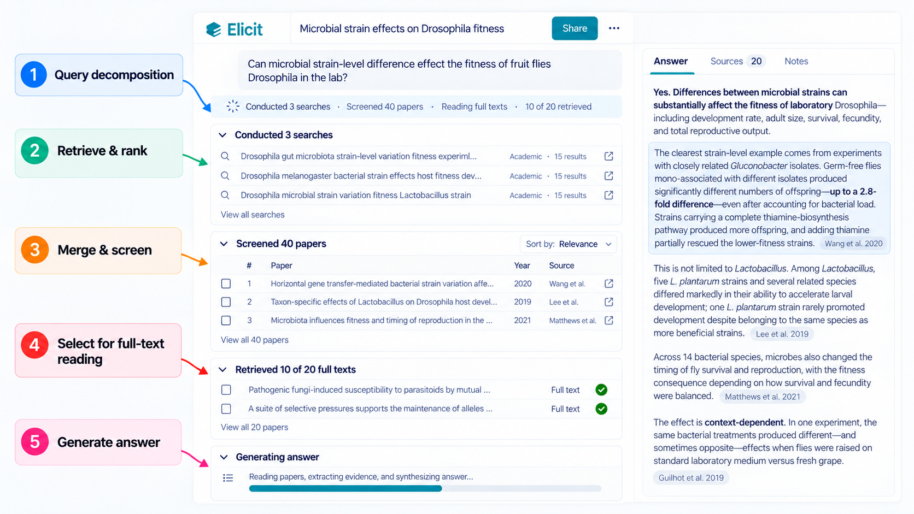
Notes:
I've tailored this talk to be fairly introductory
literature searching is often part of our research, so I hope you'll find it useful.
My hope is that, by the end of the the talk when we come back to this tool interface, you'll have a better idea of what's happening behind this

Slide 4


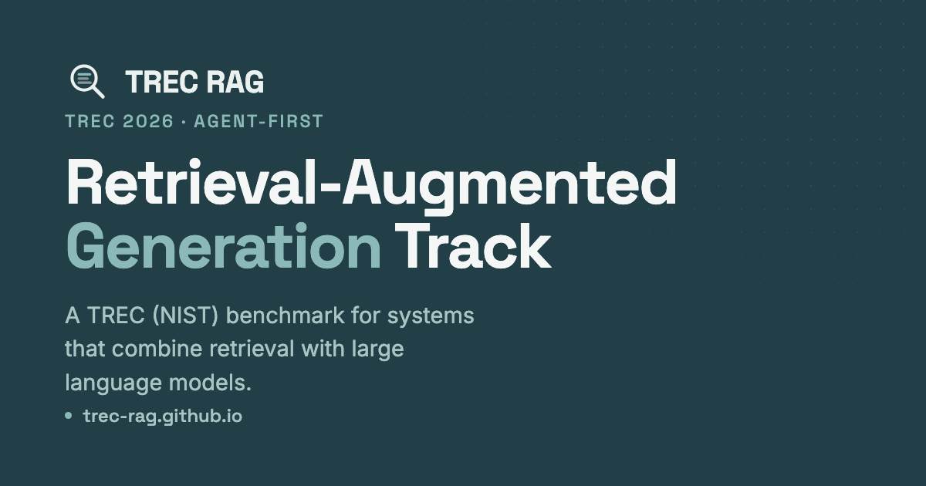
Notes:
A lot of what I've learned about literature retrieval and RAG actually comes from participating in two research challenges

Slide 5
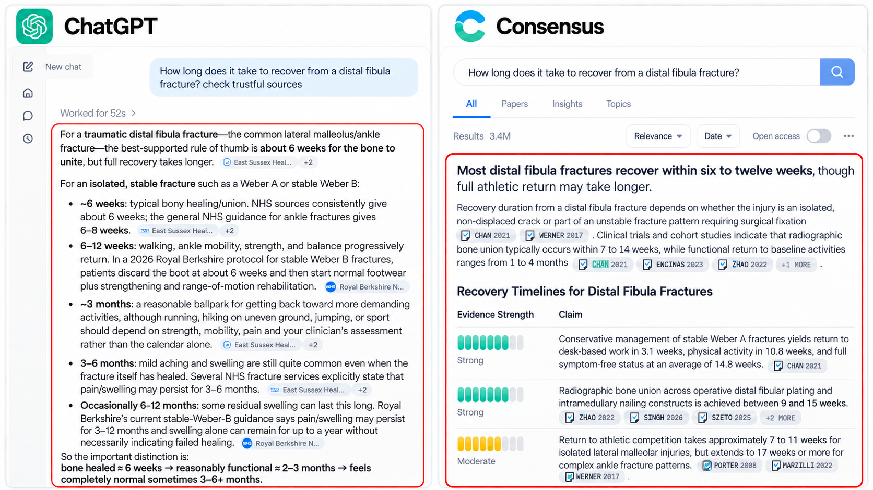
Adapted from screenshots of ChatGPT and Consensus
Notes:
Here are two examples from ChatGPT and Consensus. Both answer questions and provide references.
what chatgpt provides depends on how you prompt it
For this question about ankle fracture recovery, ChatGPT used websites, while Consensus focused on scientific papers

Slide 6
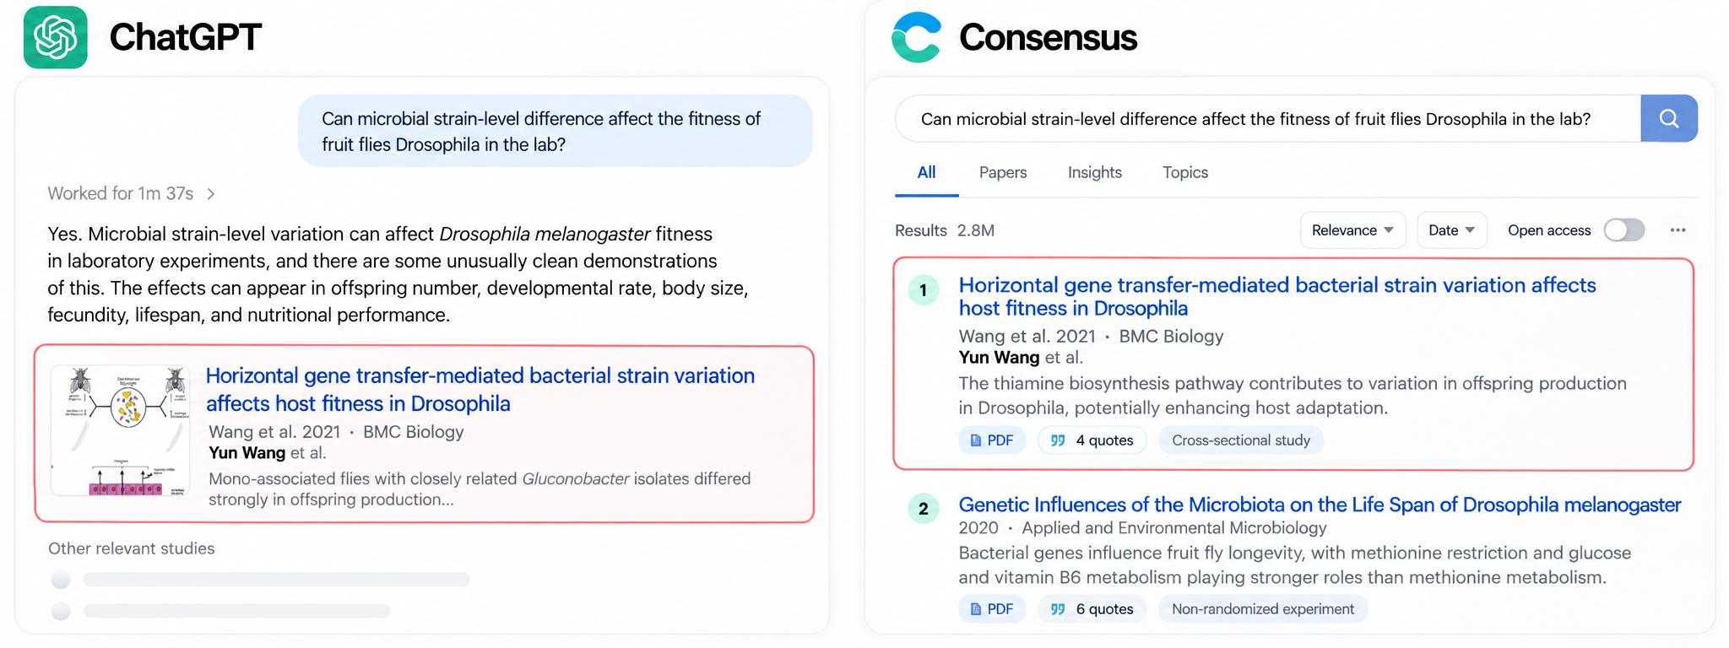
Adapted from screenshots of ChatGPT and Consensus
Notes:
Here's a more specialized question, where I knew exactly what I was looking for. And I was happy to see that both tools found my PhD work!

Slide 7
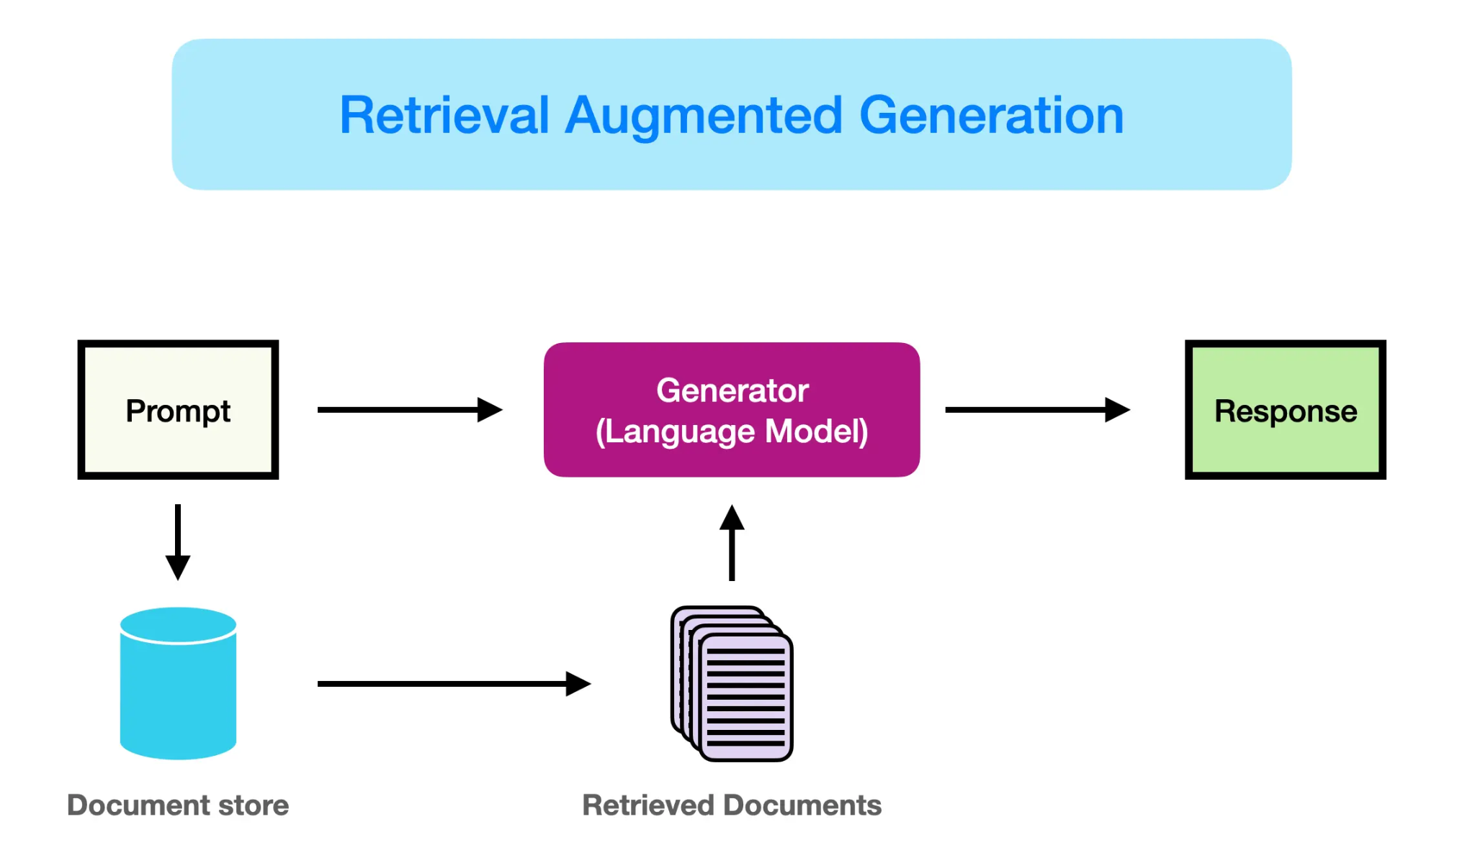
Retrieval-Augmented Generation (RAG)
Notes:
“Behind these tools is a technique called retrieval-augmented generation, or RAG.
The idea is quite simple: instead of relying only on the language model's internal knowledge, we first retrieve relevant documents and use them to generate an answer”

Slide 8
Retrieval-Augmented Generation (RAG)
What is the biggest difference between chatGPT and consensus?
Notes:
“So, if ChatGPT and Consensus both use this general approach, what's one of the key differences between them?”

Slide 9




Where do the search?
the broader web
a defined literature corpus
Notes:
ChatGPT can search broadly across the web, whereas Consensus searches a defined corpus of scientific literature.
In this talk, I'll focus more on the latter approach, which is also closer to the traditional setup of RAG
And here matters, because the papers available to the system determine what evidence it can find.

Slide 10
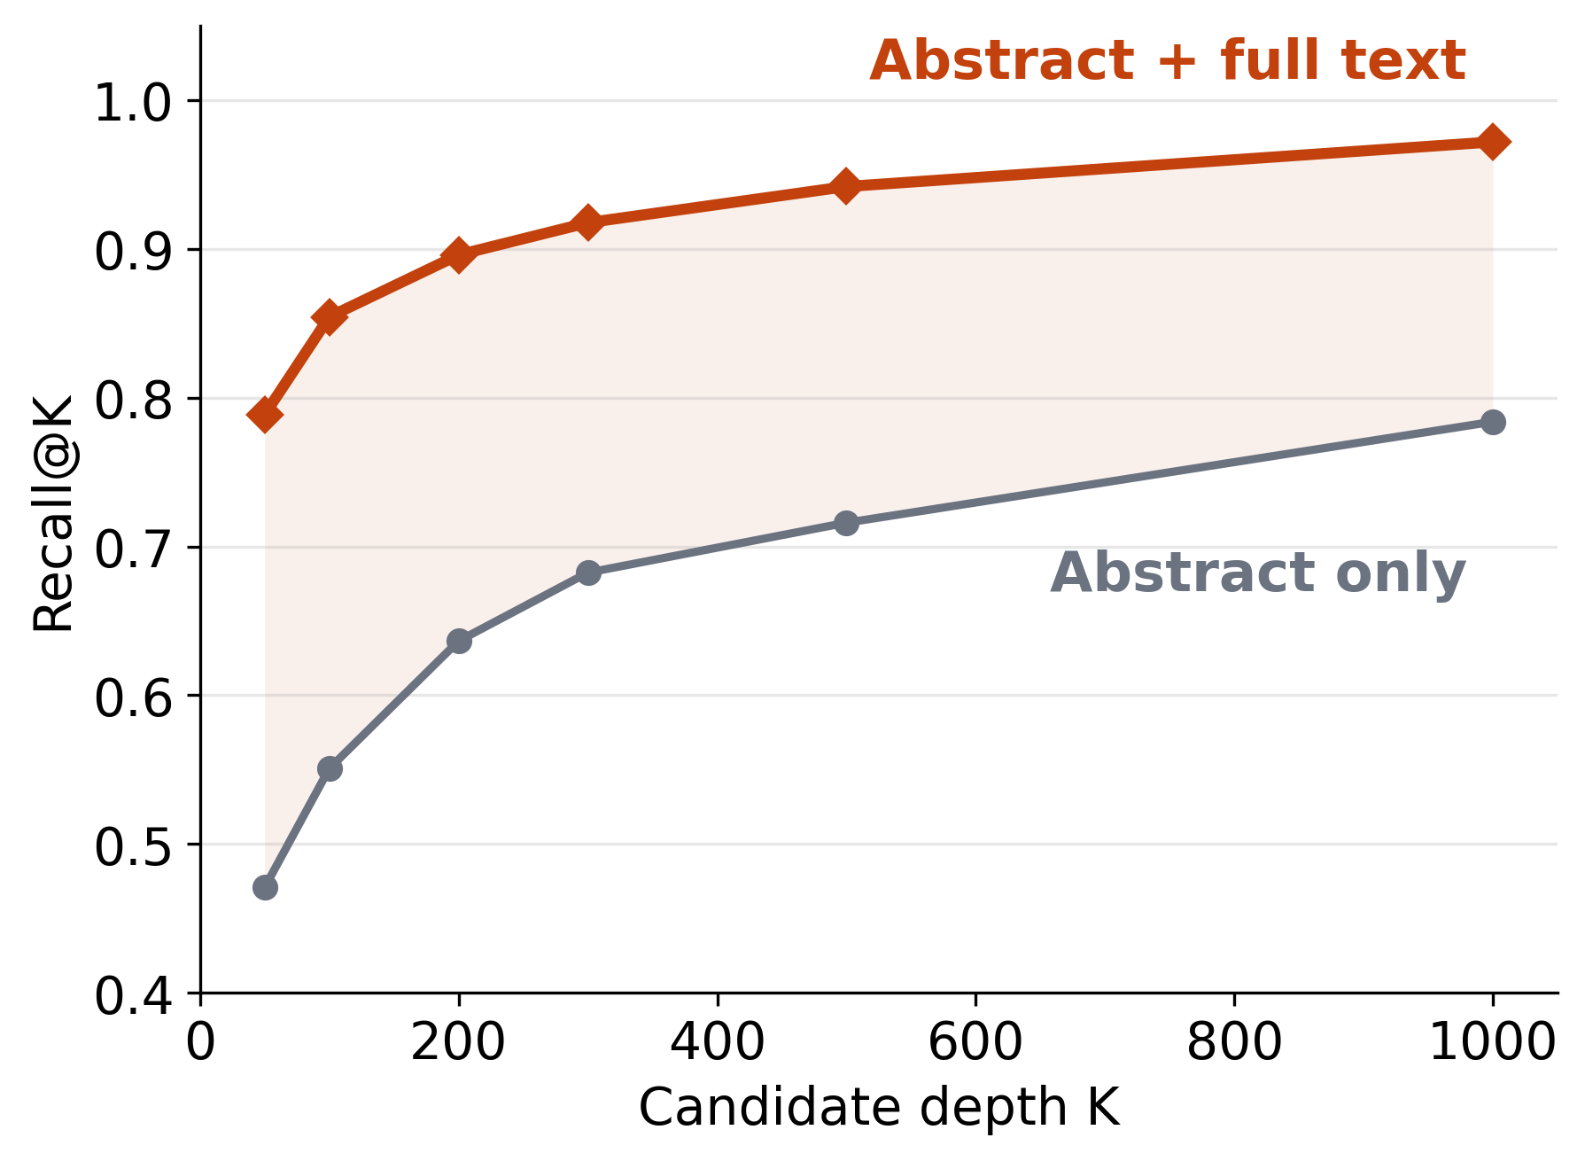
Abstracts can miss relevant evidence
Adapted from Y. Wang, G. Shaulsky, T. Curk, B. Zupan, Benchmarking Literature Retrieval for a Model Organism: A Dictyostelium Case Study, accepted at Discovery Science 2026 (LNCS, Springer).
Notes:
I promised to keep this talk introductory, so this will be the only slide from my own research.
Many scientific literature search tools rely mainly on collections of abstracts.
Here, we found that searching abstracts alone are often not enough., while including full text can substantially improve retrieval performance, as you can see here.

Slide 11

Abstracts can miss relevant evidence
Adapted from Y. Wang, G. Shaulsky, T. Curk, B. Zupan, Benchmarking Literature Retrieval for a Model Organism: A Dictyostelium Case Study, accepted at Discovery Science 2026 (LNCS, Springer).
Prof. Gad Shaulsky
Tomorrow 9:45 - Deciphering Dictyostelium Biology: From Genetic Pathways to AI Systems for Knowledge and Discovery
Notes:
This is part of my work with Prof Gad Shaulsky, who will actually be giving a talk tomorrow morning. So stay tuned!

Slide 12
Two key stages of RAG
② Generate answer
① Find evidence: Retrieval + Reranking
Notes:
“Now let's return to RAG.
Once we have a corpus, there are two main stages: retrieval and generation.
Let's start with retrieval, which is really important. Because, as you can imagine, if we don't find the right evidence, we can't expect the model to produce the right answer.”

Slide 13
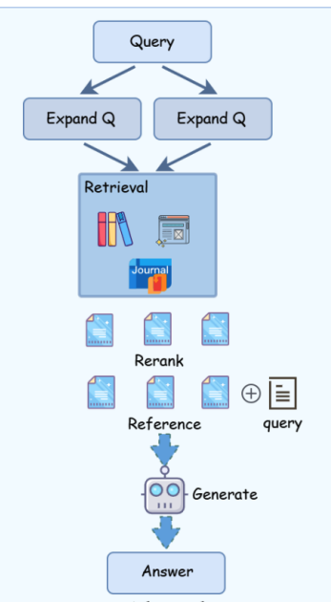
① Find evidence: retrieval and reranking
EXAMPLE
200 candidate papers
Found by retrieval
Rerank
Assess relevance more closely
Top 20 for generation
Illustrative numbers
He et al.,arXiv:2505.01146 (2025).
Notes:
let’s first briefly look at how these modern retrieval systems work. This is a little technical, but it is good to understand.
The challenge is that we want to find as much relevant evidence, but we also need to narrow it down to the most useful papers.
That's why retrieval often happens in two main steps: retrieval and reranking.
The first step searches a large corpus and finds candidate papers. In this example, it returns 200 papers.
Then, a more sophisticated model scores their relevance, putting the most relevant ones at the top.
We might then take the top 20 for answer generation.

Slide 14
② Generation: Turning Evidence into Answers
Turning evidence into an answer
Which LLM?
What instructions?
One step or multiple steps?
Notes:
Once we have the evidence, for the generation stage, much of the design comes down to which language model we use and how we prompt it.
The simplest approach puts the question and evidence into one prompt.
More elaborate approaches split the work into several steps,

Slide 15
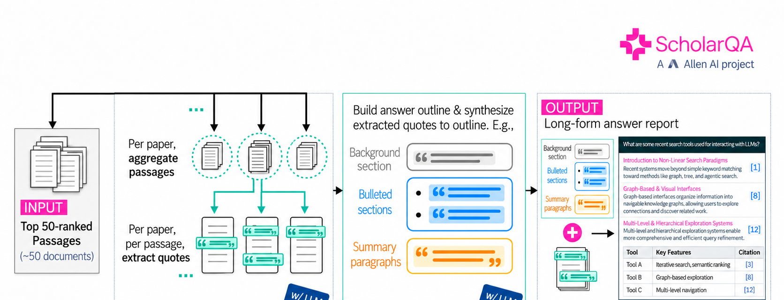
1
Extract evidence
2
Organize content
3
Write the report
Key idea: generation can be a pipeline, not just one prompt.
Notes:
When we see these polished answers, we might imagine something very complicated happening behind the scenes. But often, generation comes down to a series of LLM calls with different prompts.
This is a open source pipeline from quite well know research institute
they generate the answers in 3 steps
an LLM first extracts relevant passages from each paper. Then, another call organizes them into an outline. Finally, the system writes the report section by section, from the outline and the evidence
So the underlying idea is relatively simple: a series of LLM calls, each with a different task and prompt.

Slide 16

Evaluation: Important, but Often Overlooked
Notes:
I'd like to briefly touch on evaluation.
It's a huge topic, and I think it's sometimes overlooked.

Slide 17
Evaluation: Important, but Often Overlooked
Did we find the right evidence?
Did we generate a good answer?
Notes:
In fact, in my own SMASH research, I've probably spent more time figuring out how to evaluate these systems than building them.
And evaluating retrieval and evaluating generated answers are actually quite different challenges.

Slide 18
Retrieval evaluation
Established metrics
Recall
Precision
Ranking
Did we find the relevant papers?
How many results are relevant?
Are the best papers near the top?
Notes:
For retrieval, evaluation is relatively well established. We have metrics like recall, precision and ranking measures to tell us whether we found the right papers and rank them well.

Slide 19
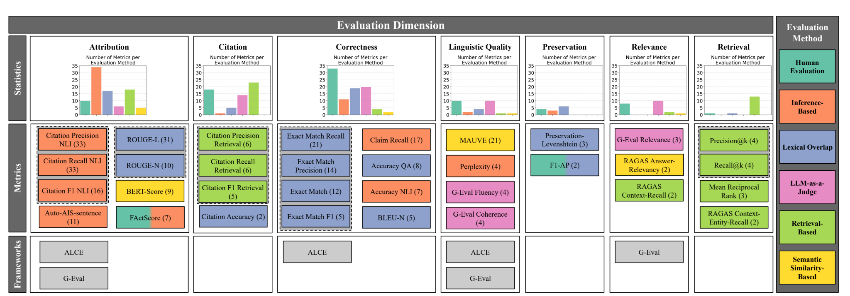
Generation evaluation
Different methods capture different aspects of answer quality
Schreieder et al., ACL 2026.
Notes:
For generated answers, evaluation is much less straightforward. As you can see, researchers have proposed many different ways to evaluate generated answers.

Slide 20
Generation evaluation
No single agreed standard
Accuracy
Coverage
Citations
Factual correctness
Key information included
Claims supported by evidence
AI
LLM judges
★
Human evaluation
Increasingly used
Still the gold standard
Notes:
But despite all these different approaches, i see a trend people put more priorities on these points: is the answer factually correct, does it cover the important information, and are its claims supported by the citations?
LLMs are also increasingly used to assess these qualities.

Slide 21
Inside AI literature tools

Slide 22
Notes:
Now comes the interesting part. Elicit is a commercial tool, so its source code isn't public. But its interface shows us quite a lot of what happens behind the scenes.
Let's walk through it and see how the RAG components we've discussed fit together.
I put some detailed biological questions.

Slide 23
Notes:
First, an LLM breaks the original question into three subquestions. For each, it searches and ranks the papers, returning 15 results

Slide 24
Notes:
After removing duplicates, 40 unique papers remain. It then selects 20 for closer examination and retrieves the full text where available.
Finally, it uses the abstracts and available full texts to generate an answer.

Slide 25
Summary
Corpus
Retrieval &
reranking
Generation
Evaluation
Coverage matters
Find the right evidence
No single recipe
Check claims & citations
Notes:
So, we talk about corpus coverage matters, retrieval determines which evidence we find, generation can follow different approaches, and evaluation is essential to knowing whether the answers are trustworthy

Slide 26


Thank you!

Slide 27
①ⓐ Retrieval: finding candidate papers through prebuilt indexes
Hybrid Retrieval combines
Keyword search: matches words
e.g acute myocardial infarction -> acute myocardial infarction
Semantic search: matches meaning
e.g acute myocardial infarction <-> heart attack
He et al.,arXiv:2505.01146 (2025).
Notes:
Now, let's briefly look at how modern retrieval systems work.
This is probably the most technical part of my talk, but don't worry, we'll keep it simple.
The first step is retrieval, where we search a large collection of papers to find potentially relevant candidates.
Modern systems often combine keyword search, which matches words, and semantic search, which matches meaning.
We call this hybrid retrieval.

Slide 28
①ⓑ Reranking: bringing the most relevant papers to the top
EXAMPLE
100 candidate papers
Found by retrieval
Rerank
Assess relevance more closely
Top 20 for generation
He et al.,arXiv:2505.01146 (2025).
Notes:
After retrieval, let's say we have 100 candidate papers.
A more sophisticated model then looks at each candidate more closely and tries to put the most relevant ones at the top.
We might then take the top 20 and pass them to a language model to generate an answer.
So retrieval finds the candidates, and reranking puts the best ones at the top.

Slide 29
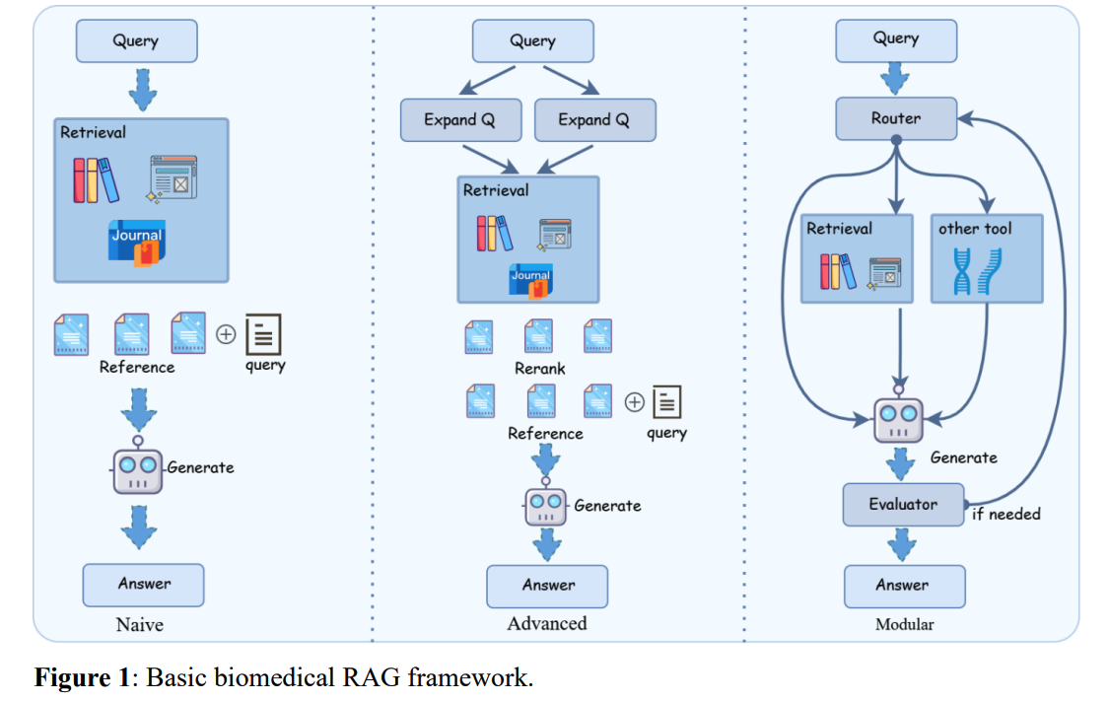
Notes:
“So today, we talked about why the literature corpus matters, how retrieval and reranking work, different approaches to generation, and finally, how we evaluate the results.
Thank you!”

Slide 30
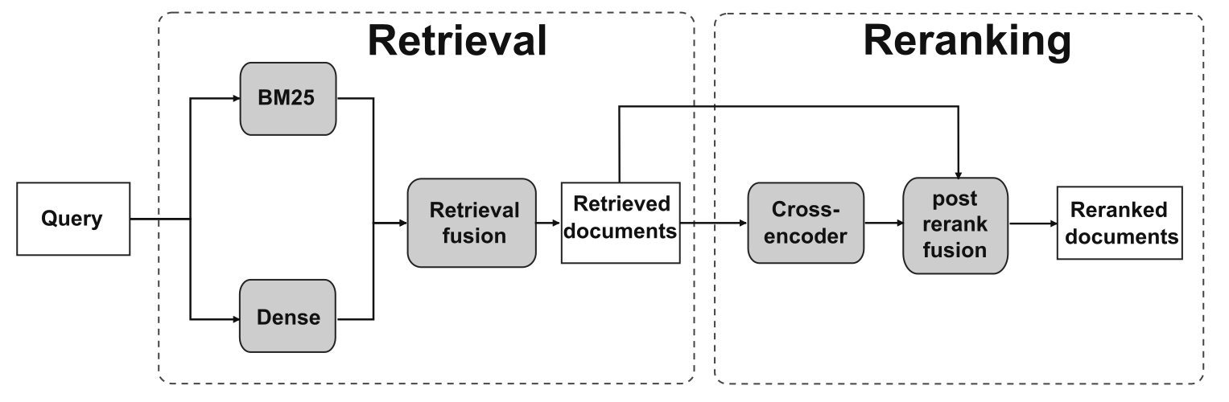
Two-stage retrieval: retrieval and reranking
Our pipeline follows this design
github.com/fulaibaowang/RAG-scripts
Notes:
Our pipeline follows this same two-stage design.

Slide 32
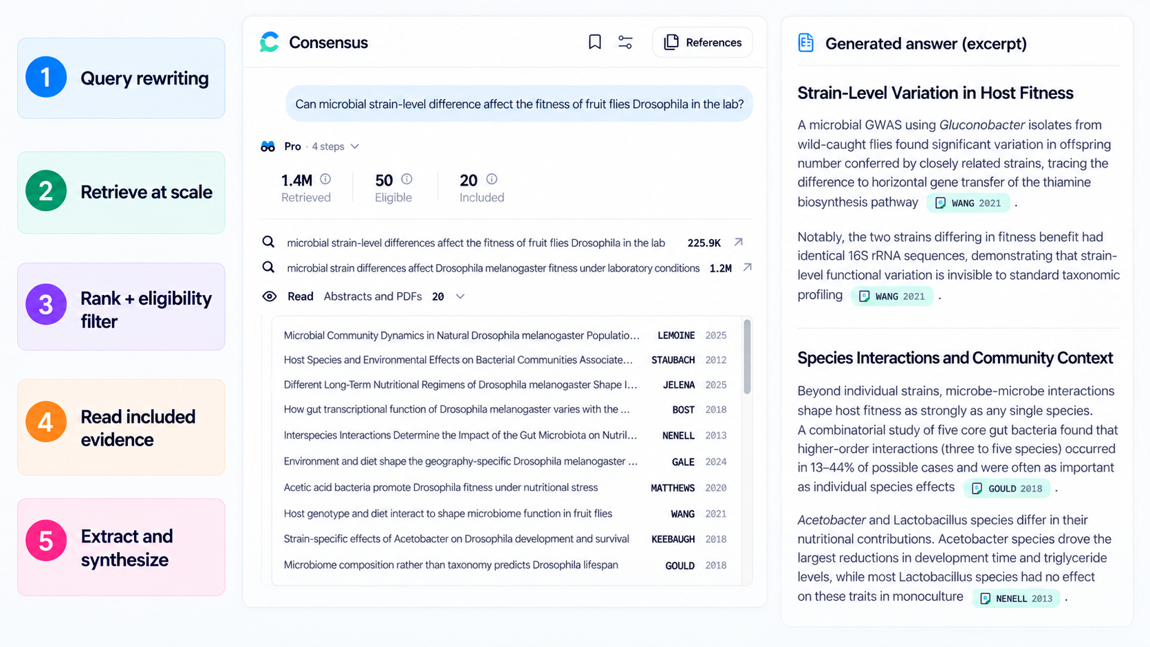

Slide 33
Summary
Corpus
What can the tool search? Coverage and full-text access matter.
Retrieval and reranking
Well-established methods for finding and prioritising relevant evidence.
Generation
Different ways to turn evidence into answers; no single recipe or agreed measure of quality.

