Slide 1
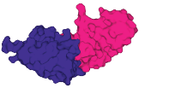





Structural plausibility
without binding specificity
What confidence scores do and don’t tell us
about antibody–antigen prediction
Klara Kropivšek Brumat, PhD
University of Nova Gorica
2nd SMASHING Workshop · 21 October 2026
When can a predicted complex guide a binding experiment?
01
Notes:
0:00–0:30
· Klara · Nova Gorica
· Oslo (Eva, Victor) · Cambridge (Montader, Pietro) · Nova Gorica (Ario)
→ when can a confidence score guide a binding experiment?

Slide 2
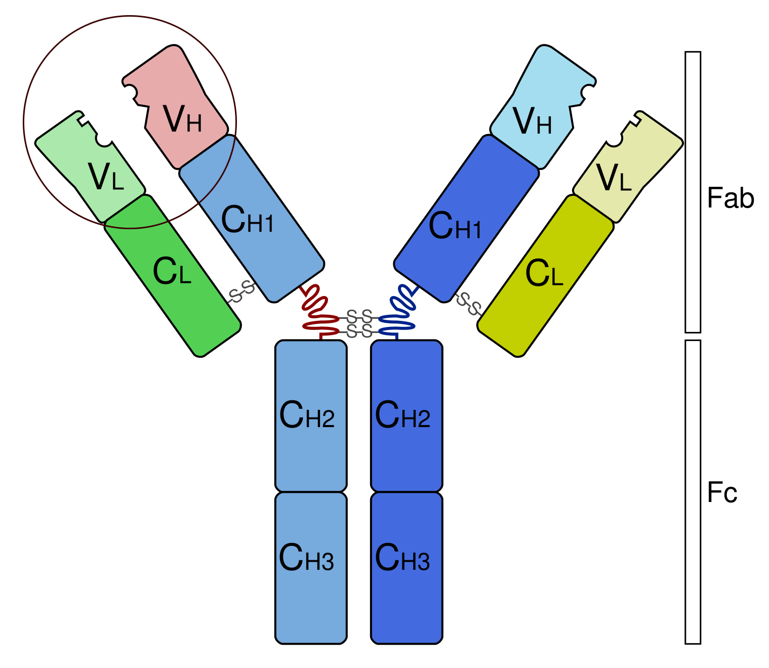
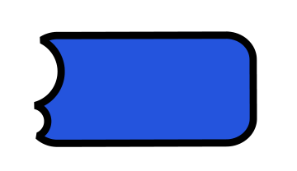
Binder discovery depends on molecular recognition
A binder recognises a target protein, the antigen.
The binding surface
is the paratope.
It recognises an epitope:
a region on the antigen.
Antibody
VHH or Nanobody
Selective binding underpins
diagnostics, targeted treatments
and research reagents.
Antibody binding tip: Fv
Nanobody: VHH
VH + VL domains
Six variable CDR loops
One domain
Three variable CDR loops
02
Notes:
0:30–1:20
· binder recognises antigen
· antibody → Fv tip: 2 domains, 6 loops
· nanobody VHH → 1 domain, 3 loops, camelids
· paratope (binder) / epitope (target)
→ selectivity = diagnostics, therapy, reagents

Slide 3
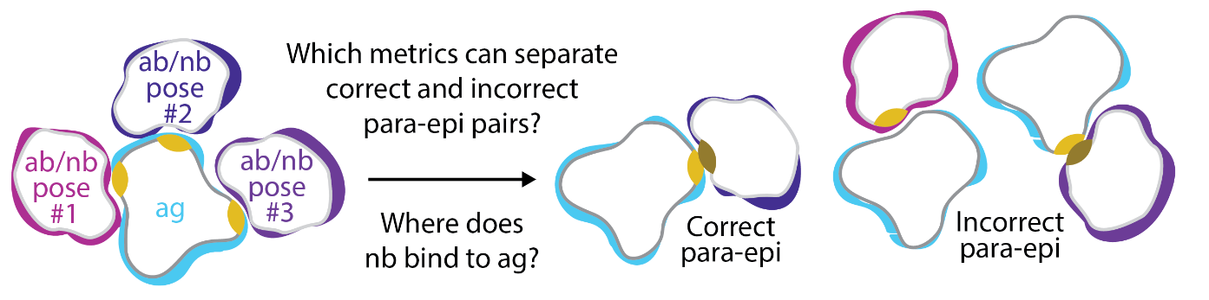
Correct partner, binding site and pose
Partner
Binding site
Pose
Do these molecules bind?
Does the binder find
the correct epitope?
Is its orientation accurate?
ipTM: predicted interface confidence. DockQ: accuracy against an experimental reference.
Molecular schematic adapted by cropping Figure 1C
03
Notes:
1:20–2:05
· three questions: partner / site / pose
· field answers pose — today: partner
· ipTM = model's own confidence, always available
→ DockQ needs the answer — ipTM does not

Slide 4
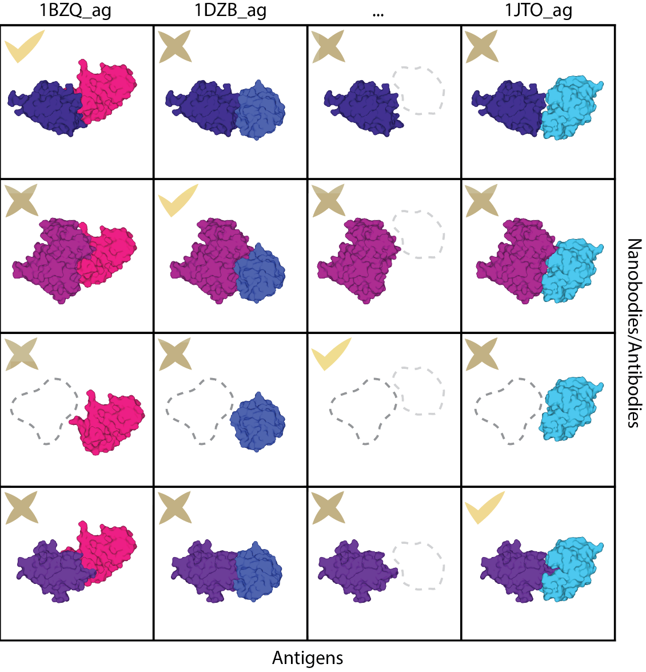
An all-versus-all benchmark of binding partners
106 nanobody–antigen systems
106 cognate pairs
11,130 shuffled combinations
46 Fv–antigen systems
46 cognate pairs + 2,070 cross-pairs
AlphaFold3 · Boltz-2 · Chai-1
50 predictions per pair per tool
~2.1 million structures overall
Smorodina, Ali, Kropivšek Brumat et al. · Revised manuscript · Figure 1
04
Notes:
2:05–3:05
· 106 nanobody–antigen, solved structures
· all vs all → 106 cognate + 11,130 shuffled
· + 46 Fv systems, 2,070 cross-pairs
· 50 × 3 tools → ~2.1 M structures · VEGA Maribor
→ identical conditions → difference = the pairing

Slide 5
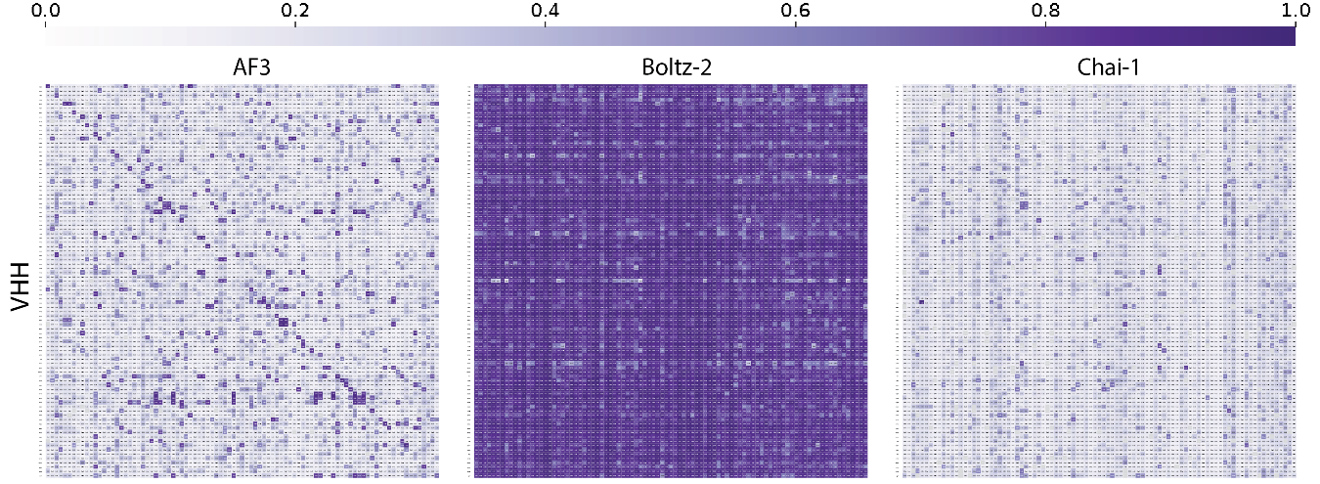
Confidence does not cleanly isolate cognate partners
Maximum ipTM across 50 predictions. Cognate pairs lie on the diagonal.
AF3 shows enrichment. Boltz-2 scores most pairs highly. Chai-1 scores are generally low.
Smorodina, Ali, Kropivšek Brumat et al. · Revised manuscript · Figure 2A
05
Notes:
3:05–3:55
· max ipTM over 50 · real pairs = diagonal
· expect: bright diagonal, light background
· AF3 some enrichment · Boltz-2 high everywhere · Chai-1 low everywhere
→ plausible interface for ANY two proteins

Slide 6
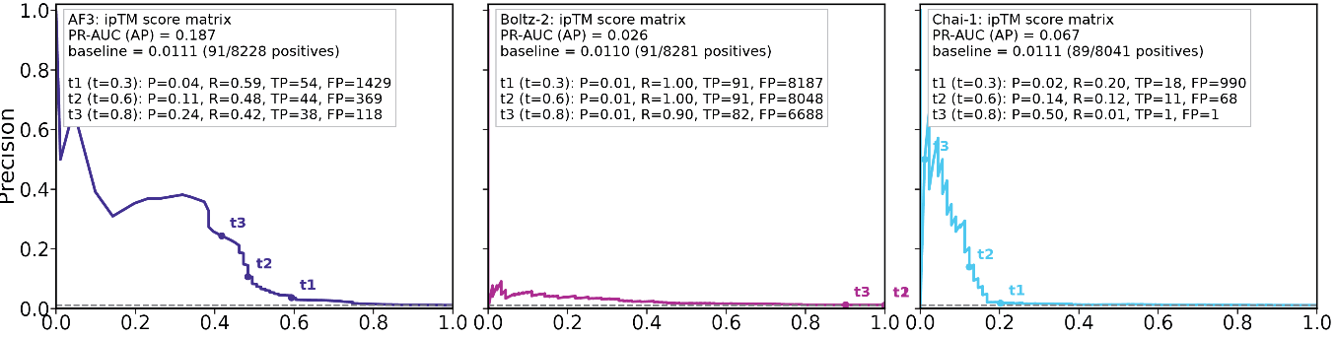
Rare binders make false selections costly
AlphaFold3
Boltz-2
Chai-1
Recall: fraction of known pairs recovered
AP 0.187
AP 0.026
AP 0.067
AF3 at ipTM ≥ 0.8: 42% recall, but 3 out of 4 hits are wrong
Smorodina, Ali, Kropivšek Brumat et al. · Revised manuscript · Figure 2B
06
Notes:
3:55–4:55
· binders rare → ~1% of matrix → precision–recall
· AP 0.187 / 0.067 / 0.026 · baseline 0.011
· AF3 ~17× above chance — real, but…
· ipTM ≥ 0.3 → 59% recall, 4% precision
→ most of what goes to the lab is wrong

Slide 7
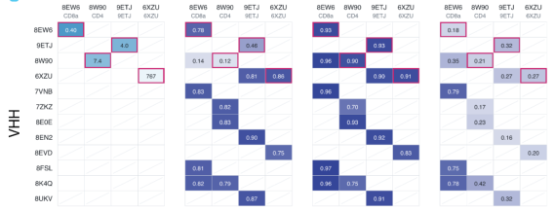
Experimental negatives retain high model confidence
15 / 15 cognate pairs bind
0 / 454 tested shuffled pairs show measurable affinity
Measured KD
AlphaFold3
Boltz-2
Chai-1
One validation subset shown. SPR measurements at two independent providers.
Smorodina, Ali, Kropivšek Brumat et al. · Revised manuscript · Supplementary Figure 2B (shown) and 2A–B (totals)
07
Notes:
4:55–5:45
· objection: maybe shuffled pairs do bind?
· SPR · two independent providers
· 15 / 15 cognate bind · 0 / 454 shuffled bind
· confirmed non-binders still get high confidence (Boltz-2 > 0.9)
→ negatives are real — models confident anyway
· (tested conditions — not proof no pair ever binds)

Slide 8
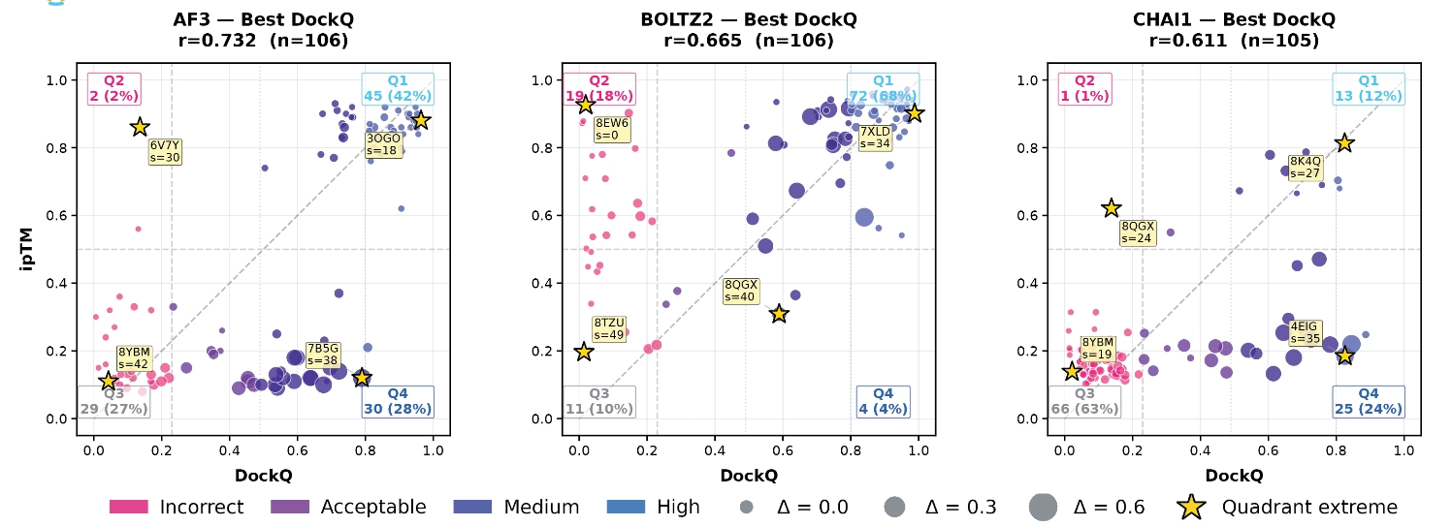
Confidence and structural accuracy diverge by model
Best-DockQ structure among 50 predictions, with its own ipTM score
Boltz-2 includes confident failures. Chai-1 includes accurate poses with low confidence.
Smorodina, Ali, Kropivšek Brumat et al. · Revised manuscript · Figure 3A · Cognate VHH complexes
08
Notes:
5:45–6:35
· cognate only · best of 50 vs its own ipTM
· r = 0.73 / 0.67 / 0.61 → real information
· Boltz-2: 18% confident failures (top left)
· Chai-1: 24% accurate but unconfident (bottom right)
→ predicts pose quality, NOT whether the pair is real

Slide 9
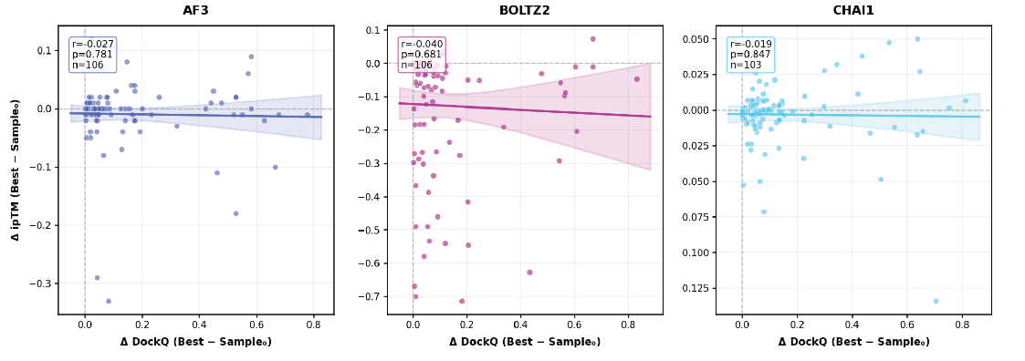
Sampling improves poses more than their confidence
Change from the first prediction to the best-DockQ prediction
Horizontal: gain in DockQ Vertical: change in ipTM
Near-zero correlations across all three tools: better structures do not reliably receive higher scores
Smorodina, Ali, Kropivšek Brumat et al. · Revised manuscript · Figure 3C
09
Notes:
6:35–7:15
· x = gain in DockQ · y = change in ipTM
· would slope up if score followed quality
· r ≈ 0 for all three
· best pose = top ipTM in only 18% / 4% / 5%
→ good structure is there — score doesn't point at it

Slide 10
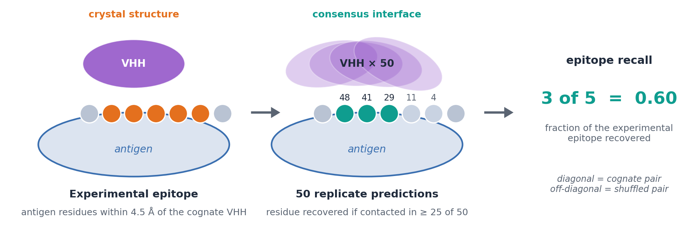
Epitope recall
Epitope recall: fraction of the experimental binding site recovered by predicted contacts
Ground truth: antigen residues within 4.5 Å of the cognate VHH in the crystal structure.
Prediction: 50 replicates per pair; a residue counts as recovered when contacted in at least half of them.
Recall: the fraction of the experimental epitope recovered — one number per VHH–antigen pair, cognate or shuffled.
Definition as implemented in the Methods · Smorodina, Ali, Kropivšek Brumat et al., bioRxiv 2026
Notes:
7:15–7:55
· TURN: negative → constructive · first: what the number is
· truth = antigen residues ≤ 4.5 Å of cognate VHH (orange)
· 50 predictions · recovered if contacted in ≥ 25 (majority vote)
· recall = fraction recovered · cartoon: 3 of 5 = 0.60
· every pair — real AND shuffled = the control
→ not 'is the score high' but 'did it land on the right patch, reproducibly'

Slide 11
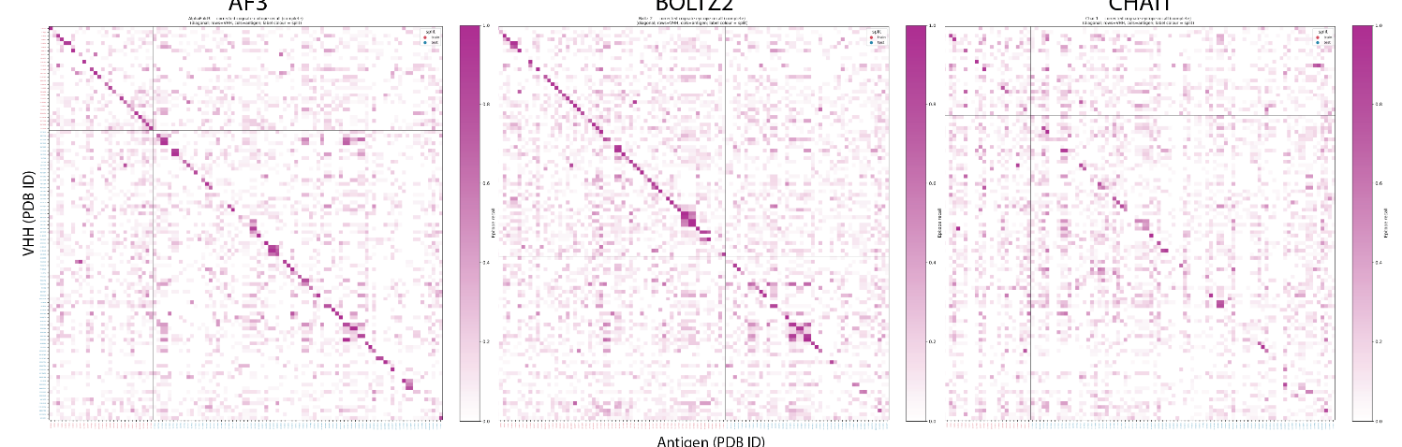
The correct binding site leaves a partial signal
Epitope recall: fraction of the experimental binding site recovered by predicted contacts
AF3
BOLTZ2
CHAI1
Held-out AUROC
AF3 0.77
Boltz-2 0.68
Chai-1 0.62
Partial epitope specificity survives surface-aware controls, but requires a reference to evaluate
Smorodina, Ali, Kropivšek Brumat et al. · Revised manuscript · Figure 3D–E
11
Notes:
7:55–8:40
· diagonal much clearer than for ipTM (AF3, Boltz-2)
· AUROC 0.77 / 0.68 / 0.62 on held-out pairs
· survives surface-aware nulls → not just easy surface
→ needs a reference → evaluation, not prospective

Slide 12
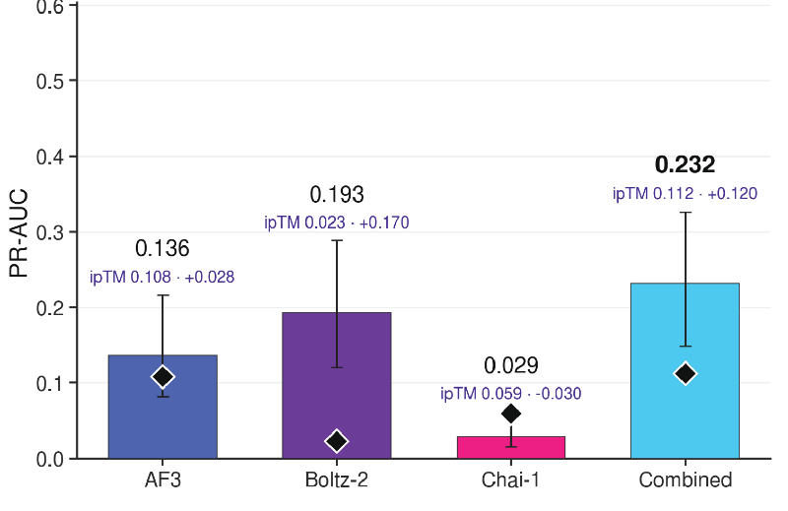
Interface features can improve partner ranking
A supervised classifier combines
Native confidence scores
Interface-contact geometry
Variation across 50 predictions
Combined AP: 0.232
Best native ipTM: 0.112
Additional signal is recoverable. Prospective experimental validation remains necessary.
Smorodina, Ali, Kropivšek Brumat et al. · Revised manuscript · Figure 5D · Antigen-grouped cross-validation
12
Notes:
8:40–9:30
· can we get it without a reference?
· features: confidence + contact geometry + variation over 50
· antigen groups held out in cross-validation
· AP 0.232 vs 0.112 → roughly double
· strongest: across-replicate statistics → cognate more reproducible
→ real gain — still needs prospective validation

Slide 13
What these predictions support today
Useful structural and epitope hypotheses
Some molecular recognition signal is present,
but confidence alone does not reliably select binding partners.
For candidate prioritisation
Use realistic negatives and precision–recall evaluation.
Validate selection experimentally, including after de novo design.
A confidence score needs validation for the decision it will support.
Eva Smorodina · Montader Ali · Klara Kropivšek Brumat and collaborators
Ario de Marco · Victor Greiff · Pietro Sormanni
13
Notes:
9:30–10:20
· useful structural + epitope hypotheses — signal is real
· confidence alone ≠ partner selection
· realistic negatives + precision–recall
· validate experimentally — also after de novo design
→ a score needs validation for the decision it supports
· next: tip of the iceberg → thanks

Slide 14
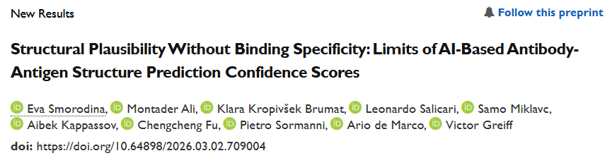
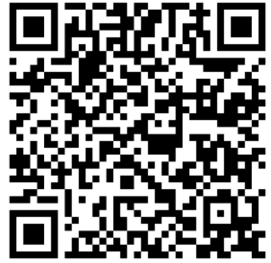
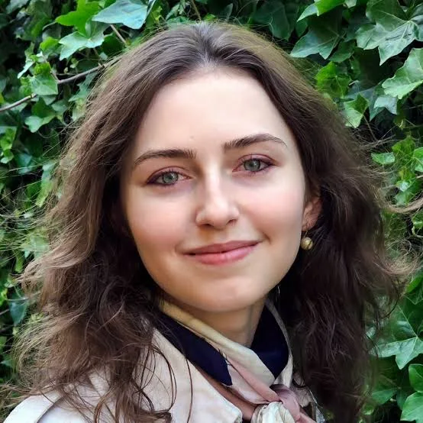


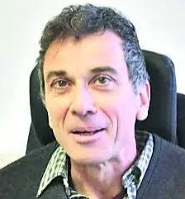
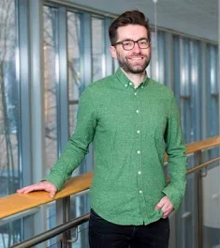
Only The Tip Of An Iceberg:
Montader Ali (Cambridge)
Pietro Sormanni (Cambridge)
Ario de Marco
(UNG)
Smorodina, Ali, Kropivšek Brumat et al., bioRxiv 2026 · doi 10.64898/2026.03.02.709004 · structures on Zenodo 18390239
Eva Smorodina (Oslo)
Victor Greiff
(Oslo)
Notes:
10:20–10:50
· tip of the iceberg → full preprint on bioRxiv (QR code)
· all structures on Zenodo → test your own model
· Eva + Victor (Oslo) · Montader + Pietro (Cambridge) · Ario (UNG)
→ the benchmark is open — use it

Slide 15








Thank You For Your Attention
Funding:
Marie Curie SMASH Fellowship (EU Horizon 2020; 2024-2026)
EU-HPC grants for European HPC projects (2025-2027)
NASA STAR program (September 2026 – February 2027)
Key Collaborators:
Prof. Ario de Marco (UNG) and LELS lab members- Nanobodies & AL
Prof. Charlotte Deane (University of Oxford) – ML, Nanobody Database
Prof Victor Greiff (University of Oslo) - benchmarking ML models for docking
  Eva Smorodina
Prof. Pietro Sormanni (Imperial College & Cambridge University)
  Montader Ali
Samo Miklavc (IZUM) & Leonardo Salicari (CINECA) – EU HPC support
Prof. Berend Snijder (ETH Zurich) – PhD supervision, MM work
Prof. Luka Cehovin Zajc (FRI, University of Ljubljana) - MM work
Prof. Matthias Lütolf, Dr. Lauriane Cabon (EPFL/Roche) - Organoids
Prof. Katharina Dost, Dr. Sašo Džeroski (University of Canterbury, NZ, Jožef Stefan Institute) - Machine Learning
Contact: klara.kropivsek@ung.si
15
Notes:
10:50–11:10
· funding: Marie Curie SMASH · EU-HPC · NASA STAR
· thank the collaborators on the list
→ Thank you — happy to take questions

Slide 16
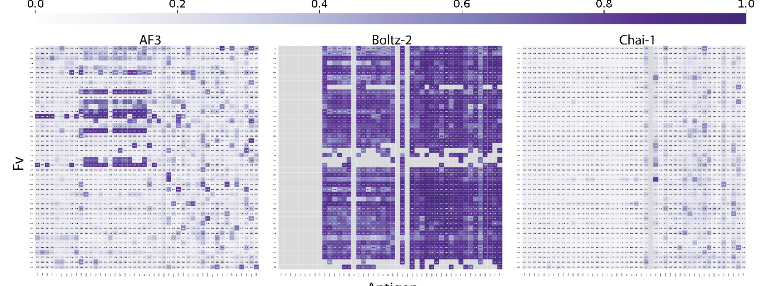
Q&A · Conventional antibodies show the same limitation
Matched AP: AF3 0.121 · Boltz-2 0.120 · Chai-1 0.103
Baseline 0.051. Antigen-interface scores exclude the VH–VL interface.
Smorodina, Ali, Kropivšek Brumat et al. · Revised manuscript · Figure 2C–D
16
Notes:
BACKUP · if asked about conventional antibodies
· 46 Fv: 25 SARS-CoV-2 Spike/RBD + 21 diverse
· related variants may truly cross-react → strata separate
· VH–VL packing excluded from the score
· matched AP 0.121 / 0.120 / 0.103 vs 0.051
→ same limitation as nanobodies

Slide 17
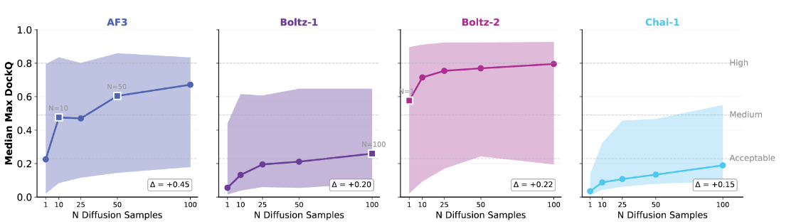
Sampling has diminishing returns and seed effects
Most gains occur at moderate sampling depth (~10–25).
These curves change both seed and sample count.
The decoupled analysis is in Supplementary Figure 9.
Smorodina, Ali, Kropivšek Brumat et al. · Revised manuscript · Figure 4B
17
Notes:
about sampling / compute
· median best DockQ per depth · IQR shaded
· retrospective maximum — NOT selected by confidence
· curves mix seed + sample count → Suppl. Fig. 9 decouples
· energy depends on hardware, MSA caching, length
→ most gain at ~10–25 samples

Slide 18
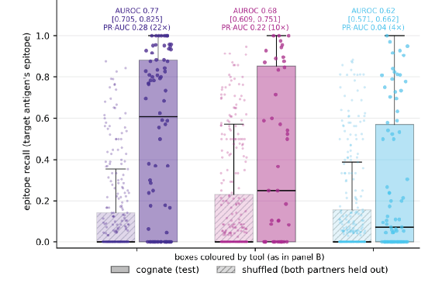
Epitope recovery is measurable but incomplete
Cognate test complexes
versus shuffled pairs with
both partners held out
AUROC: 0.77 / 0.68 / 0.62
AP: 0.28 / 0.22 / 0.04
Reference-dependent metric.
Not a prospective binder score.
Smorodina, Ali, Kropivšek Brumat et al. · Revised manuscript · Figure 3E
18
Notes:
epitope recall
· recall = epitope residues hit in ≥ half of 50 predictions
· cognate test vs shuffled with BOTH partners held out
· geometric null (accessible surface) + empirical null (shuffled landings)
→ enrichment survives both — but needs a reference

Slide 19
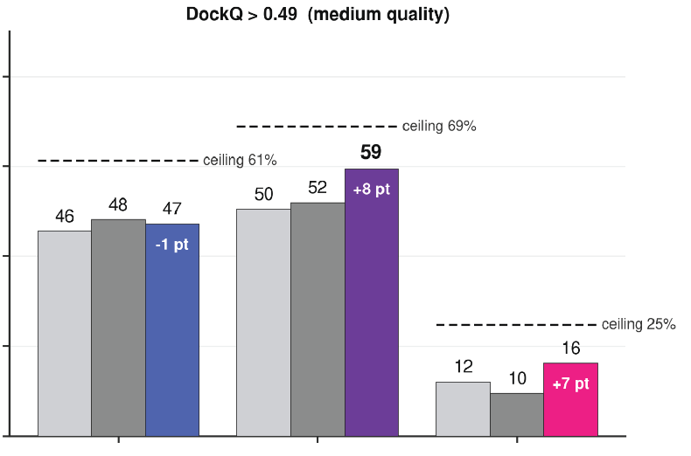
Selecting a pose differs from selecting a partner
Systems with an accurate selected pose (%)
Task A: known binding pair
Select an accurate pose
from 50 predictions.
Task B: candidate pair
Prioritise the cognate partner
among shuffled alternatives.
AF3
Boltz-2
Chai-1
Grey: random / ipTM · Colour: classifier
Dashed ceiling: at least one accurate pose exists. Accuracy here: DockQ > 0.49.
Smorodina, Ali, Kropivšek Brumat et al. · Revised manuscript · Figure 5C (Task A)
19
Notes:
about pose vs partner
· Task A = pick a pose for a KNOWN pair
· AF3: ipTM 48% · classifier 47% · ceiling 61%
· Boltz-2 59 vs 52 · Chai-1 16 vs 10
· 'oracle' in paper = learned classifier, NOT perfect DockQ pick
→ choosing a pose ≠ choosing a partner

Slide 20
Scope and definitions
Specificity
Discrimination between alternative molecular partners
Affinity
Binding strength under defined experimental conditions
The benchmark does not calibrate ipTM to KD.
Negative controls
454 tested shuffled pairs support the non-binding assumption.
Most of the full matrix remains putative negatives.
Model scope
Three tools and specific inference settings.
This is not a benchmark of every de novo design pipeline.
20
Notes:
scope and definitions
· Chai-1: embeddings, no MSAs
· train/test overlap stratified
· Fv panel not representative of all antibodies
· false discovery FP/(TP+FP) ≠ false positive rate FP/(FP+TN)
→ AUROC, AP, recall, DockQ = different questions

