Slide 1
Simulation-Based inference for massive black hole binary from mock LISA data
G. Puleo, R. Trotta, E. Barausse,
SISSA, Trieste, Italy
Today's route through the talk
1
GRAVITATIONAL WAVES AND THE LISA MISSION
What data are we analysing?
2
SBI vs MCMC
Simulation Based Inference. Learn from a simulator — throw the likelihood away
3
TMNRE
the method I use: Truncated Marginal Neural Ratio Estimation
4
RESULTS ON LISA MBHB
the target: massive black-hole binaries
Notes:
Bayesian inference turns a measurement into a statement about nature, with honest error bars.
Today: from a GW signal to the parameters of its source (LISA MBHBs).
One question hangs over the talk: how do we find the POSTERIOR, p(parameters | data)?
Two answers: classical Monte Carlo, and machine-learning SBI; then the specific method I use, TMNRE.
Bayes: posterior proportional to likelihood x prior. Prior = what we knew before; likelihood = physical model.
Classically we sample the posterior with MCMC: walk parameter space, evaluate the likelihood each step.
You don't get a formula, you get SAMPLES. [PLAY] The histogram IS the posterior; the band IS the error bar.
Two things to hold on to: (1) it leans entirely on the LIKELIHOOD; (2) it all happens AFTER the observation.
Each method next breaks one of them.

Slide 2
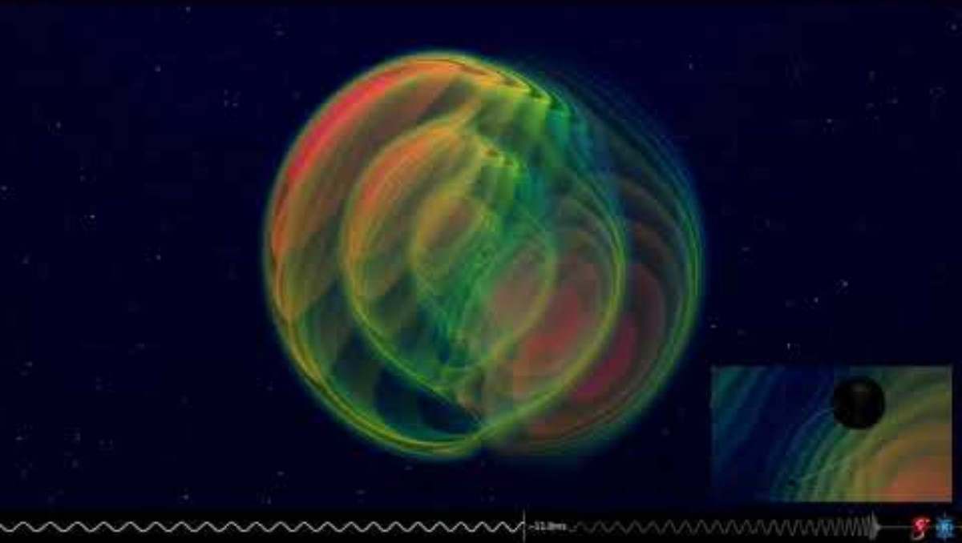
BUT WHAT ARE GRAVITATIONAL WAVES?

Slide 3
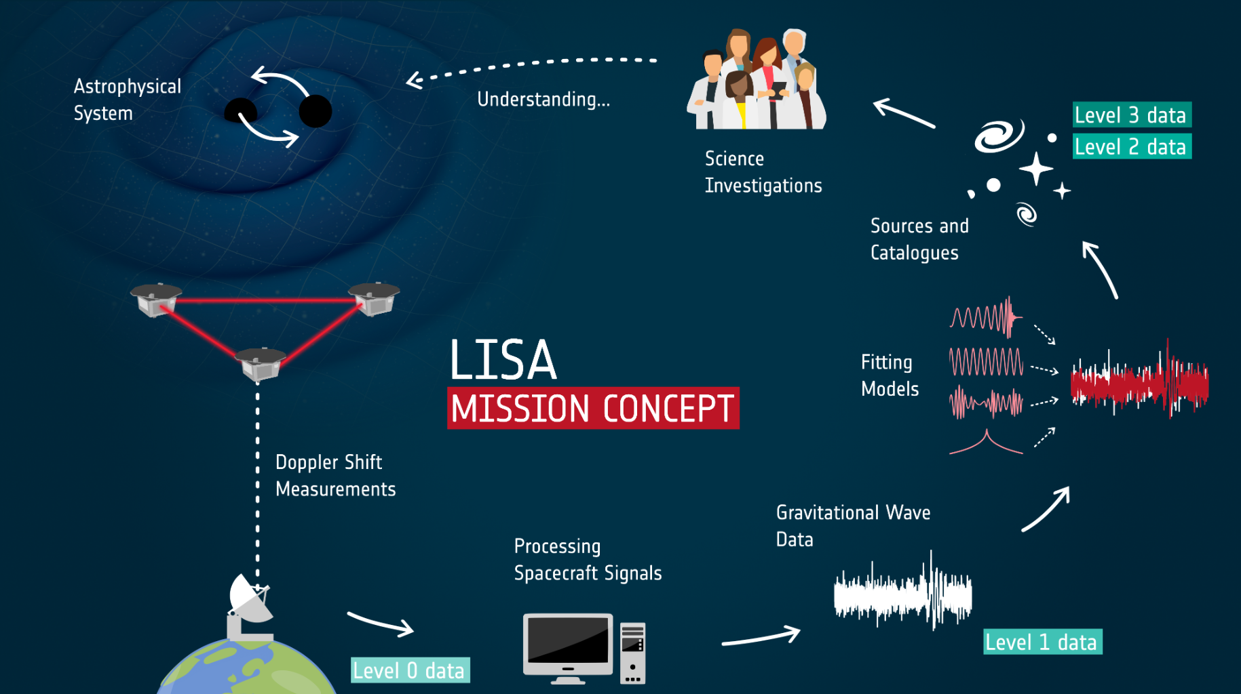
Image Credits: Colpi et al. , LISA definition study report (2023)

Slide 4
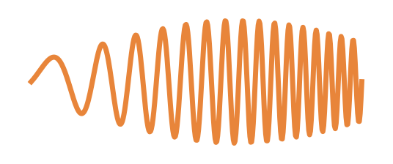
2
Simulation-based inference: """MCMC without likelihood"""
parameters θ
data d
SIMULATOR
θ
d
BAYES THEOREM:
p(θ | d) ∝ p(d | θ) · p(θ)
posterior ∝ likelihood × prior
No likelihood. Only a SIMULATOR:
Trade: pay to simulate + train; gain: no likelihood, instant* inference.
A few flavors — a sampler (like image generators), or a function you evaluate. I use neural ratios (NRE).
training set
( θ , d ) × many
① WHERE does the posterior live?
② HOW do we read error bars off it?
Notes:
First thing to hold on to: classical inference needs the LIKELIHOOD at every step. SBI throws it away.
The only thing it needs is a SIMULATOR: theta in, data out. We already build these.
Recipe: run the simulator many times -> a big pile of PAIRS (parameters, and the data they produced).
[PLAY native anim] Then train a model to learn the posterior directly from those pairs. No likelihood.
This is a TRADE. Pay twice (simulate + train). Gain twice: works when the likelihood is intractable/expensive
(you only simulate FORWARD); and once trained, inference is essentially INSTANT (asterisk -- back to it shortly).
SBI comes in a few flavors: learn a sampler (noise->draws, like image generators), or learn a function you
evaluate. I use neural RATIO estimation, NRE -- that's the next slide.
Keep two questions in front of us: WHERE does the posterior live, and HOW do we read error bars off it?

Slide 5
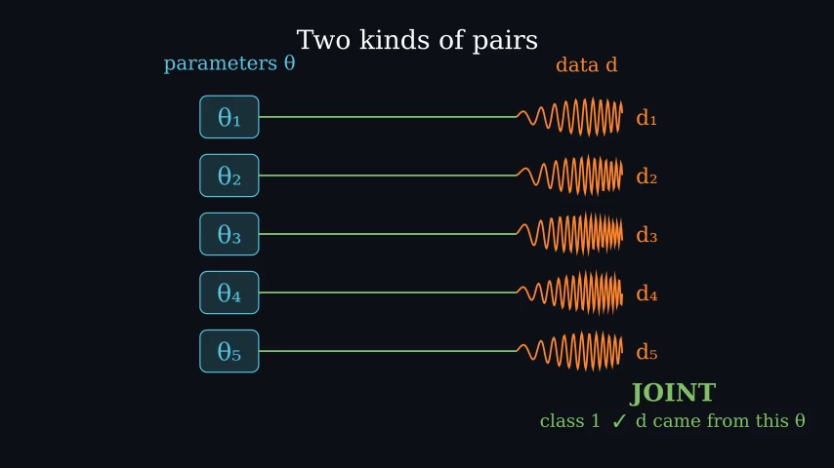
3
Neural Ratio Estimation — the classifier trick
JOINT vs SCRAMBLED
genuine pair — or keep d and swap in an unrelated θ?
→ a binary classifier (cross-entropy)
optimal classifier
= p(θ|d) / p(θ)
× prior ⇒ posterior
the N–R of TMNRE
next: train on 1–2 params → the M
Notes:
How does the method learn the posterior function? A surprisingly simple trick. Take the simulated pairs.
A pair is genuine -- JOINT -- when the data really was generated from that parameter. Make a fake one by
SCRAMBLING: keep the data, swap in an unrelated parameter drawn on its own. [PLAY]
Train a model to do one job: tell genuine from scrambled. That's a BINARY CLASSIFIER, standard cross-entropy --
the same object you'd use for cats vs dogs.
The beautiful part: to succeed, the classifier must notice which parameters go with which data more than chance,
and one can prove its optimal answer is exactly the RATIO posterior/prior. Multiply by the known prior -> posterior.
This is why it's called Neural RATIO Estimation -- the N-R of TMNRE. Next: the M.

Slide 6
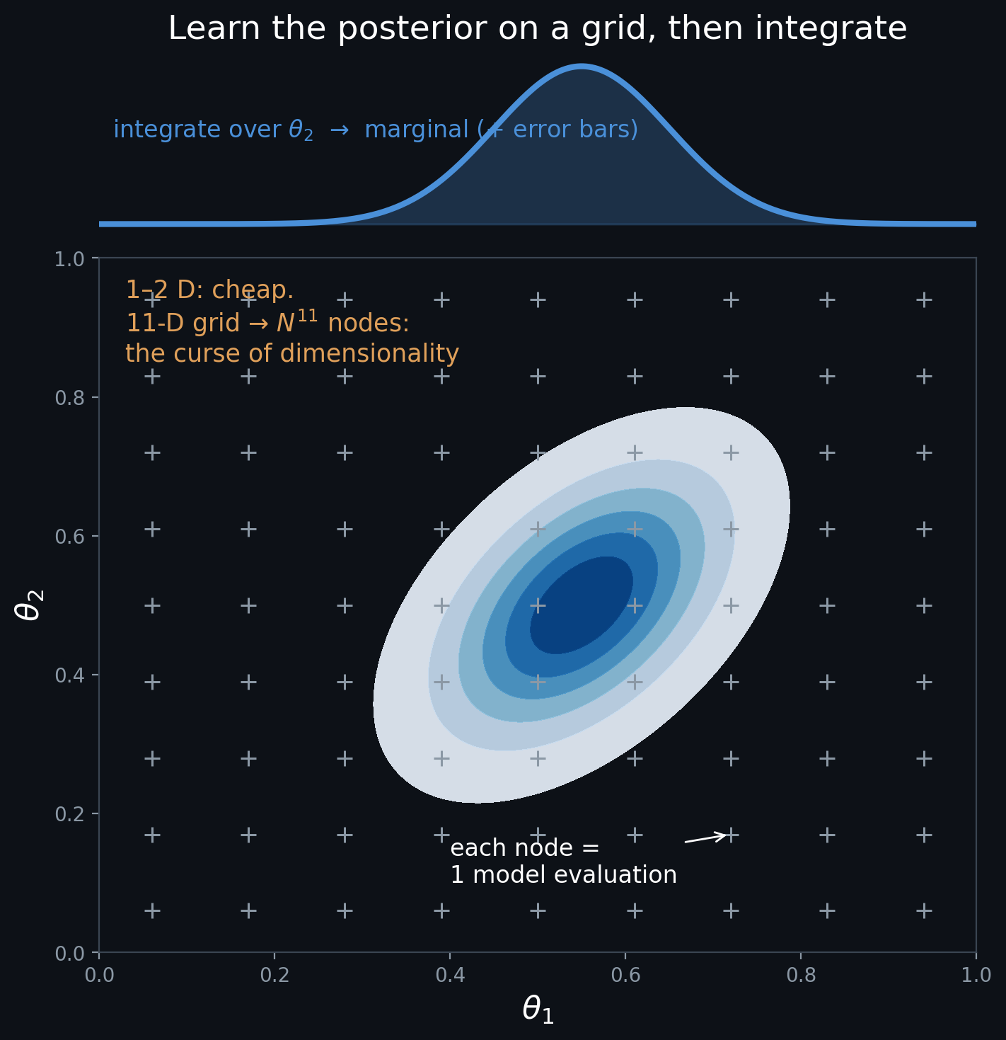
4
Marginals — error bars, and the curse
M = MARGINAL
train the classifier on 1–2 parameters at a time → the marginal posterior for those.
Read it off:
fix the data, sweep those 1–2 params on a grid, evaluate, integrate → error bars.
Problem:
In gravitational wave parameter estimation the posterior can be 10^{-20} narrower than the prior.
How to search the parameter space?
① WHERE does the posterior live?
✓ HOW do we read error bars off it?
Notes:
Now, how do we read a posterior off the ratio, and how do we survive 11 dimensions?
The M in TMNRE: MARGINAL. Train the classifier on just ONE or TWO parameters at a time, and it learns the
marginal posterior for those. To read it off: fix the observed data and sweep those 1-2 parameters on a grid,
evaluate the ratio at each node, integrate -- error bars are calculus.
Here's the payoff against the curse of dimensionality. A grid fine enough to resolve an 11-D posterior has
astronomically many nodes -- infeasible. But we NEVER grid 11 D: only ever 1 or 2 at a time. The EVALUATION
curse is dodged. (Keep this separate from WHERE to place the simulations -- that's the next slide.)

Slide 7
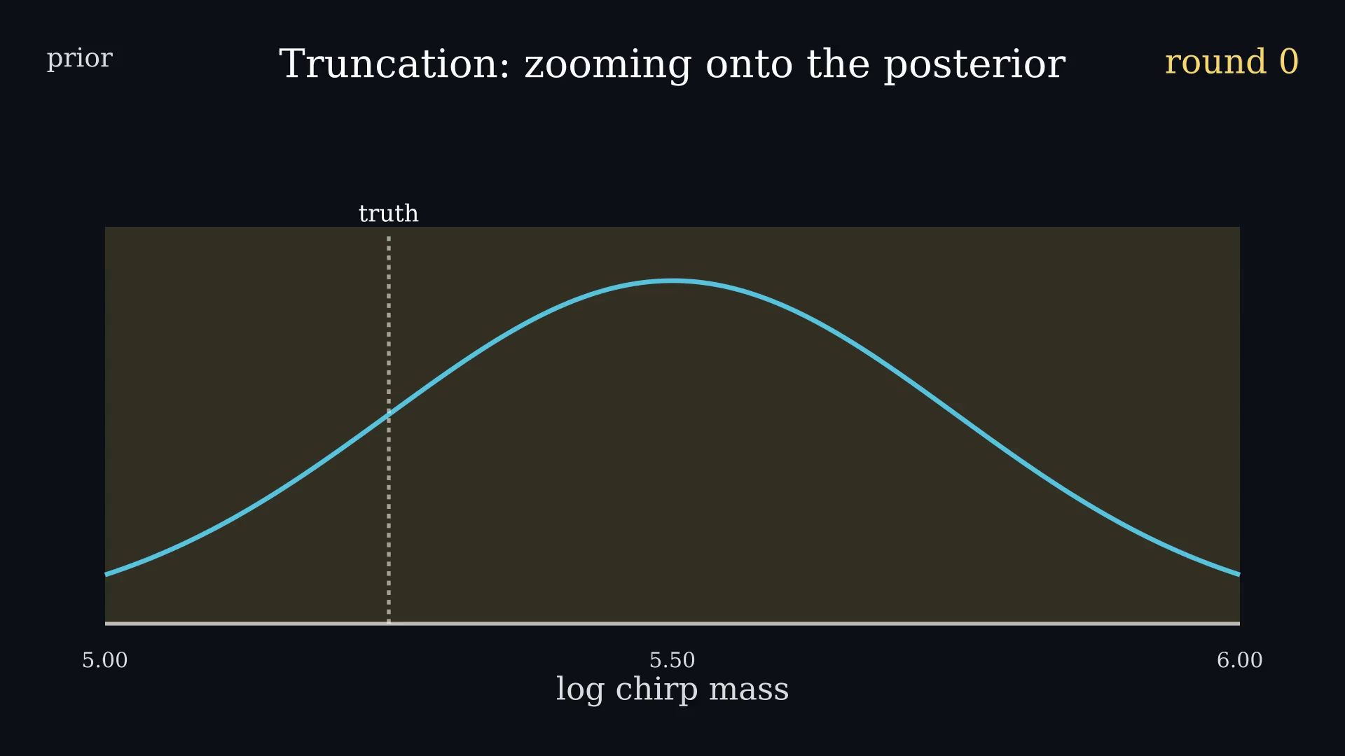
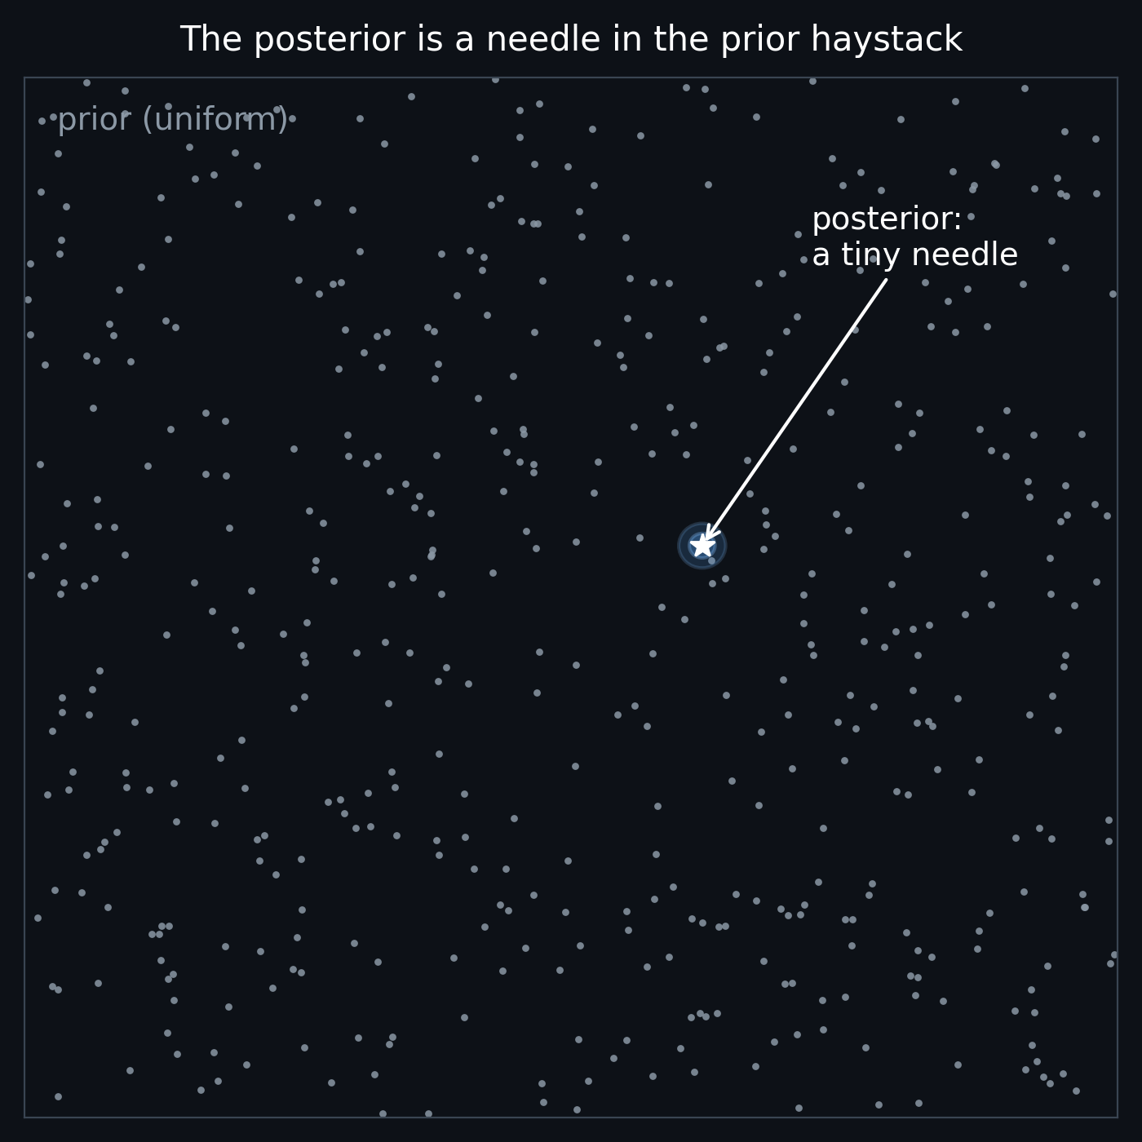
5
Amortized vs sequential → truncation
AMORTIZED
once, over the whole prior → instant. Challenging – requires extensive resources
SEQUENTIAL → TRUNCATION
train for THIS observation, in rounds.
each round: marginals → rough posterior → drop mass < 10⁻⁴ → smaller box → repeat
On LISA: start from a physically reasonable, agnostic prior — truncation finds the source.
✓ WHERE it lives — the T completes TMNRE
Notes:
Here's the asterisk on 'instant'. AMORTIZED inference does the expensive work once, up front, over the ENTIRE
prior, before you have the data -- then any observation is a lookup. The dream. But combine 11 dimensions with a
posterior that's a tiny NEEDLE in a huge prior HAYSTACK: scatter sims uniformly over the prior and almost none
land near the needle. The model wastes its budget on ruled-out regions. Amortizing becomes challenging.
So we go SEQUENTIAL: train for THIS observation, in rounds -- and our sequential mechanism is TRUNCATION, the T.
Each round: train the marginal classifiers -> a rough posterior. Then truncate: throw away every slice of the
prior where the posterior mass falls below a tiny threshold (one in ten thousand). What survives is a smaller
box; the next round simulates only inside it. [PLAY HERO] Round after round, the prior COLLAPSES onto the posterior.
This is the pipeline I build for LISA: from a physics-agnostic wide prior, truncation zooms onto the source.
That answers WHERE -- and completes the name, TMNRE. Let me show you where it lands.

Slide 8
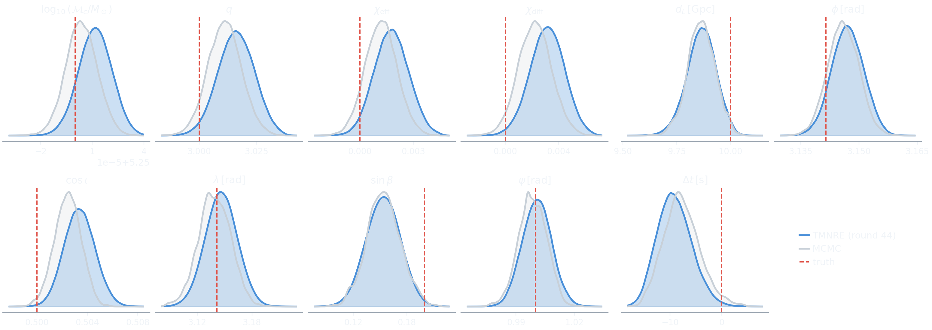
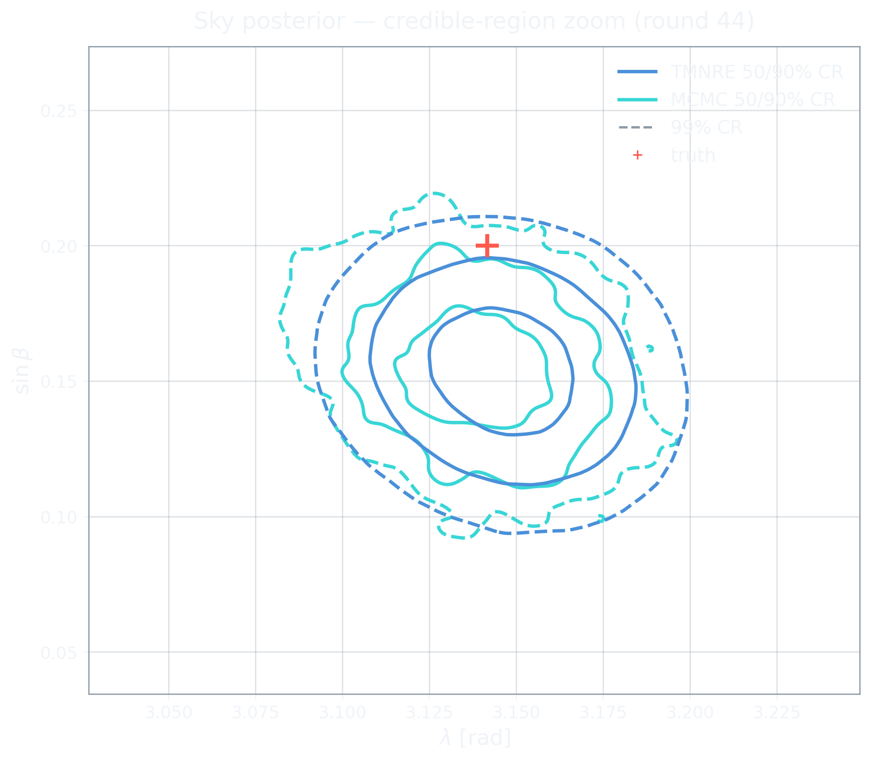
6
Preliminary Result: TMNRE vs MCMC on LISA MBHB (42 rounds)
We run TMNRE on a mock observation with chirp mass ~ 10^5 solar mass, SNR ~ 2200 , starting from a physically reasonable agnostic prior. Here is the result:
TMNRE agrees with MCMC on all 11 parameters · truth recovered
POSTERIOR/PRIOR VOLUME RATIO: 10^{-25}
42 rounds · wide physics-agnostic prior · ~30 h · 1 GPU · 14.2 M params
Notes:
[FIGURE: round-44 corner, TMNRE vs MCMC] After 44 rounds of truncation, here's where it lands. The final
posterior over all 11 parameters. In colour, TMNRE; overlaid, classical MCMC on the same data. They agree --
that's the point: our likelihood-free method recovers what the gold-standard likelihood-based method gives,
with tight, sensible error bars on every parameter.
The cost: about 40 hours on a single GPU, for a network of 14 million parameters. Not instant -- we gave up
amortization -- but entirely tractable, and fully automated from that wide prior down to this.

Slide 9
In summary
One question — how do we find the posterior? Two answers:
MCMC
classical — samples via the likelihood
SBI
likelihood-free — learn from a simulator
TMNRE
a tiny posterior in a huge prior, no likelihood ever
Why this matters ?
the MBHB likelihood is tractable: we assume gaussian noise. The easy case is a proof of concept for the hard one
Future direction 1: include overlapping sources, data gaps, glitches, non-stationary noise
where writing a likelihood becomes hard, but simulating forward doesn't.
Future direction 2: start the sequential inference before the merger, potentially building a low latency alert pipeline?
Thank you.
Notes:
To close the loop I opened at the start: we asked one question -- how do we find the posterior. We saw the
classical answer, Monte Carlo; the machine-learning answer, simulation-based inference; and one concrete method,
TMNRE, that finds a tiny posterior inside a huge prior without ever evaluating a likelihood.
And that's why this matters even though the MBHB likelihood is tractable: the easy case earns trust for the hard
one -- overlapping sources, data gaps, glitches, non-stationary noise -- where writing a likelihood breaks down,
but simulating forward doesn't. And here it is, working on LISA data. Thank you.

