Slide 1

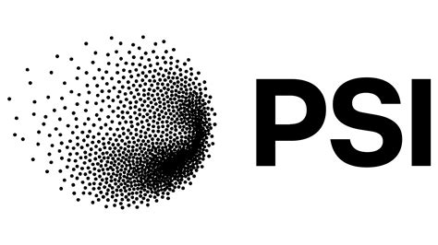



ML methods for source apportionment and harmonisation of atmospheric aerosol
Marta Via Ph.D.
Atmospheric Composition Group - Barcelona Supercomputing Centre
Upgrading Particulate matter Source apportIonment through Data sciencE
Supervision: Prof. Griša Močnik (Centre of Atmospheric Research, University of Nova Gorica).
Dr. Kaspar Daellenbach (Laboratory of Atmospheric Chemistry, Paul Scherrer Institute).

Slide 2


















…
Notes:
In my research I focus on air pollution specifically on the particulate matter.
Both natural and anthropogenic emissions contribute to their emission and formation.
These particles can be directly emitted as particles called primary or formed through atmospheric processing of volatile compounds called secondary.
When PM is emitted

Slide 3
Air pollution in numbers
180.000
#1
>70%
Environmental health risk in Europe
Deaths in 2023 attributed to PM_{2.5} in the EU
World population will live in cities by 2050 (poorer AQ)
2050
1.3-4x
-57%
First global cause of child mortality
Higher exposure to harmful PM2.5 levels in low-medium income countries
2005-2023 reduction of PM_{2.5}-related premature deaths in Europe due to clean-up

Slide 4

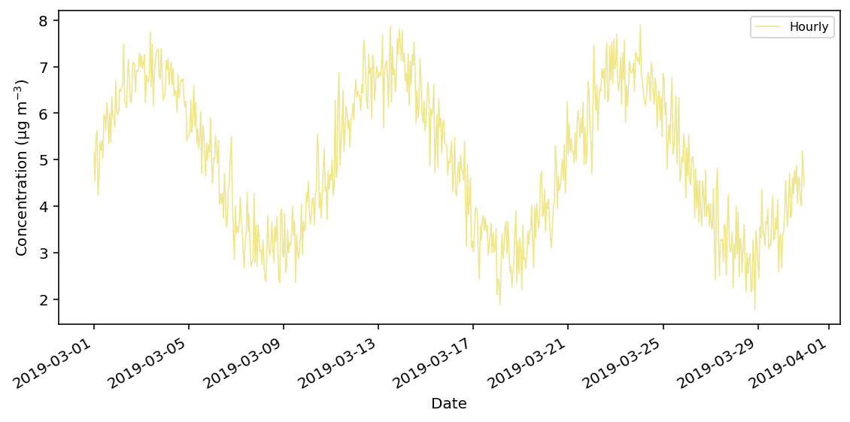

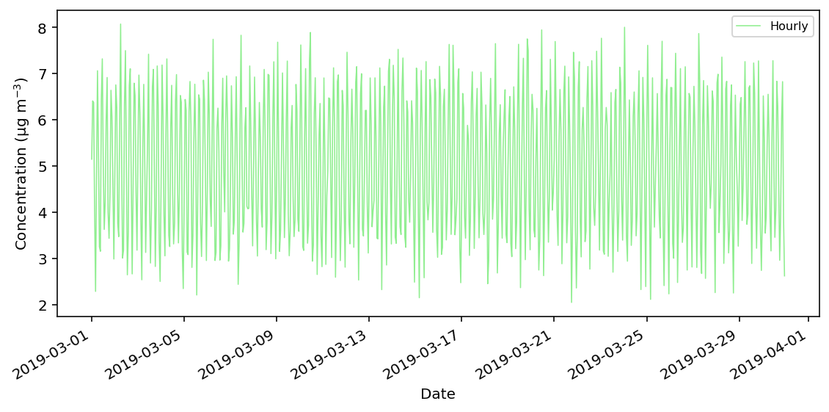

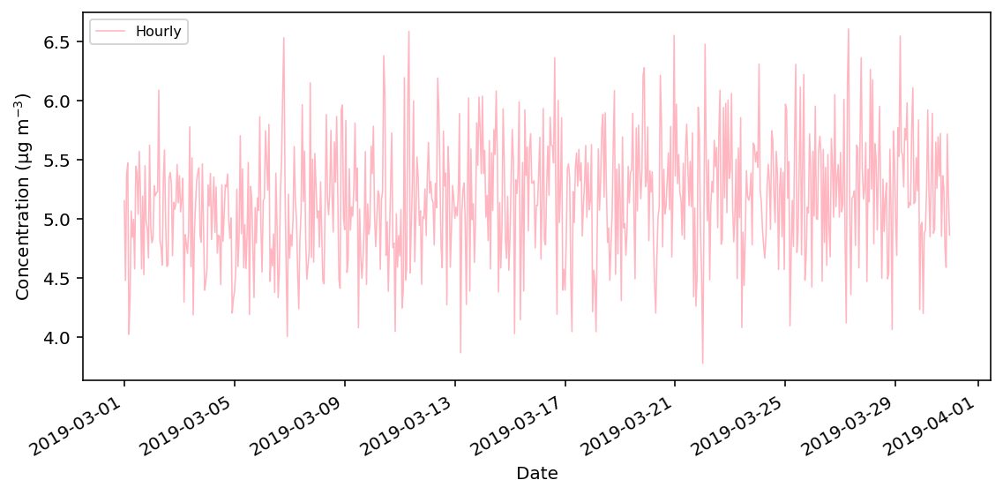
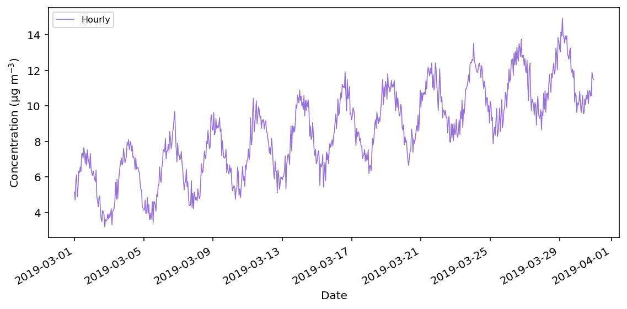

Topic I: SOURCE APPORTIONMENT
Measurements
Sources
Chemical fingerprint
Time Series

Slide 5
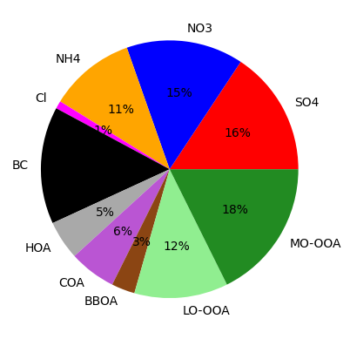
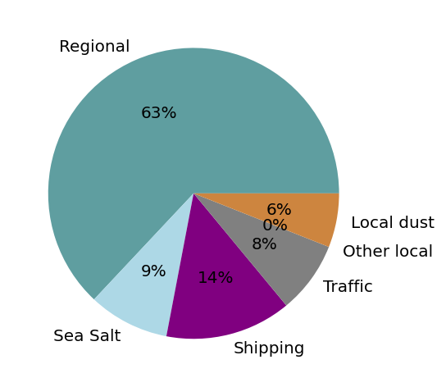
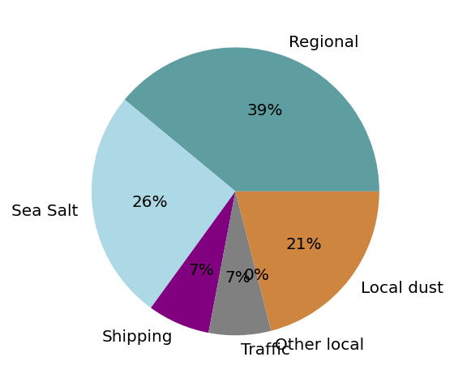
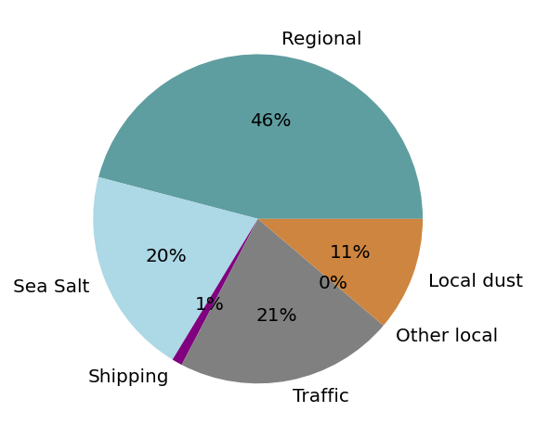
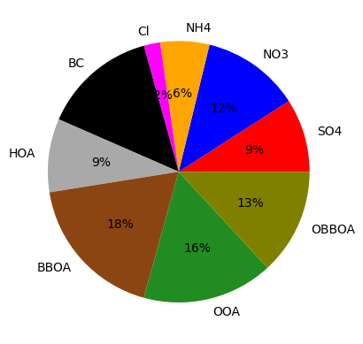
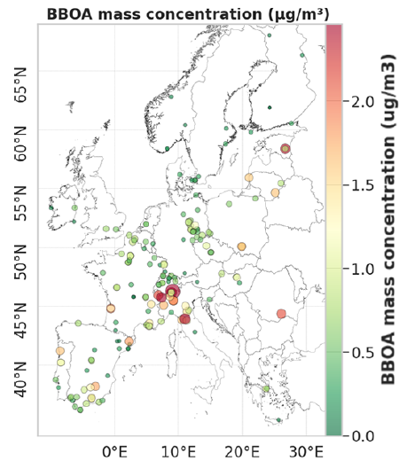
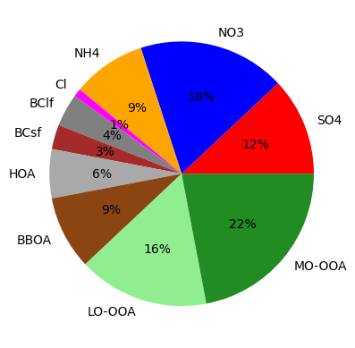
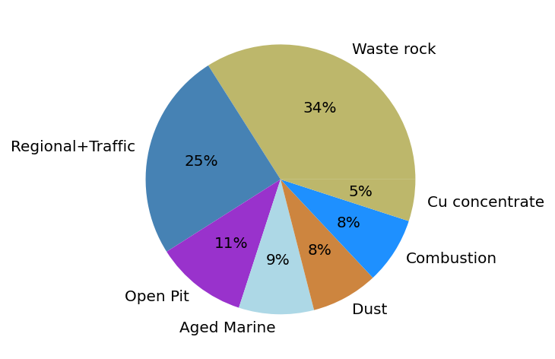
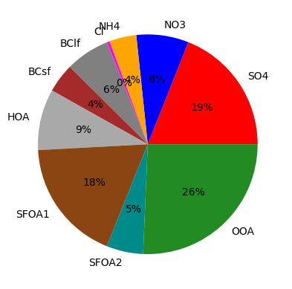
Campaign → Data analysis → Source apportionment
Barcelona - Palau Reial [PM₁]
Barcelona -
Harbour [El_{2.5}]
Barcelona -
Harbour [El₁₀]
Barcelona -
Traffic [El₁₀]
Manlleu
[PM₁]
Via et al. (2021)
Glojek et al. (und. rev.)
Glojek et al. (und. rev.)
Canals-Angerri et al. (2024)
Nova Gorica (SI)
[PM₁]
Ríotinto (ES)
[PM₁]
Sarajevo (BiH)
[PM₁]
Stavroulas et al. (in prep.)
Pérez-Vizcaíno et al. (accept.)
Via et al. (2026)
Jouanny et al. (2025)
Via et al. (under review)

Slide 6
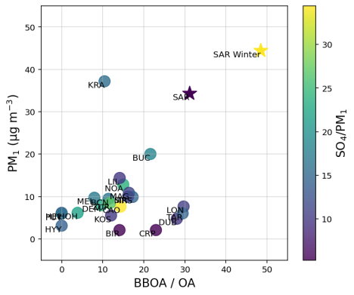
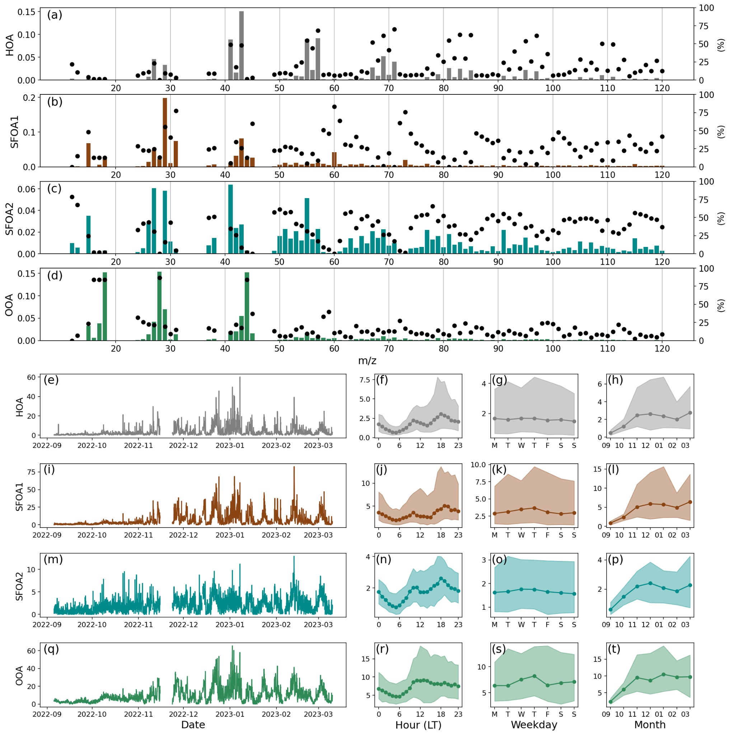

Example: Sarajevo - Bjelave (BiH)
September 2022 - March 2023
+10% all-cause mortality during its heavy-polluted episodes
x4 EU directive PM_{2.5} limit value exceedances only during this 8-month campaign
Residential heating, power plants, traffic
Via et al. (under review)

Slide 7
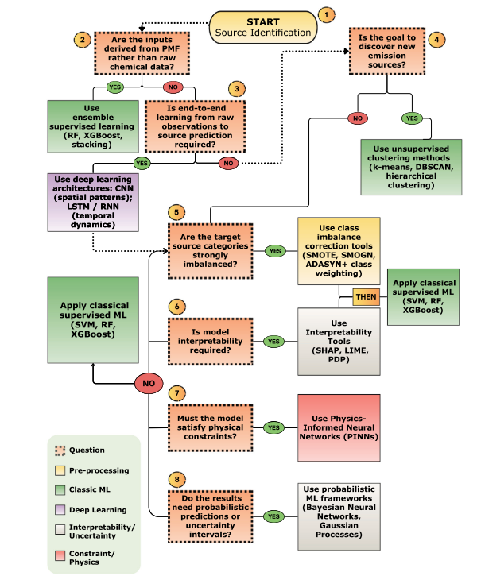
How to do source apportionment?
Short answer:
Long answer:
Positive Matrix Factorisation (PMF)
Paatero and Tapper (1994)
Oshakbayeva et al. (2026)

Slide 8
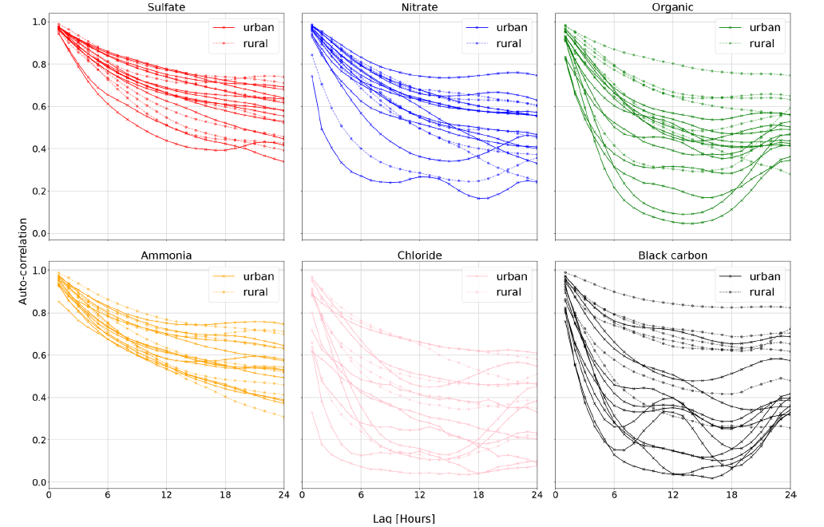

Bayesian Autocorrelated Matrix Factorisation (BAMF)
X = G · F + E
OA
Probabilistic ML approach
Bayesian Inference
Autocorrelation
Autocorrelation term
Rusanen et al. (2025) AMT
Sparsity in profiles
Via et al. (2026) AMT
Lag (h)
Tried on:
Synthetic datasets
Real-world datasets

Slide 9
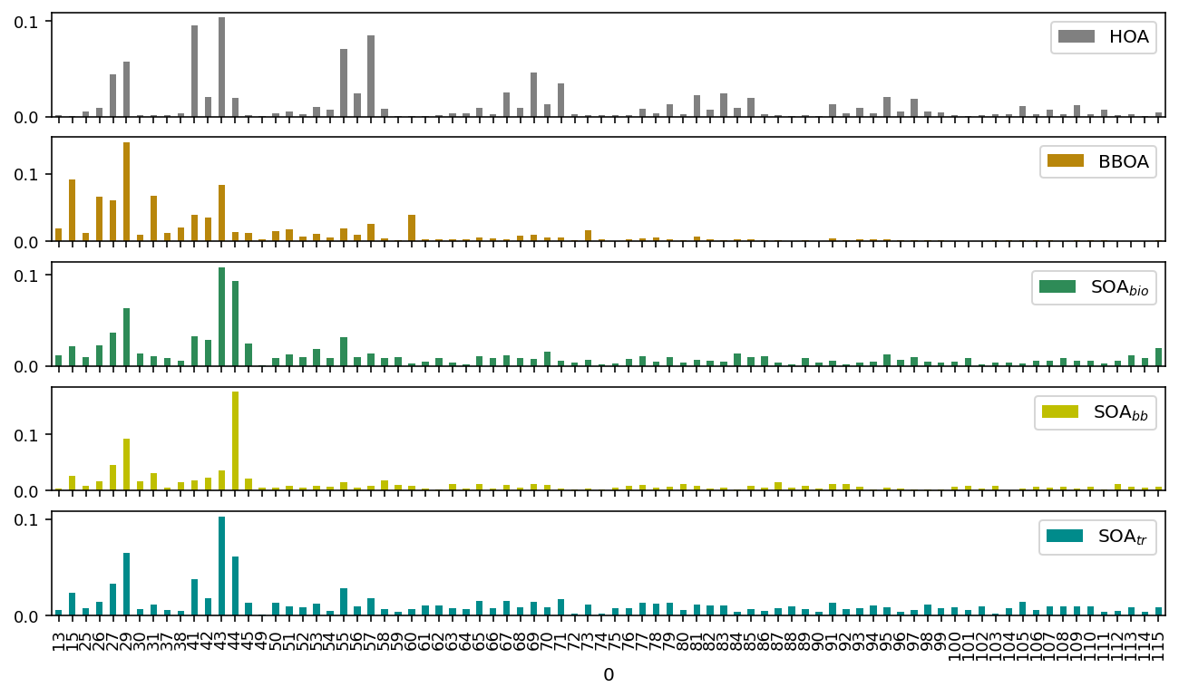

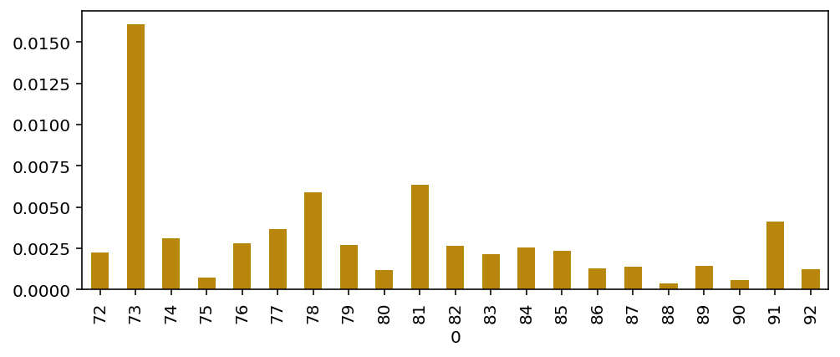
Step further: Sparsity
Sparsity := with only few, scattered elements
To source apportionment
BAMF + HS
Sparsity term
(on F)
+
Autocorrelation term
(on G)
+
X ≈ G*F
Bayesian formulation
(Probabilistic)
2

Slide 10
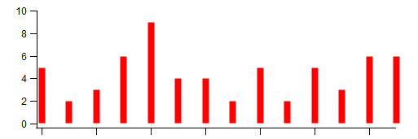
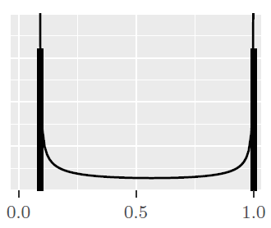

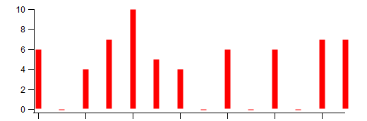

Step further: Sparsity
BAMF
Sparsity prior:
Regularised Horseshoe Prior
Regular profile
Piironen and Vehtari (2017)
Shrinkage
Shrinks to zero low signals
Cutoff for too high signals.
Allows moderate signal to scape shrinkage
BAMF+HS
Sparse profile
Notes:
The standpoint of our study is the BAMF (Bayesian Autocorrelated Matrix Factorisation) model.
These models are, differently from PMF, probabilistic, we solve them through Montecarlo markov chains.
Its main novedous feature with respect to PMF is its autocorrelation capacity, meaning that measurements at a certain time t are similar to t-1.
This, as shown in Rusanen et al. 2024 has shown to improve source apportionment in two synthetic datasets.
Our work has focused on adding another interesting feature into BAMF, the sparsity
Sparsity is the property of having only few, scattered elements, which in our case, we want to appply into our F matrices.
These could lead to have less noisy profiles, by only keeping the essential contributing species into each source and getting rid of unnecessary contributions.
Thsi is added on top of BAMF through the regularised horseshoe prior, hence we call it BAMF+HS.

Slide 11
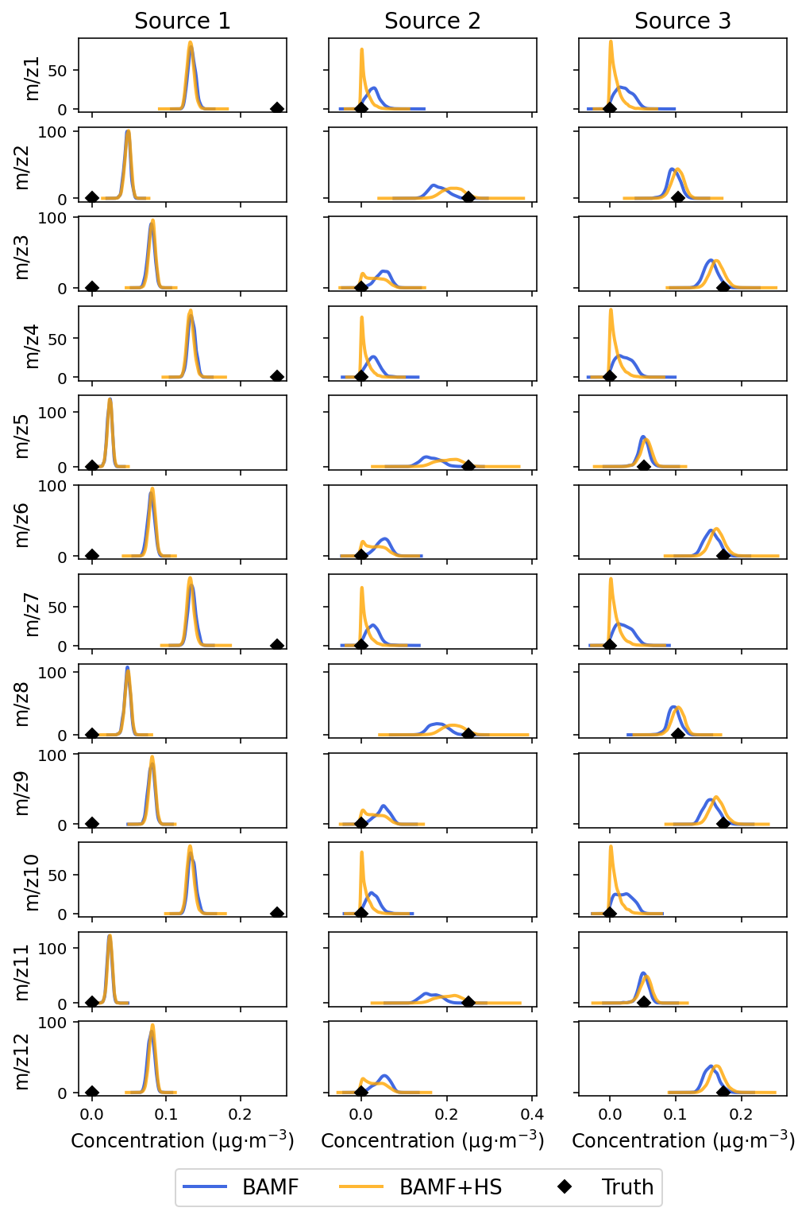

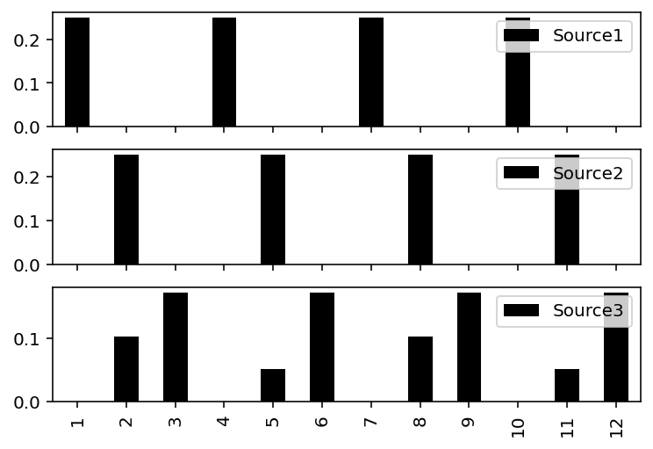
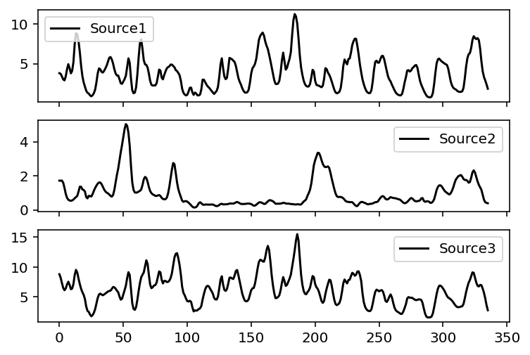
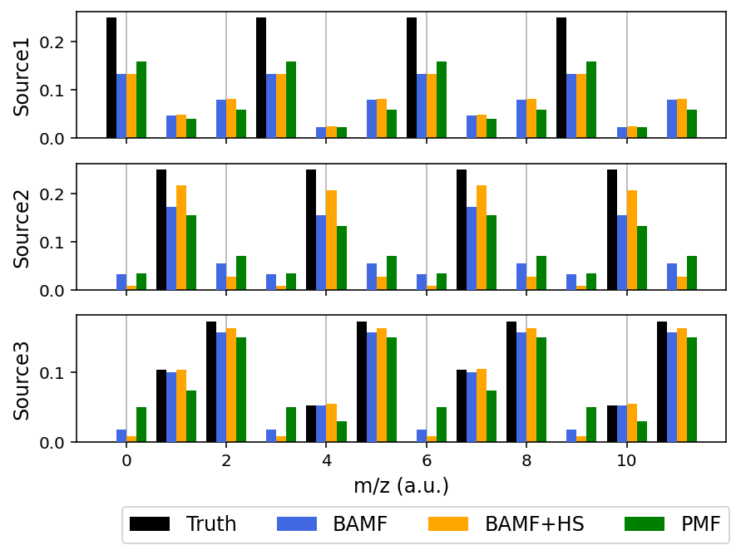
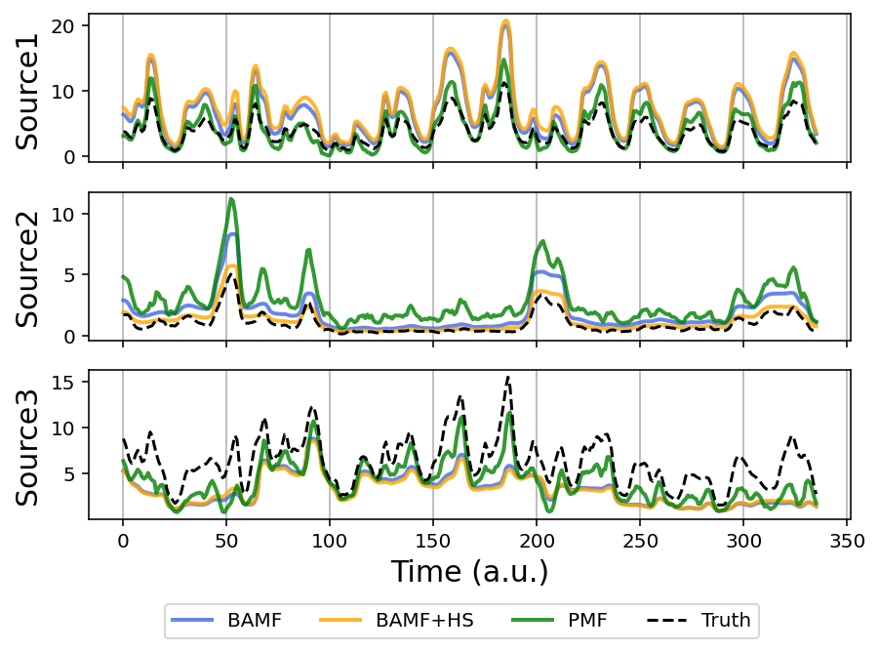
Tests: Toy dataset
F
G
TRUTH
3
Notes:
First of all, we used a very simple synthetic toy dataset with three factors only and time series from CAMx model set in zurich 2011. Note that for the experiment, we have many zeros in these profiles.
The point of synthetic datasets is to know the truth in advance once the input matrices are constructed.
We applied to this dataset the PMf, BAMF, BAMF+HS models.
We see how the horseshoe is the model with better profile resemblance to the truth. We see a clear sparsity introudction effect in profile number two, where when anrrowing certain signals down, the most relevant are increased, improving the profile accuracy of the models.
If we take a look at the distribution of the solutions, we see this horseshoeing effect in action in the second and third profiles. However, teh first profile was not horsehoed, meaning still the models are challenged by the data.

Slide 12


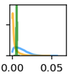
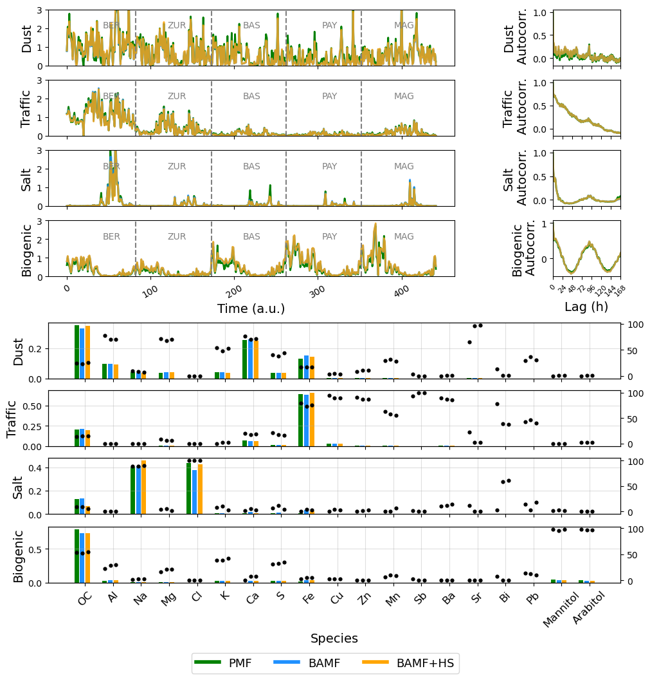
Tests: offline real-world dataset
Salt factor:
Filters measurements for coarse PM (PM₁₀ – PM_{2.5}) in 6 Swiss sites.
SEM profiling: truth determination in Manousakas et al. (2025)
K
S
OC
Results
✔ BAMF+HS ↔ Sparsity
✔ Similar performance amongst models.
✔ BAMF+HS likely more accurate.
10

Slide 13

Summary + Conclusions
>>> Check the paper!
Sparsity can be an interesting property for certain dataset types and/or sources.
BAMF+HS achieves sparsity in matrix factorisation.
BAMF+HS proves advantageous for offline datasets.
  Sparsity in solution is achieved.
  Profiles improve with respect to other models.
  Correlation with time series and autocorrelation are equal or better with BAMF+HS.
BAMF+HS struggles with ACSM-like datasets (not sparse). There, BAMF>BAMF+HS>PMF.
BAMF+HS results on real-world datasets seem sensible and sparsity is properly enforced.

Slide 14
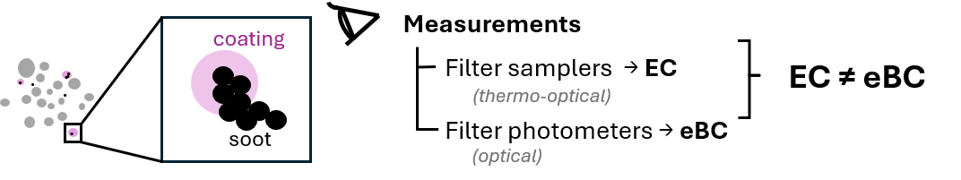



Topic II: ELEMENTAL CARBON
Notes:
is the soot-like form of elemental carbon made by incomplete combustion, such as from diesel, coal, forest fires, and cookstoves, and it is a type of fine particulate pollution. It warms the Earth by absorbing sunlight and by darkening snow and ice so less heat is reflected, and it can contribute to faster Arctic sea-ice melting.

Slide 15
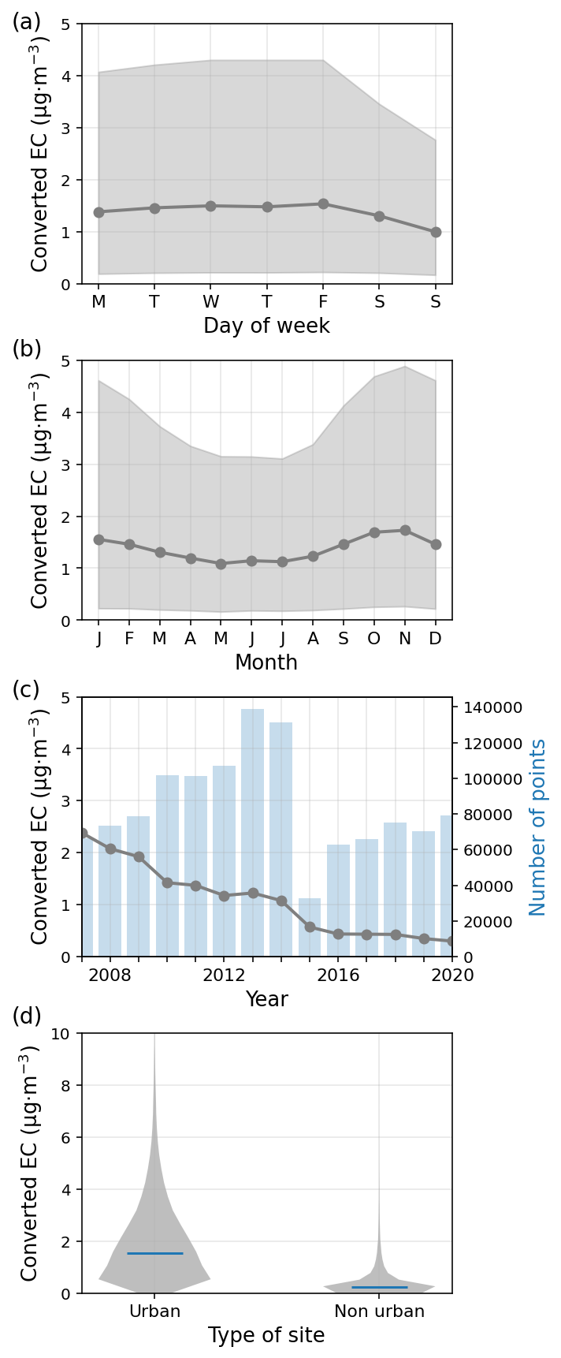

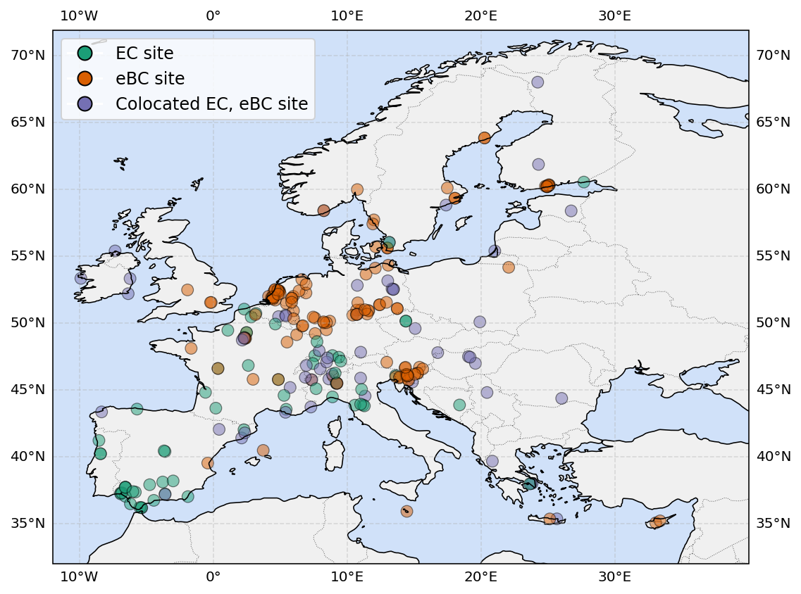
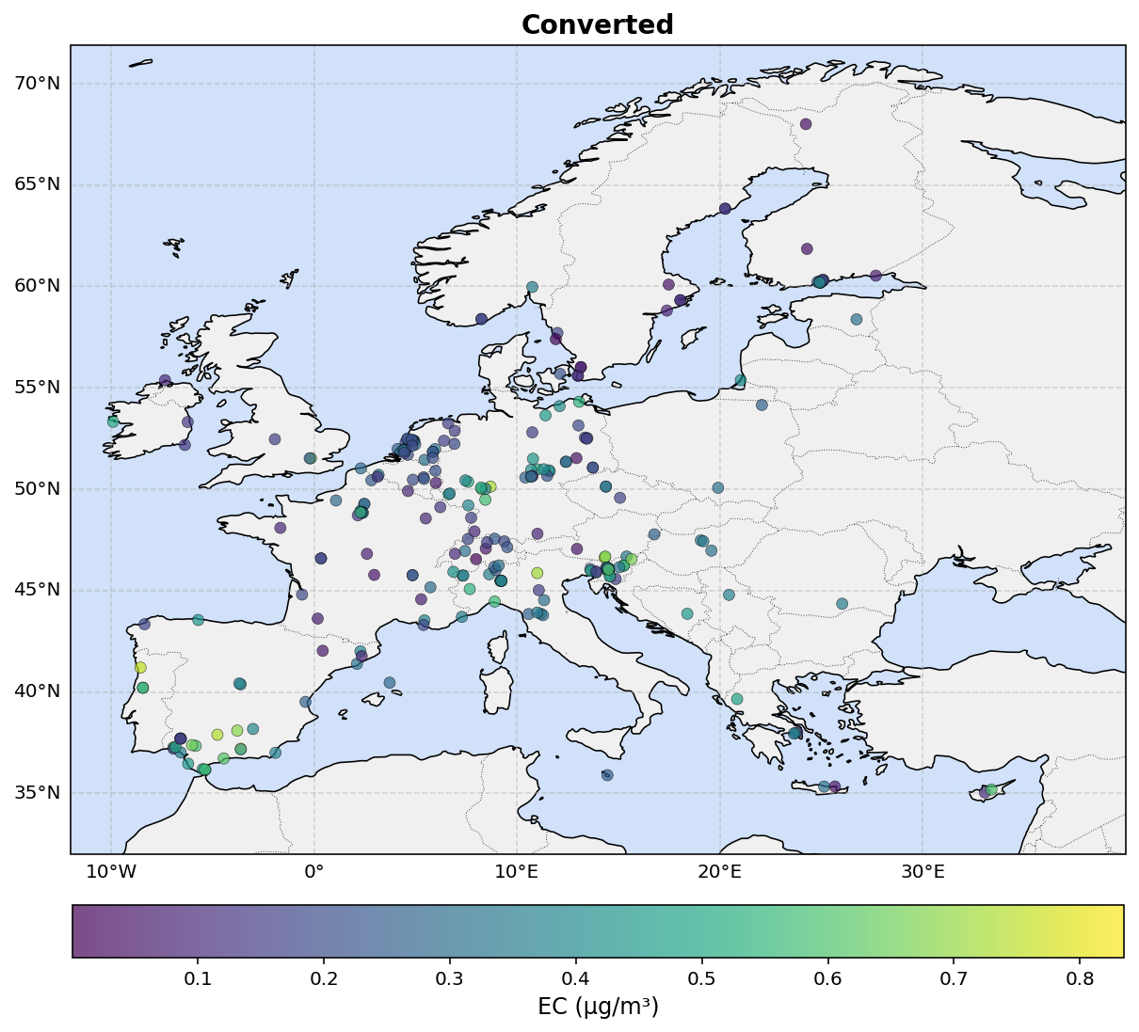
Harmonization of EC
Colocated ~35k measurements
~2M measurements
ML harmonisation
> 2M points (2000-2025)
>350 sites
Instruments: HV filters, LV filters, aethalometer, MAAP, …
Via et al. (in prep)

Slide 16
>>> Check the online tool!
Summary + Conclusions
Problem: EC (thermal–optical) and eBC (optical) measurements aren’t comparable, limiting trend analysis, model evaluation, and exposure studies.
Solution: A Bayesian harmonization framework, trained on 35,000+ colocated daily observations from 57 European sites, gives probabilistic conversion coefficients with uncertainty bounds.
    Largest correction is the overall eBC-to-EC relationship (~1.89).
    Thermal protocol and instrument type also matter substantially.
    Particle size effects are negligible at the global scale.
    Coating and dust effects are detectable but only partially constrained

Slide 17
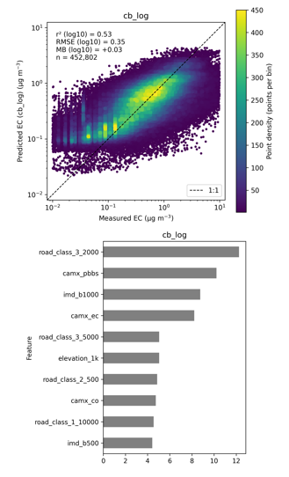
Next steps: EC maps
Training:
+
CAMx
LU
WRF

Slide 18
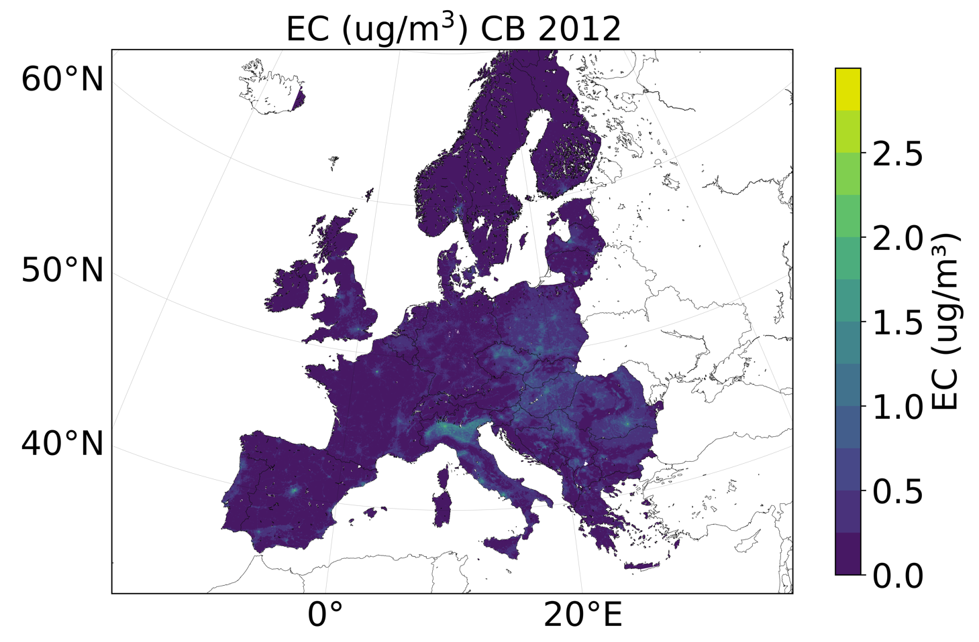

Next steps: EC maps
Thank you for your attention.
marta.viagonzalez@bsc.es

