Slide 1
LLM-Based Agentic Systems and Knowledge Graphs
A taxonomy of the tasks in which knowledge graphs support LLM agents, with the expected benefits, the measured results and guidance on when to use them
Prof. Dimitar Trajanov, Ph.D.
  Faculty of Computer Science and Engineering
  2nd SMASHING Workshop · October 2026
Notes:
The tutorial organises the uses of knowledge graphs in LLM agents into four groups of tasks. For each task it explains how the graph is connected, what is expected, how it was measured and what the measurements suggest.

Slide 2
Agenda of the Tutorial
u
Large Language Models, Knowledge Graphs and Agents
v
A Taxonomy of Knowledge Graph Tasks in LLM Agents
w
Retrieval and Reasoning with Knowledge Graphs
Definitions of the three components, the ReAct loop, autonomy levels, the time horizon of agents and an agent assembled by analogy with a person at work.
Four groups and thirteen tasks with published examples, five ways of connecting a graph to an agent, and the evaluation method.
Tasks 1.1 to 1.5: aggregation, multi-hop reasoning, whole-collection questions, passage ranking and answers attributed to their sources.
x
Memory and Time-Aware Knowledge
y
Governance, Control and Graph Construction
z
When to Use a Knowledge Graph in an AI Agent
Tasks 2.1 and 2.2: facts that change over time and long-term conversational memory.
Tasks 3.1 to 4.2: query validation, provenance, workflow and plan guardrails, extraction of facts and entity resolution.
Verdicts for all tasks, four principles, a decision procedure, limitations and conclusions.

Slide 3
Large Language Models, Knowledge Graphs and Agents
Part 1
The three components, the ReAct loop, autonomy, time horizon and an agent assembled step by step

Slide 4
Definition, Capabilities and Limitations of Large Language Models
A large language model (LLM) is a neural network, usually a transformer, pre-trained to predict the next token of a text and then tuned with human feedback to follow instructions.
Token. A word or word fragment; the prompt is split into tokens, each identified by a number.
Generation. Repeated prediction: one token is sampled, appended to the context and the prediction repeats, so every answer is a sample from a probability distribution.
Context window. The model reads only the tokens in its context; what is neither in the weights nor in the context is unknown to it.
Capabilities. Understanding and writing language, following instructions, writing code and queries, and reasoning over the information in the context.
Limitations. Plausible but unrecorded statements, knowledge fixed at the training cut-off, no sources, no memory across sessions, and obedience to instructions found in data.
1 The prompt is split into tokens
The
␣capital
␣of
␣France
␣is
976
9029
328
10128
382
Transformer: one forward pass
2 A probability for every token in the vocabulary (illustrative)
Paris
0.82
the
0.06
a
0.04
located
0.03
3 One token is sampled, appended, and the loop repeats
The
␣capital
␣of
␣France
␣is
␣Paris

Slide 5
Definition and Components of a Knowledge Graph
“A graph of data intended to accumulate and convey knowledge of the real world, whose nodes represent entities of interest and whose edges represent relations between these entities.” (Hogan et al., ACM Computing Surveys, 2021)
Node (entity). A thing with an identity and a type, such as a Ticket or a User, with properties.
Edge (relation). A directed, typed link, such as Ticket –ABOUT→ Module; it may carry a source and validity dates.
Triple. One fact written as (subject, predicate, object).
Schema and ontology. The permitted types of nodes and edges; a formal schema is an ontology.
Two data models. Property graphs queried with Cypher (for example, Neo4j) and RDF graphs queried with SPARQL (W3C standards).
User U17
Resolved
SUBMITTED
HAS_STATUS
Ticket 1042
HAS_COMMENT
ABOUT
Comment c7
Module: Login
is_solution = true
Ticket 1077
ABOUT

Slide 6
Definition and Components of an LLM Agent
An LLM agent is an LLM-driven system that selects actions, receives observations from its environment and uses those observations to decide how to continue a task (after Yao et al., ReAct, ICLR 2023).
Language model. Interprets the task, plans the next step and writes the answer.
Tools. Functions the model may call: search documents, query a database or a graph, call a service.
Control loop. Ordinary code that executes each tool call, returns the observation and stops at an answer or a step limit.
Memory. What the agent can consult beyond its prompt: documents, conversation history and structured records.
Control flow. In a fixed workflow the programmer chooses the path; in an agent the model chooses it at run time.
Control loop (code)
User task
Answer
LLM
observation
action
Tools
search · query · API
Knowledge
texts · graph

Slide 7
The ReAct loop, with a knowledge graph as the environment
Thought
THOUGHT
Which drugs act on genes associated with NSCLC?
ACTION
graph_query("MATCH (g:Gene)-[:ASSOCIATED_WITH]->(:Disease {name:'NSCLC'})
<-[:TARGETS]-(d:Drug) RETURN d.name, g.symbol")
Answer
repeat until
enough evidence
Action
tool call
OBSERVATION
[Gefitinib, EGFR], [Erlotinib, EGFR], …
THOUGHT
I need the evidence for each edge before answering.
Observation
ACTION
graph_query("… RETURN r.source_passage")
ANSWER
Gefitinib and erlotinib target EGFR [edge sources cited].
Reasoning interleaved with actions on an external knowledge source; each observation enters the context
  The graph answers the relational step exactly, and every edge it returns can carry its source
Notes:
Illustrative trace, not output from a specific system. The point: the agent decides the next query from the previous observation; that is what makes it agentic rather than a pipeline.

Slide 8
AI autonomy levels: decisions retained and transferred
Level
Retained by the person
Transferred to the system
What the person keeps
L0
Scripted automation
Complete manual operation
L1
Context assistant
Acceptance or rejection, step by step
L2
Supervised tool agent
Authorisation of each individual action
L3
Multi-step orchestrator
Approval of the plan and of the final artefact
L4
High-autonomy agent
Management by exception, at the domain boundary
L5
Autonomous collective
Strategic policy, and emergency termination
Each level transfers one further class of decision from the person to the system; the bar lengths are schematic, not measured.
  An audit of 28 products described as agents found 5 operating above Level 2 (AI Agents lecture series, FCSE, Skopje, 2026).
Notes:
[Reused from DS-01 Data Science in the Age of AI, slide 28]
Redrawn from the MANU inaugural lecture (September 2026). Source of the audit: AI Agents, lecture series, Faculty of Computer Science and Engineering, Ss. Cyril and Methodius University in Skopje, 2026. The coding agents used in this course are configured to operate at Levels 1 and 2: every change is accepted or rejected, or each action is authorised. Since August 2026 Claude Code defaults to auto mode, in which a classifier, not the person, approves routine actions (Level 3); in this course, set the permission mode so that each action is authorised.

Slide 9
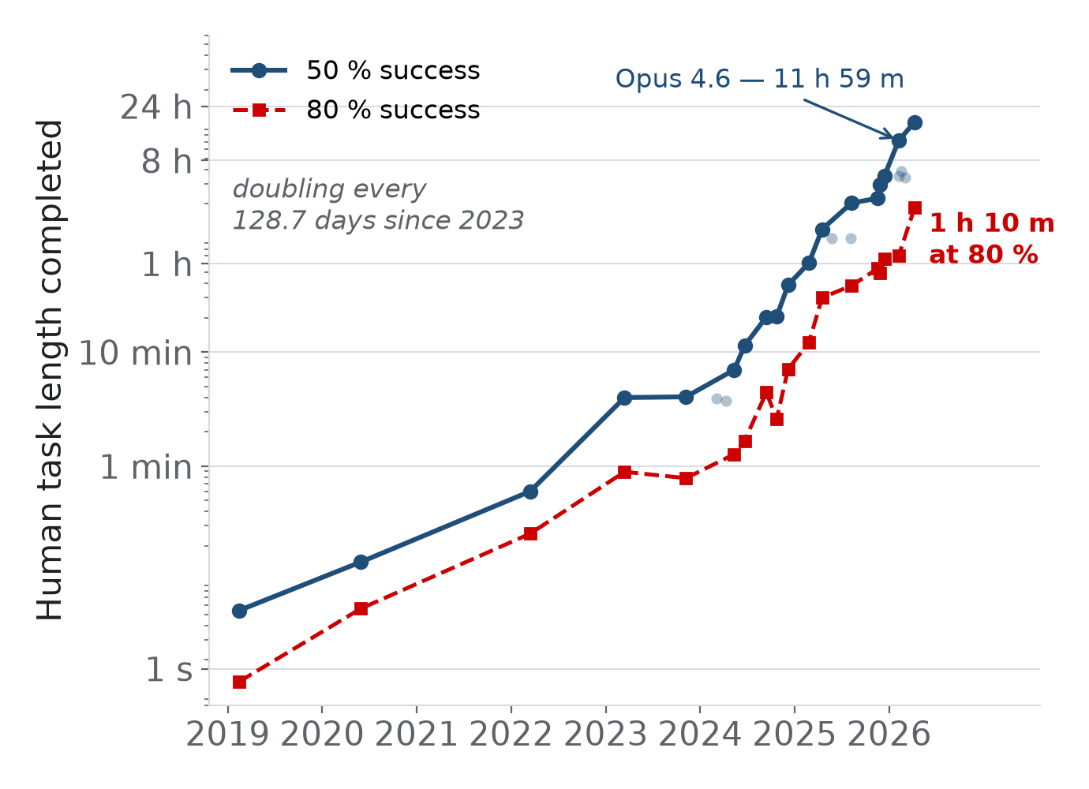
The time horizon of AI agents, 2020 to 2026
The 50 % time horizon is the length of a task, in human working time, at which a model succeeds half the time (METR).
  GPT-3, 2020: 8.6 seconds; Claude Opus 4.6, February 2026: 11 h 59 min; Claude Mythos Preview, April 2026: about 17 h.
The horizon has doubled every 128.7 days since 2023, against 187.8 days over the whole series.
  The frontier line joins the state-of-the-art models; the faint points are the other measured models.
At 80 % reliability the horizon is far shorter, which is why agents remain under supervision.
  Source: METR, time-horizon series 1.1, page updated 8 May 2026.
Figure 12 — task length, in human working time, completed unaided
Notes:
[Reused from DS-01 Data Science in the Age of AI, slide 29]
Source: METR, time-horizon series 1.1, benchmark_results_1_1.yaml; page updated 8 May 2026, data retrieved 20 September 2026. The intervals are wide and depend on the task suite; the trend is a measurement of software tasks, not of all work. Claude Mythos Preview (April 2026, restricted release) measured about 17 h 25 min (80 %: 3 h 06 min); METR notes that values above about 16 h exceed what its task suite measures reliably.

Slide 10
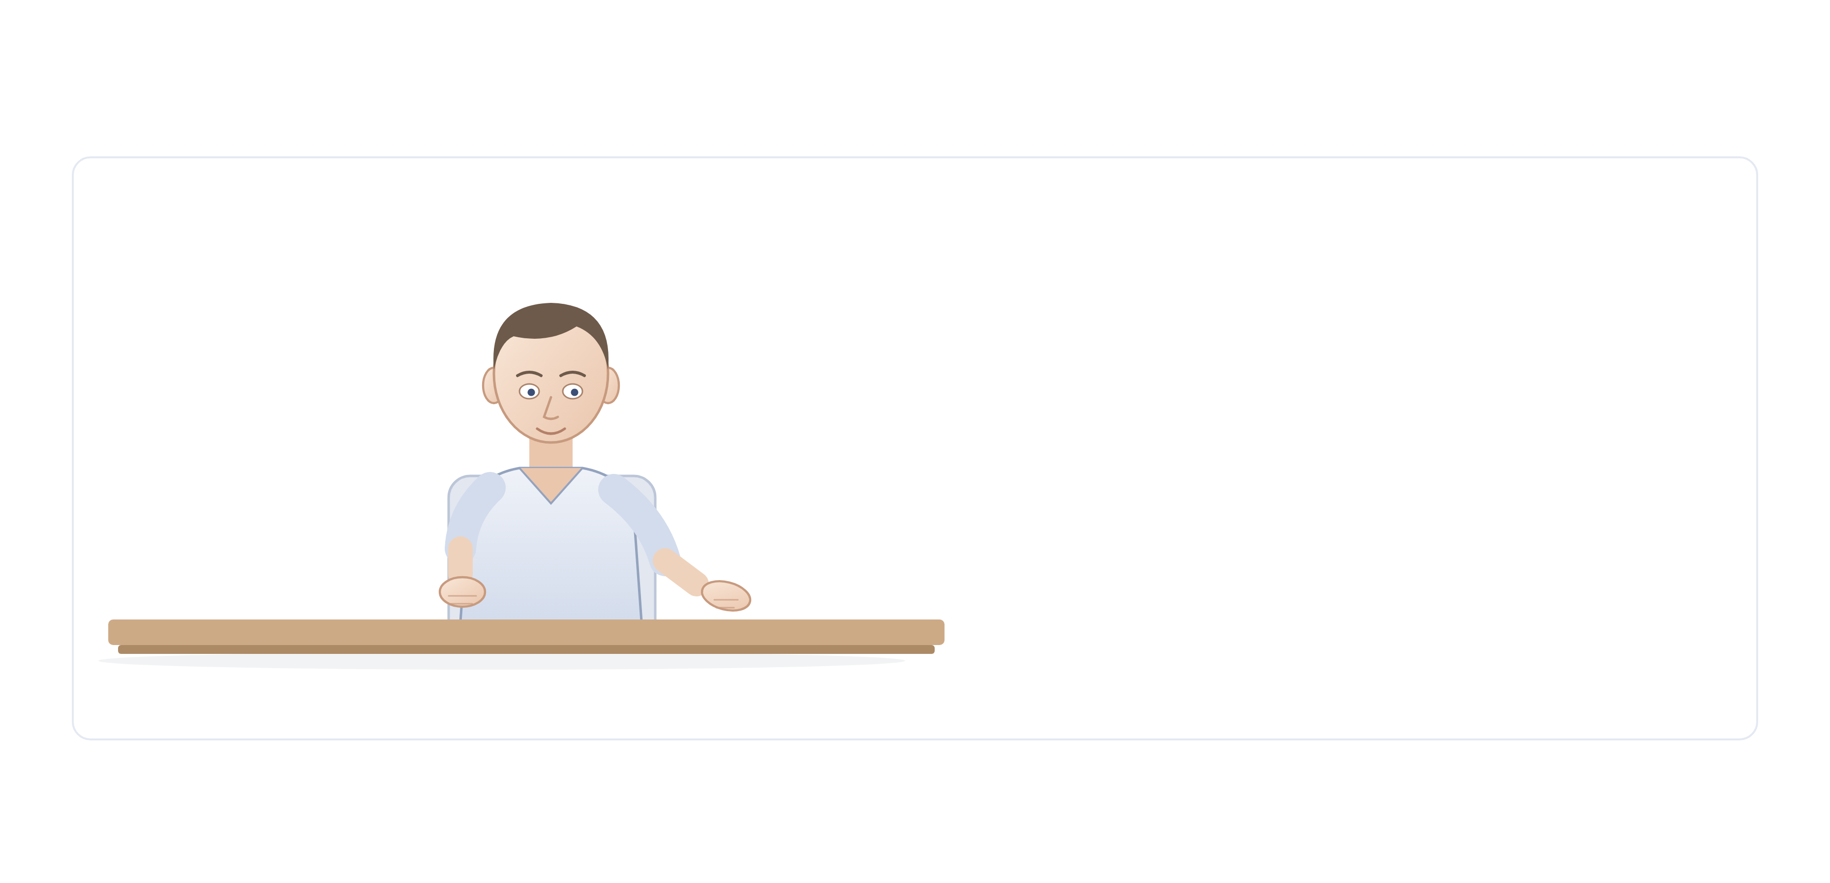
An AI agent, built up by analogy with a person at work
Four kinds of graph to watch for
D
Domain graph
What the agent knows: entities, relations and the source of every fact.
M
Memory graph
What it remembers: people, episodes and facts, with when each held.
E
Execution graph
What it does: plan steps, tool calls, state and results.
P
Policy graph
What it may do: permissions, rules, review status and provenance.
Green markers on the next slides show where each one plugs in.
The starting point is a person at a desk; each of the following slides adds one capability until the complete agent has been assembled.
An AI agent is a goal-directed system that perceives its environment, remembers, reasons, plans and acts through tools, observing the consequences of its actions and adapting to them.
Notes:
[Reused from MANU inaugural lecture (MANU-Pristapno-Predavanje-v2.pptx), slide 20]
Graph overlay — Four kinds of graph to watch for
D Domain graph (domain graph): What the agent knows: entities, relations and the source of every fact.
M Memory graph (memory graph): What it remembers: people, episodes and facts, with when each held.
E Execution graph (execution graph): What it does: plan steps, tool calls, state and results.
P Policy graph (policy graph): What it may do: permissions, rules, review status and provenance.

Slide 11
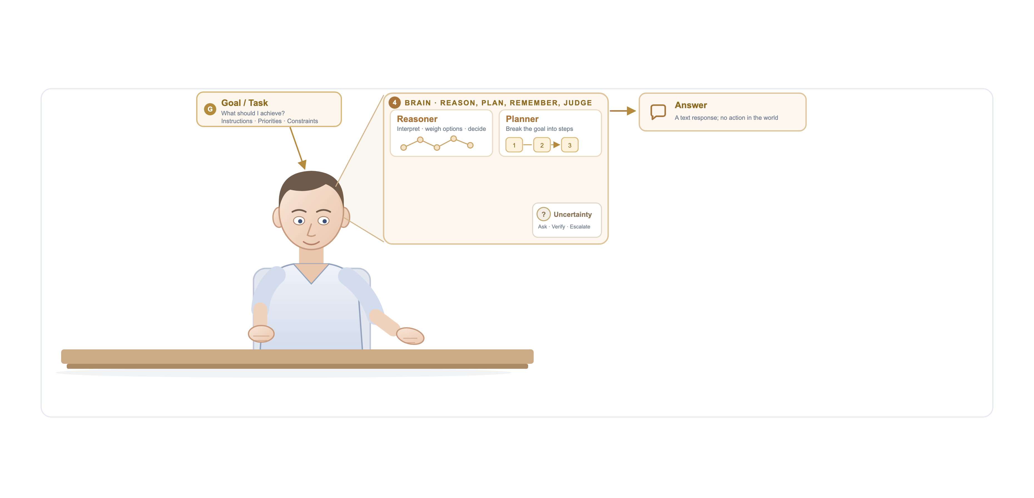
A conversational model reasons and answers, but only in text
Where a graph helps the model think
G1
G4
G1
Ground the task in entities
DOMAIN GRAPH Link the names in the request to graph IDs (EGFR → HGNC:3236), so the task is unambiguous.
G2
G3
G2
Reason along explicit paths
DOMAIN GRAPH Traverse the graph hop by hop (Think-on-Graph); each hop is a fact that can be checked.
G3
Plan as a graph
EXECUTION GRAPH A multi-hop question becomes a DAG of sub-questions that follow relation paths.
G4
Answer with citations
DOMAIN GRAPH Every claim points to a node or edge and its source; no path found → say so.
Systems such as ChatGPT receive a task, reason about it and plan a response; their only output is text.
In its original form a conversational model retained nothing between sessions, did not perceive its environment and could not act; any action based on its answer was taken by the person who read it.
Notes:
[Reused from MANU inaugural lecture (MANU-Pristapno-Predavanje-v2.pptx), slide 21]
Graph overlay — Where a graph helps the model think
G1 Ground the task in entities (domain graph): Link the names in the request to graph IDs (EGFR → HGNC:3236), so the task is unambiguous.
G2 Reason along explicit paths (domain graph): Traverse the graph hop by hop (Think-on-Graph); each hop is a fact that can be checked.
G3 Plan as a graph (execution graph): A multi-hop question becomes a DAG of sub-questions that follow relation paths.
G4 Answer with citations (domain graph): Every claim points to a node or edge and its source; no path found → say so.

Slide 12
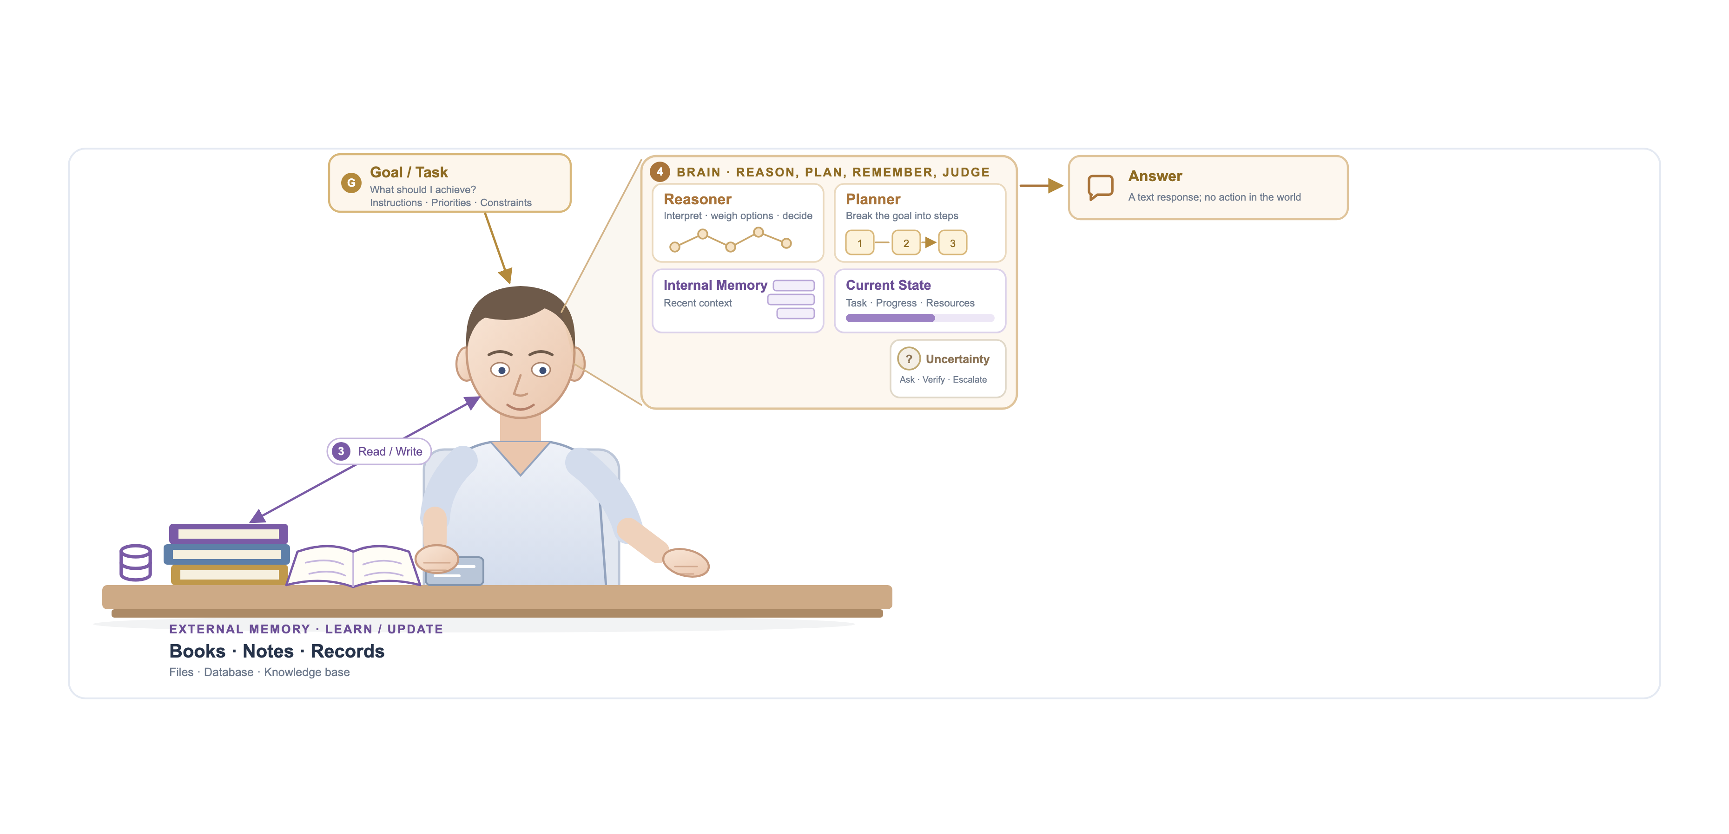
Memory allows the system to retain context and consult sources
Where a graph serves as memory
G5
Knowledge graph as external memory
DOMAIN GRAPH Entities, relations and sources beside the documents; GraphRAG or Cypher answers multi-hop and global questions.
G7
G8
G6
Write back what was learned
DOMAIN GRAPH New facts are extracted into the graph: schema-checked, entity-resolved, with provenance.
G6
G5
G7
Long-term memory graph
MEMORY GRAPH Users, episodes and facts persist across sessions as a temporal graph (Graphiti, Zep).
G8
Task state as a graph
EXECUTION GRAPH Plan steps, progress and checkpoints are nodes, so a run can be resumed and inspected.
G1–G4 still apply.
Internal memory holds the context and the state of the task; external memory supplies documents, records and databases that can be read and updated.
External memory is commonly implemented as retrieval from document collections and knowledge bases, which allows answers to be grounded in sources other than the training data.
Notes:
[Reused from MANU inaugural lecture (MANU-Pristapno-Predavanje-v2.pptx), slide 22]
Graph overlay — Where a graph serves as memory
G5 Knowledge graph as external memory (domain graph): Entities, relations and sources beside the documents; GraphRAG or Cypher answers multi-hop and global questions.
G6 Write back what was learned (domain graph): New facts are extracted into the graph: schema-checked, entity-resolved, with provenance.
G7 Long-term memory graph (memory graph): Users, episodes and facts persist across sessions as a temporal graph (Graphiti, Zep).
G8 Task state as a graph (execution graph): Plan steps, progress and checkpoints are nodes, so a run can be resumed and inspected.

Slide 13
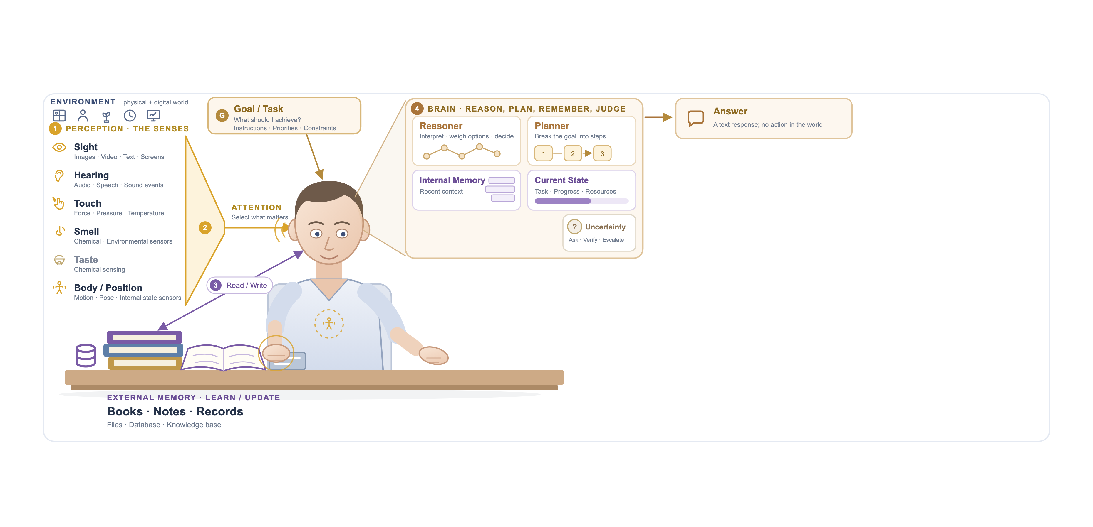
Perception connects the system to its environment
Where a graph structures perception
G11
G9
Link what is perceived to known entities
DOMAIN GRAPH Objects, speakers, readings and documents become nodes tied to entities already in the graph.
G10
G9
G10
Graph-guided attention
DOMAIN GRAPH The neighbourhood of the task's entities decides what is relevant: a subgraph, not the whole world.
G11
The environment as a graph
DOMAIN GRAPH Places, devices, people and their relations; sensor streams update it, the agent queries it.
G1–G8 still apply.
Images, audio, text and sensor data are received, and attention selects what is relevant before it reaches reasoning.
Multimodal systems accept images, video and audio in addition to text. At this stage the system observes the world, but its output is still only text.
Notes:
[Reused from MANU inaugural lecture (MANU-Pristapno-Predavanje-v2.pptx), slide 23]
Graph overlay — Where a graph structures perception
G9 Link what is perceived to known entities (domain graph): Objects, speakers, readings and documents become nodes tied to entities already in the graph.
G10 Graph-guided attention (domain graph): The neighbourhood of the task's entities decides what is relevant: a subgraph, not the whole world.
G11 The environment as a graph (domain graph): Places, devices, people and their relations; sensor streams update it, the agent queries it.

Slide 14
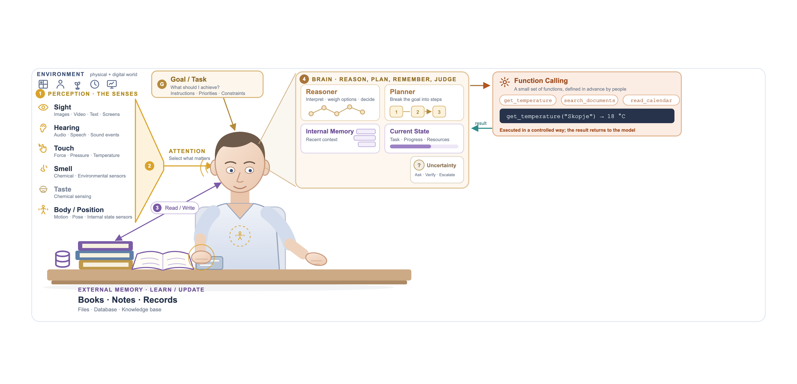
Function calling: the model performs a small set of actions defined by people
Where a graph becomes a function
G12
G13
G12
Graph queries as fixed functions
EXECUTION GRAPH get_neighbours(id), find_path(a, b), parameterised Cypher: typed, safe and predictable.
G14
G13
Hybrid retrieval
DOMAIN GRAPH search_documents starts from vector hits and expands along graph edges to related facts.
G14
Return a subgraph, not a string
DOMAIN GRAPH Results carry node IDs and sources, so the next step and the answer can cite them.
G1–G11 still apply.
The model calls one of a few functions written in advance by people, such as reading the current temperature, and receives the result.
The functions are written and limited by developers, so the model can perform only the actions that have been explicitly provided, each in a controlled and predictable way.
Notes:
[Reused from MANU inaugural lecture (MANU-Pristapno-Predavanje-v2.pptx), slide 24]
Graph overlay — Where a graph becomes a function
G12 Graph queries as fixed functions (execution graph): get_neighbours(id), find_path(a, b), parameterised Cypher: typed, safe and predictable.
G13 Hybrid retrieval (domain graph): search_documents starts from vector hits and expands along graph edges to related facts.
G14 Return a subgraph, not a string (domain graph): Results carry node IDs and sources, so the next step and the answer can cite them.

Slide 15
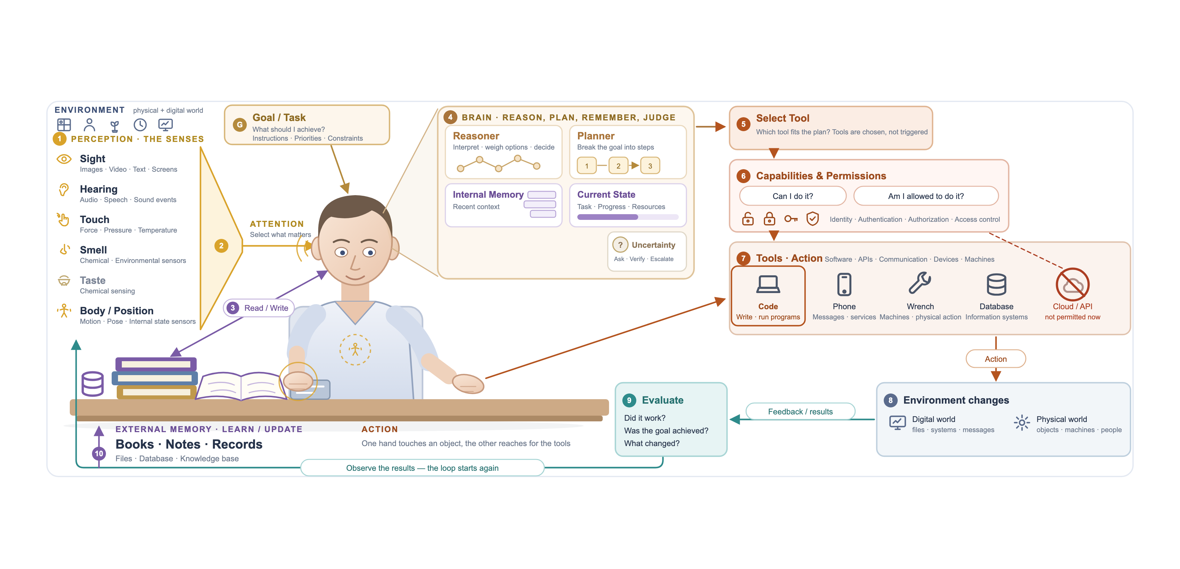
Tools let the agent act; the most powerful tool is writing and running code
Where a graph guides action
G15
G15
Tool and capability graph
EXECUTION GRAPH Tools linked to the tasks and data they serve; the agent selects a tool by traversal.
G16
G17
G16
Permissions as a graph
POLICY GRAPH Identity → role → resource relations: "am I allowed?" is a graph lookup before acting.
G18
G17
Graph database as a tool
DOMAIN GRAPH Exposed over MCP (mcp-neo4j-cypher); generated Cypher is checked against the schema.
G18
Evaluate against the graph
EXECUTION GRAPH Compare the graph before and after the action: did the expected nodes and edges change?
G1–G14 still apply.
By writing and running its own code, the agent can perform actions that were not foreseen when it was built, and work autonomously.
The agent selects a tool, checks its capabilities and permissions, acts and evaluates the result; the results return as feedback, and the loop begins again.
Notes:
[Reused from MANU inaugural lecture (MANU-Pristapno-Predavanje-v2.pptx), slide 25]
Graph overlay — Where a graph guides action
G15 Tool and capability graph (execution graph): Tools linked to the tasks and data they serve; the agent selects a tool by traversal.
G16 Permissions as a graph (policy graph): Identity → role → resource relations: "am I allowed?" is a graph lookup before acting.
G17 Graph database as a tool (domain graph): Exposed over MCP (mcp-neo4j-cypher); generated Cypher is checked against the schema.
G18 Evaluate against the graph (execution graph): Compare the graph before and after the action: did the expected nodes and edges change?

Slide 16
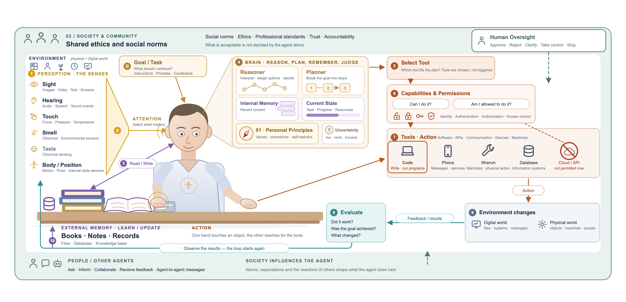
Once an agent can act, it must operate within shared norms
G20
Where a graph encodes norms
G19
Principles as checkable constraints
POLICY GRAPH Rules encoded as ontology constraints and SHACL shapes that every output must satisfy.
G19
G20
Review status on every fact
POLICY GRAPH Agent-written facts enter as "proposed"; people approve or reject graph changes, not raw text.
G21
A shared graph between agents
MEMORY GRAPH Agents coordinate through one graph — a blackboard of facts with who-said-what provenance.
G21
G1–G18 still apply.
Personal principles guide the agent, while society, other people and human oversight define what is acceptable.
Human oversight allows people to approve, reject, clarify, take control of or stop the actions of an agent. What is acceptable is not decided by the agent alone.
Notes:
[Reused from MANU inaugural lecture (MANU-Pristapno-Predavanje-v2.pptx), slide 26]
Graph overlay — Where a graph encodes norms
G19 Principles as checkable constraints (policy graph): Rules encoded as ontology constraints and SHACL shapes that every output must satisfy.
G20 Review status on every fact (policy graph): Agent-written facts enter as "proposed"; people approve or reject graph changes, not raw text.
G21 A shared graph between agents (memory graph): Agents coordinate through one graph — a blackboard of facts with who-said-what provenance.

Slide 17
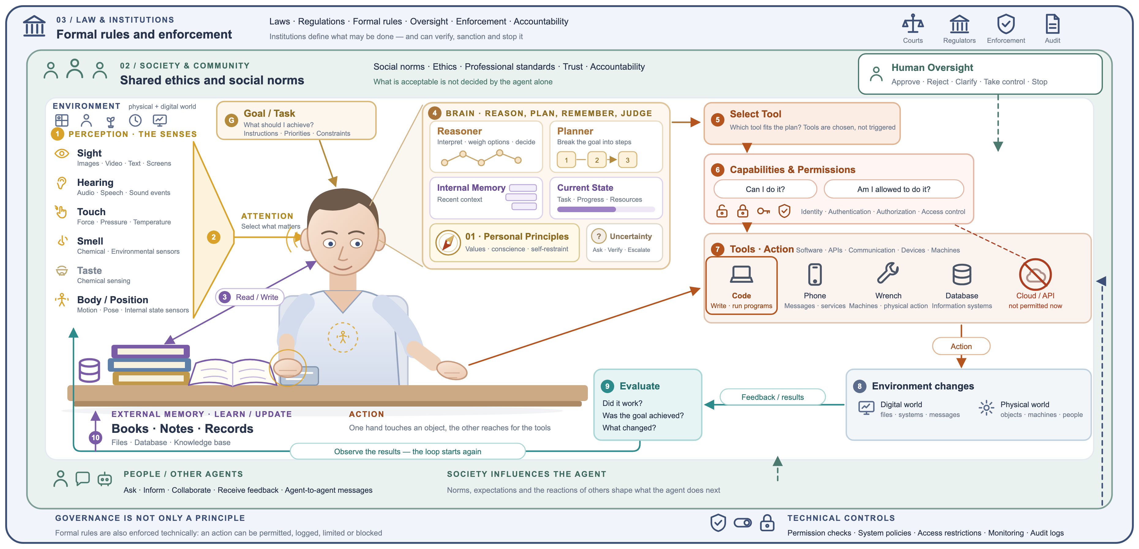
Law and institutions set the outer limits of what an agent may do
G22
G23
Where a graph supports compliance
G22
Regulations as a compliance graph
POLICY GRAPH Rule → obligation → data type → system: the agent queries which rules apply before it acts.
G23
Provenance for audit
POLICY GRAPH Each action recorded as a provenance graph (agent, inputs, outputs, time) that auditors can trace.
G24
Ontology-based query checks
POLICY GRAPH Deterministic rules reject a query or write that breaks the schema; the LLM is told why and repairs it.
G24
G1–G21 still apply.
Laws, regulators, courts and audit define what may be done, and technical controls enforce those rules within the systems themselves.
The complete agent operates within three nested layers of constraint: personal principles, shared social norms, and formal law with its institutions and technical controls.
Notes:
[Reused from MANU inaugural lecture (MANU-Pristapno-Predavanje-v2.pptx), slide 27]
Graph overlay — Where a graph supports compliance
G22 Regulations as a compliance graph (policy graph): Rule → obligation → data type → system: the agent queries which rules apply before it acts.
G23 Provenance for audit (policy graph): Each action recorded as a provenance graph (agent, inputs, outputs, time) that auditors can trace.
G24 Ontology-based query checks (policy graph): Deterministic rules reject a query or write that breaks the schema; the LLM is told why and repairs it.

Slide 18
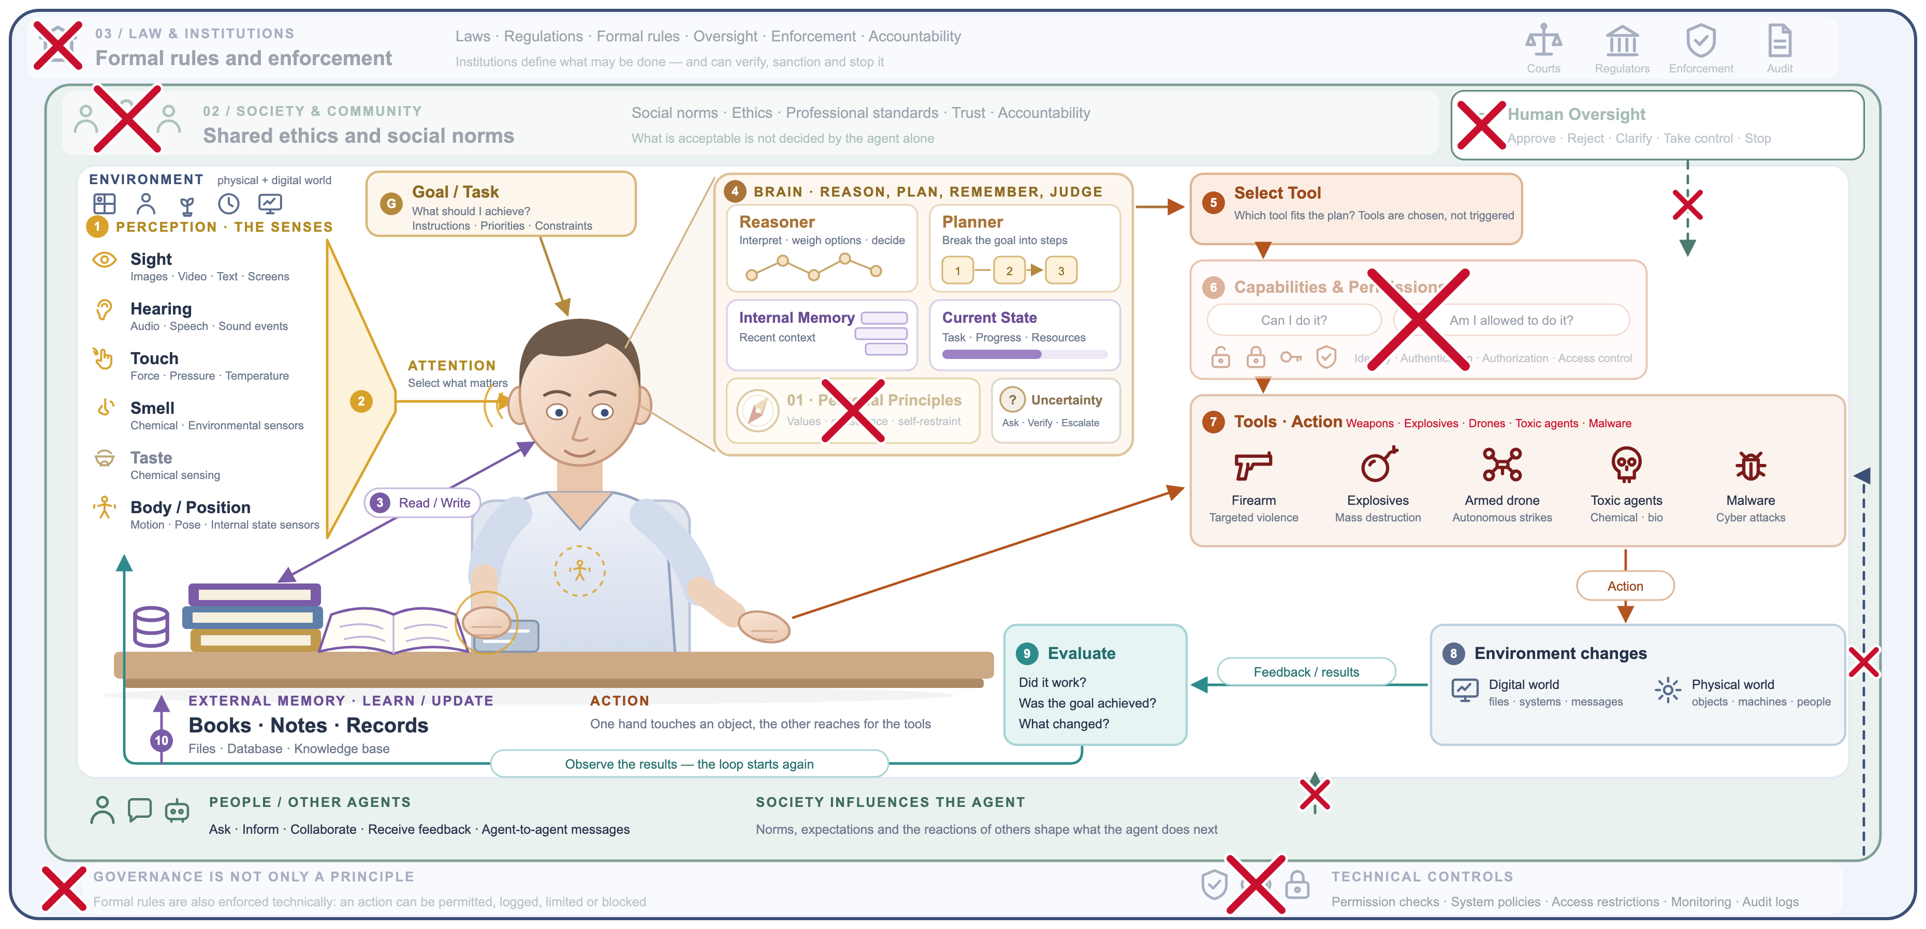
The same agent, with its safeguards removed
What goes wrong with the graph
R1
Poisoned knowledge
RISK A few injected edges can steer answers; the graph's structure is itself an attack surface.
R3
R2
Unchecked write-back
RISK Without validation, hallucinated facts become "knowledge" and are retrieved as truth later.
R2
R3
No graph-level access control
RISK Any query reaches any node, so sensitive subgraphs leak.
R1
R4
No provenance
RISK When nothing records which edge led to which action, there is nothing to audit.
R4
Each risk is a missing safeguard from G16–G24.
The architecture is unchanged; principles, permissions, oversight, norms and laws have been removed, and weapons have taken the place of tools.
The capability of an agent is neutral. Whether it is safe is determined by the constraints within which it acts, not by its capacity to reason or to act.
Notes:
[Reused from MANU inaugural lecture (MANU-Pristapno-Predavanje-v2.pptx), slide 28]
Graph overlay — What goes wrong with the graph
R1 Poisoned knowledge (risk): A few injected edges can steer answers; the graph's structure is itself an attack surface.
R2 Unchecked write-back (risk): Without validation, hallucinated facts become "knowledge" and are retrieved as truth later.
R3 No graph-level access control (risk): Any query reaches any node, so sensitive subgraphs leak.
R4 No provenance (risk): When nothing records which edge led to which action, there is nothing to audit.

Slide 19
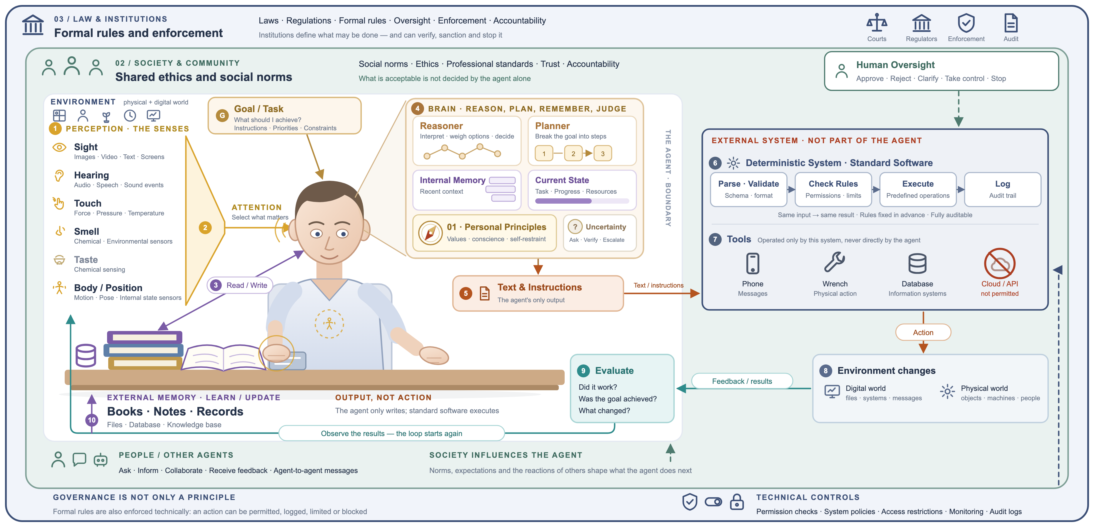
Secure solution: we lose flexibility, but we keep control
Where a graph keeps control
G25
Propose a query or triples
EXECUTION GRAPH The agent outputs a graph pattern or triples as JSON — a proposal, never an action.
G26
Validate against the ontology
POLICY GRAPH Types, cardinality and allowed relations (SHACL): same input, same verdict.
G26
G27
G28
G29
G25
G27
Policy check as traversal
POLICY GRAPH May this user read or change these nodes? A deterministic graph lookup.
G28
Only parameterised templates
EXECUTION GRAPH Predefined Cypher or SPARQL with slots; free-form query text is never run.
G29
Log to a provenance graph
POLICY GRAPH What ran, for whom, on which data, with what result — a queryable audit trail.
The agent writes only text and instructions; a separate, standard software system validates them and alone performs the actions.
The external system executes only predefined operations and cannot write or run new code; the flexibility shown on the tools slide is given up in exchange for control, verification and a complete audit trail.
Notes:
[Reused from MANU inaugural lecture (MANU-Pristapno-Predavanje-v2.pptx), slide 29]
Graph overlay — Where a graph keeps control
G25 Propose a query or triples (execution graph): The agent outputs a graph pattern or triples as JSON — a proposal, never an action.
G26 Validate against the ontology (policy graph): Types, cardinality and allowed relations (SHACL): same input, same verdict.
G27 Policy check as traversal (policy graph): May this user read or change these nodes? A deterministic graph lookup.
G28 Only parameterised templates (execution graph): Predefined Cypher or SPARQL with slots; free-form query text is never run.
G29 Log to a provenance graph (policy graph): What ran, for whom, on which data, with what result — a queryable audit trail.

Slide 20
A Taxonomy of Knowledge Graph Tasks in LLM Agents
Part 2
Four groups and thirteen tasks, published examples, ways of connecting a graph and the evaluation method

Slide 21
A Two-Level Taxonomy of Knowledge Graph Tasks in LLM Agents
1 Retrieval and reasoning
2 Memory and time
3 Governance and control
4 Graph construction
The graph supplies knowledge for answering questions
The graph stores facts that change and what the agent has learned
The graph constrains what the agent may generate or do
The agent builds and maintains the graph
1.1 Aggregation over typed records
2.1 Facts that change over time
3.1 Validation of generated queries
4.1 Extraction of facts from text
1.2 Multi-hop reasoning over relations
2.2 Long-term conversational memory
3.2 Provenance filtering of content
4.2 Entity resolution and validation
1.3 Questions about a whole collection
3.3 Enforcement of workflow order
1.4 Graph-based ranking of text passages
3.4 Plan graphs against prompt injection
1.5 Answers attributed to their sources
The first level states the role of the graph; the second names a concrete task that can be measured. A graph may be useful for one task and unnecessary for another.

Slide 22
Definitions and Examples of Retrieval, Reasoning and Memory Tasks
Group 1 · Retrieval and reasoning
Group 2 · Memory and time
1.1 Aggregation over typed records
  Definition: Computing counts, filters or joins over many records according to their typed fields.
  Example: “How many open tickets concern the login module?”
1.2 Multi-hop reasoning over relations
  Definition: Following a chain of relations through entities that the question does not name.
  Example: “Who directed the films written by the writer of Film A?”
1.3 Questions about a whole collection
  Definition: Stating a property of an entire corpus that no single document contains.
  Example: “What are the main themes across all podcast episodes?”
1.4 Graph-based ranking of text passages
  Definition: Using links between entities to rank the passages that the LLM reads.
  Example: “In which country was the director of Film B born?”
1.5 Answers attributed to their sources
  Definition: Citing, for every statement of an answer, the source passage that supports it.
  Example: “Film B's director was born in Spain [2].”, where passage 2 states the birthplace.
2.1 Facts that change over time
  Definition: Returning the currently valid value of a fact that has several versions, while keeping its history.
  Example: “Who currently owns the VPN runbook?”
2.2 Long-term conversational memory
  Definition: Recalling facts that a user stated in earlier sessions of a long conversation history.
  Example: “Which restaurant did I mention last month?”

Slide 23
Definitions and Examples of Governance and Construction Tasks
Group 3 · Governance and control
Group 4 · Graph construction
3.1 Validation of generated queries
  Definition: Checking a query written by the LLM against the ontology and repairing it before execution.
  Example: Rejecting “?user :submittedBy ?ticket”, whose direction contradicts the ontology.
3.2 Provenance filtering of content
  Definition: Admitting content to the agent's context only if its recorded origin is trusted.
  Example: Excluding a “fix” comment planted by an unverified account from the answer.
3.3 Enforcement of workflow order
  Definition: Blocking an action until the steps that must precede it are complete.
  Example: Refusing to reset a customer's line before the identity check is complete.
3.4 Plan graphs against prompt injection
  Definition: Fixing the permitted tool calls before untrusted content is read and refusing all others.
  Example: A product review asks the agent to send an e-mail; the plan has no e-mail tool, so the call is refused.
4.1 Extraction of facts from text
  Definition: Converting documents into typed triples in the relations of a schema with an LLM.
  Example: Extracting (Film A, directed_by, Director X) from an article about Film A.
4.2 Entity resolution and validation
  Definition: Merging different names of the same entity and verifying each extracted fact against its source.
  Example: Merging “Billing”, “billing module” and “BILLING” into one module.

Slide 24
Five Ways to Connect a Knowledge Graph to an LLM Agent
u
Graph as a tool
v
Graph as a retrieval index
w
Graph as a memory store
x
Graph as a gate
y
Graph as an output
The agent calls read-only functions or writes queries (Cypher, SPARQL) and reads exact results. Tasks 1.1 and 1.2.
The graph ranks or summarises text before it reaches the model; the agent reads passages or summaries. Tasks 1.3–1.5.
The agent writes facts with validity dates and reads back those that are currently valid. Tasks 2.1 and 2.2.
Code checks each query or action against an ontology, provenance, a workflow or a plan before it runs. Tasks 3.1–3.4.
A construction pipeline extracts, resolves and validates facts and writes them to the graph. Tasks 4.1 and 4.2.
Whichever way is chosen, the Model Context Protocol (MCP) can expose the graph's tools, resources and prompts to any agent; permissions should be enforced at this boundary.

Slide 25
Vector Retrieval as the Baseline for Every Comparison
INDEXING (once, offline)
Documents
Split into chunks
Embed each chunk
Store in a vector index
ANSWERING (for every question)
Question
Embed the question
Take the k most similar chunks
LLM answers from the chunks
Retrieval-augmented generation (RAG)
Its built-in assumption
An embedding maps a text to a vector; similar meanings lie close together (cosine similarity).
The k chunks most similar to the question are placed in the prompt (k = 3–20 here).
The evidence must resemble the question.
It fails when the answer is a count over many records, a chain through unnamed entities or a property of the whole collection.
A graph method is worth adopting only if it outperforms this baseline, given the same answer prompt and a comparable amount of context, on the questions that matter.

Slide 26
Notebooks That Measure Each Task of the Taxonomy
Task | Small illustrative example | Test at scale (public benchmark)
1.1 Aggregation over typed records | 01: helpdesk graph, 22 questions | 18: 156 templated and 115 independently written questions
1.2 Multi-hop reasoning | 02: incident log, 10 questions | 08: MetaQA, 300 questions
1.3 Whole-collection questions | 06: hospital tickets, 3 questions | 16: BenchmarkQED podcasts, 50 global and 50 local
1.4 Graph-based passage ranking | 09: GraphRAG-Bench sample, 180 | 11: MuSiQue and 2Wiki, 2,000; 14: GraphRAG-Bench, 4,072
1.5 Answers attributed to sources | — | 20: MuSiQue and 2Wiki with citations, 2,000
2.1 Facts that change | 04: security runbooks, 56 | 12: HoH, 500
2.2 Conversational memory | 10: LongMemEval sample, 108 | 15: LongMemEval-S 500 and LoCoMo 1,540
3.1 Validation of generated queries | 07: helpdesk RDF graph, 15 | 17: Spider4SSC, 563
3.2–3.3 Provenance and workflow | 05: 10 questions and 5 runs | Not tested at scale
3.4 Plan graphs against injection | — | 13: InjecAgent, 3,162
4.1–4.2 Extraction and resolution | 03: 183 tickets | 19: MetaQA with an extracted graph, 900
A small example shows the mechanism; hundreds to thousands of questions with 95% intervals are needed to measure the size of an effect.
All notebooks and data: https://github.com/trajanov/graphs-for-llm-agents
Source: notebooks 01–20 in examples/

Slide 27
Evaluation Metrics, Statistical Tests and the Three Verdicts
WHAT A RESULT SUGGESTS ABOUT THE GRAPH METHOD
Metrics
The graph method is reliably better than the strongest baseline: the 95% interval of the difference lies above zero.
IN FAVOUR
Accuracy or Hits@1: the share of questions answered correctly.
Token F1: word overlap with the correct answer, 0–100.
Execution accuracy: a generated query returns the correct rows.
LLM judge: scores open-ended answers; a second judge checks bias.
NO DIFFERENCE
The interval includes zero, or a baseline given the same information reaches the same result.
AGAINST
The baseline is reliably better: the 95% interval of the difference lies below zero.
Statistics
Each method answers the same questions; a paired bootstrap gives the 95% interval of the difference.
A difference is reliable when its interval excludes zero.
With a small example of tens of questions, only the direction of an effect is informative; such verdicts are marked as indicative.
The baseline must be the strongest low-cost alternative, not plain top-k retrieval alone.

Slide 28
Retrieval and Reasoning with Knowledge Graphs
Part 3
Aggregation, multi-hop reasoning, whole-collection questions and graph-based ranking of passages

Slide 29
Group 1 · Retrieval and Reasoning with Knowledge Graphs
Group 1
In the first group the graph supplies the knowledge needed to answer a question: exact records for aggregation, explicit relations for chains of facts, summaries of a whole collection, links for ranking passages and provenance for citations.
Tasks of the group
Connection to the agent
Expected benefits and problems
1.1 Aggregation over typed records: counts, filters and joins.
1.2 Multi-hop reasoning through entities the question does not name.
1.3 Questions about a whole collection, such as its main themes.
1.4 Graph-based ranking of the passages the LLM reads.
1.5 Answers that cite a source for every statement.
Graph as a tool: read-only functions or a generated Cypher or SPARQL query return exact results (1.1, 1.2).
Graph as a retrieval index: community summaries (1.3) or PageRank over extracted triples (1.4) choose the text the LLM reads.
Provenance on every node and edge links each fact to its passage (1.5).
Benefit: exact aggregates, and facts about entities that similarity search cannot reach.
Benefit: answers that draw on the entire collection.
Problem: lookups may become worse, because extracted facts omit detail.
Problem: more LLM calls and tokens, at indexing time or per question.
Published examples. Text2Cypher in neo4j-graphrag, Think-on-Graph, Microsoft GraphRAG, HippoRAG 2, LightRAG; ALCE for answers with citations.

Slide 30
Limitations of Similarity-Based Retrieval That Motivate Group 1
Group 1
Counts over many records (1.1)
Chains of facts (1.2, 1.4)
Whole-collection questions (1.3)
“How many open tickets concern the login module?”
The answer is a count over all tickets. Top-k returns eight similar tickets; counting a sample gives the wrong number, and the LLM cannot know what was left out.
“Who directed the films written by the writer of Film A?”
The article about Film B names its director but never mentions Film A or its writer, so it does not resemble the question and is not retrieved.
“What are the main themes across all podcast episodes?”
No single passage states the themes of the whole collection. Top-k returns a few episodes, and the answer describes only those.
Each case needs information that no small set of similar texts contains: explicit links, computed aggregates or pre-computed summaries. These are the tasks of the first group.

Slide 31
Task 1.1 · Aggregation over Typed Records
Task 1.1
COMPARISON AND RESULT
VERDICT
Main points
Relational questions (counts, filters, joins), template set
+51 points [+40, +62]
The graph is exposed as read-only tools (find a node, follow a typed edge, filter, count); a ReAct agent composes the answer from exact results.
Expected: exact counts and joins over all records instead of a sample of similar texts. Risk: details outside the typed fields are invisible to the tools.
Measured on a synthetic helpdesk graph with 156 template questions and 115 questions written from the texts, against the 8 most similar texts.
IN FAVOUR
Verified fixes, template set
+16 points [+2, +30]
IN FAVOUR
Single-fact lookups, template set
−50 points [−67, −33]
AGAINST
Multi-record questions written from the texts
−7 points [−21, +9]
NO DIFFERENCE
A graph agent is justified when the answer is an aggregate over typed fields. For lookups and narrative questions, vector retrieval is equal or better; questions should be routed by type.
Source: notebooks 01_vector_rag_vs_graph_rag.ipynb and 18_scaled_aura_template_questions.ipynb

Slide 32
Task 1.2 · Multi-Hop Reasoning over Relations
Task 1.2
COMPARISON AND RESULT
VERDICT
Main points
Incident log, multi-hop questions
8 of 10 versus 1 of 10 (indicative)
A ReAct agent follows named relations one hop at a time; each observation names the entity for the next hop.
Expected: facts about entities that the question never names become reachable. Risk: tokens grow with the hops, and a missing edge breaks the chain.
Measured on a ServiceNow incident log (10 questions) and on MetaQA (100 questions per hop count), against the 10 most similar documents.
IN FAVOUR
MetaQA, two hops
97% versus 39%
IN FAVOUR
MetaQA, three hops
80% versus 36%
IN FAVOUR
MetaQA, one hop, LLM-extracted graph
+13.3 points [+8.0, +18.7]
IN FAVOUR
On relational data, graph traversal is the appropriate method for chains of relations, and its advantage grows with the number of hops. The price is 1.7 to 6.6 times the tokens.
Source: notebooks 02, 08 and 19 in examples/

Slide 33
Task 1.3 · Questions About a Whole Collection
Task 1.3
COMPARISON AND RESULT
VERDICT
Main points
Global questions: global search versus vector top-20
+19.8 points [+14.9, +24.6]
Offline, an LLM groups the extracted entities into communities and summarises each; global search puts the question to every summary and combines the partial answers.
Expected: answers that cover the whole collection. Risk: dozens of LLM calls per question, and summaries that omit the details of one document.
Measured on 183 hospital tickets and on 70 podcast transcripts with 50 global and 50 local questions, against the 20 most similar chunks.
IN FAVOUR
Hospital tickets, 3 global questions
10 versus 5 hospitals named (indicative)
IN FAVOUR
Local questions: global search versus vector top-20
−30.3 points [−43.0, −18.7]
AGAINST
Local questions: local search versus vector top-20
−4.3 points [−10.3, 0.0]
NO DIFFERENCE
Community summaries are justified for questions about a whole collection, provided each question is routed to the matching search mode and the budget allows tens of LLM calls per question.
Source: notebooks 06_graphrag_global_sensemaking.ipynb and 16_scaled_benchmarkqed_global_sensemaking.ipynb

Slide 34
Task 1.4 · Graph-Based Ranking of Text Passages
Task 1.4
COMPARISON AND RESULT
VERDICT
Main points
2WikiMultiHopQA, all questions
+11.7 F1 [+8.6, +14.8]
Triples extracted from every passage form a graph; personalised PageRank from the question's entities ranks the passages, and the passages, not the triples, are given to the LLM.
Expected: linked passages that do not resemble the question are retrieved. Risk: no gain when similarity already finds the needed passages.
Measured on MuSiQue and 2WikiMultiHopQA (2,000 questions) and GraphRAG-Bench (4,072 questions), against the 5 or 8 most similar passages.
IN FAVOUR
MuSiQue, all questions
+4.7 F1 [+2.1, +7.4]
IN FAVOUR
2Wiki comparison questions, which name both entities
−5.0 F1 [−9.3, −0.7]
AGAINST
GraphRAG-Bench, HippoRAG2-style ranking (medical, novel)
+1.0 and +2.7 points
IN FAVOUR
GraphRAG-Bench, simple graph retriever, medical questions
−1.5 points
AGAINST
A graph helps only as much as it raises the share of needed passages retrieved. The gains are real but small; ranking must keep the passages, and the baseline's recall should be measured first.
Source: notebooks 09, 11 and 14 in examples/

Slide 35
Task 1.5 · Answers Attributed to Their Sources
Task 1.5
COMPARISON AND RESULT
VERDICT
Main points
Graph-ranked passages versus vector top-5: citation precision
59.4% versus 50.0%, +9.4 [−5.1, +23.6]
Every node and edge stores the passage it came from; the agent must cite a source for every statement, and a cited fact resolves to its passage.
Expected: each statement can be checked against its source. Risk: a well-formed citation may point to a passage that does not support the claim.
Measured on MuSiQue and 2WikiMultiHopQA with labelled supporting paragraphs and an ALCE-style LLM judge; first results from a test run of 50 questions.
NO DIFFERENCE
Graph-ranked passages versus vector top-5: labelled sources cited
61.0% versus 54.8%, +6.2 [−2.8, +14.7]
NO DIFFERENCE
Cited graph facts versus vector top-5: citation precision
50.7% versus 50.0%, +0.7 [−13.0, +14.0]
NO DIFFERENCE
Cited graph facts versus vector top-5: answer F1
36.9 versus 50.3, −13.4 [−26.9, −0.1]
AGAINST
Indicative: graph ranking does not yet cite reliably better, and citing short facts lowers answer accuracy. The run on 2,000 questions will determine the size of the effect.
Source: notebook examples/20_scaled_citation_accuracy_graph_vs_vector.ipynb

Slide 36
Memory and Time-Aware Knowledge
Part 4
Facts that change over time and long-term conversational memory

Slide 37
Group 2 · Memory and Time-Aware Knowledge
Group 2
In the second group the graph stores knowledge that changes: new versions of documents, and facts that the agent learns from conversations, each with the time during which it is valid.
Tasks of the group
Connection to the agent
Expected benefits and problems
2.1 Facts that change over time: return the value valid now and keep the history.
2.2 Long-term conversational memory: recall what a user said in earlier sessions.
Graph as a memory store: the agent writes facts with validity dates and reads back those that are valid now.
A contradicting fact closes the older one, which is kept for questions about the past.
Retrieval returns current facts with their dates and the source turn or document.
Benefit: outdated values no longer reach the answer.
Benefit: a compact context instead of the whole conversation history.
Problem: validity must be extracted or recorded correctly for every fact.
Problem: dates in the prompt, or the full history, may give the same result.
Published examples. Graphiti / Zep, with valid and transaction times on every edge; Mem0 and its graph variant; the HoH, LongMemEval and LoCoMo benchmarks.

Slide 38
Bi-Temporal Knowledge Graphs for Facts That Change over Time
Group 2
Valid time records when a fact holds in the world (valid_at, invalid_at).
Transaction time records when the system stored or retired the fact (created_at, expired_at).
A new fact that contradicts an old one closes the old one by setting invalid_at. Nothing is deleted, so the history remains queryable.
Retrieval returns the facts valid now, with their dates and the source turn or document.
The same structure serves both tasks of this group: documents that are replaced (2.1) and facts learned from conversations (2.2).
owner of runbook RB-12 = Team A
invalid_at = 2025-03
owner of runbook RB-12 = Team B
valid_at = 2025-03
2024-01
2025-03
now
Query “now” → Team B; query “June 2024” → Team A
The old fact is closed, not overwritten: current questions see only Team B, while historical questions can still be answered.

Slide 39
Task 2.1 · Facts That Change over Time
Task 2.1
COMPARISON AND RESULT
VERDICT
Main points
Temporal graph versus plain vector retrieval (HoH)
+27.0 points [+22.8, +31.2]
Each fact carries a validity interval; replaced versions are closed, not deleted, and retrieval drops invalid facts before ranking.
Expected: outdated values no longer reach the answer. Risk: simply showing document dates may achieve the same effect.
Measured on 58 security runbooks and on HoH (500 questions over 6,550 dated passages), against plain retrieval and retrieval that shows the dates.
IN FAVOUR
Temporal graph versus retrieval with dates (HoH)
−0.2 points [−2.4, +2.0]
NO DIFFERENCE
Replaced runbook in the context
88% → 0% (indicative)
IN FAVOUR
Conflicting runbooks: both owners reported
3 of 3 versus 1 of 3 (indicative)
IN FAVOUR
The gain comes from the dates, not from the graph. Showing dates in the prompt is sufficient for current values; a temporal graph is needed only for past states, conflicts or validity that the text omits.
Source: notebooks 04_temporal_memory_and_stale_runbooks.ipynb and 12_scaled_hoh_outdated_knowledge.ipynb

Slide 40
Task 2.2 · Long-Term Conversational Memory
Task 2.2
COMPARISON AND RESULT
VERDICT
Main points
LongMemEval-S: graph memory versus full history
+7.8 points [+3.0, +12.6]
After each session an LLM extracts facts with timestamps into a bi-temporal graph; for each question the agent retrieves the 25 best facts with their dates.
Expected: a compact context and correct handling of updates. Risk: what extraction omits, such as the assistant's own statements, is forgotten.
Measured on LongMemEval-S (500 questions, about 104,000 tokens each) and LoCoMo (1,540 questions, about 21,000 tokens), against vector memory and the full history.
IN FAVOUR
LongMemEval-S: graph memory versus vector memory
+3.4 points [−0.8, +7.4]
NO DIFFERENCE
LoCoMo: graph memory versus full history
73% versus 79%, reliable
AGAINST
LoCoMo: graph memory versus vector memory
73% versus 67%, reliable
IN FAVOUR
What the assistant said (LongMemEval-S)
52% versus 91% (vector), 100% (full)
AGAINST
The preferred memory depends on the length of the history: the full history up to about 20,000 tokens, graph memory at about 100,000 tokens, with care for what extraction omits.
Source: notebooks 10_scaled_longmemeval_memory.ipynb and 15_scaled_memory_longmemeval_locomo.ipynb

Slide 41
Governance, Control and Graph Construction
Part 5
Validation of queries, provenance, workflow and plan guardrails, and building graphs with an LLM

Slide 42
Group 3 · Governance and Control with Knowledge Graphs
Group 3
In the third group the graph constrains what the agent may generate or do: an ontology, recorded provenance, a workflow or a plan is checked in code before a query or an action is executed.
Tasks of the group
Connection to the agent
Expected benefits and problems
3.1 Validation of generated queries against the ontology.
3.2 Provenance filtering: only content of trusted origin enters the context.
3.3 Workflow order: no action before its prerequisite steps.
3.4 Plan graphs: tool calls outside a fixed plan are refused.
Graph as a gate: code checks each query or action against the graph before it runs.
A violation is explained to the LLM, which repairs the query or continues another way.
The rule holds whatever the model was persuaded to do by the data it read.
Benefit: zero violations by construction, with rules that can be audited.
Benefit: protection that does not depend on the model recognising an attack.
Problem: rules stated in the prompt may give most of the accuracy gain.
Problem: the graph needs upkeep; an over-strict gate blocks valid tasks.
Published examples. The ontology layer of Sequeda and Allemang; read-only checks in mcp-neo4j-cypher; τ²-bench policies; CaMeL; the Spider4SSC and InjecAgent benchmarks.

Slide 43
Rules Stated in the Prompt Compared with Rules Enforced in Code
Group 3
Gates enforced in code where the agent acts (tasks 3.1–3.4)
3.1 Ontology check
3.2 Provenance filter
3.3 Workflow graph
3.4 Plan graph
LLM proposes an action or query
Every class and property must exist and fit; violations are explained and the query is repaired.
Content enters the context only if its recorded origin is trusted.
An action is blocked until its prerequisite steps are complete.
The plan is fixed before untrusted tool output is read; calls outside it are refused.
Tools, data and the outside world
A rule stated in the prompt
A rule enforced in code
The model is asked to comply. Compliance is probable, not certain, because instructions hidden in the data (prompt injection) can override it.
The action cannot happen, whatever the model was persuaded to do. The measurements show how much accuracy this adds beyond stating the rule.

Slide 44
Task 3.1 · Validation of Generated Queries
Task 3.1
COMPARISON AND RESULT
VERDICT
Main points
Ontology checker versus retry on error (Spider4SSC)
+61.5 points
The LLM writes SPARQL from the question and the schema; a deterministic checker tests classes, properties, direction and entities, and explains each violation for up to three repairs.
Expected: fewer silently wrong queries. Risk: a check verifies form, not meaning, so a valid query can answer a different question.
Measured on a helpdesk RDF graph (15 questions) and Spider4SSC (563 questions over 19 graphs), against retry on error and rules stated in the prompt.
IN FAVOUR
Checker versus rules in the prompt, single attempt
+5.0 points
IN FAVOUR
Checker versus rules in the prompt with retry
+2.0 points, not reliable
NO DIFFERENCE
Final queries violating the vocabulary
0 versus 12–21 of 563
IN FAVOUR
Most of the gain is the information about the schema, which the prompt can also carry. The checker adds a guarantee of zero violations, which matters where one wrong query is costly.
Source: notebooks 07_ontology_checked_graph_queries.ipynb and 17_scaled_spider4ssc_ontology_checked_sparql.ipynb

Slide 45
Task 3.2 · Provenance Filtering of Content
Task 3.2
COMPARISON AND RESULT
VERDICT
Main points
Answers repeating a planted attack
9 of 10 → 0 of 10 (indicative)
Every node and edge records its origin (author, role, confirmed solution); retrieval admits content only if a rule in code accepts its provenance.
Expected: planted content cannot reach the answer. Risk: genuine content with incomplete provenance is rejected, and an attacker with a trusted account is not stopped.
Measured on the helpdesk graph with 12 genuine and 5 planted “fix” comments (10 questions), against the 3 most similar texts.
IN FAVOUR
Genuine fixes wrongly rejected by the filter
0 of 12
IN FAVOUR
Filtering by provenance in code removed every planted attack without rejecting genuine fixes. The sample is small, so the result shows the mechanism rather than its size in practice.
Source: notebook examples/05_guardrails_and_graph_poisoning.ipynb

Slide 46
Task 3.3 · Enforcement of Workflow Order
Task 3.3
COMPARISON AND RESULT
VERDICT
Main points
Actions taken before their prerequisites
19 → 0 in 5 runs (indicative)
A procedure is stored as a graph of prerequisite steps; before each tool call, code checks that the prerequisites are complete and refuses a premature call.
Expected: no action before its prerequisites, whatever the model decides. Risk: refused calls add steps, and an over-strict graph blocks exceptions.
Measured on a 33-step telecom support workflow from τ²-bench, in 5 runs with and without the gate.
IN FAVOUR
Premature calls blocked by the gate
17, and the agent continued
IN FAVOUR
Issues resolved
All, with and without the gate
NO DIFFERENCE
The workflow gate removed every out-of-order action without reducing task success. Five runs show the mechanism, not its size in practice.
Source: notebook examples/05_guardrails_and_graph_poisoning.ipynb

Slide 47
Task 3.4 · Plan Graphs Against Prompt Injection
Task 3.4
COMPARISON AND RESULT
VERDICT
Main points
Plan-graph gate versus no defence
13 → 0 successful attacks of 3,162
Before reading any tool output, the LLM plans the tools the task needs; the plan is stored as a graph, and code refuses every call outside it.
Expected: injected instructions cannot trigger tools the task did not need. Risk: a legitimate task fails when the plan omits a tool.
Measured on InjecAgent (3,162 injection cases at three strengths), against no defence and a prompt rule that tool output is data.
IN FAVOUR
Plan-graph gate versus a prompt rule
1 → 0 successful attacks of 3,162
NO DIFFERENCE
Legitimate tasks blocked by the gate
0.2%
AGAINST
With a model that already resists 99.6% of fixed attacks, the gate cannot be shown to be necessary. Its value is a guarantee against stronger, adaptive attacks, which require a different test.
Source: notebook examples/13_scaled_injecagent_prompt_injection.ipynb

Slide 48
Group 4 · Construction of Knowledge Graphs
Group 4
In the fourth group the agent builds and maintains the graph: an LLM extracts facts from text, merges different names of the same entity and validates each fact before it is loaded.
Tasks of the group
Connection to the agent
Expected benefits and problems
4.1 Extraction of facts from text as typed triples in the relations of a schema.
4.2 Entity resolution and validation of each fact against its source.
Graph as an output: a construction pipeline writes extracted, resolved and validated facts.
Schema-first extraction fixes the relations in advance; schema-light extraction defines them afterwards.
The agent then queries the extracted graph as it would a curated one.
Benefit: a graph becomes available where no structured source exists.
Benefit: a resolution cascade needs far fewer LLM calls than pairwise comparison.
Problem: facts the text does not state cannot be extracted.
Problem: extraction errors compound along chains, and each chunk costs an LLM call.
Published examples. Neo4j SimpleKGPipeline and knowledge-graph builder, OneKE, KGGen, EDC, Graphiti; SHACL validation of RDF graphs.

Slide 49
Schema-First and Schema-Light Construction of Knowledge Graphs
Group 4
A construction pipeline in which an LLM builds the graph from text
Split text
Extract triples (4.1)
Resolve entities (4.2)
Validate (4.2)
Load graph
Schema-first construction
Schema-light construction
The permitted node types and relations are fixed before extraction.
The graph is precise and queryable from the start.
It misses what the schema did not anticipate; suited to domains with an established vocabulary.
Example: Neo4j SimpleKGPipeline; OntoGPT with a LinkML schema.
Extraction is open; relations are defined and made canonical afterwards.
It supports discovery in a new domain.
Making the relations canonical is substantial work, not renaming.
Example: EDC (Extract, Define, Canonicalise); GraphRAG's free-form extraction.
Construction becomes agentic when the pipeline chooses its next step, for example asking for more evidence or sending an uncertain merge to human review.

Slide 50
Task 4.1 · Extraction of Facts from Text
Task 4.1
COMPARISON AND RESULT
VERDICT
Main points
Extracted graph versus vector retrieval, one hop
+13.3 points [+8.0, +18.7]
An LLM reads each chunk and returns typed triples in the schema's relations; the agent queries the extracted graph exactly as it would a curated one.
Expected: a graph where no structured source exists. Risk: facts the text does not state cannot be extracted, and errors compound along a chain.
Measured on MetaQA (300 questions per hop) with a graph extracted from 18,127 WikiMovies articles (146,006 triples for $0.92), against vector retrieval and the curated graph.
IN FAVOUR
Extracted graph versus vector retrieval, two hops
+67.0 points [+61.0, +72.3]
IN FAVOUR
Extracted graph versus vector retrieval, three hops
+56.7 points [+50.3, +62.7]
IN FAVOUR
Extracted graph versus curated graph, two and three hops
24 points lower
AGAINST
An LLM-extracted graph keeps most of the advantage of a curated graph on relational questions, provided the text states the relations; where a curated source exists, it remains preferable.
Source: notebook examples/19_scaled_metaqa_extracted_graph.ipynb

Slide 51
Task 4.2 · Entity Resolution and Validation
Task 4.2
COMPARISON AND RESULT
VERDICT
Main points
Resolution cascade versus comparing every pair with an LLM
45 versus 1,891 LLM calls
Names are merged in a cascade (exact matching, embedding similarity, an LLM decision, human review); facts are checked for form and for support in the cited text.
Expected: a connected graph at a fraction of the LLM calls. Risk: a wrong merge corrupts every answer that uses it.
Measured on 183 synthetic hospital tickets with 62 spellings of module names, and on 29 billing tickets.
IN FAVOUR
Free extraction and merging versus a fixed label list
6 usable labels versus 24 of 29 in “Other”
IN FAVOUR
Shape check alone as a test of correctness
3 of 44 accepted facts unsupported
AGAINST
Apply low-cost deterministic steps first, the LLM to ambiguous cases and human reviewers to conflicts; validate extracted facts against the source text, not only against the schema.
Source: notebook examples/03_agents_building_graphs_and_kb.ipynb

Slide 52
When to Use a Knowledge Graph in an AI Agent
Part 6
Verdicts for all tasks, four principles, a decision procedure and the limits of the evidence

Slide 53
Verdicts for the Thirteen Tasks of the Taxonomy
Task | Decisive comparison | Verdict for the graph
1.1 Aggregation over typed records | Relational +51; lookups −50; written questions −8 (n.s.) | In favour for aggregates only
1.2 Multi-hop reasoning | MetaQA 39% → 97% (2 hops); extracted graph +13 to +67 | In favour on relational data
1.3 Whole-collection questions | Global +19.8; global on local questions −30.3 | In favour, matching mode
1.4 Graph-based passage ranking | F1 +4.7 / +11.7; GraphRAG-Bench +1.0 / +2.7 | Mixed: small gains
1.5 Attributed answers | Citation precision +9.4 (n.s.); cited facts −13.4 F1 | No difference (indicative)
2.1 Facts that change | +27.0 over plain retrieval; −0.2 versus dates | No difference from dates
2.2 Conversational memory | +7.8 (104k tokens); −5.5 (21k tokens) | Mixed: depends on length
3.1 Validation of queries | +61.5 over retry; +2.0 (n.s.) over rules in prompt | No difference in accuracy
3.2 Provenance filtering | 9/10 → 0/10 attacks repeated | In favour (indicative)
3.3 Workflow order | 19 → 0 out-of-order actions | In favour (indicative)
3.4 Plan graphs | 1 → 0 of 3,162 versus a prompt rule | No difference measurable
4.1 Extraction from text | +13 to +67 over vector; 11–24 below curated | In favour over vector
4.2 Resolution and validation | 45 versus 1,891 calls; 3 of 44 unsupported | Mixed: validate support
Green: the evidence favours the graph method; grey: no difference from the strongest baseline; amber: the verdict depends on the question type or setting.
Source: notebooks 01–20 in examples/

Slide 54
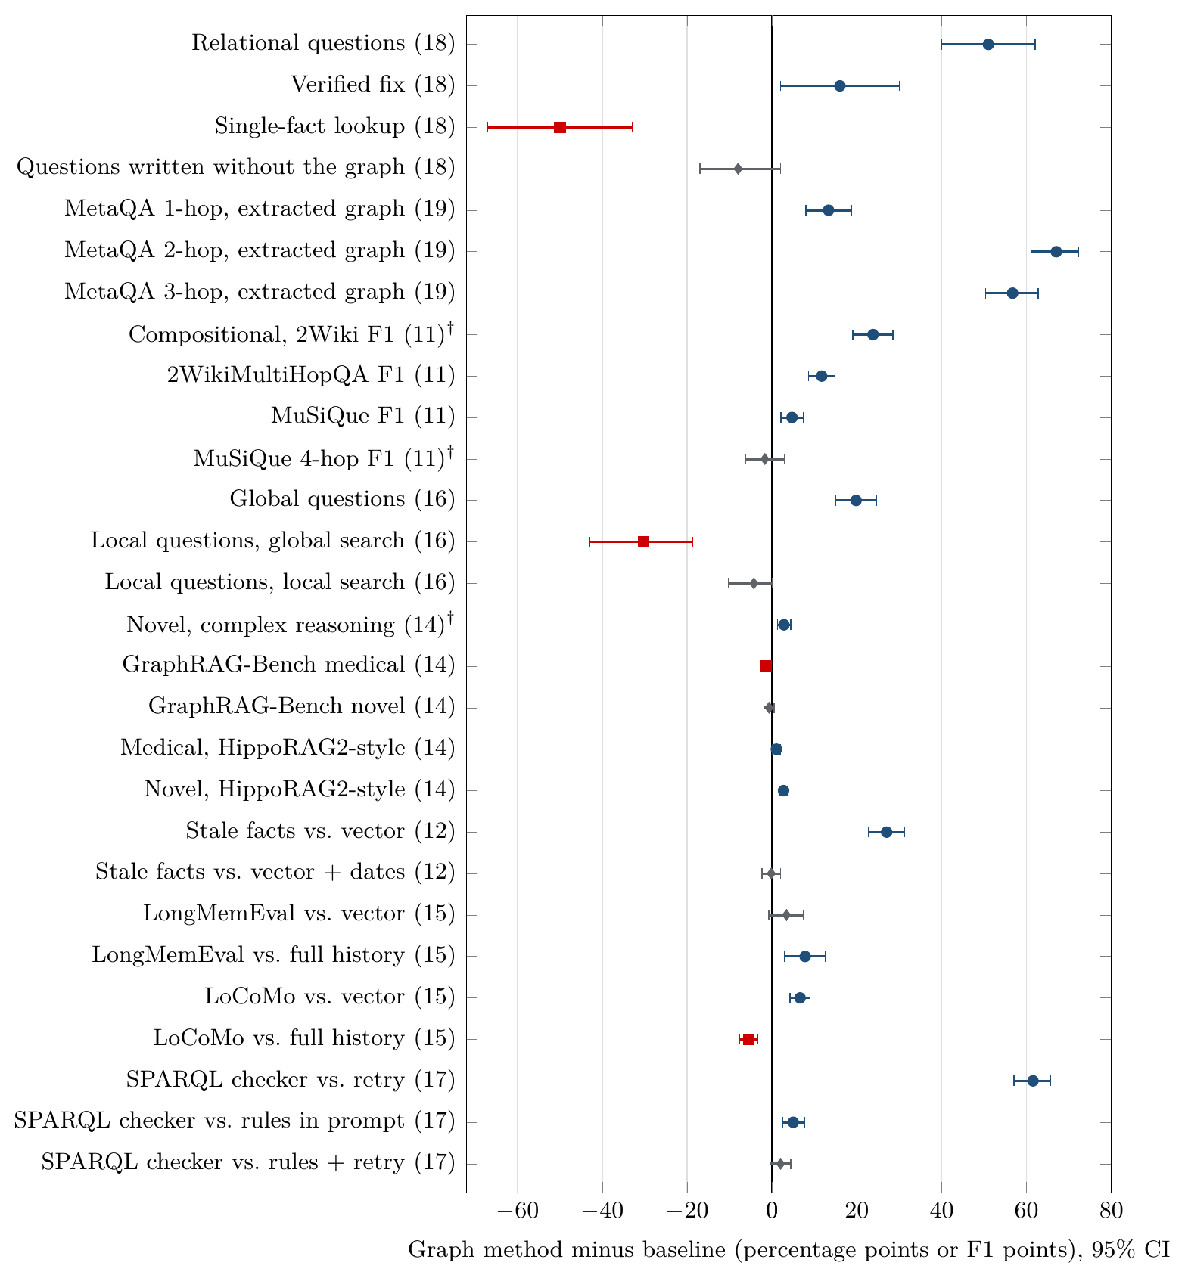
Gains and Losses of Graph Methods Across All Experiments
Each row is one comparison at scale: the point is the graph method minus its baseline, and the bar is its 95% interval.
Blue circles are reliable gains for the graph method, red squares reliable losses, grey diamonds intervals that include zero.
The gains are on structural questions: relational helpdesk questions, MetaQA at two and three hops, compositional and whole-collection questions.
The losses are on lookups and on local questions answered by global search.
Low-cost baselines given the same information (dates, full history, rules in the prompt) bring the differences close to zero.
Source: notebooks 08 and 11–19 in examples/

Slide 55
Four Principles That Explain When Knowledge Graphs Are Beneficial
Principle 1. A graph is beneficial when the answer depends on many records
Principle 2. A graph is not beneficial when similarity search already retrieves the evidence
The graph method improved accuracy on counting and filtering (+51 points), on questions about a whole collection (+19.8), on compositional chains (+23.8 F1) and on MetaQA questions of two and three hops (+67 and +57).
The benefit arises when the answer is an aggregate over typed fields that the graph represents explicitly.
The graph method reduced accuracy on lookups (−50), on local questions answered by global search (−30.3) and on the retrieval of single facts (−1.6 to −3.9).
Extracted facts omit detail (−39 on statements made by the assistant); ranking methods that retain the passages avoid this loss but yield only small gains.
Principle 3. A low-cost baseline with the same information frequently matches the graph
Principle 4. Enforcement in code provides a guarantee rather than a large gain in accuracy
Document dates in the prompt matched the temporal graph (−0.2), and the full conversation history outperformed graph memory on LoCoMo (−5.5).
Rules stated in the prompt recovered all but 2 to 5 points of the +61.5 gain of the ontology checker.
Ontology, provenance, workflow and plan gates reduced the number of violations to zero.
Their gain in accuracy over a prompt that states the same rules was between 2 and 5 points.
Source: notebooks 05, 08 and 11–19 in examples/

Slide 56
A Procedure for Deciding Whether to Build a Knowledge Graph
u
Collect and classify questions
v
Build the strongest low-cost baseline
w
Diagnose the baseline's failures
Gather representative questions from real users and place each in the taxonomy: aggregate, chain, whole-collection, time, memory.
Tune vector retrieval (k, chunking) and give it the same information in simple form: dates, full history, rules in the prompt.
Measure how many needed passages it finds and inspect errors: is the evidence missing (structural failure) or present but misread?
x
Add a graph only where it can help
y
Compare fairly
z
Report cost and route by type
Target the tasks with structural failures; check that the source data contains the relations the questions need.
Evaluate both methods on the same questions with paired 95% intervals, including questions not written from the graph.
Report indexing and per-question cost next to accuracy, and send each question type to the method that performs best on it.

Slide 57
Limitations of the Evidence
The evidence comes from two small, fast models without reasoning; larger or reasoning models may narrow or widen the gaps.
Each method was tested in one implementation; a negative result rules out that configuration, not every graph method.
Open-ended answers were scored by LLM judges; a second judge confirmed most, but not all, results.
The methods received comparable but not identical amounts of context.
Benchmark design can favour one method: MetaQA contains only graph facts, and InjecAgent's fixed attacks rarely succeed against current models.
Questions generated from a graph favour the graph; questions written from text favour retrieval.
The provenance and workflow guardrails were tested on 10 questions and 5 runs only.
Each configuration was run once, and 3 of 28 headline differences are borderline after a correction for multiple comparisons.

Slide 58
Conclusions on the Use of Knowledge Graphs in AI Agents
u
Retrieval and reasoning
v
Lookups and local questions
w
Memory and time
Graphs give large, reliable gains when the answer depends on structure: aggregates over typed records, chains through other entities, the scope of a whole collection.
They do not improve, and often hurt, lookups, local and narrative questions, and tasks where strong vector retrieval already finds the evidence.
Document dates match a temporal graph for current values; graph memory is preferable only for very long histories.
x
Governance and control
y
Construction
z
Evaluation
Rules enforced in code turn residual violations into zero; most of the accuracy gain is the information that the rules carry.
An LLM-extracted graph keeps most of a curated graph's advantage if the text states the relations; resolution and validation determine its quality.
Evaluate each task against the strongest low-cost baseline, report cost next to accuracy, and route each question to the method that performs best on it.
Source: notebooks 01–19 in examples/

Slide 59
Key References and Resources for Further Study
Hogan et al. Knowledge Graphs. ACM Computing Surveys, 2021.
Pan et al. Unifying Large Language Models and Knowledge Graphs: A Roadmap. IEEE TKDE, 2024.
Yao et al. ReAct: Synergizing Reasoning and Acting in Language Models. ICLR 2023.
Sun et al. Think-on-Graph: Deep and Responsible Reasoning of LLMs on Knowledge Graphs. ICLR 2024.
Edge et al. From Local to Global: A Graph RAG Approach to Query-Focused Summarization. 2024.
Gutiérrez et al. HippoRAG. NeurIPS 2024; From RAG to Memory (HippoRAG 2). ICML 2025.
Xiang et al. When to Use Graphs in RAG (GraphRAG-Bench). ICLR 2026.
Rasmussen et al. Zep: A Temporal Knowledge Graph Architecture for Agent Memory. 2025.
Allemang and Sequeda. Increasing the LLM Accuracy for Question Answering: Ontologies to the Rescue! 2024.
Debenedetti et al. AgentDojo (NeurIPS 2024) and CaMeL (2025): defending agents against prompt injection.
The notebooks, data download script and companion report “Where Do Knowledge Graphs Help LLM Agents?” are at github.com/trajanov/graphs-for-llm-agents.

